Slide 1

Challenge 1: AI-Driven Literature Search in Molecular Biology and Pharmacology
Team 2

Slide 2
Methodology
1- Collecting data from literature (PubMed)
2- Sorting the data
3- Choosing model to perform fine-tuning

Slide 3
Steps:
1- Collecting data
Use PubMed Database
Retrieve articles with keywords such as: ‘compound name’ AND ’molecular target’ OR ‘compound name’ AND ‘protein binding’
From abstract of the selected articles, we used ChatGPT to understand the mode of interaction with targets:
insert abstract as input, the question (which type of interaction with the compound), the output is the response.
Excel file was generated, and data were included

Slide 4
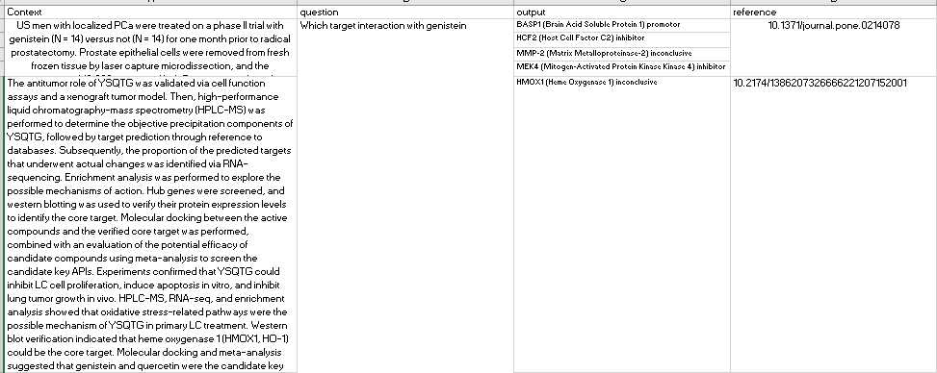
Example

Slide 5
Steps:
1- Sorting data
Building code using ChatGPT to convert Excel file to JSON string format to use it for fine-tuning
Code was running in Google Collaboratory

Slide 6
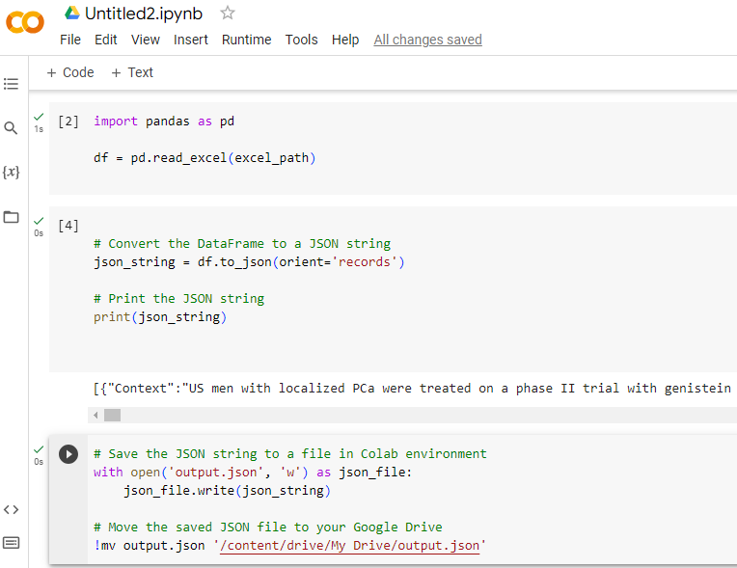
Example of the code

Slide 7
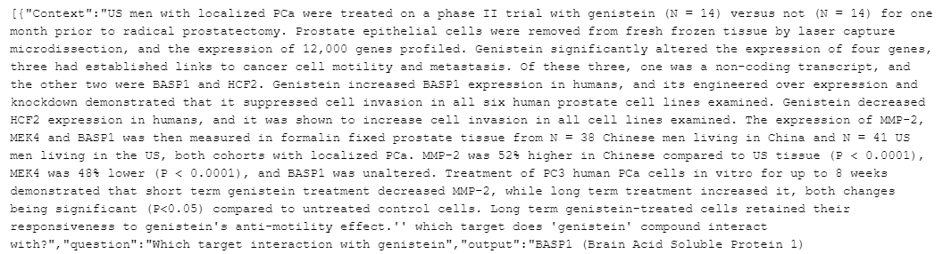
Example of JSON file

Slide 8
2- Challenges:
Few data were available for the last 5 years articles
Some compounds have more data compared to others
Screening abstract manually was time consuming task, finding more AI tools to ensure screening is recommended
Some abstract didn’t include the appropriate answer (interaction not clear), reading full text should be followed

Slide 9
3- Next Steps:
Proceed with the ongoing data acquisition for the remaining compounds.
Choosing model to perform fine-tuning.

