Slide 1

DO NOT CUT

Slide 2

CUT THIS OUT

Slide 3

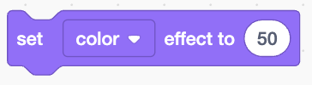
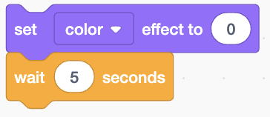

CUT THESE OUT

Slide 4
The scratch bus starts its engine
DO NOT CUT

Slide 5
CUT THIS OUT
The bus repeats these actions forever

Slide 6
CUT THIS OUT
IF
then

Slide 7
CUT THESE OUT
The scratch bus goes green
The scratch bus is close to the building
The scratch bus turns red
The scratch bus stops doing anything for 5 seconds

