Slide 1
DO NOT CUT
When Start button is pushed
When Space button is pushed
When the cat gets a pat

Slide 2

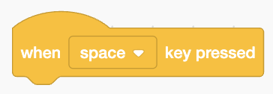

DO NOT CUT

Slide 3
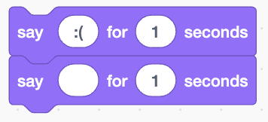
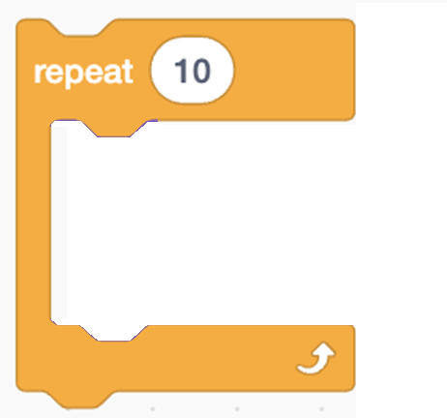


CUT THESE OUT
The cat stops what it was doing
Repeat 10 times
The cat reports that it is healthy
The cat reports that it needs help
:(
The cat reports that it is healthy

