Slide 1

DO NOT CUT

Slide 2



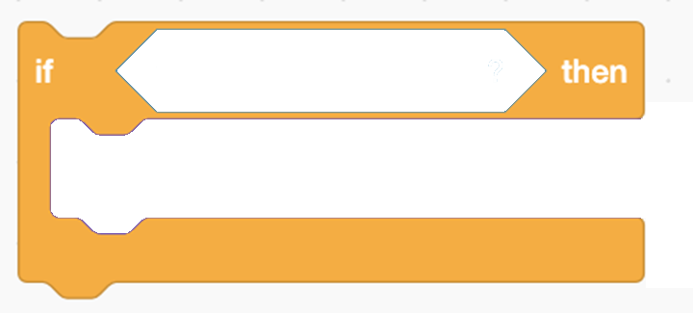
CUT THESE OUT

Slide 3
DO NOT CUT
The cat is told to sort rubbish

Slide 4
CUT THIS OUT
The rubbish sorter keeps repeating these actions forever

Slide 5
The cat is touching something red
CUT THESE OUT
The cat says
“Put in rubbish bin”
IF
then

