Slide 1

DO NOT CUT

Slide 2
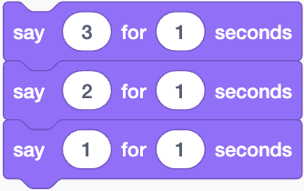
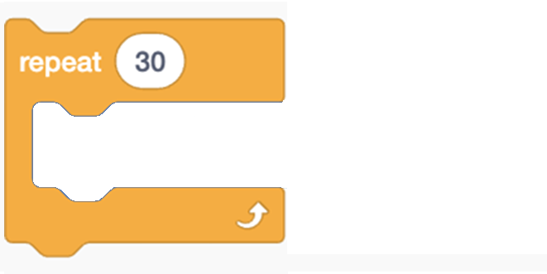

CUT THESE OUT

Slide 3
DO NOT CUT
The scratch cat will start its program

Slide 4
The scratch cat will do a 3 second countdown
The cat will repeat
this action 30 times
The cat will rotate 80 degrees clockwise
CUT THESE OUT

