Slide 1
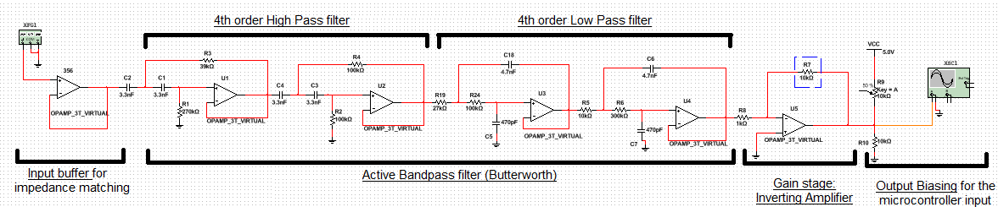
Scenario W: Phone Tapping Scenario Bruno Calogero Daniel Saul Franky Saxena Theo Velon
Context and Overall System Diagram
Notes:
Explain overall context and what we are trying to achieve , add flowchart ?

Slide 2
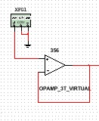
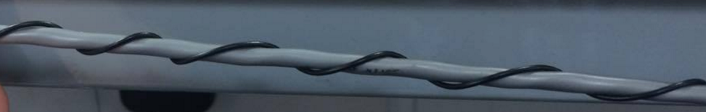
Extracting the signal (Coil and buffer stage)
Coiling the wire (twisted-parallel as by Faraday’s Law)
Impedance matching using a high input impedance Buffer (MOSFET 365 OP-AMP)
Fig.1 Parallel wiring to internal cabling
Fig. 2 Buffer
Notes:
Coiling the wire – explain the black box way + antenna hence no grounding + need or impedance matching + only presence of AC signals

Slide 3
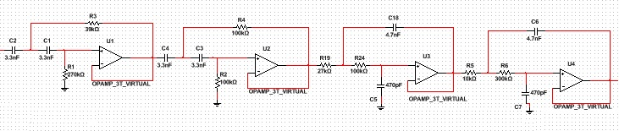
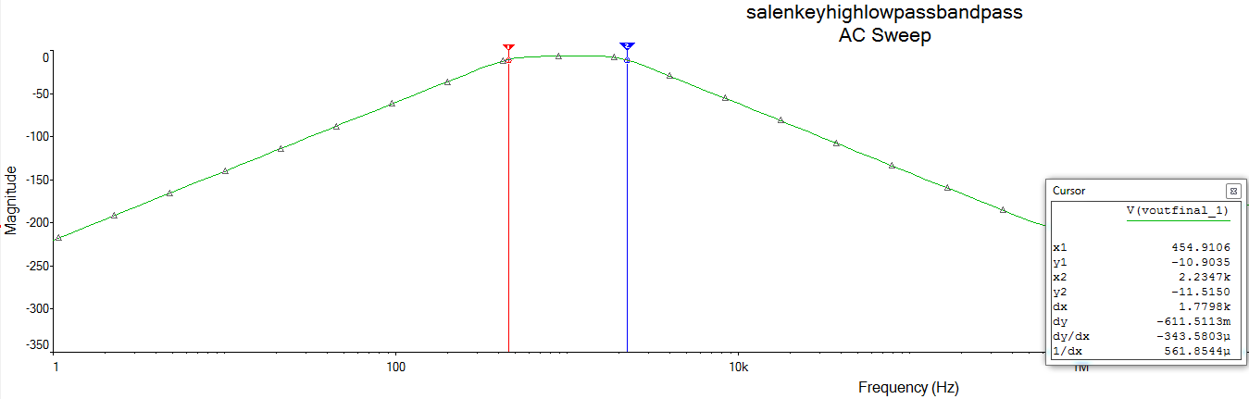
Band-pass filtering
Notes:
Oscilloscope output + bode plot + system diagram with only bandpass (2nd order highpass +2nd order lowpass )

Slide 4
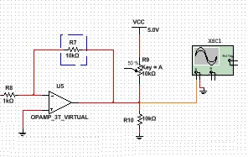
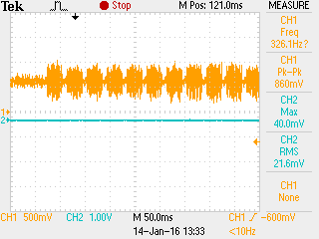
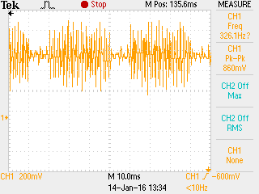
Gain/DC Bias/ADC
Inverting amplifier stage
DC Bias stage
All selected suitably for the Microprocessor

Slide 5
Goertzel Algorithm (Digital Signal Processing and API)
Notes:
Coupling/Decoupling capacitors at the rail voltages to get rid of the noise from the powersupply/oscilloscope

Slide 6
Conclusion
Problems encountered : - Decoupling capacitor to reduce rail noise - Coding implementation
Final phone number retrieved

