Slide 1
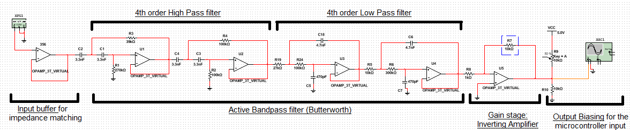
Scenario W: Phone Tapping Scenario Bruno Calogero Daniel Saul Franky Saxena Theo Velon
Context and Overall System Diagram
Notes:
Explain overall context and what we are trying to achieve , add flowchart ?

Slide 2
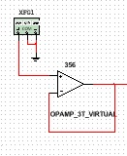
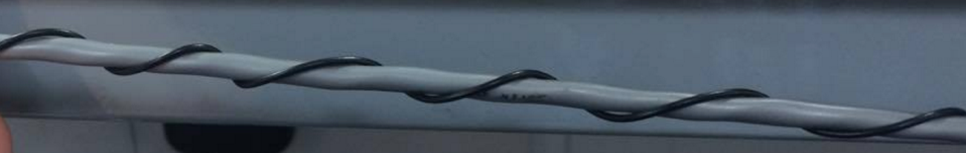
Extracting the signal (Coil and buffer stage)
Coiling the wire (twisted-parallel as by Faraday’s Law)
Impedance matching using a high input impedance Buffer (MOSFET 365 OP-AMP)
Fig.1 Parallel wiring to internal cabling
Fig. 2 Buffer
Notes:
Coiling the wire – explain the black box way + antenna hence no grounding + need or impedance matching + only presence of AC signals

Slide 3
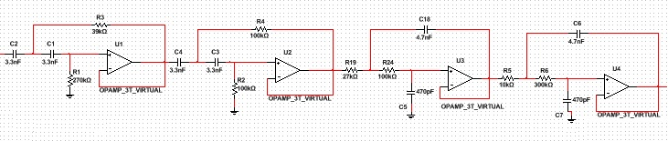
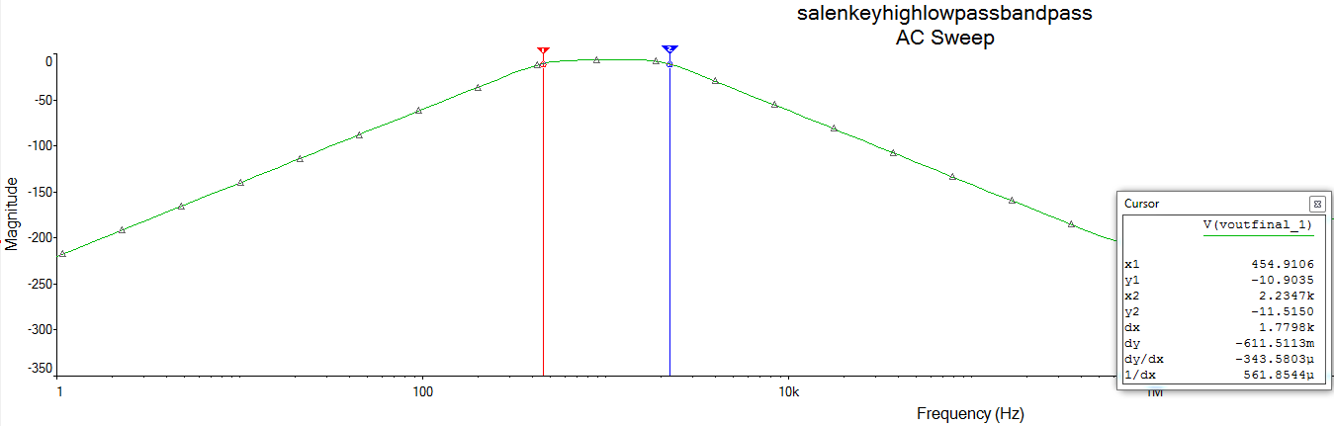
Band-pass filtering
Notes:
Oscilloscope output + bode plot + system diagram with only bandpass (2nd order highpass +2nd order lowpass )

Slide 4
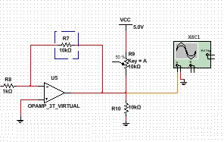
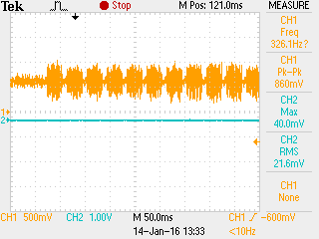
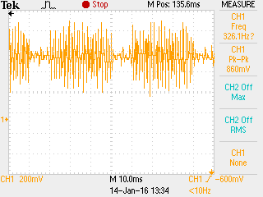
Gain/DC Bias/ADC
Inverting amplifier stage
DC Bias stage
All selected suitably for the Microprocessor

Slide 5
Goertzel Algorithm (Digital Signal Processing and API)
Data → Serial
Sample rate = 4000Hz, high enough for accurate sampling but low enough so data can be read and sent to DTMF function
Acquiring bin width = Fs / N
Threshold = magnitude threshold
Goertzel function:
Compute coefficients
Calculate magnitude for each frequency
DTMF function:
Finding the max magnitude and goes through each row frequency and column frequency to identify the number
Outputs the 11 digit number, setting the threshold against the noise (to get rid of background noise)
Notes:
Coupling/Decoupling capacitors at the rail voltages to get rid of the noise from the powersupply/oscilloscope

Slide 6
Conclusion
Problems encountered : - Decoupling capacitor to reduce rail noise - Coding implementation
Final phone number retrieved

