Slide 1
Scenario W: Phone Tapping Scenario Bruno Calogero Daniel Saul Franky Saxena Theo Velon

Slide 2
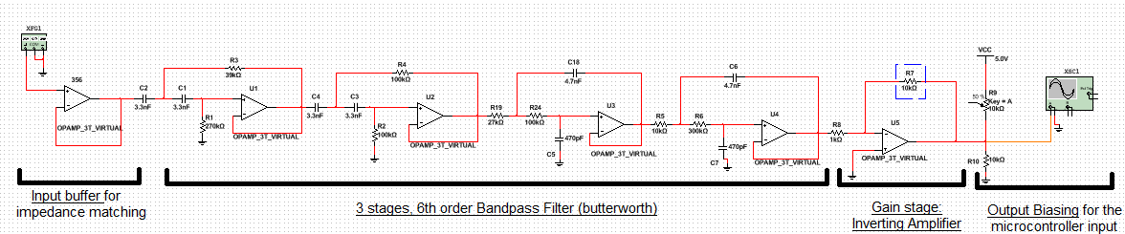
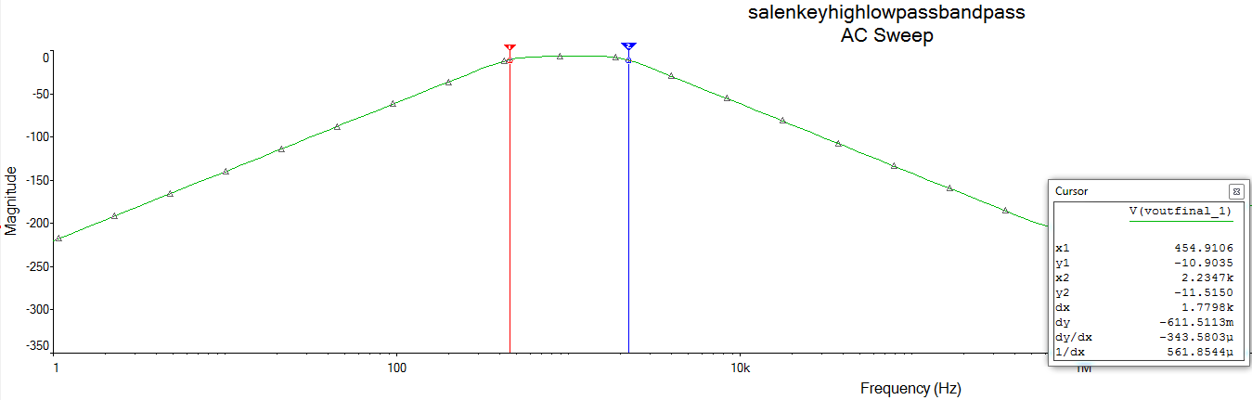
Extracting the signal #Fleming #Faraday #Coil #buffer
Plastic coil ~ current transformer 😐
Coiling wire ~ antennae 😃

Slide 3
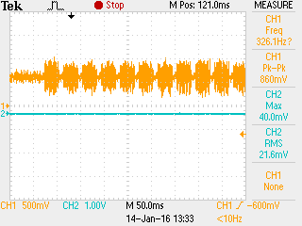
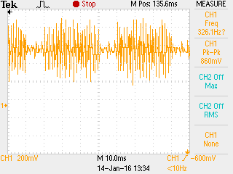
Bandpass filtering

Slide 4
Gain/DC Bias/ADC

Slide 5
Goertzel Algorithm #DSP #API
Notes:
Coupling/Decoupling capacitors at the rail voltages to get rid of the noise from the powersupply/oscilloscope

