Slide 1
Flow
A smarter degree auditing system created by students, for students.
The Company
Notes:
Flor

Slide 2
About the Company
Joel Marquez - CS
Vincent Mahathirash - CS
Jose Núñez - CS
Flor Gordivas - ECE

Slide 3
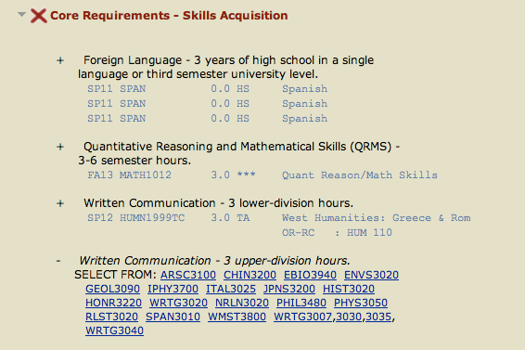
About Flow
Seek to make an improved degree audit method
Flow-chart visualization of degree demands
Course tracker
Notes:
Flor

Slide 4

Trello
Project Tracker
What is it?
A collaboration tool which organizes our project into boards of what’s done and needs to be done
Purpose:
Keeps track of project progress and user story completion
Organize and break down project milestones on “cards”
Thoughts: Rating:
It’s okay
Notes:
Flor

Slide 5

GitHub
VCS Repository
What is it?
GitHub is web-based repository using the git version control system
Has several features for group coding
Purpose:
Allows for collaborative code development
Keep track of user contributions
Thoughts: Rating:
Not only indispensable, but required.
Notes:
Vincent

Slide 6

Gitlo
Linker
What is it?
Link user stories on Trello to the issue tracker on Github and Automatically updates
Purpose:
Keeps our project managing apps consistent
Makes project management more efficient
Thoughts: Rating:
Not useful, never use again.
Notes:
Vincent

Slide 7
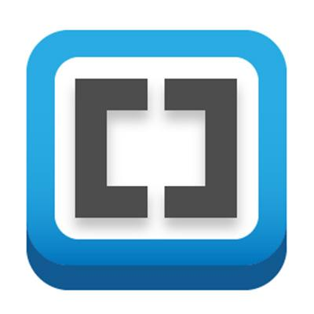
Brackets
IDE
What is it?
An open source text editor written in HTML, CSS, and Javascript geared towards front-end web development.
Purpose:
Allows us to edit the look of the website and see the changes in real time.
Thoughts: Rating:
Extremely useful, lightweight
Notes:
Vincent

Slide 8

Node.js
Framework
What is it?
Cross-platform runtime environment
Open source
Purpose:
Used to develop the server side of our web application
Routes
Authentication
Thoughts: Rating:
Less code, smaller learning curve
than PHP
Notes:
Joel

Slide 9

AngularJS
Framework
What is it?
AngularJS is a structural framework for dynamic web apps
Can use HTML as template
Purpose:
Develop the client-side portion of our application. We used this to create all of the partial html pages on our site as well as to create controllers to handle all the logic of our application.
Thoughts: Rating:
Very useful. Would definitely use again!
Notes:
Joel

Slide 10

MongoDB
Database
What is it?
Database Management System Software
Purpose:
Hold user account and course information
Store arrays with courses taken
Thoughts: Rating:
Easy to use
Notes:
Joel

Slide 11

mLab
Web-Host
What is it?
mLab is an online host for databases
Purpose:
Host our MongoDB
Thoughts: Rating:
Super easy
Notes:
Joel

Slide 12

Heroku
Deployment
What is it?
Heroku is a platform which excels at allowing companies to build, deliver, monitor, and develop applications.
Purpose:
In hopes of our future, Heroku is too allow us the opportunity to deploy our web page to the world.
Thoughts: Rating:
Very good for our use.
Notes:
Joel

Slide 13

Mocha
Testing
What is it?
A Javascript testing framework built on Node.js.
Purpose:
Used for unit testing
Thoughts: Rating:
Simple to use
Notes:
Vincent

Slide 14

GroupMe
Communication
What is it?
A private chat room for small or large group to coordinate, organize and keep touch
Purpose:
To provide a great way to communicate between us peers.
Thoughts: Rating:
It was a great way to get in
touch with everyone.
Notes:
Jose

Slide 15
Challenges
Difficult getting started
Mostly new to web design
New languages/frameworks: HTML, CSS, JS, NodeJS, Java, Git, SQL, AngularJS,
Scheduling Conflicts
Unable to meet regularly
Teaching each other
Tasks not being completed by deadline; always behind
I got surgery, was out for 3 weeks, lost a precious organ, location of organ unknown.
Notes:
All

Slide 16
Demo
Notes:
Jose

Slide 17
Questions?
Notes:
EVERYONE :)

