Slide 1
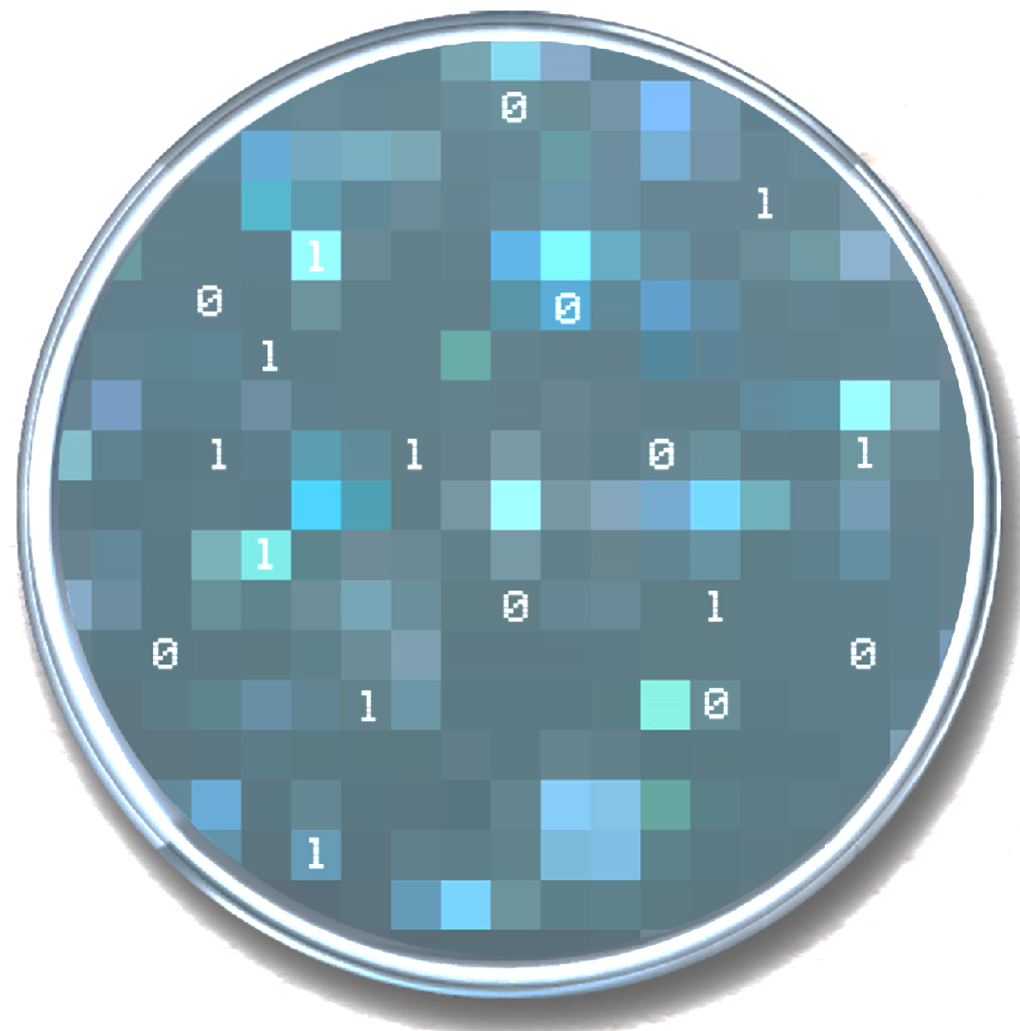


Applied Computational Multi-Omics
Genetic Alterations and Functional Impact

Slide 2
Topics
https://onlinelibrary.wiley.com/doi/10.1002/humu.24311
Finding Genetic Alterations
Single Nucleotide Variants and small Indels
https://www.ncbi.nlm.nih.gov/pmc/articles/PMC3083463/
Copy Number Alterations and other Structural Variants
https://www.ncbi.nlm.nih.gov/pmc/articles/PMC4300727/
Finding clonal vs subclonal variants
https://www.sciencedirect.com/science/article/pii/S2001037017300946
Variant annotation
https://www.nature.com/articles/nprot.2015.105
https://genomebiology.biomedcentral.com/articles/10.1186/s13059-016-0974-4

Slide 3

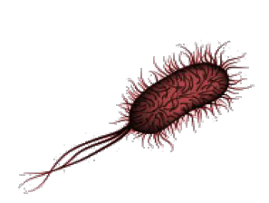

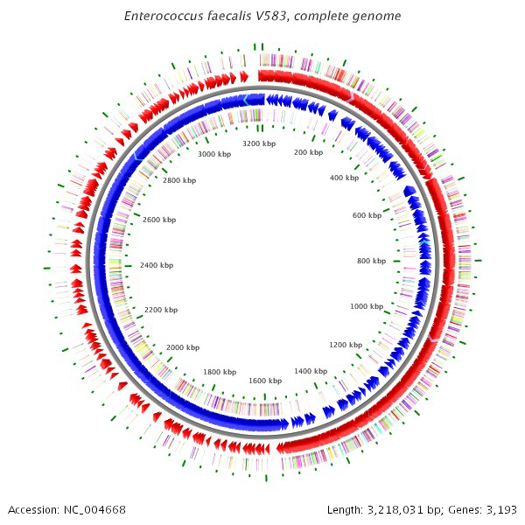
Application of Resequencing: variant calling
Most frequent biological question: find mutations causing certain phenotypes
?
?

Slide 4
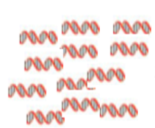
Application of Resequencing: variant calling
DNA Extraction

Slide 5


Application of Resequencing: variant calling
Whole Genome (WGS) or Targeted (eg. Whole Exome - WES)
Whole Genome
Targeted

Slide 6
Application of Resequencing: variant calling
GTTGT
TGCTCAGTT
TGAC
ACTCCAT
FastQ files
DNA Extraction
Sequencing

Slide 7
Application of Resequencing: variant calling
AGTTGTGT
TGCTCAGTT
AAGCGATG
TCCATGC
GTGTGTTT-CA
ACTCCAT
GTTGT
SAM/BAM files
geneA
geneB
geneC
AAGCGATGACTGCATGCACAGTTGTGTGTTTTCACGTGAC
Alignment algorithms
(most frequent is BWT)
GTTGT
TGCTCAGTT
TGAC
ACTCCAT
FastQ files
DNA Extraction
Sequencing

Slide 8
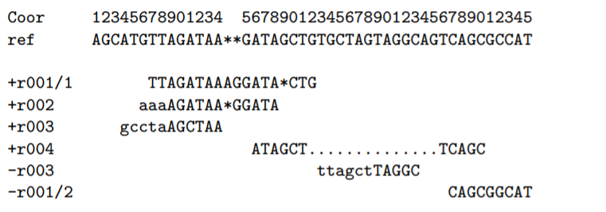
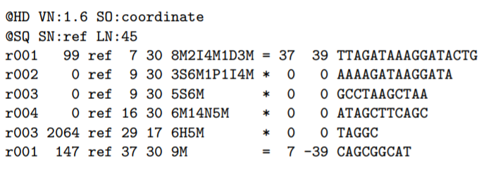
HTS Data Analysis: Resequencing
Sequence Alignment/Map Format (SAM): a file format to represent alignments
Most often used for HTS alignments
https://samtools.github.io/hts-specs/SAMv1.pdf

Slide 9
Application of Resequencing: variant calling
VCF files
Amplification
SNP
Variant Detection algorithms
SNP
AGTTGTGT
Indel
TGCTCAGTT
AAGCGATG
TCCATGC
GTGTGTTT-CA
Deletion
ACTCCAT
GTTGT
SAM/BAM files
geneA
geneB
geneC
AAGCGATGACTGCATGCACAGTTGTGTGTTTTCACGTGAC
Alignment algorithms
(most frequent is BWT)
GTTGT
TGCTCAGTT
TGAC
ACTCCAT
FastQ files
DNA Extraction
Sequencing

Slide 10
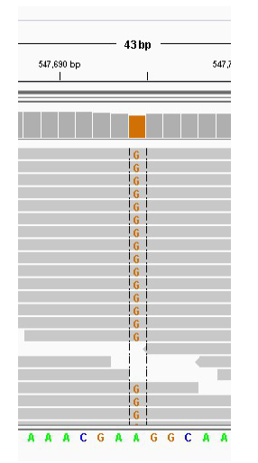
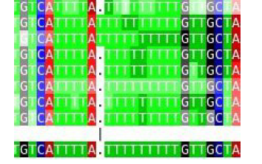
Single Nucleotide Variants (SNV) and small Indels
Variants detected within reads (smaller than size of read)
SNVs:
Change of a single nucleotide
Indels:
“Small” deletion or amplification
(less than the size of a read)
SNP
Indel

Slide 11
Single Nucleotide Variants (SNV) and small Indels
Main factors affecting the detection of SNVs and indels
Number of reads (coverage)
base quality (mostly affects SNVs)
Duplicates (eg. Bias due to PCR)
Misalignments (mostly affects indels, but also affects SNVs)
Strand bias (mostly in the case of targeted sequencing and near repetitive regions)

Slide 12
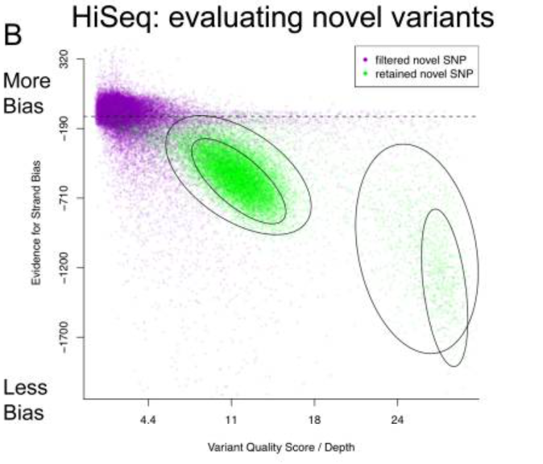
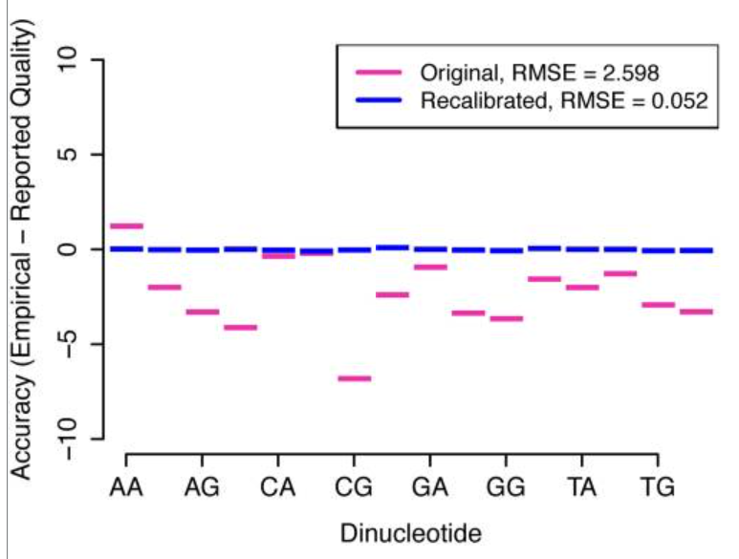
Single Nucleotide Variants (SNV) and small Indels
In the case of Human and other well studied model organisms
Known variants (obtained and confirmed using other methods) can be used to
Perform base recalibration
Evaluate alignment problems
Perform variant recalibration
Heterozygous
Homozygous
Gaussian mixture
Models on known
variants
(DePristo et al.)

Slide 13
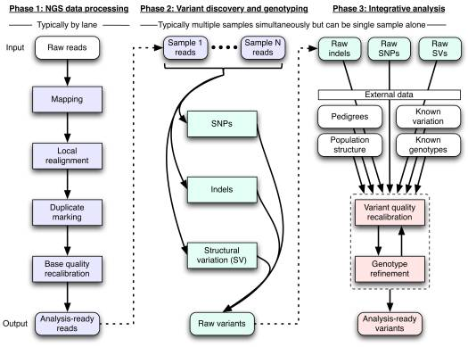
DePristo et al. (GATK)

Slide 14
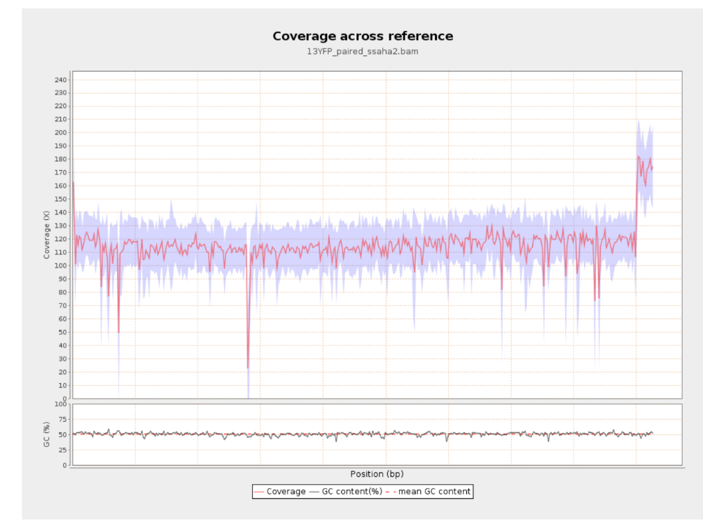
Copy Number Variants and other Structural Variants
Variants larger than the size of reads
Copy Number Variants
Large Deletions and Amplifications
Other Structural Variants
Fusions; Inversions, etc...
Horizontal Transfer
Needs to be analyzed separately
Deletion
Amplification

Slide 15
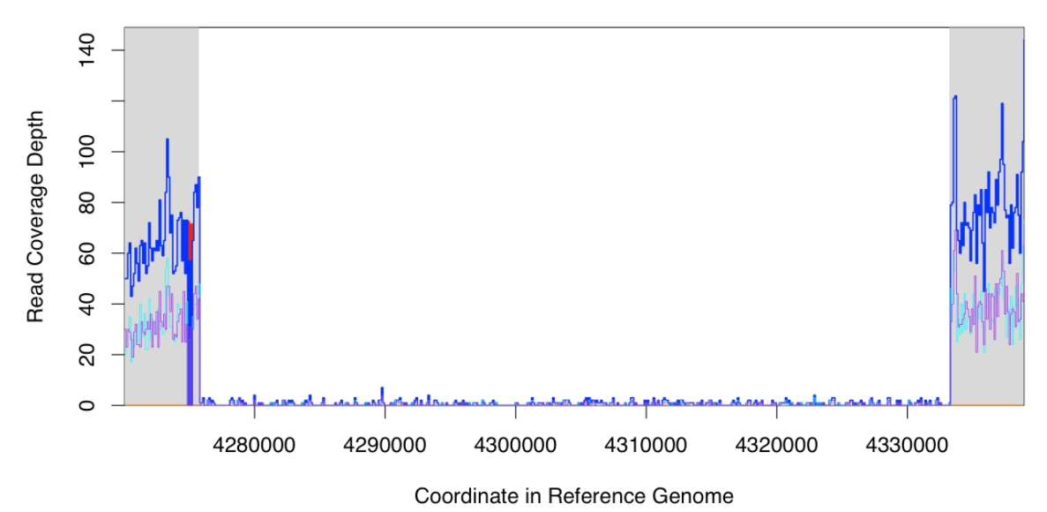
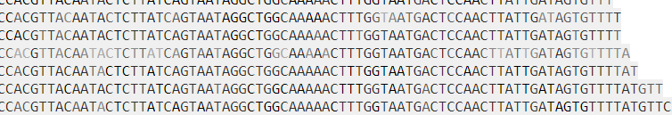
Copy Number Variants and other Structural Variants
Evidence used to detect Structural Variants
Differences in Coverage
Most commonly used
Particularly with targeted sequencing
Although there’s still amplification bias
Junction evidence (difficult in targeted sequencing)
Can use paired read information (namely, expected fragment length – noisier)
Can use information within reads (more precise - requires bigger reads)

Slide 16
Finding clonal vs subclonal variants
Distinguish finding variants vs inferring genotype
Finding variants: not due to technical errros
Infer the genotype: what the most likely genotype (homozygote; heterozygote in diplody)
Finding subclonal (population) variants require specific analysis
Many algorithms assume diplod organisms to infer a genotype
Eg. a “real” variant at 25% is most llkely associated to a heterozygous genotype
To find subclonal populations you can infer genotypes using a large ploidy
In case of haploid, “real” variants at less than 100% are considered subclonal

Slide 17
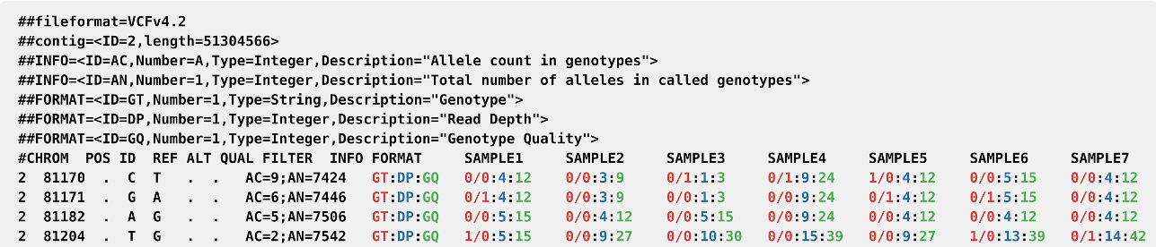
Variant Call Format (VCF):
A file format to represent variants and their properties
From https://doi.org/10.1093/gigascience/giab007
https://samtools.github.io/hts-specs/VCFv4.2.pdf

Slide 18
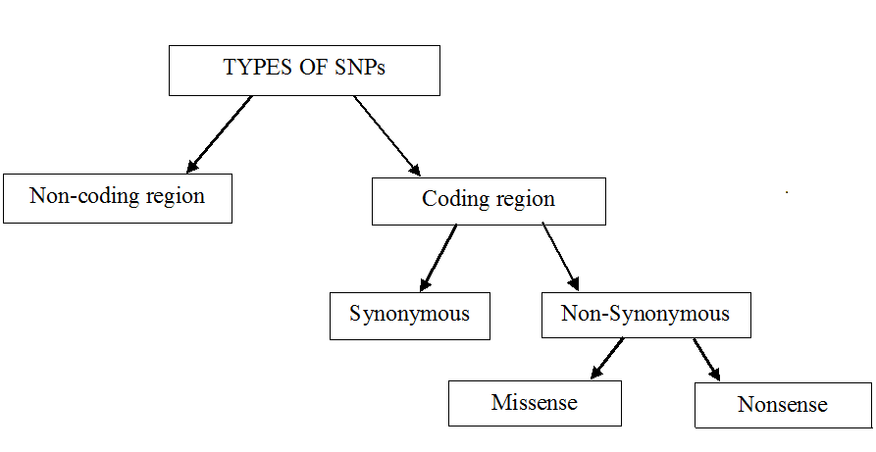
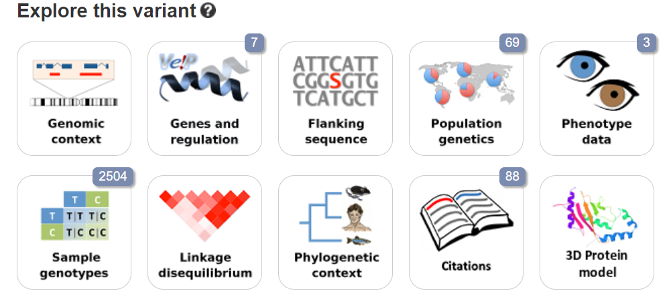
Variant Annotation
Main goal is to uncover effect and relevance of variant
Coding versus non-coding
Coding: Silent versus non-silent
Non-coding: can be complex
For Human and other model organisms
Population frequency; Disease-association; etc...

Slide 19
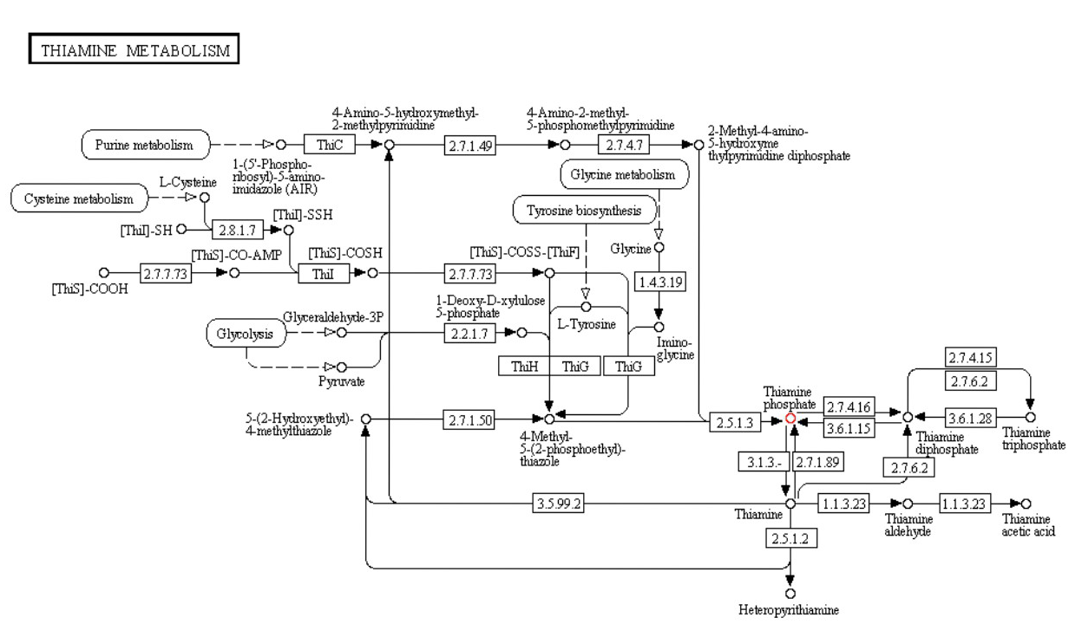
Variant Annotation
Amplification
Variant Annotation algorithms
SNP
Deletion

Slide 20
Summary
Finding Genetic Alterations using High Throughput Sequencing
General process: from fastq to BAM to VCF
Distinguish beween small SNVs/indels and large structural variants
Different methods are used to find evidence for each of them
What are the main factors affecting their detection
Distinguish between uncovering clonal / subclonal (population) variants
Estimating most likely genotype versus finding a real (not artifactual) mutation
Variant Annotation
Distinguish coding versus non-coding variants
Distinguish Coding (silent versus non silent)
Integrate other types of information (eg. population frequency)

