Slide 1
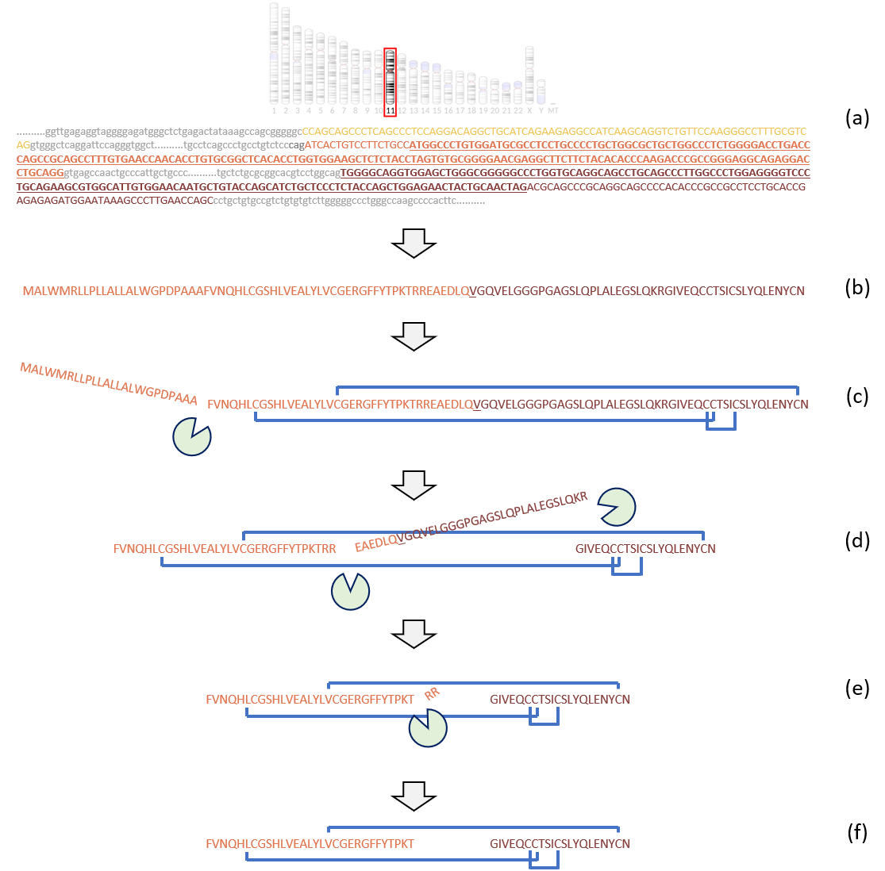
From Gene to Function

Slide 2
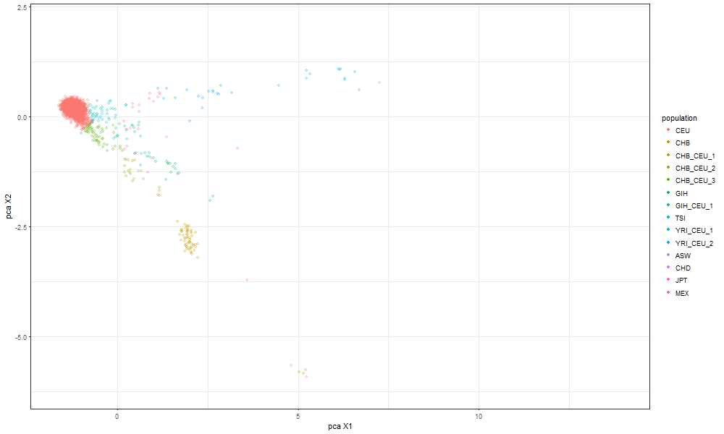
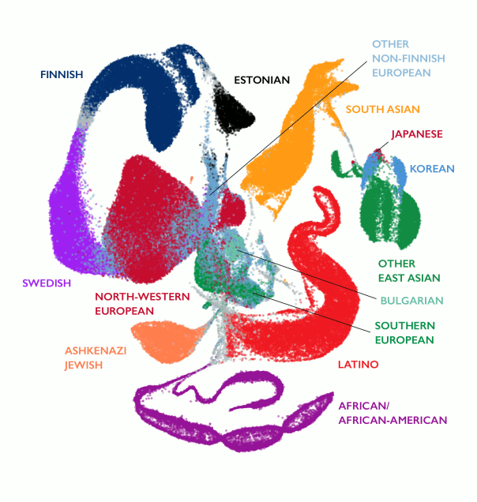
Admixture
UMAP from ExAC (exac.broadinstitute.org)

Slide 3
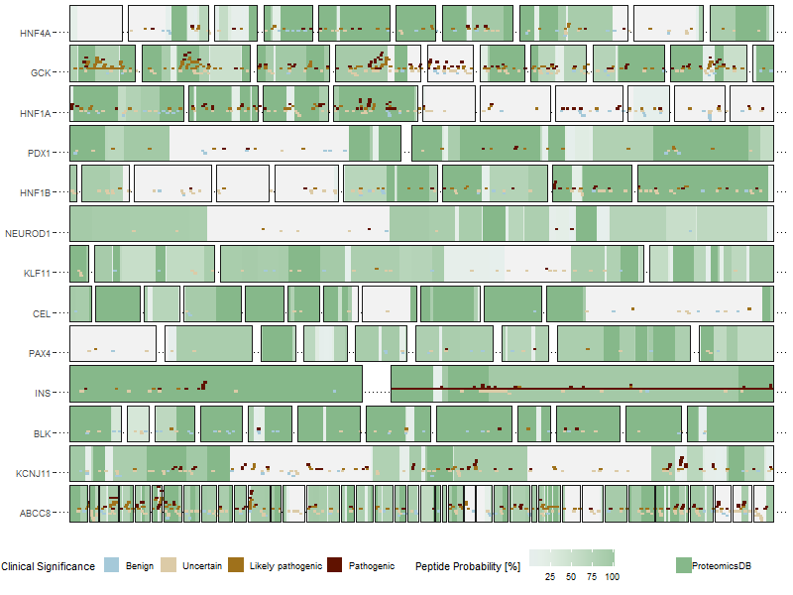
MODY genes coverage

