Slide 1
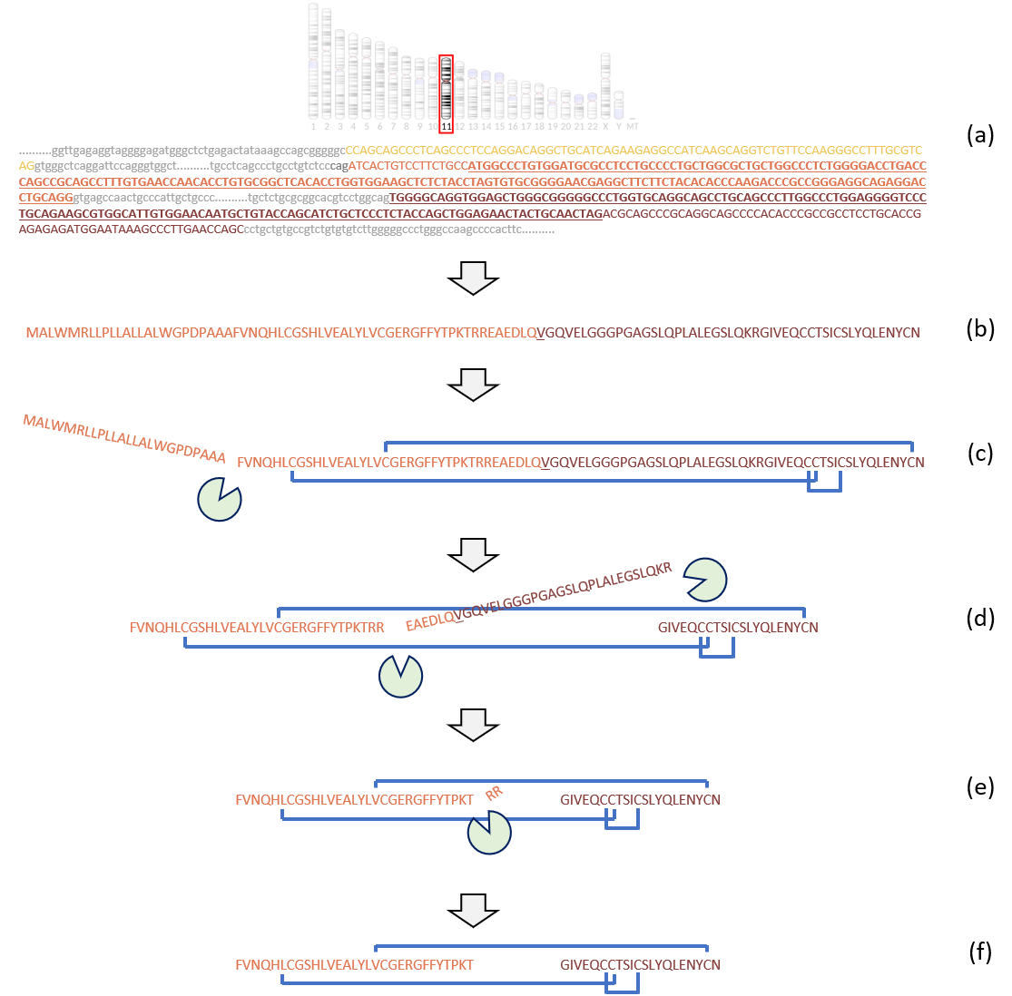
From Gene to Function
<number>

Slide 2
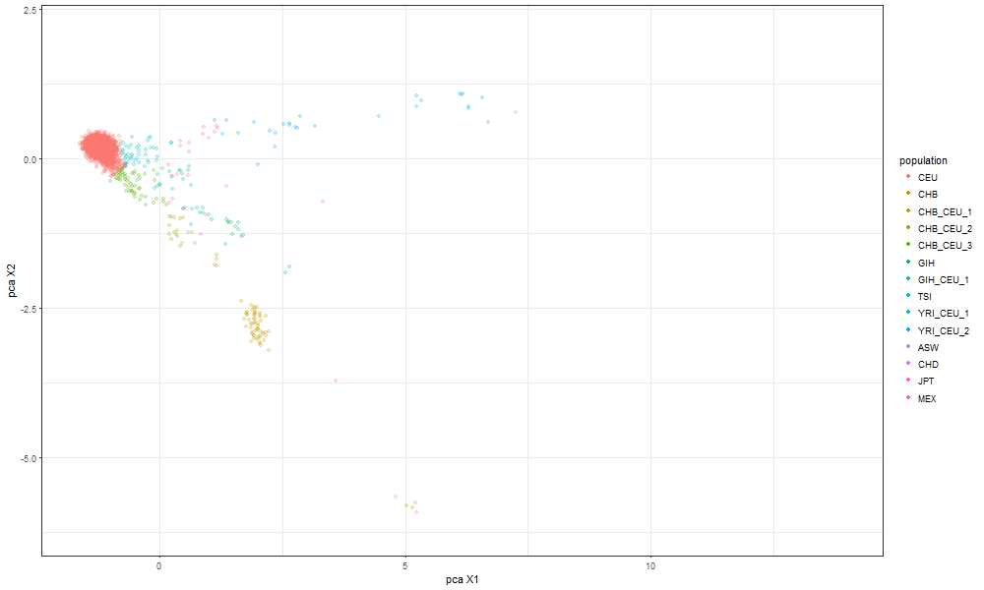
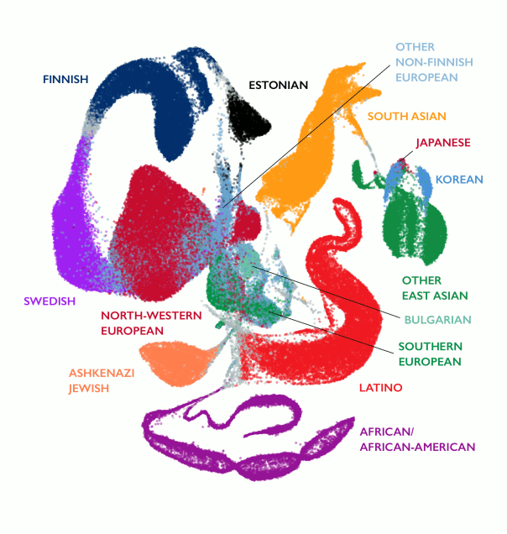
Admixture
<number>
UMAP from ExAC (exac.broadinstitute.org)
Notes:
<number>

Slide 3
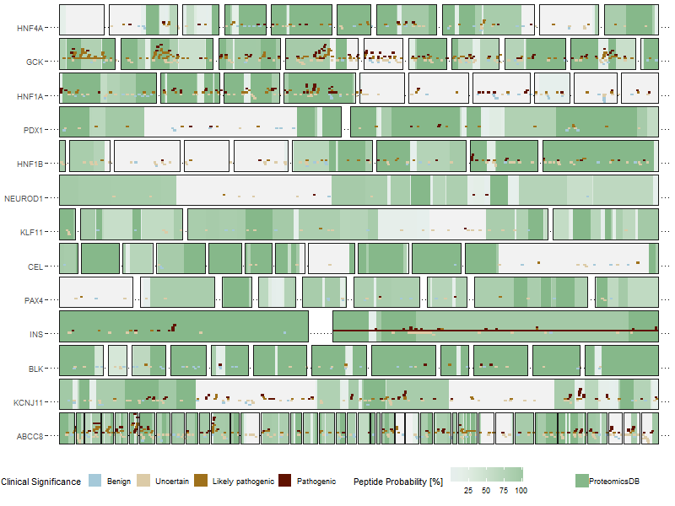
MODY genes coverage
<number>
Notes:
<number>

