Slide 1
Proteins
Peptides
Preparation
LC-MS/MS
MS1 Spectra
MS2 Spectra
Intensity
Precursor m/z
+
Intensity
Fragment m/z
Retention Time
Precursor m/z
Proteomics Dataset

Slide 2
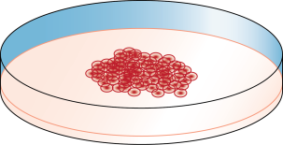
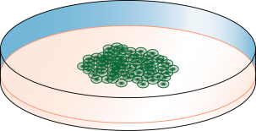
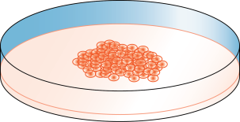
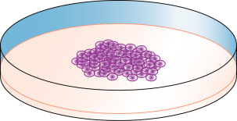
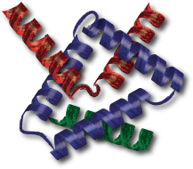
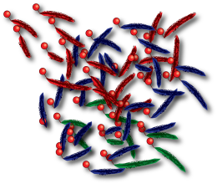
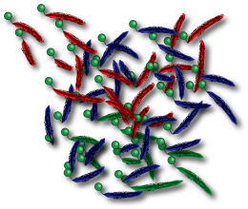
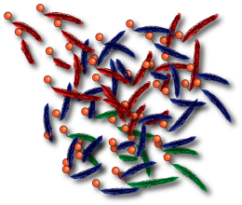
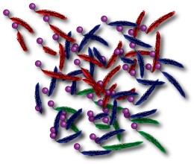
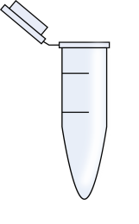
Reporter Intensities |  |  |  | Sequence
4 | 20 | 10 | 15 | NLLDEELQR

