Slide 1

Quantification in MS proteomics
lennart martens
lennart.martens@vib-ugent.be
computational omics and systems biology group
VIB / Ghent University, Ghent, Belgium
www.compomics.com
@compomics

Slide 2
Protein quantification by MS in one slide
Quantification methods
Isotope labeling
SRM/MRM
Label free
MS2
Multiplexing
MS1
emPAI
TIC
Replicate
Average
iTRAQ
TMT
In vivo
In vitro
SILAC
other
18O
ICPL
ICAT
AQUA
Vaudel, Proteomics, 2010

Slide 3
Data processing introduces uncertainty
Raw data
Peaklists
Peptide sequences
Protein accession numbers
uncertainty
data size
Martens and Hermjakob, Molecular BioSystems, 2007

Slide 4
The primary principles in quantitation
Make each sample distinguishable
fluorescent markers with different excitation wavelengths (1)
introduce mass differences between the samples (2)
perform distinct experimental runs for each sample (3)
Measure the intensity of the signal for each analyte in each sample
Statistically process the accumulated information
1/2
1/1
2/1

Slide 5
Techniques: overview
SILAC (2), cell cultures, relative
2D PAGE spot intensity (1), proteins, relative
ICAT (2), proteins, relative
ICPL (2), proteins, relative
LC peak area (3), peptides, relative, absolute
Trypsin-mediated ¹⁸O incorporation (1), peptides, relative
iTRAQ (2), peptides, relative
Spiked peptides (eg. AQUA) (2), peptides, absolute
Label-free approaches (3), peptides, peptide fragments, relative, absolute
MRM (2, 3), peptide fragments, relative²

Slide 6
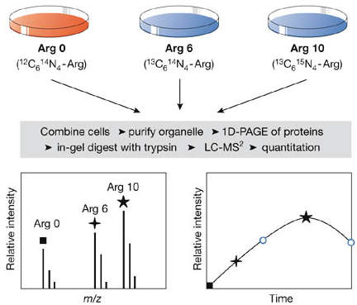
SILAC
Mix in 1:1 ratio and analyse with mass spec
Andersen and Mann, EMBO Reports, 2006

Slide 7
¹⁶O – ¹⁸O labelling
O
O
Arg – C – OH + HO – Tryp.
Arg – C – O – Tryp.
H₂O
H₂O
H₂O
O
O
Arg – C – O – Tryp.
Arg – C – OH
H₂O
HO – Tryp. +
H₂O
Arg – C – O – Tryp.
Arg – C – OH
O
O
H₂O
Arg – C – OH
H₂O = ¹⁶O water ¹⁸O = H₂O
O
Staes, Journal of Proteome Research, 2004

Slide 8
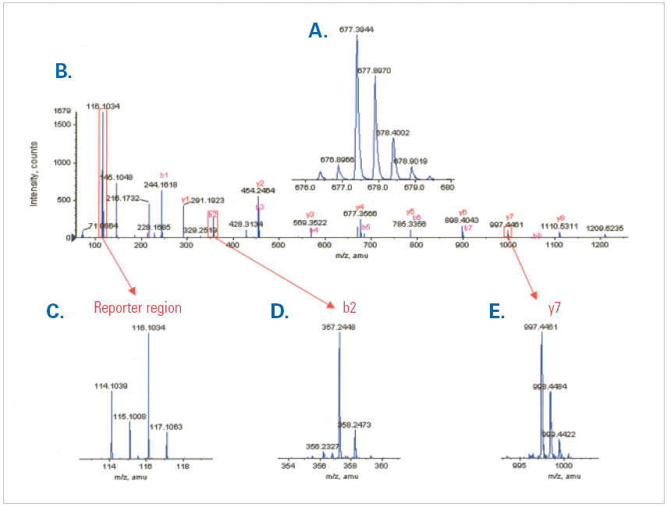
iTRAQ / TMT
neutral
balancer
precursors
1+
reporter
fragmentation
Reporter fragments
Applied Biosystems, Product Bulletin iTRAQ™ Reagents

Slide 9
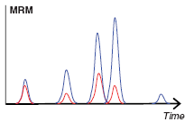
AQUA
Aimed at absolute quantitation
sample
unlabelled peptides
unknown abundance
internal standard
labelled, synthesized peptides
known abundance
Mix in desired ratio
MS analysis
Compare signal intensities
Derive absolute quantitation

Slide 10
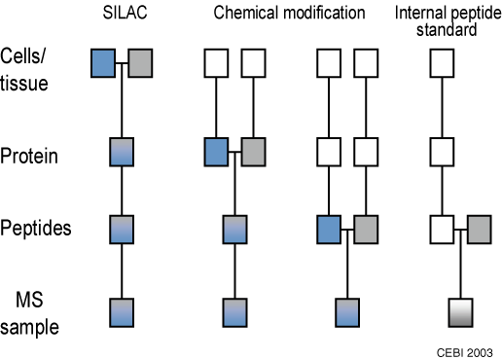
Moment of labelling matters
http://www.biochem.mpg.de/en/research/rd/mann/approaches/silac/silac_intro/index.html

Slide 11
Thank you!
Questions?

