Slide 1
The basics of inference in population genetics:
Wright Fisher and the coalescent
Oeiras, 14-18 May 2018
Mark Beaumont^{1 /} Lounès Chikhi^{2,3}
Vitor Sousa ⁴ / Willy Rodriguez⁵/ Armando Arredondo⁵
¹ Department of Mathematics, Bristol University, UK
² Evolution et Diversité Biologique, CNRS, Toulouse, France
³ Instituto Gulbenkian de Ciência, Oeiras, Portugal
⁴ Faculdade da Universidade de Lisboal
⁵ Institut de Mathématiques de Toulouse, Toulouse, France

Slide 2
GENETIC DIVERSITY
POPULATION
SIZE (FINITE)
Past
NEW
MUTATIONS
TIME
LOSS OF
MUTATIONS
Present
MUTATIONS
GENETIC DIVERSITY
GENETIC DRIFT

Slide 3
GENETIC DIVERSITY
N_{e} = 100
Past
N_{e} = 1000
N_{e} = 500
N_{e} = 100
Present
N_{e} = 1000
Present
Present
GENETIC DIVERSITY
Different demographic histories can produce
similar or counter-intuitive results

Slide 4
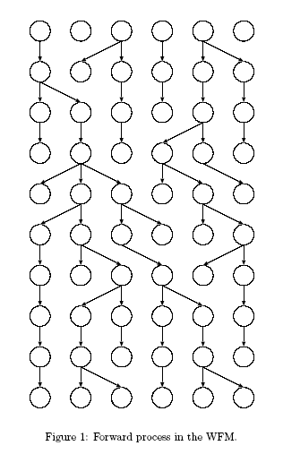
Towards a genealogical perspective
on genetic data
Genes (segments of chromosome) are transmitted from generation to generation by copying.
In any generation some genes are copied a lot of times, others are never copied.
A consequence of this is that any pair of genes share a common ancestor in the past.

Slide 5
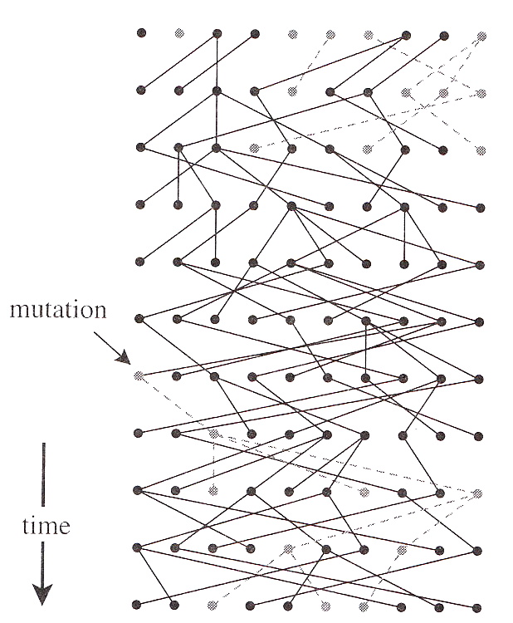
The copying process is error prone – mutations.
Genes that share a recent common ancestor are unlikely to have a mutation in their ancestry.
Genes with a distant common ancestor are more likely to have a mutation in their ancestry.
Demography affects the copying process: in small populations genes have a greater chance of being lost than copied.

Slide 6
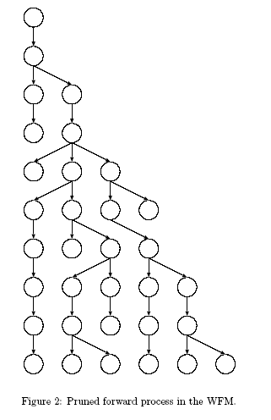
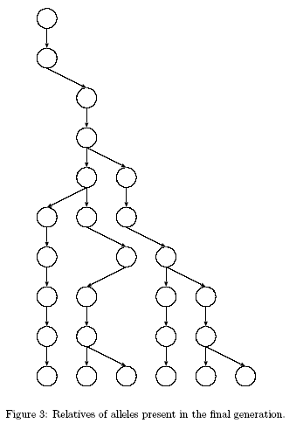
Wright-Fisher Model
for N = 6
0
1
2
3
MRCA
4
5
9
MRCA = Most Recent Common Ancestor

Slide 7
Wright-Fisher Model
for N = 6
VISUAL BREAK !
http://willyrv.com/WFsimulation
You can change the number of genes and generations.
Not visually optimized:
use only n < 10 and T < 10
You can also use the R script:
plot_ms_trees_mig.R
(after R introduction)
MRCA
MRCA = Most Recent Common Ancestor

Slide 8
Case of 2 gene copies (sample size of 2)
1 Probability of coalescence 1 generation ago for 2 gene copies:
We assume a population of N diploid individuals
Thus we have 2N haploid genomes
If we pick 2 genes at random:
  the probability that they are descended from the same copy is 1/2N
  the probability that they come from different copies is 1-(1/2N).
Why is the first probability equal to 1/2N ?

Slide 9
Case of 2 gene copies (sample size of 2)
1 Probability of coalescence 1 generation ago for 2 gene copies:
We assume a population of N diploid individuals
Thus we have 2N haploid genomes
If we pick 2 genes at random:
  the probability that they are descended from the same copy is 1/2N
  the probability that they come from different copies is 1-(1/2N).
Why is the first probability equal to 1/2N ?
To understand this we consider that each gene ‘chooses’ its parent at random in the previous generation.
Take a pair of genes and let one choose its parent; then the probability the other chooses the same parent is 1/(2N).
Another way to look at it is to arrange all (2N)2 possible pairs of parents chosen by the two genes on a grid (matrix), of which 2N (those on the diagonal) will be identical, giving (2N)/(2N)2 = 1/(2N)

Slide 10
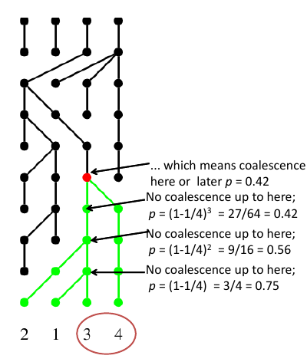
Case of 2 gene copies (sample size of 2)
Example:
2N = 4
s=2

Slide 11
Case of 2 gene copies (sample size of 2)
2 Probability of coalescence GREATER THAN T generations ago for 2 gene copies:
(We make the assumption that N is large and t is large)
It is the probability that they do not coalesce for T generations:
P(coalescence time > T) = [1-(1/2N)]^{T}
For large N, 1/2N is small and we can approximate:
[1-(1/2N)]^{T} ≈ e^{-T/2N}
If we rescale time in units of 2N (continuous time): t= T/2N we have :
P(coalescence time > t) ≈ e^{-t}
In other words: coalescence time follows an exponential distribution, defined as:
f(t)=λe^{-λt} - where λ and t > 0
with an expectation of 1/λ and a variance of 1/λ².
With coalescence rescaling we have λ = 1

Slide 12
Case of 2 gene copies (sample size of 2)

Slide 13
Case of k gene copies (sample size of k)
1.Probability that any two of the k sequences coalesce 1 generation ago is
(1/2N)×k(k-1)/2 = k(k-1)/4N, (ignoring multiple coalescence)
indeed, there are k(k-1)/2 possible pairs of sequences in k sequences.
Note that for k=2 you find the result from above.
2. Probability that any two of the k sequences coalesce t+1 generations ago is:
k(k-1)/4N e^{-tk(k-1)/4N}
Thus, following the same rational as above, we can show that the time T_{k} until the first coalescence follows an exponential distribution where λ=k(k-1)/4N.
Thus, the expectation of this time is
E(T_{k}) = 4N/k(k-1).
Note that these results require k(k-1)/4N to be <<1 which is true if k<<N. This means that we assume that the sample size is small compared to the population size. So in theory the coalescent should not work for small populations (endangered species, bottlenecked pops). In practice, simulations show that the coalescent actually works very well even in such cases.

Slide 14
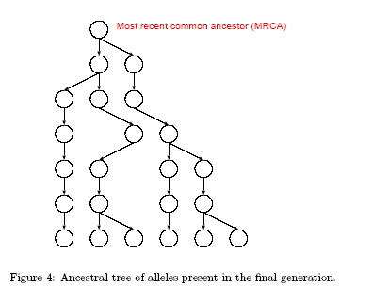
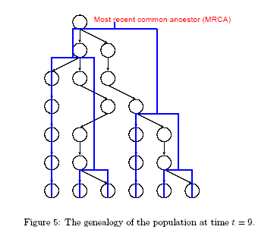
  Coalescent = probabilistic model
  Gives the distribution coalescence times (Wright-Fisher, Moran).
  Exponential law (T_{k} = time during which there are k lineages):
    E(T_{k}) = 4N/k(k-1)
  E(T_{MRCA}) = E(T_{k}) + E(T_{k-1}) + … + E(T₂) = 4N( 1- 1/k) ~ 4N
  E(T₂) = 4N( 1- 1/2) = 2N

Slide 15
Standard coalescent
tree
N
E(T₂)=2N_{e}
E(T_{MRCA})=4N_{e}(1-1/5)
E(T₅)=N_{e}/5
  E(T_{k}) = 4N/k(k-1)
  E(T_{MRCA}) ~ 4N
  E(T₂) = 4N( 1- 1/2) = 2N

Slide 16
Standard coalescent
tree
N
E(T₂)=2N_{e}
E(T_{MRCA})=4N_{e}(1-1/5)
E(T₅)=N_{e}/5
  E(T_{k}) = 4N/k(k-1)
  WHAT DO YOU EXPECT TO HAPPEN IF POPULATION SIZE CHANGES?
  POPULATION GROWTH / CRASH ?

Slide 17
Tree A
N
E(T₂)=2N_{e}
E(T_{MRCA})=4N_{e}(1-1/5)
E(T₅)=N_{e}/5
Tree B
Tree C
N₀
N₀
time
N₁
N₁

Slide 18
Stable
Contracting
Growing

Slide 19
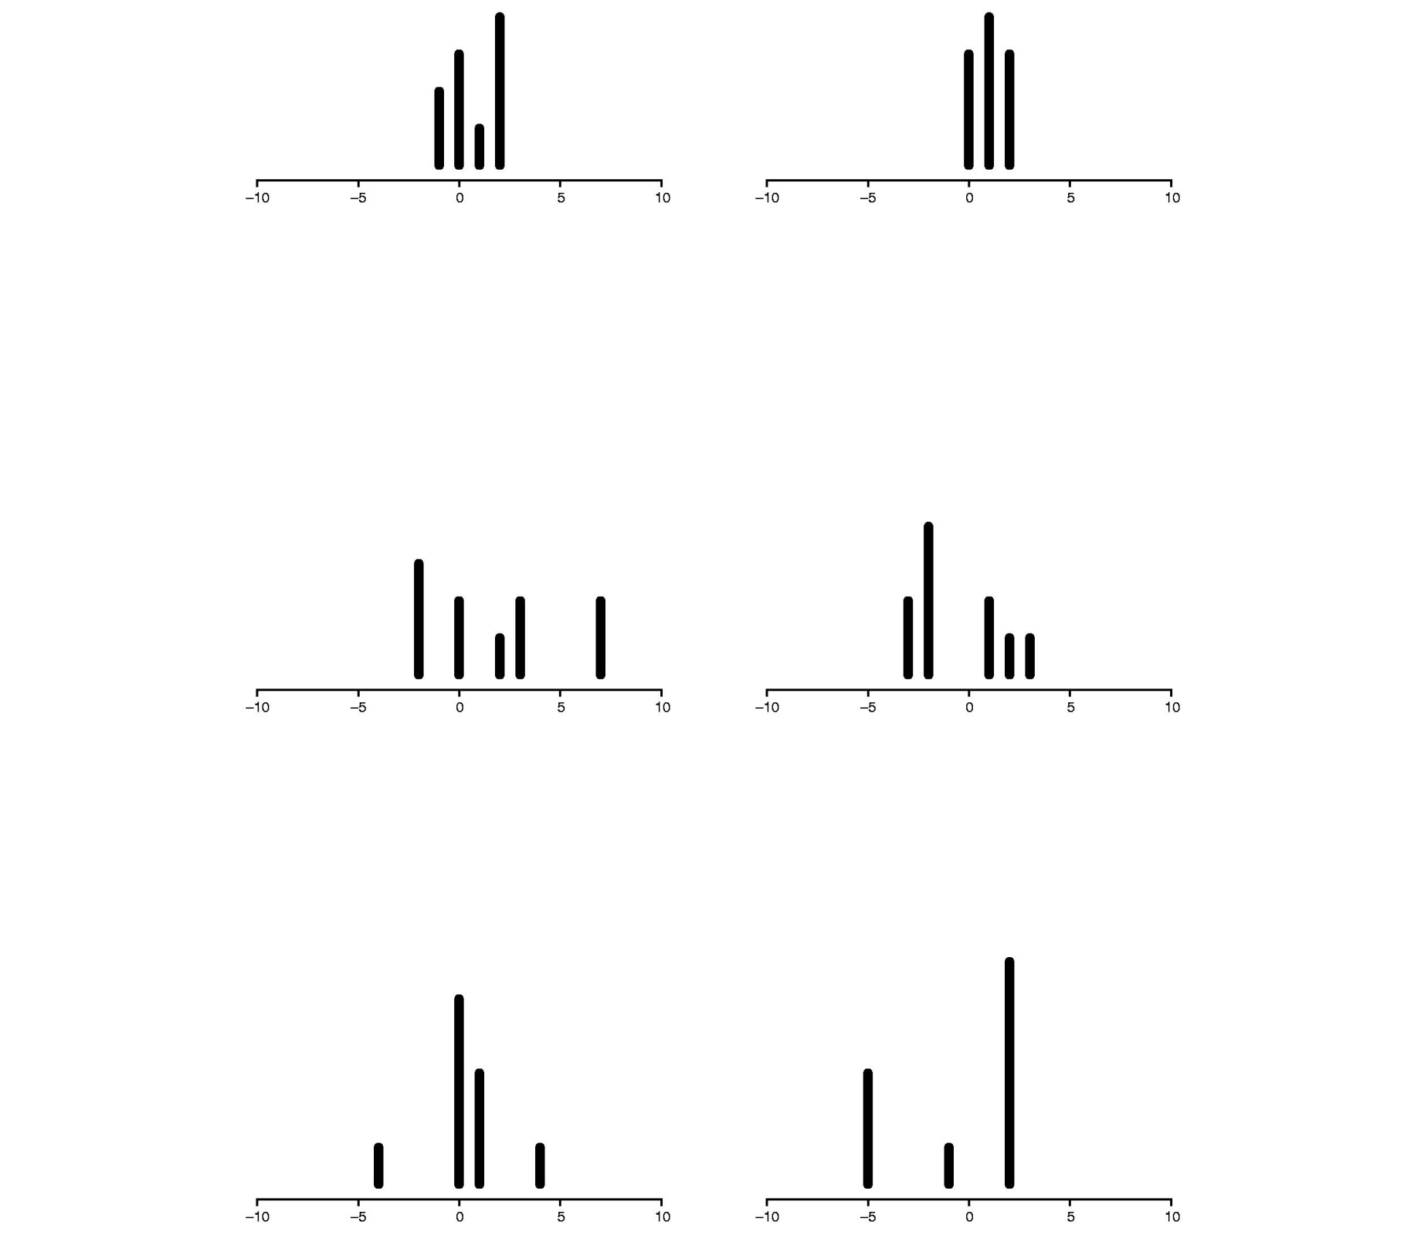
Stable
Contracting
Growing

Slide 20
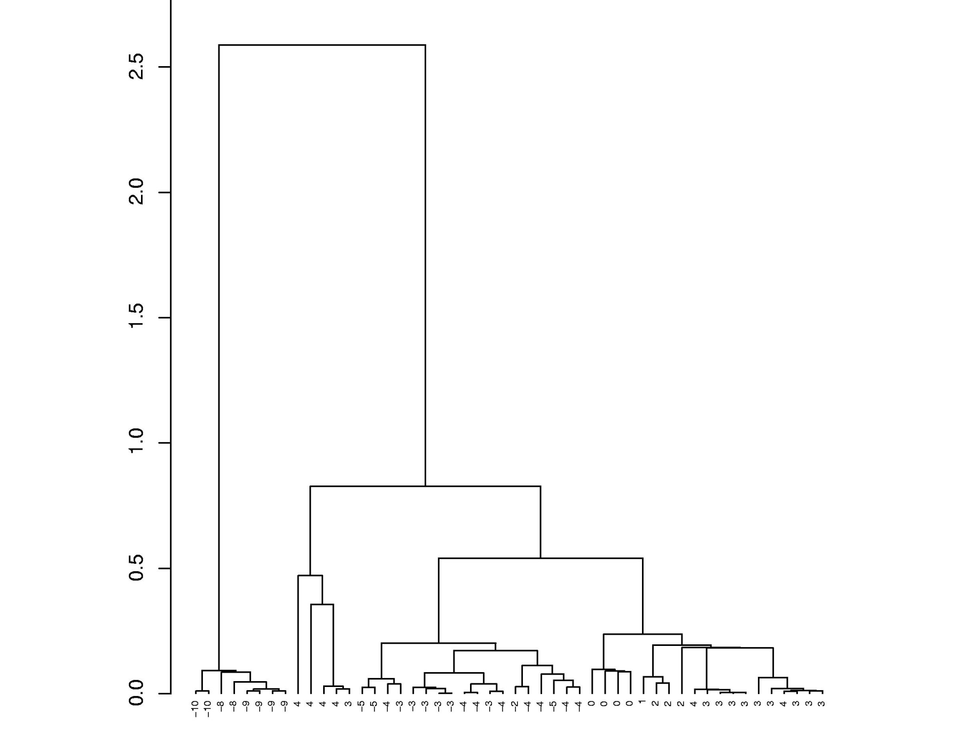
This figure shows an example of simulated data: the tree is simulated under the coalescent and mutations are added. In this case these are microsatellites. The same alleles can be found in different parts of the tree (homoplasy).

Slide 21
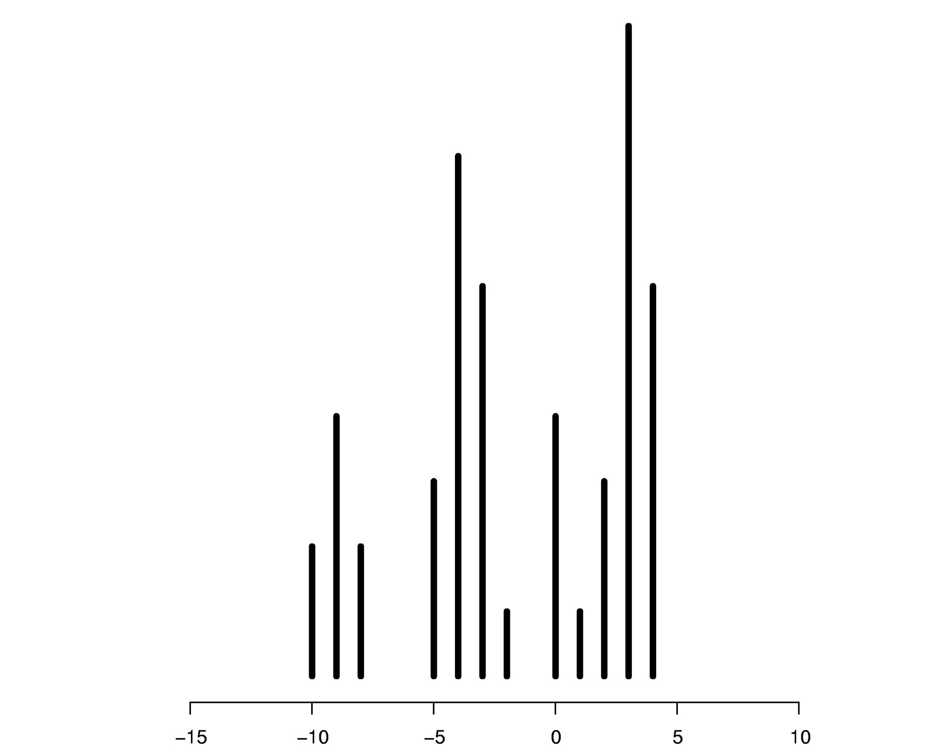
This figure shows the allelic frequency distribution corresponding to the tree from the previous slide.
Its multimodality is typical of demographically stable populations.

Slide 22
NEXT STEPS
Simulations with ms
Introduction to R
Coalescent simulations and tree visualization with R
ANY QUESTIONS ?

