Slide 1
ms - a program for generating samples under neutral models
Hudson (2002) Bioinformatics 18:337-8
http://home.uchicago.edu/~rhudson1/source/mksamples.html

Slide 2
ms
Generates samples under a variety of assumptions about migration, recombination rate and population size
Samples are generated using the standard coalescent approach:
  1st Generate the genealogy
  2nd Add mutations to the genealogical tree
Assumes the small sample approximations of the coalescent (n << N)
Assumes infinite sites model for mutations
  BUT, when used in conjunction with other programs, other mutation models can be used

Slide 3
The ms command line
For a constant population size, with random mating, no recombination and infinite site mutation model the command is:
ms nsam nreps –t 4N₀μ
Number of gene copies sampled
Number of repetitions (simulations)
Scaled mutation parameter:
N₀ diploid population size
μ mutation rate for the entire locus
EASY!!

Slide 4
The ms output
For instance, for the folowing command line
ms 10 1 –t 4 > ms.out
The output is stored in the file ms.out
ms 10 1 -t 4
60711 7473 11225
//
segsites: 17
positions: 0.1690 0.2248 0.3120 0.3346 0.3662 0.3935 0.4243 0.4814 0.5587 0.5735 0.5753 0.6957 0.7958 0.8226 0.8943 0.9272 0.9404
01010111000010000
01010111001010000
01011111010010000
01010111000010000
11010111000010000
01010111000110000
01010111000010000
01010111000110000
01010111000010000
00100000100001111
Population with effective size 1000 and mutation rate 0.001
Command line
Random number generator seeds
number segregating sites
Position of segregating sites
Sample for 10 gene copies and 17 segregating sites
0 indicates ancestral state
1 indicates derived state
10 gene copies (5 diploids)
17 seg sites
Notes:
Position of each polymorphic site, on a scale between 0 and 1

Slide 5
Population Expansion or Collapse
Sudden Population Collapse
ms 100 1 –t 4 –eN 0.5 10
Exponentially growing population
ms 100 1 –t 40 –G 46.05 –eN 0.05 0.1
N₁ = 10 000
N₀=1000
T=2000 gen
4N₀μ
Event
Change N
μ=10⁻³
Scaled time
t=T/4N₀
Relative N
x=N₁/N₀
N₁ = 1000
4N₀μ
T=2000 gen
Set Growth rate
Positive: expansion
Negative: decrease
μ=10⁻³
N₀ = 10 000
Growth rate α
N₁=N₀*exp(-αt), where t=T/4N₀

Slide 6
Population Structure
Island Model
ms 30 1 –t 4 –I 3 10 10 10 40
Population Split
ms 40 1 –t 4 –I 2 10 30 –n 1 5
-ej 1.25 2 1 –en 1.25 1 10
m=0.01
Number of pop
Scaled migration rate
4N₀m
N=1000
Sample from pop1, pop2,etc
N1=10 000
Number of present pop
N3 as reference pop
N₀ = N3
Set relative N for pop1
N2=5000
N3=1000
5000 gen
Event of joining lineages (Split)
Scaled time = 5000/4N₀ = 1.25
All lineages of pop2 go to pop1
Event of changing size
Scaled time = 5000/4N₀ = 1.25
Pop1 is 10 times N₀

Slide 7
Remember
N₀ is the reference effective size, and it can be chosen arbitrarily
Mutation rate, migration rate and time of the events are scaled by the chosen effective size N₀

Slide 8
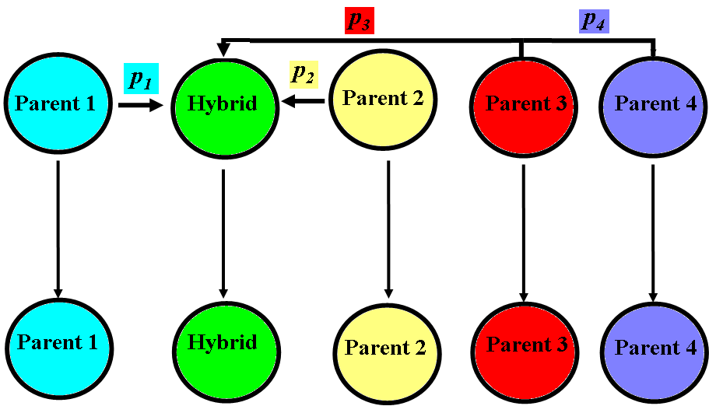
One example of complex ms command
Pop1
Pop2
Pop3
Pop4
Pop5
N1=100 N2=100 Nh=100 N3=100 N4=100
Nanc=100
Mutation rate=0.0001
Tadm=100 Tsplit=10000
p1=0.2 p2=0.3 p3=0.1 p4=0.4
Nsam1=20 Nsam2=20 Nsam3=20 Nsam4=20 Nsam5=20
Number of simulations=20

Slide 9
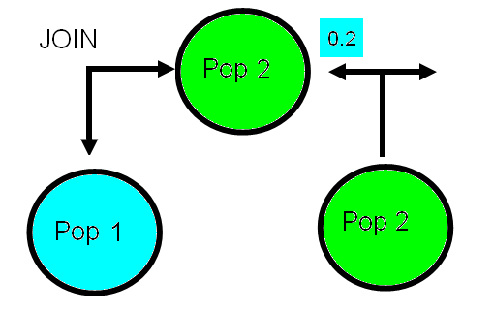
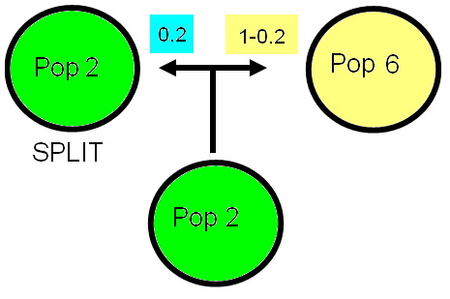
One example of ms command
ms 100 20 -t 0.04 -I 5 20 20 20 20 20 -n 1 1 -n 2 1 -n 3 1 -n 4 1 -n 5 1 -es 0.25 2 0.2 -ej 0.25 2 1 -es 0.25 6 0.375 -ej 0.25 6 3 -es 0.25 7 0.2 -ej 0.25 7 4 -ej 0.25 8 5 -en 25 1 1 -ej 25 3 1 -ej 25 4 1 -ej 25 5 1 | microsat > ms_result_msat.txt
N1=100 N2=100 Nh=100 N3=100 N4=100
Nanc=100
Mutation rate=0.0001
Tadm=100 Tsplit=10000
p1=0.2 p2=0.3 p3=0.1 p4=0.4
Nsam1=20 Nsam2=20 Nsam3=20 Nsam4=20 Nsam5=20
Number of simulations=20
Some issues:
  Population sizes and time are scaled
  long commands for complex models

Slide 10
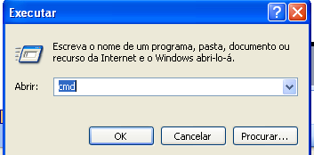
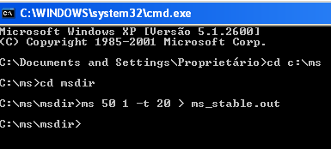
Example
Simulate a sample of 50 gene copies with 5000 nucleotides, from a constant population with effective size 10 000 and mutation rate 10⁻⁸ per nucleotide per generation
Open the command line. If you are on Windows do: START>Run>cmd
Go to the folder with ms.exe
Compute 4N₀μ = 4*10000*5000*10⁻⁸ =20
ms 50 1 –t 20 > ms_stable.out
Have a look at the file ms_stable.out with a text editor (TextPad, WordPad, NotePad, etc)

