Slide 1
The coalescent with recombination and the Sequentially Markovian
Coalescent (SMC)
Oeiras, 14-18 May 2018
Mark Beaumont^{1 /} Lounès Chikhi^{2,3}
Vitor Sousa ⁴ / Willy Rodriguez⁵/ Armando Arredondo⁵
¹ Department of Mathematics, Bristol University, UK
² Evolution et Diversité Biologique, CNRS, Toulouse, France
³ Instituto Gulbenkian de Ciência, Oeiras, Portugal
⁴ Faculdade da Universidade de Lisboal
⁵ Institut de Mathématiques de Toulouse, Toulouse, France

Slide 2
The Coalescent with recombination. Two genes (n=2)
recombination
Position a
Position a+1

Slide 3
The Coalescent with recombination
Past
recomb
Present

Slide 4
The Coalescent with recombination
recomb

Slide 5
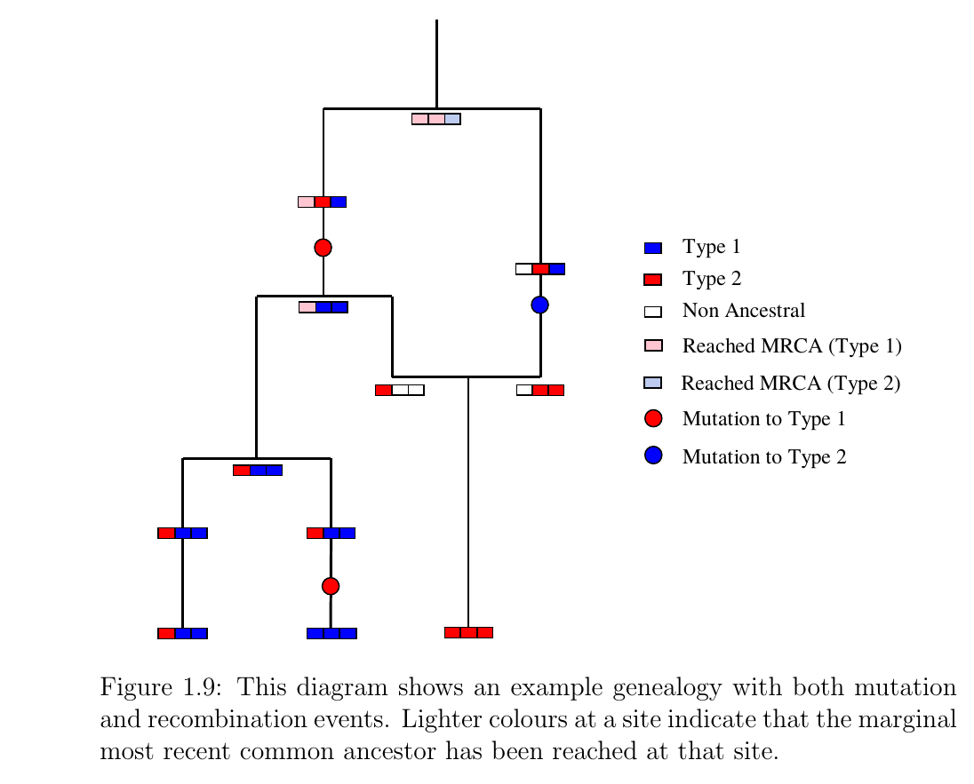
Figure taken from Niall Cardin. Approximating the Coalescent with Recombination.

Slide 6
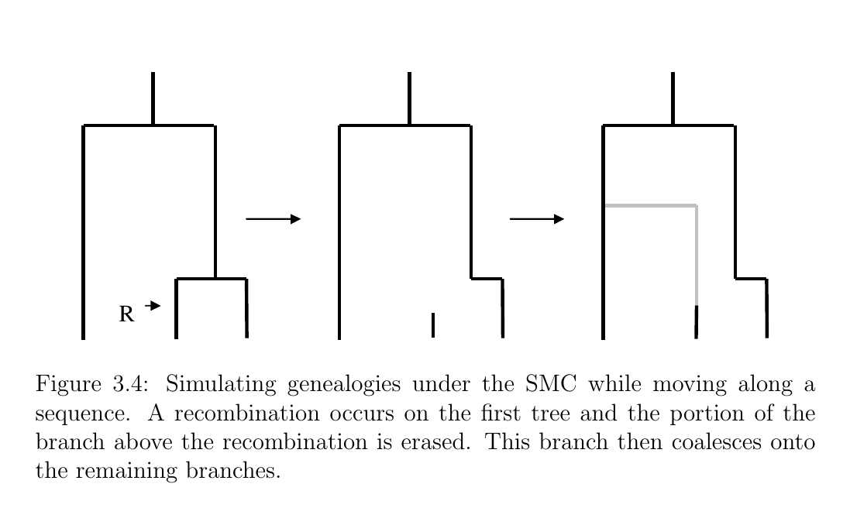
Sequentially Markovian Coalescent (SMC). Nial Cardin 2007

