Slide 1
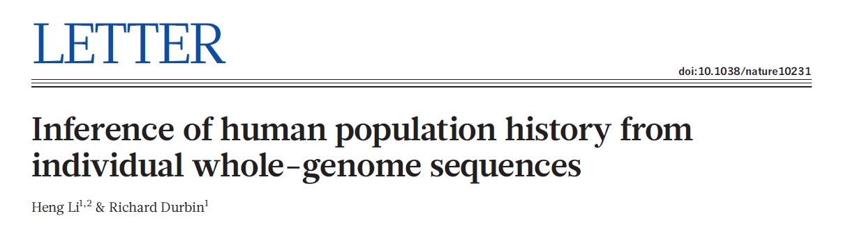
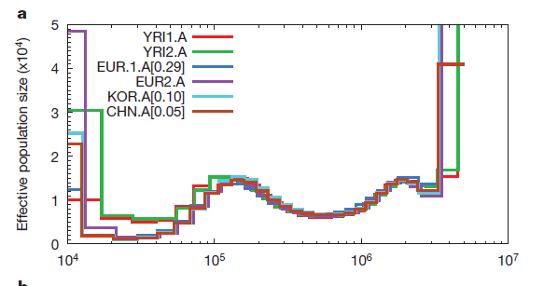
THE PSMC
(Pairwise Sequentially Markovian Coalescent)

Slide 2
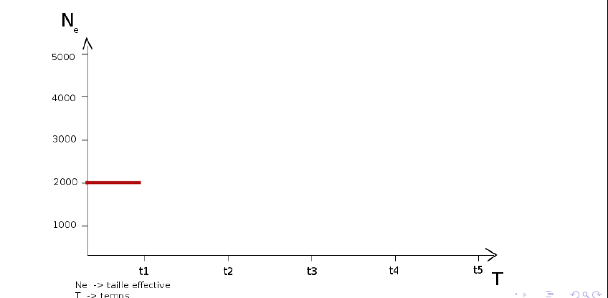
THE PSMC
Population size
Present
Past

Slide 3
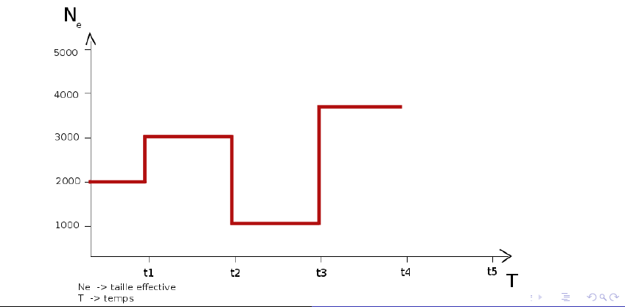
THE PSMC
Population size
Present
Past

Slide 4
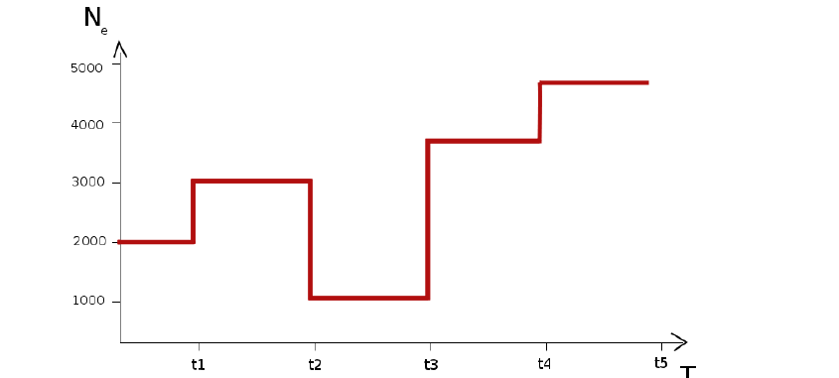
THE PSMC
Population size
Present
Past

Slide 5
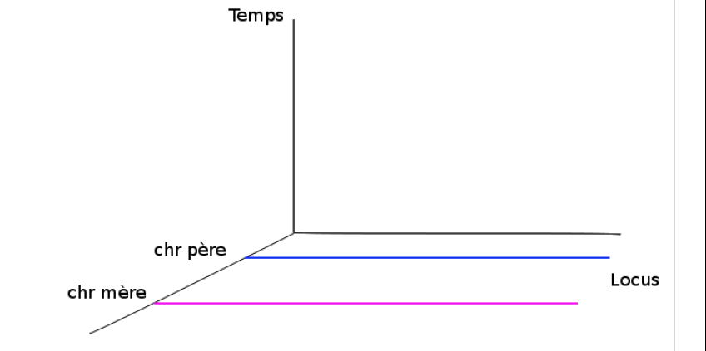
THE PSMC
Time
Parental chromosomes

Slide 6
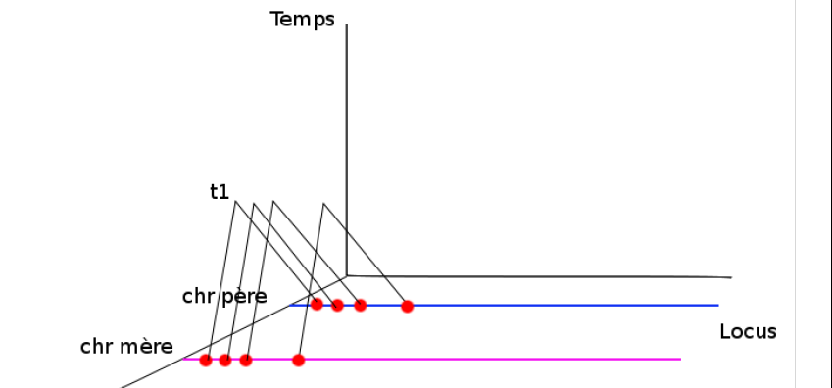
THE PSMC
Time
Parental chromosomes

Slide 7
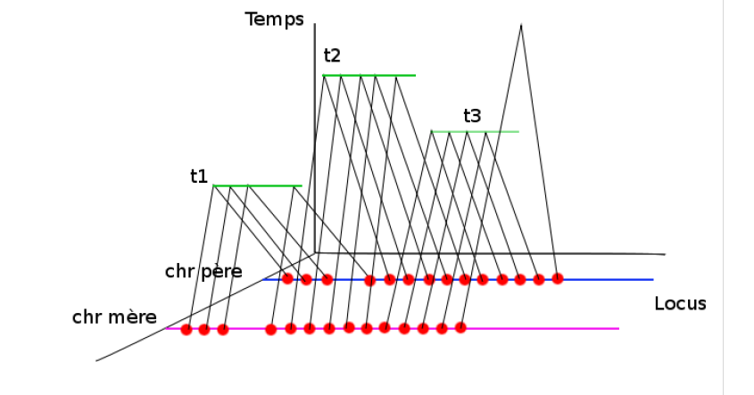
THE PSMC
Time
Parental chromosomes

Slide 8
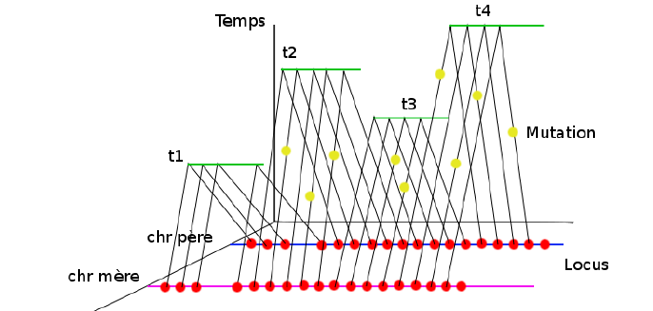
THE PSMC
Time
Parental chromosomes

Slide 9
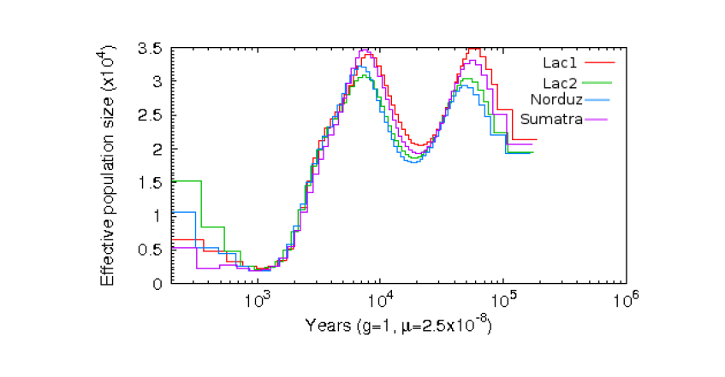
THE PSMC
(applied to three sheep breeds)
Time
S. Boitard – W. Rodriguez – O. Mazet

Slide 10

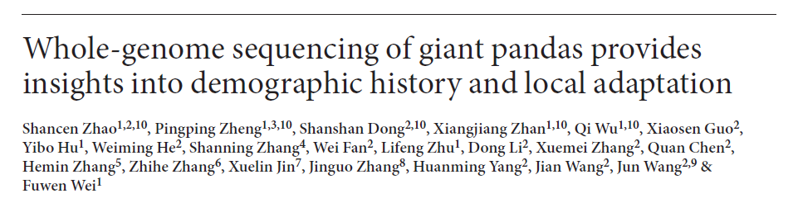
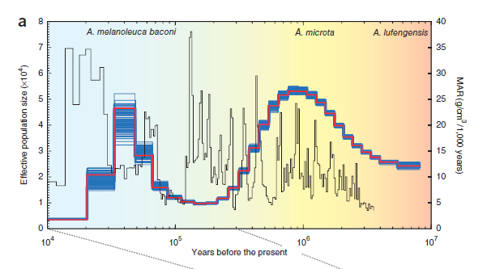
THE PSMC

Slide 11
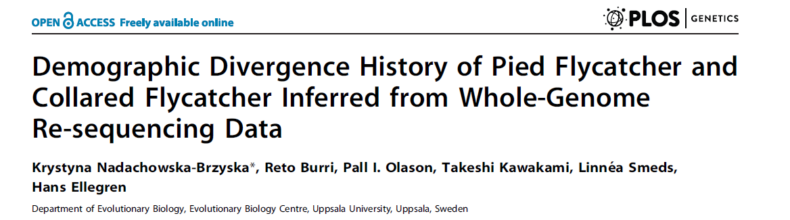

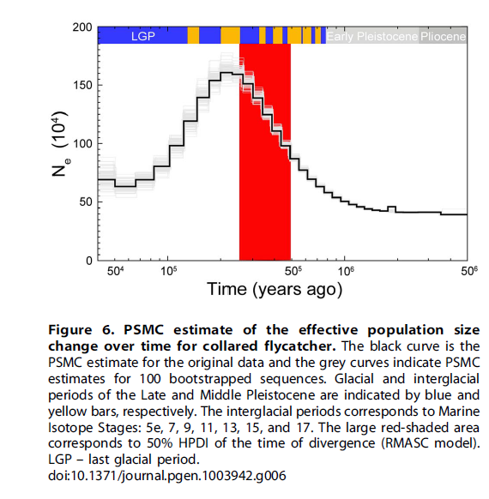
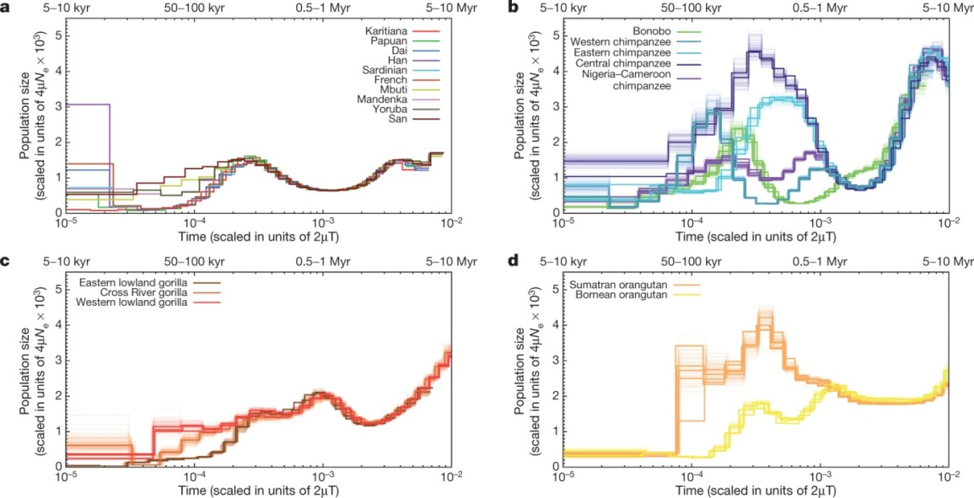
THE PSMC
J Prado-Martinez et al. 2013

Slide 12
THE PSMC
Now it’s your turn !!!
Run psmc on simulated data
Open the file:
psmc_tutorial_sim.odt
and follow the instructions

Slide 13
Past
2N
TIME
4N gen.
Present
N = 1,000 -- gen. = 20 years
4N = 80,000 years
2N = 40,000 years

Slide 14
THE PSMC

Slide 15
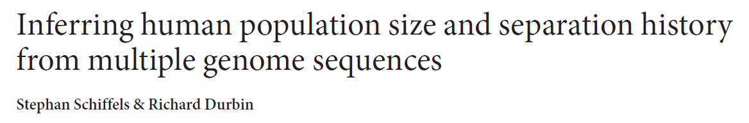

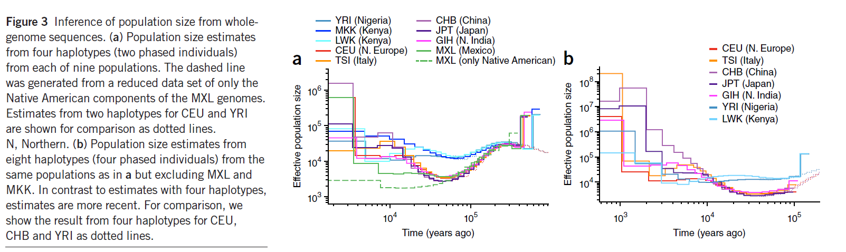
MSMC

Slide 16
GENETIC DIVERSITY
IN A PANMICTIC POPULATION
Past
Standard
Coalescent tree:
Hight = 4N gen.
TIME
Present
STANDARD COALESCENT (STATIONARY POPULATION) PREDICTS
* SHAPE OF THE GENE TREE / GENEALOGY
* PATTERNS OF GENETIC DIVERSITY

Slide 17
GENETIC DIVERSITY
WHEN POPULATION SIZE CHANGES
Past
TIME
Present
POPULATION SIZE CHANGES / DEMOGRAPHY
* SHAPE OF THE GENEALOGY
* PATTERNS OF GENETIC DIVERSITY

Slide 18
GENETIC DIVERSITY
IN ISOLATED PANMICTIC POPULATIONS
Past
X
X
TIME
Present

Slide 19
GENETIC DIVERSITY
IN THE CASE OF GENE FLOW
Past
X
?
X
?
TIME
Present

Slide 20
GENETIC DIVERSITY
IN THE CASE OF GENE FLOW
Past
TIME
Present
POPULATION STRUCTURE AND GENE FLOW
* SHAPE OF THE GENEALOGY
* PATTERNS OF GENETIC DIVERSITY

Slide 21
TO SUMMARISE
Pop size changes and pop structure modify the shape of gene genealogies
More specifically population structure often mimics bottlenecks
(the situation is actually more complex but let us ignore that for a moment)
(and both can mimic the effect of selection but we will ignore that too, ok?)

Slide 22
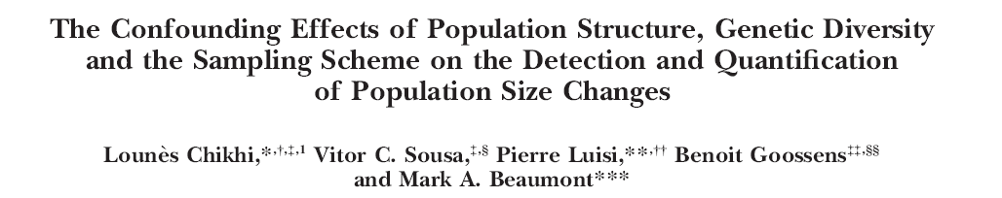
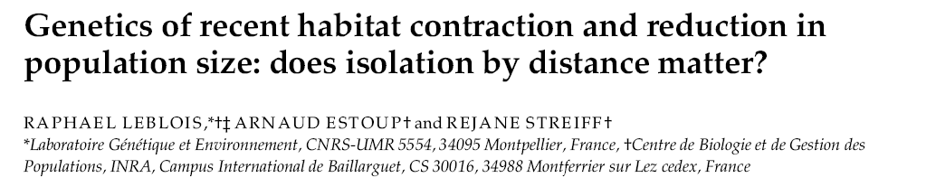
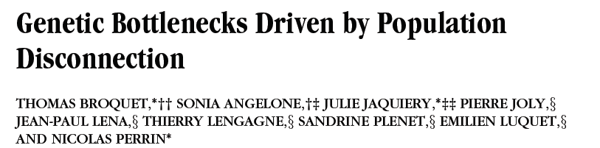
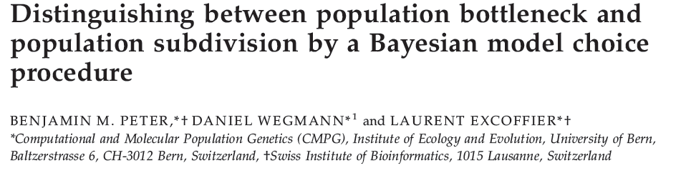
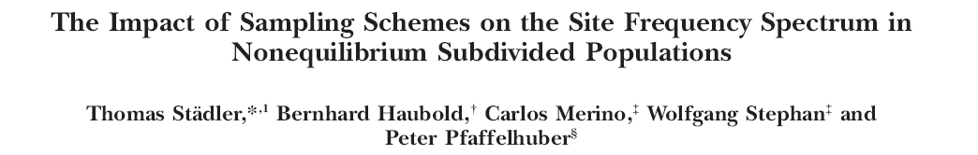

Slide 24
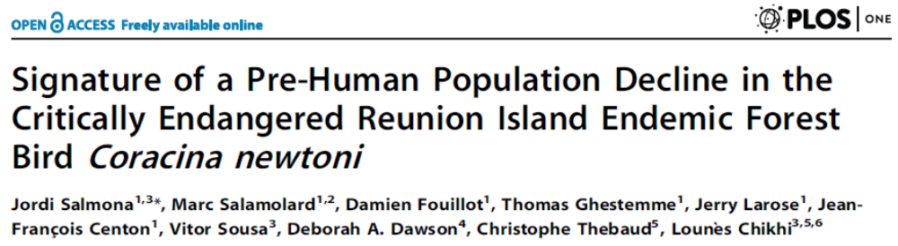
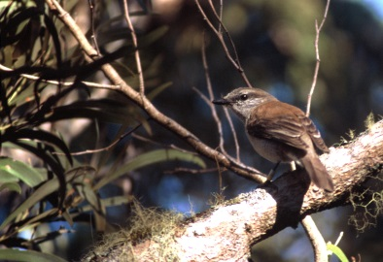
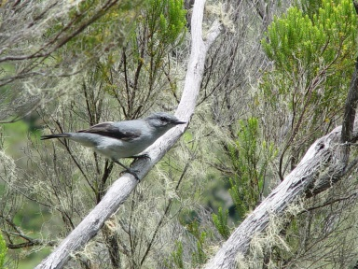
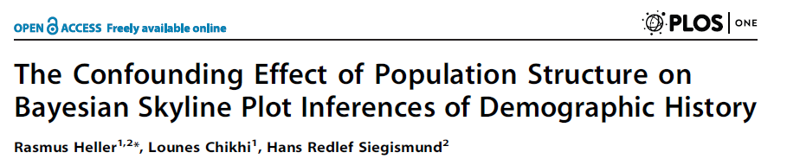
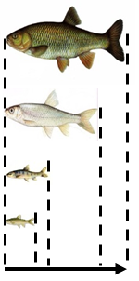

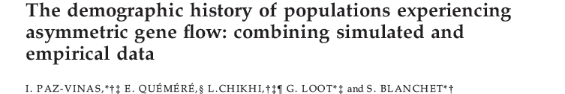
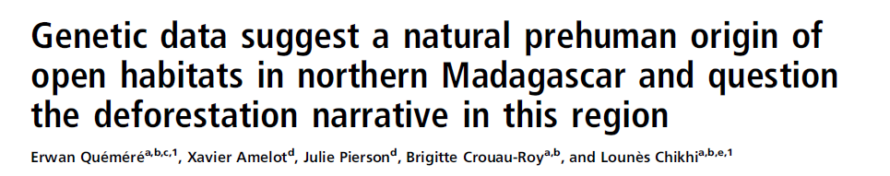
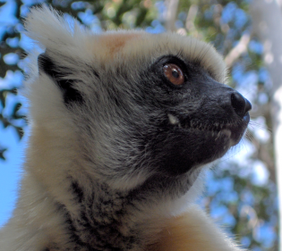

Slide 25
population size changes: real or artefacts?
robustness to population structure?
Can we use genetic information alone to identify the best model (structure versus pop size change)?
How much information? (sample size versus number of loci ?)
Are genomic data the answer?
Full genomes ? SNPs ?

Slide 26


Slide 27




Understand the properties of genetic data under simple structured and population size change models
Olivier Mazet, INSA Toulouse
Simona Grusea, INSA Toulouse
Willy Rodriguez, INSA Toulouse
Simon Boitard, INRA Toulouse

Slide 28
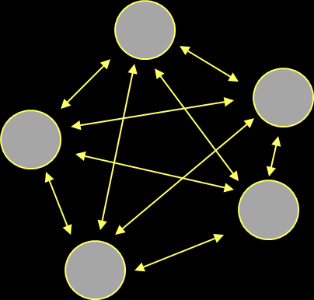
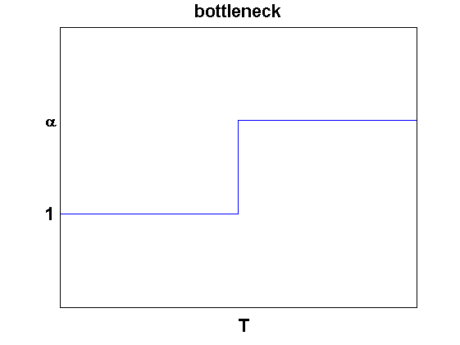
n/island
versus
stepwise population size change
alpha*N
N
Present
Past
n-island
Wright (1931)
Population size change
alpha < 1
alpha > 1

Slide 29
Past
TIME
Present

Slide 30
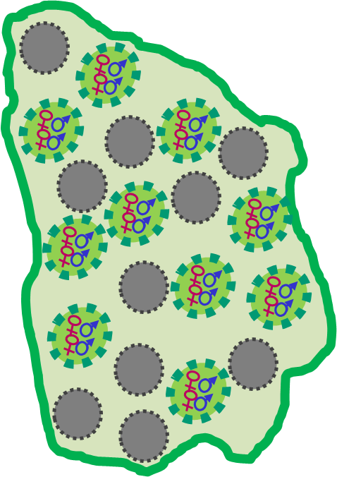
How should spatial structure be represented?

