Slide 1
Approximate Bayesian Computation
PGDH18

Slide 2
Approximate Bayesian Computation
Uses less information than full data-based methods.
Easier to implement and program (don’t need to know the likelihood for a given genealogical history).

Slide 3
Approximate Bayesian Computation
ABC
Bayesian methods aim to compute the probability distribution of parameter values θ given data x (posterior distribution):
p(θ | x)
Monte Carlo methods aim to approximate this by drawing random values of θ from the posterior distribution p(θ | x).
ABC is a very specific type of Monte Carlo method, in which the data x are transformed into summary statistics s, and instead of drawing θ from p(θ | x) we draw θ and s from p_{ε}(θ, s | s_{obs}) . That is, we have a Monte Carlo method that draws random values of θ and s from a distribution that approximates the posterior, given s_{obs}, depending on bandwidth ε.

Slide 4
Key Features of ABC
  The method depends on simulations from the ‘generative model’ that explains the data. It does not require a likelihood function.
  For most problems, we cannot hope to simulate data that are identical to the ‘true’ data.
  But similar data may have similar posterior distributions.
  If we replace the data with summary statistics, then it is easier to decide how ‘similar’ data sets are to each other.
  Our tolerance (level of approximation) is measured by the bandwidth ε.

Slide 5
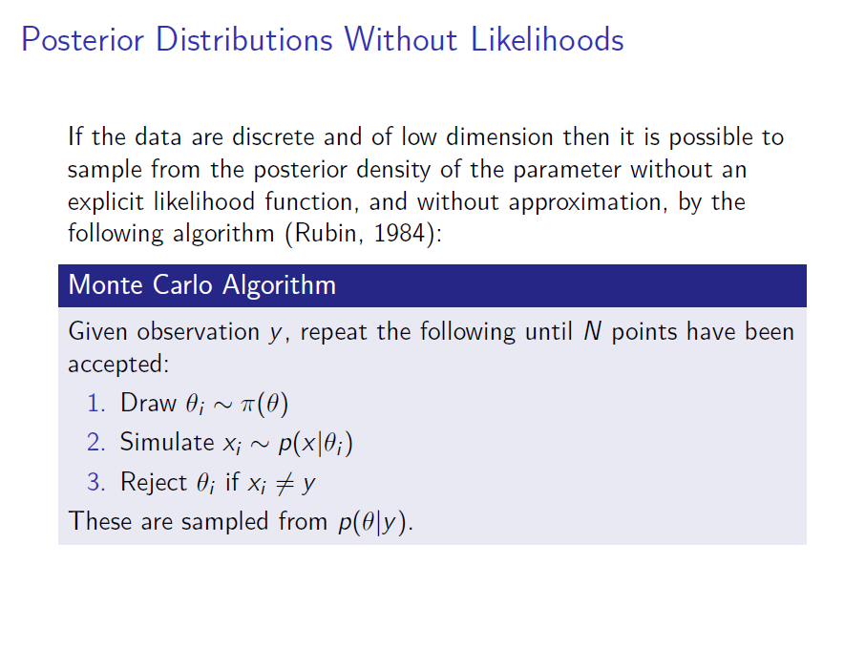

Slide 6
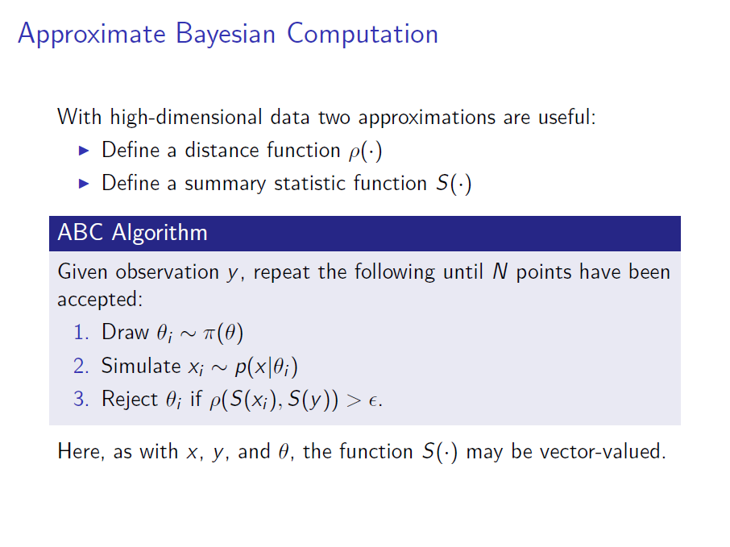
Algorithm of Pritchard et al (1999)

Slide 7
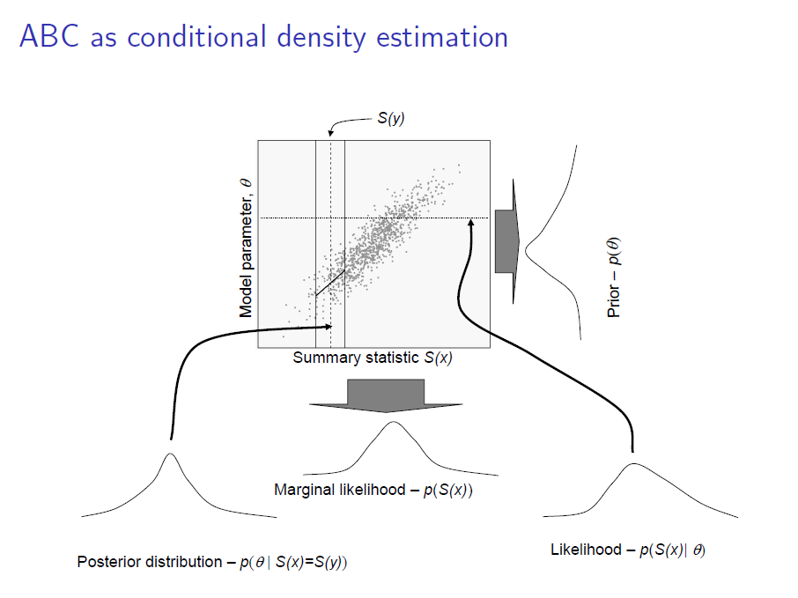

Slide 8
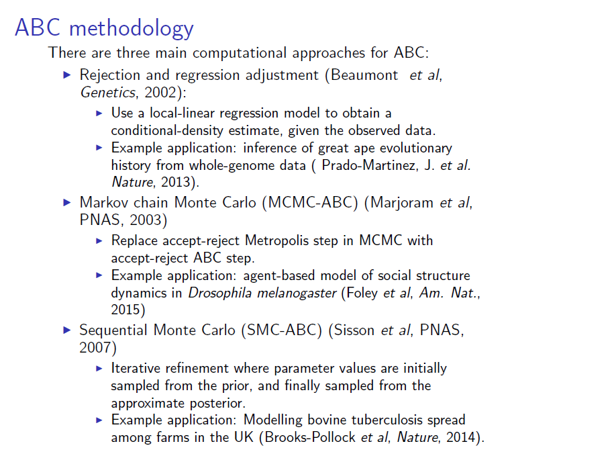

Slide 9
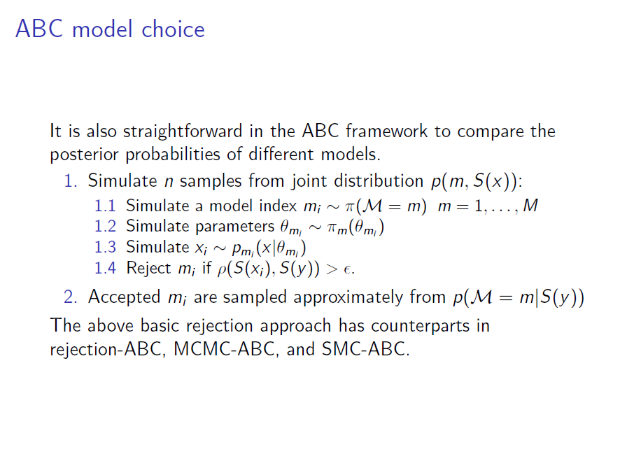
regression

Slide 10
The Curse of Dimensionality
We do not expect to capture all the information in the data with summary statistics.
Intuitively, the more summary statistics we use the more information we capture.
But the more statistics we have the less likely we will be able to closely match them for any given bandwith (tolerance interval) ε
This is an example of the ‘curse of dimensionality’.

Slide 11
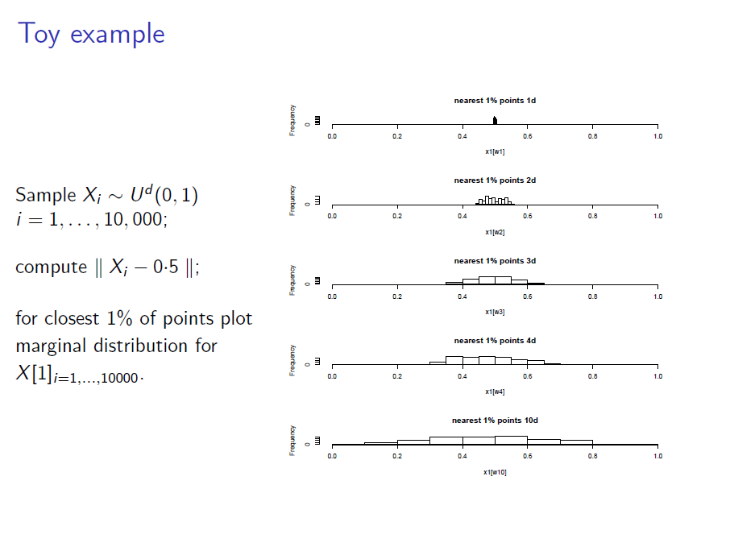

Slide 12
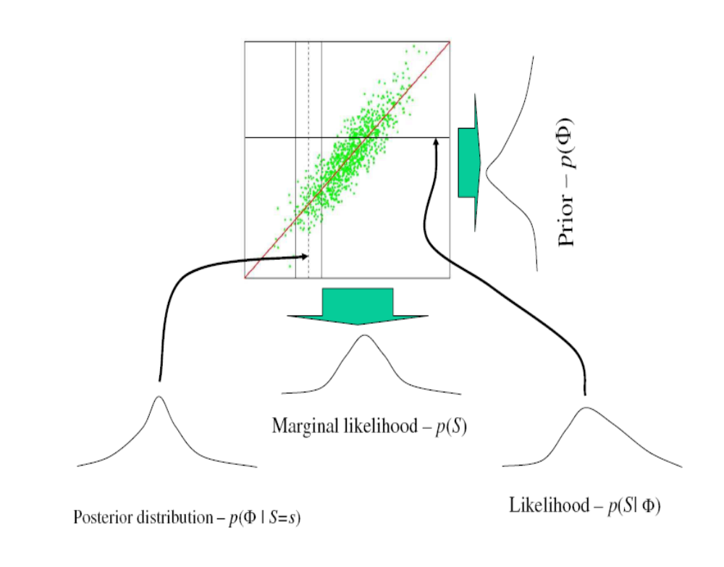
Regression Adjusted ABC
Simulate parameter values from prior
Simulate data with these parameter values from a simulation program.
Retain parameter values that give simulated data that are similar to the ‘real’ data.
Repeat a large number of times.
Adjust the parameter values by weighted regression.

Slide 13
ABC regression-adjustment method
Parameter
Fit a (local) linear regression. Project points along line.
Summary Statistic
How the points are weighted
1
0
Epanechnikov kernel

Slide 14
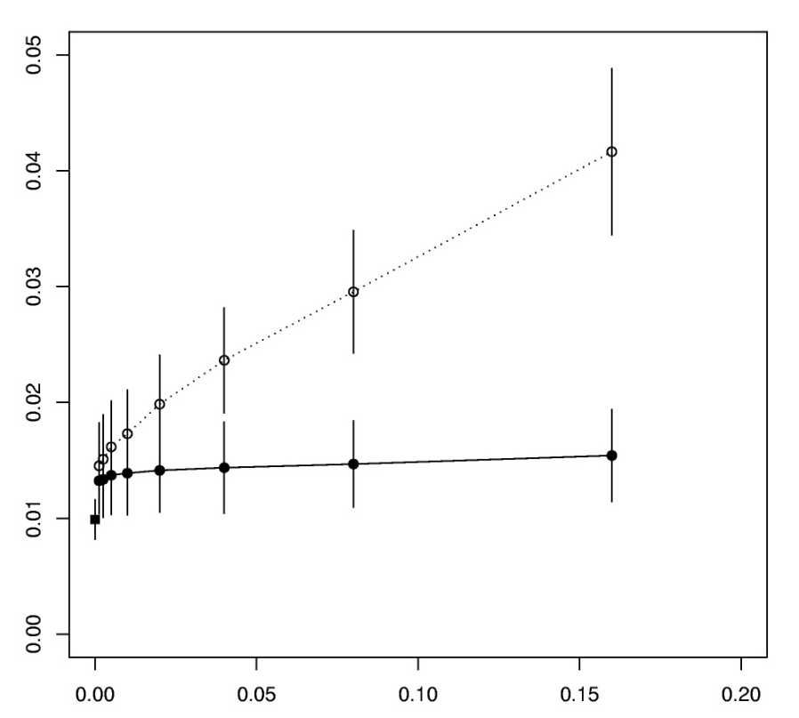
Accuracy in the estimation of scaled mutation rate θ = 2Nμ
Data:-
linked microsat loci
Standard Rejection
Relative mean square error
Summary statistics:-
mean variance in length
mean heterozygosity
number of haplotypes
MCMC
Regression
Tolerance

Slide 15
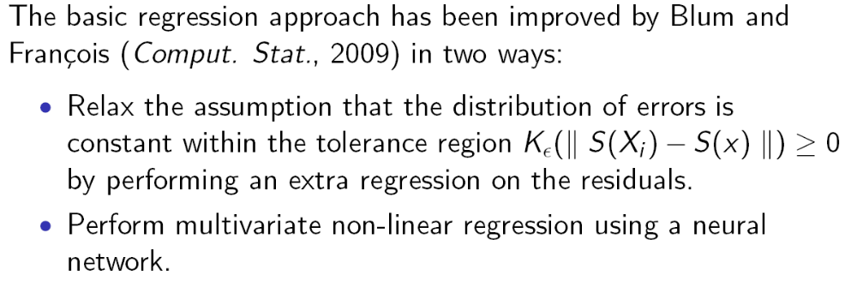
Improved Regression ABC

Slide 16
Regression Approach to Model Selection
Beaumont, M.A. (2008). Joint determination of topology, divergence time, and immigration in population trees, pp 134-154 . In Simulation, Genetics, and Human Prehistory, eds. S. Matsumura, P. Forster, & C. Renfrew. (McDonald Institute Monographs.) Cambridge: McDonald Institute for Archaeological Research.
Use regression framework. Treat model indicator as a categorical variable Y that can take values from (1,…, n_{M}).
Then get an estimate of P(Y=j | S = s). Use weighted regression, as before.

Slide 17
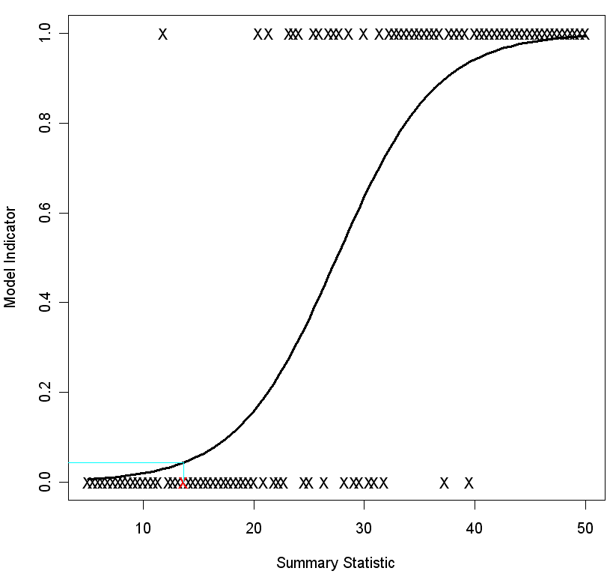
Fitted logistic regression line
P(model is 0 given that Summary Statistic is 13.6) is 0.044
13.6

Slide 18
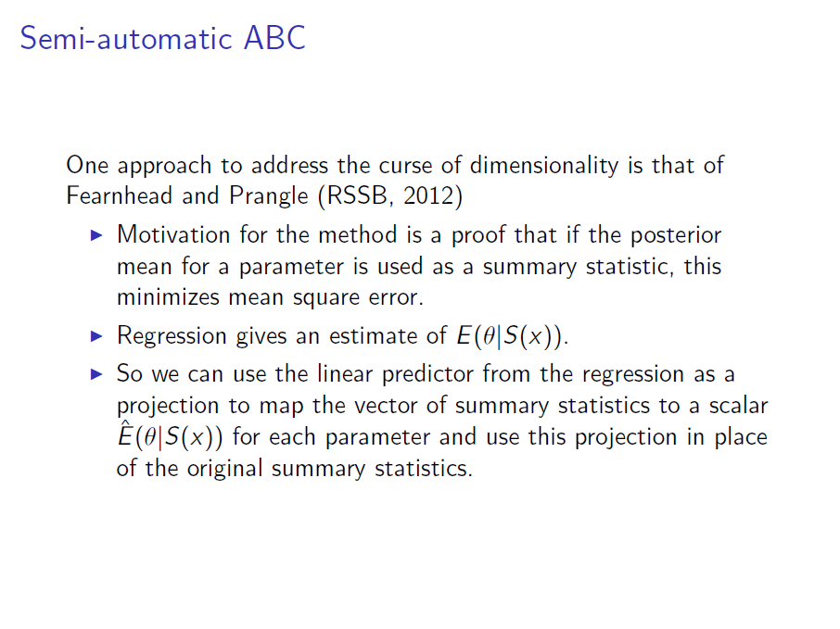

Slide 19
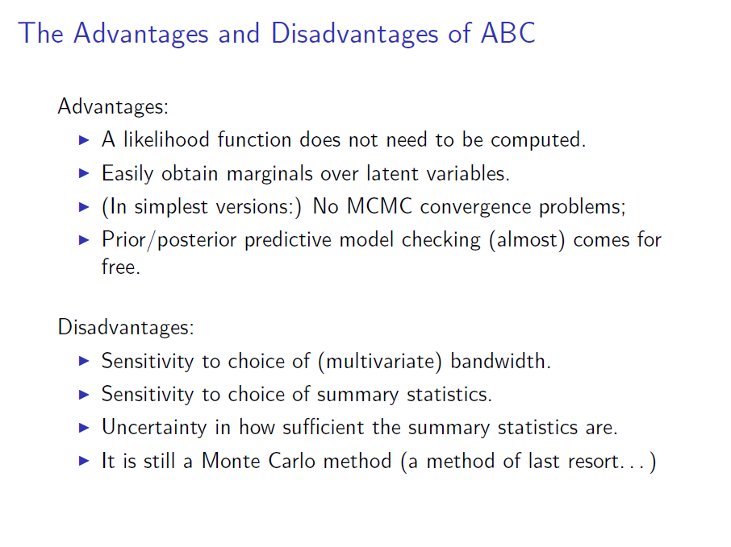

Slide 20
ABC methods and Population Genetics
The method was first developed for a population genetic problem (Pritchard et al, 1999).
Developed to compensate for the slowness of MCMC methods.
Widely used throughout for population genetic analysis in the 2000s
Used less with ‘whole-genome data’ and the advent of SFS methods from late 2000s
However, the flexibility of the approach means that it is still quite widely used, particularly in models that include selection (e.g. McManus et al, PLoS Genetics, 2017, evolution of resistance to malaria)
Increasingly used for diverse applications (cosmology, epidemiology, psychology...)
Still a major area of statistical research (particularly the interface with machine-learning methods).

Slide 21
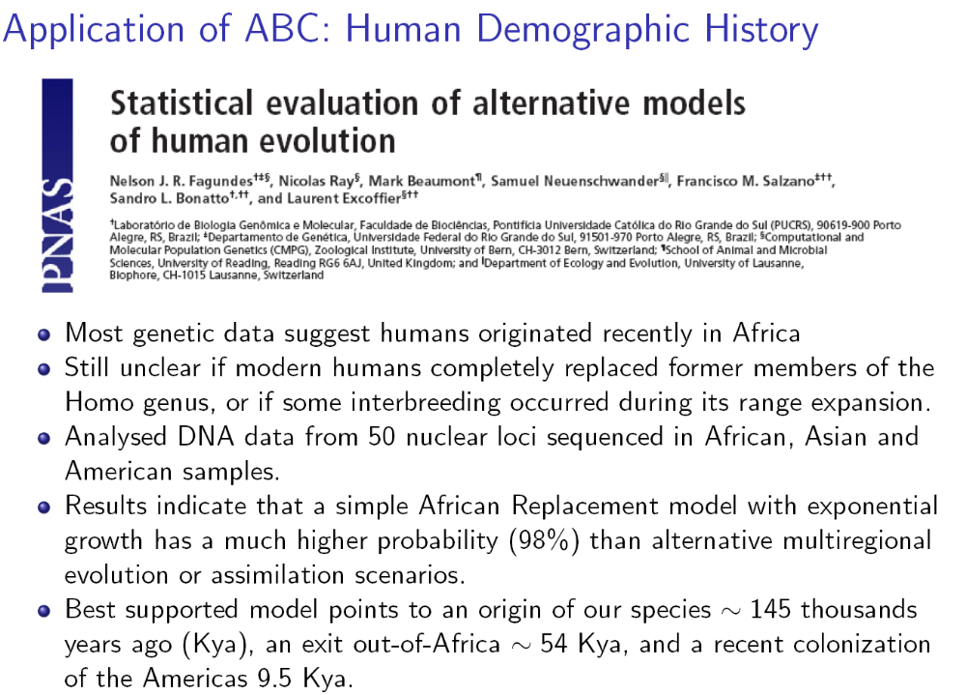

Slide 22
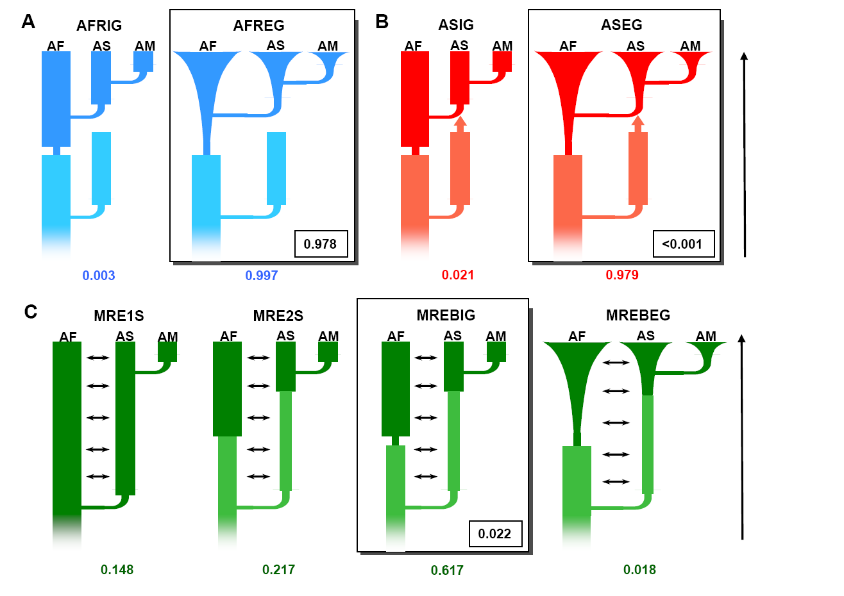

Slide 23
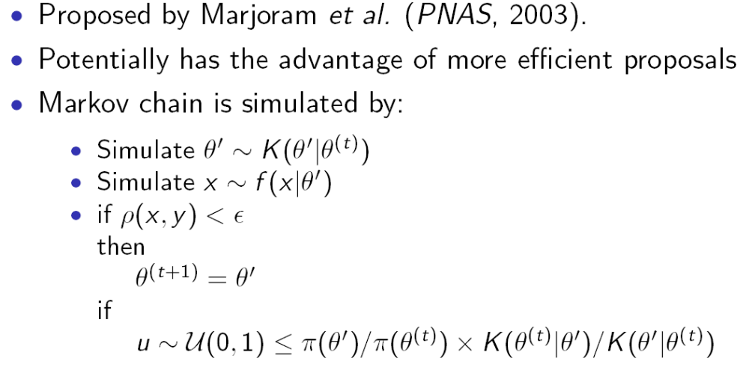
Markov chain Monte Carlo and ABC
ρ(x,y) measures distance between simulated statistic x and observed statistic y
else
θ ^{(t+1)} = θ ^{(t)}

Slide 24
MCMC-ABC
The MCMC scheme of Marjoram et al. has been widely used and adapted:
  Wegmann et al (Genetics, 2009) also analysed chimpanzee data (and introduced Partial Least Squares for ‘summarising’ summary statistics).

Slide 25
Sequential Monte Carlo and ABC
An SMC sampler for ABC was introduced by Sisson, Fan and Tanaka (PNAS, 2007)
Subsequent papers:
  Toni et al (Roy. Soc. Interface, 2009)
  Beaumont et al (Biometrika, 2009)
  Sisson et al (Correction, PNAS, 2009)
(these papers correct a potential bias in the original Sisson et al paper)

Slide 26
SMC-ABC
First step:
  simulate parameter values from prior
  Simulate data and summary statistics
  Retain closest N points
This set of points can be regarded as drawn from an approximation to posterior
Then fit a kernel density around the points
Reduce the tolerance
Data are simulated from this kernel density, summary statistics computed; closest N points retained.
Each point is given an importance weight that takes into account that the points are not sampled from the prior.
This weighted set of points gives an improved approximation because the tolerance interval is smaller.
The process is continued for further iterations.

Slide 27
Main Packages
R packages:
abc – Package from Michael Blum’s lab, originated from MAB code. Variety of regression-adjustment techniques
abctools – Package from Dennis Prangle. Implements semi-automatic abc, and a variety of diagnostic tests
easyabc – Package from Franck Jabot’s lab. Broad set of sequential ABC algorithms.
Standalone:
DIY-ABC – Package from Jean-Marie Cornuet/Arnaud Estoup’s group. ‘point and click’ interface. Regression-adjustment methods.
ABCtoolbox – Daniel Wegmann and co-workers. Extensive MCMC-ABC implementation, their own regression approach, PLS.

