Slide 1

SINS
Simulating INdividuals in Space
Tiago Maié // Population and Conservation Genetics group
Instituto Gulbenkian de Ciência // 15.03.2017

Slide 2
A look into (a few) Population Genetics Models
Stepping-stone model
N-island model
Population Size Change model
time
Structured models
population size
Spatially explicit
model
Non spatially explicit models
Population genetics inference typically assumes simple non-structured models
Notes:
To study HL&F we are interested in in space and time. The habitat is destroyed or degraded but that also happens as a temporal process

Slide 3
SINS
Simulating INdividuals in Space
Forward in time simulation (past → present → future)
Explicit diploid individuals with a given sex
Independent neutral markers (no selection, no recombination)
Sequences, microsatellites and SNPs
Sexual chromosomes and mtDNA data
Population ecology and behavior
Short and Long distance Migration (w/ sex-biased migration)
Growth-rate
Reproductive Success
Admixture
Competition
Expansion/Colonization
Dynamic demographic and environmental events
Carrying capacity
Friction

Slide 4




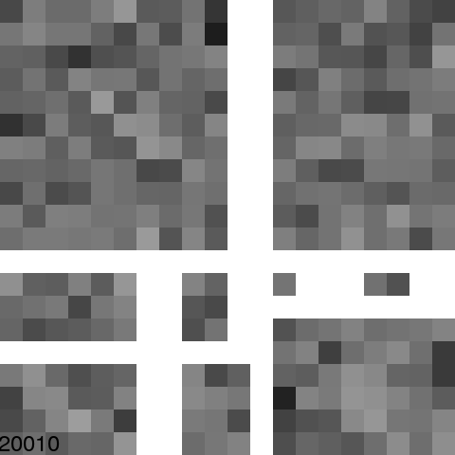
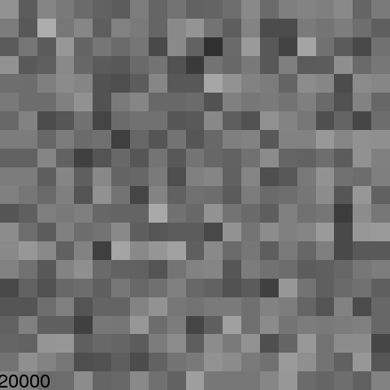
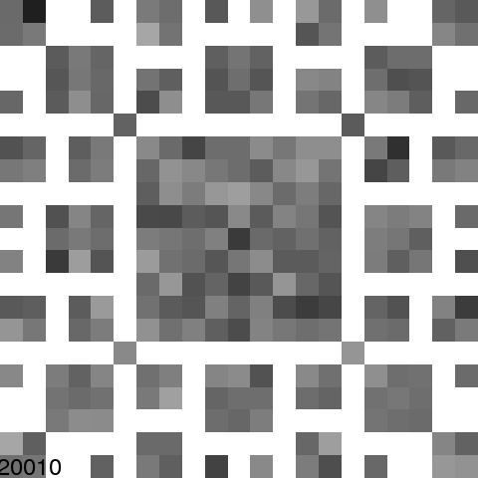
SINS - Simulating INdividuals in Space
time
fragmentation
Notes:
Stepping-stone model
Forward in time
Diploid individuals with explicit sexes
Independent neutral markers

Slide 5
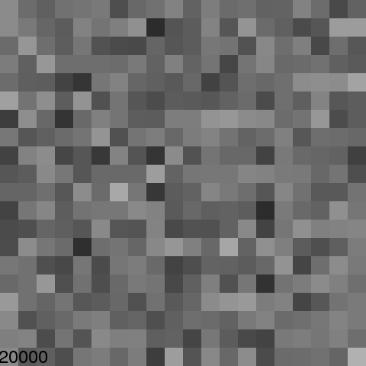
SINS - Technical details
Carrying capacity (0 ≤ K < ?)
Carrying capacity defines the (soft) maximum population size of a deme.
K is used to define the population at t + 1
Population size at t = 0 is defined by the user
Notes:
Source-sink/habitat quality example

Slide 6
SINS - Technical details
Friction (0 ≤ F ≤ 1)
Friction defines the difficulty to move to a deme.
F is used to define how migrants will be distributed among the neighbouring demes

Slide 7
SINS - Technical details
Migration
Migration can only take place in four different direction at most as in a typical 2D stepping stone model
Number of migrants
Sex-biased migration

Slide 8
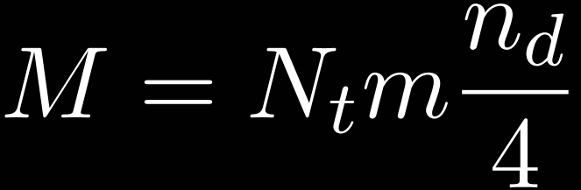
SINS - Technical details
Migration - Number of migrants (M)
The number of migrants that each deme will have is deterministic and calculated as:
M = number of migrants
N_{t} = number of individuals in the deme at time t
n_{d} = number of receiving demes
m = migration rate
Notes:
Currently the number of migrants is not drawn from a poisson with mean M, would make the migration process less deterministic but slower and less predictable

Slide 9
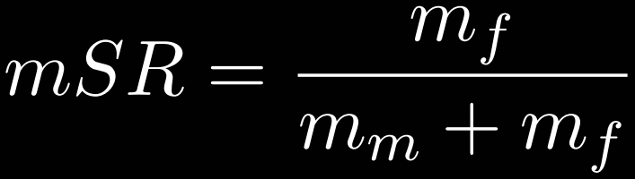
SINS - Technical details
Migration - Sex-biased migration
After we calculate the number of migrants for each direction we apply a sex-ratio parameter (mSR) to determine how males and females will migrate
mSR > 0.5 females migrate more than males
mSR < 0.5 males migrate more than females
mSR = sex-biased migration ratio ]0,1[
m_{f} = female migration rate
m_{m} = male migration rate
Notes:
mf + mm = 2m
= 0.5, the probability to migrate is the same for males and females;
> 0.5, females have a higher probability than males to migrate;
< 0.5, males have a higher probability than females to migrate.

Slide 10
SINS - Technical details
Reproductive Success (0 < RS ≤ 1)
Populations can have a complex social structure. We don’t simulate this complex social structure (yet) but we can do an approximation by limiting the reproductive success of each sex.
♀RS↘
♀RS = ♂RS
♂RS↘

Slide 11
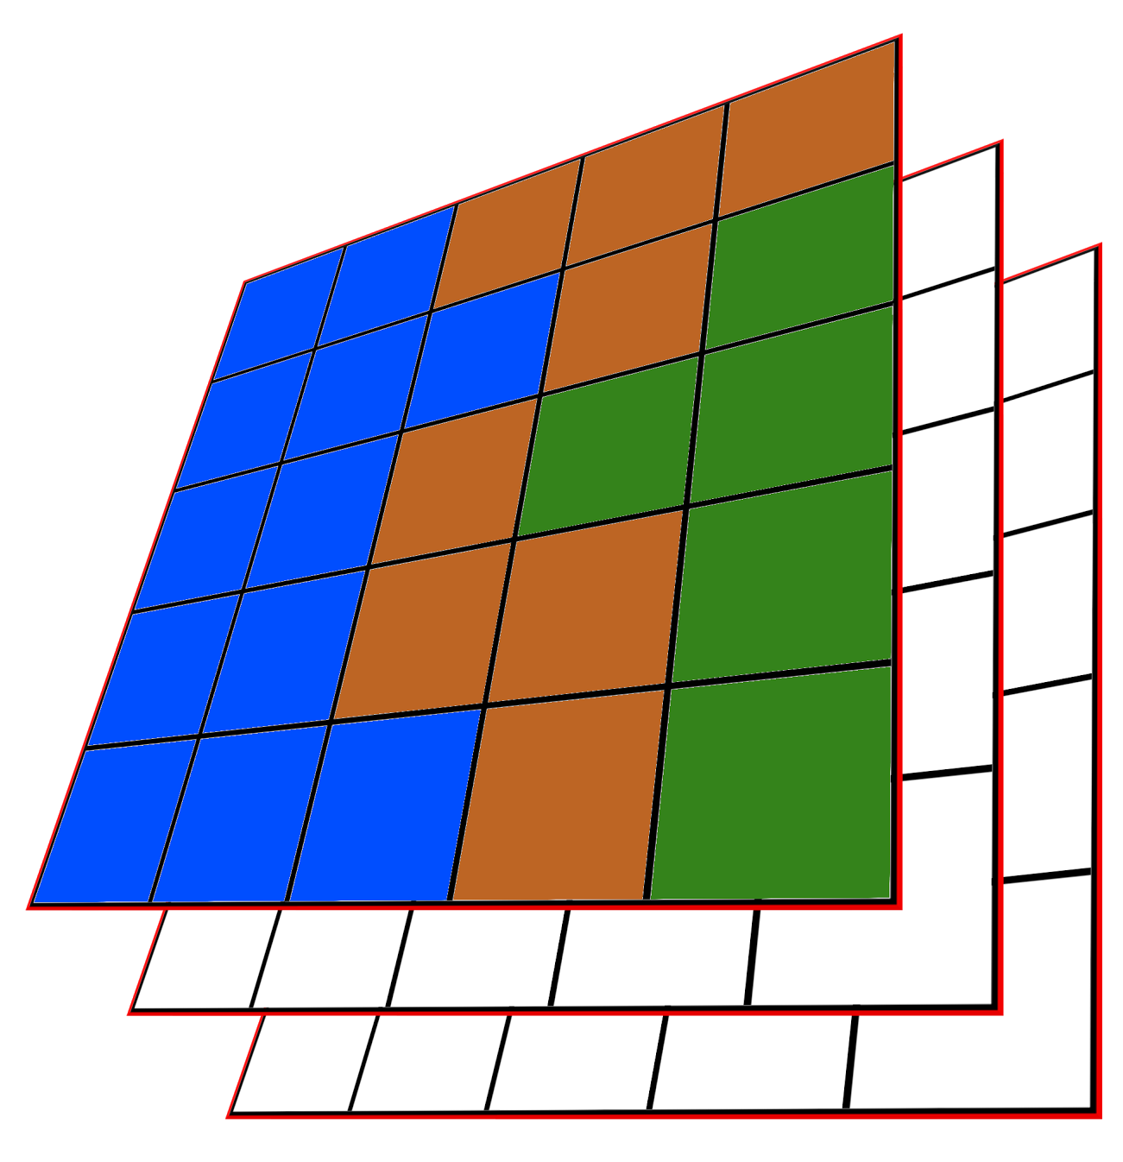
SINS
Folder and file structure
SINS_Sim
Input/
world.txt
output_preferences.txt
environment/
layer0[CC/F]Init.txt
genetics/layer0/
genotype.txt (...)
layer_parameters/
layer0.txt
layer0_init.txt
sampling_preferences/
sampling_conf.txt
subset_map.txt
Name of layer: layer0

Slide 12
SINS
Folder and file structure
SINS_Sampler
Input/
config_[name of project].txt
generations.txt
SamplingGenFiles/
sampling[generation].txt
Name of layer: layer0

Slide 13
SINS
Class Exercise
In the “To_Participant/DAY_3_2017/” folder:
Copy “SINS_Classes_Exercise” to your Desktop or working directory
Open a Command Line Interface and “move” to “SINS_Classes_Exercise” in your working directory
Run the “build_SINS_input.sh” script in your “SINS_Classes_Exercise” folder by typing:
“./build_SINS_input.sh [name of your project]”
Inside your “SINS_Classes_Exercise” folder, explore the “SINS_Sim/input” and “SINS_Sampler/input” folder.
Change the inputs accordingly
Inside your “SINS_Classes_Exercise” folder, run the “run_SINS_pipeline.sh” script

Slide 14
SINS
Class Exercise
In the “To_Participant/DAY_3_2017/” folder:
Copy “SINS_Classes_Exercise” to your Desktop or working directory
Open a Command Line Interface and “move” to “SINS_Classes_Exercise” in your working directory
Run the “build_SINS_input.sh” script in your “SINS_Classes_Exercise” folder by typing:
“./build_SINS_input.sh [name of your project]”
Inside your “SINS_Classes_Exercise” folder, explore the “SINS_Sim/input” and “SINS_Sampler/input” folder.
Change the inputs accordingly
Inside your “SINS_Classes_Exercise” folder, run the “run_SINS_pipeline.sh” script

Slide 15
SINS
Class Exercise
In the “To_Participant/DAY_3_2017/” folder:
Copy “SINS_Classes_Exercise” to your Desktop or working directory
Open a Command Line Interface and “move” to “SINS_Classes_Exercise” in your working directory
Run the “build_SINS_input.sh” script in your “SINS_Classes_Exercise” folder by typing:
“./build_SINS_input.sh [name of your project]”
Inside your “SINS_Classes_Exercise” folder, explore the “SINS_Sim/input” and “SINS_Sampler/input” folder.
Change the inputs accordingly
Inside your “SINS_Classes_Exercise” folder, run the “run_SINS_pipeline.sh” script

Slide 16
SINS
Class Exercise
In the “To_Participant/DAY_3_2017/” folder:
Copy “SINS_Classes_Exercise” to your Desktop or working directory
Open a Command Line Interface and “move” to “SINS_Classes_Exercise” in your working directory
Run the “build_SINS_input.sh” script in your “SINS_Classes_Exercise” folder by typing:
“./build_SINS_input.sh [name of your project]”
Inside your “SINS_Classes_Exercise” folder, explore the “SINS_Sim/input” and “SINS_Sampler/input” folder.
Change the inputs accordingly
Inside your “SINS_Classes_Exercise” folder, run the “run_SINS_pipeline.sh” script

Slide 17
SINS
Class Exercise
In the “To_Participant/DAY_3_2017/” folder:
Copy “SINS_Classes_Exercise” to your Desktop or working directory
Open a Command Line Interface and “move” to “SINS_Classes_Exercise” in your working directory
Run the “build_SINS_input.sh” script in your “SINS_Classes_Exercise” folder by typing:
“./build_SINS_input.sh [name of your project]”
Inside your “SINS_Classes_Exercise” folder, explore the “SINS_Sim/input” and “SINS_Sampler/input” folder.
Change the inputs accordingly
Inside your “SINS_Classes_Exercise” folder, run the “run_SINS_pipeline.sh” script

Slide 18
SINS
Class Exercise
In the “To_Participant/DAY_3_2017/” folder:
Copy “SINS_Classes_Exercise” to your Desktop or working directory
Open a Command Line Interface and “move” to “SINS_Classes_Exercise” in your working directory
Run the “build_SINS_input.sh” script in your “SINS_Classes_Exercise” folder by typing:
“./build_SINS_input.sh [name of your project]”
Inside your “SINS_Classes_Exercise” folder, explore the “SINS_Sim/input” and “SINS_Sampler/input” folder.
Change the inputs accordingly
Inside your “SINS_Classes_Exercise” folder, run the “run_SINS_pipeline.sh” script

