Slide 1
Exercise Generate a NGS analysis report

Slide 2
Objective
To generate an intelligible NGS Analysis Report (meaning a report that a non expert can understand)
To identify biologically relevant mutations:
Describing the tumor’s patient
Potential druggable targets (“actionable”)
To propose therapeutic options.

Slide 3
Case 1: Squamous Cell Lung Cancer Patient (LUSC)
58 years old male.
Advanced Squamous cell Lung Carcinoma (Stage IV). Brain mets.
Surgery (R0) + 1st line: Carboplatin/Paclitaxel. PD. 2nd line: Pemetrexed/Erlotinib
PD May 2013
Exome Sequencing + Avatar

Slide 4
NGS REPORT FOR PATIENT LUSC

Slide 5
Tumor description
Sample Characteristics
Case ID: Exercise
Date: 17/03/2013
Tumor Type: Lung cancer (Squamous cell carcinoma
Stage IV)
Tumor location: Liver
Tumor type sample Frozen
% Tumor purity: 90%
Normal sample source: Blood
Objective
- Whole exome sequencing analysis of tumor and normal samples to identify tumor-specific (somatic) sequence alterations.
Procedure
Genomic DNA was purified from tumor and normal specimens. DNA samples were enriched for coding regions in the genome using custom DNA capture approaches. Enriched tumor and normal DNA was sequenced using massively parallel sequencing instruments. Sequence data were mapped to the reference human genome sequence and sequence alterations were determined by comparison of over 50 million bases of tumor and normal DNA. The characteristics of the samples and analysis approach are indicated below.

Slide 6
Global Analysis Characteristics
Exome sequencing analysis
We found X somatic mutations
From these somatic mutations
X are single nucleotide variants (SNVs).
X are indels: X deletions and X insertions.
X mutations have been previously described in dbSNP or/and 1000GP.

Slide 7
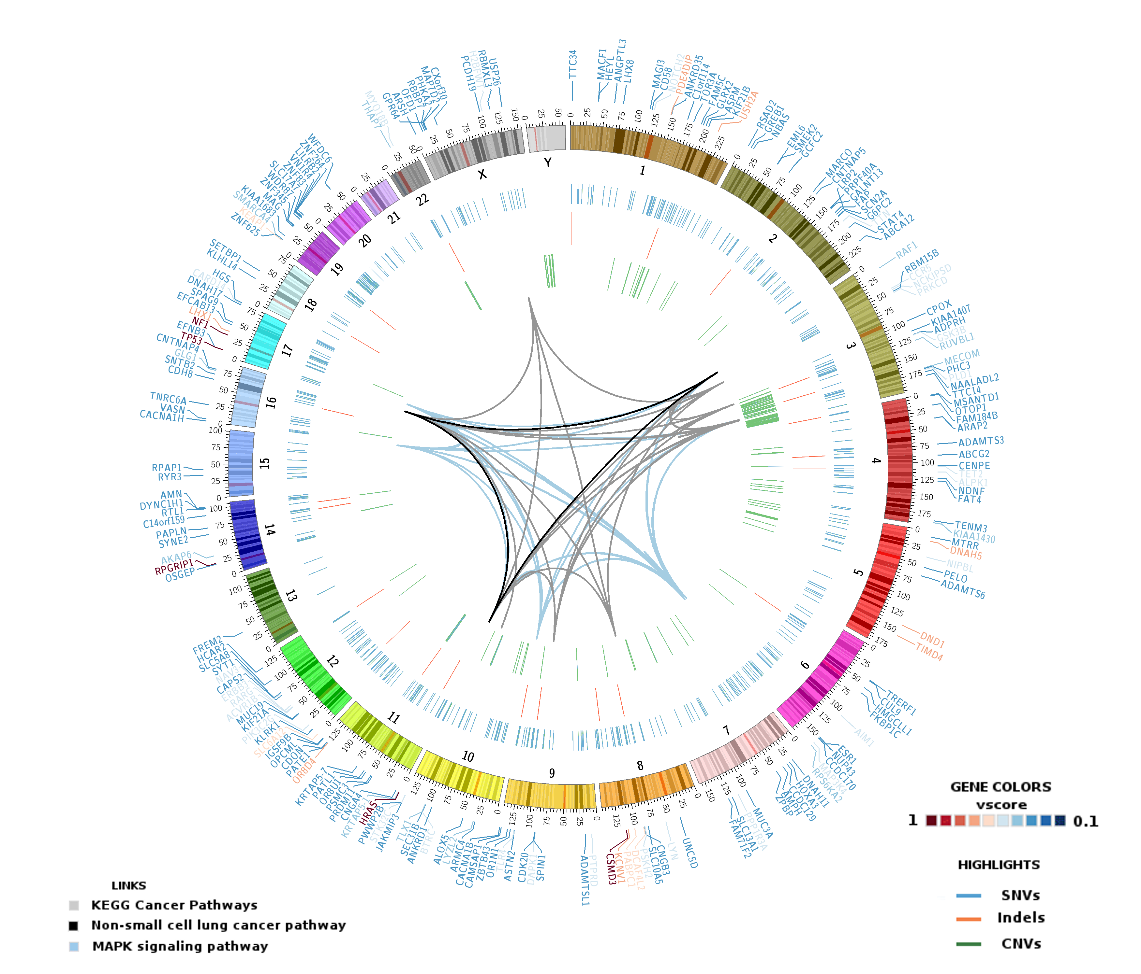
Case:
X mutations are relevant (including missense and exon junctions mutations) and Y are considered damaging (stop gained consequences, frameshift and all missense variants considered damaging by predicting methodologies).

Slide 8
List of selected relevant genes
We have selected X genes which have proteins rendered damaged classified by their consequence type such as stop gained consequences, frameshift and all missense variants considered deleterious. Table 2 summarizes X gene mutations predicted as deleterious. X are related with Squamous Cell Lung Cancer
Table 1

Slide 9
Genes with clinical relevance (select 3 genes)
Gene Name: ---
Gene Overview: ---
Mutation overview:
Type somatic mutation:
Position:
Mutation id:
AA Mutation:
Domains affected:
Known dbSNP (if any):
Gene expression (Cancer and Normal tissues):
Cancer Tissue distribution (number of samples with this mutation):
Protein Mutation Severity predicted by SIFT & Polyphen:
Gene reported to be somatically mutated in the following cancers:
Pathways affected:
CLINICAL IMPLICATION:
Prognostic information (if any):
Prognostic Literature Refs (if any):
Therapeutic options (if any):
Therapeutic Literature Refs (if any):

Slide 10
Plots for each gene (same 3 genes) from web resources that support your genes choice
Be creative!!!! ☺

Slide 11
Relevant pathway altered in this patient

Slide 12
Summary
Patient xxx ….
(Two sentences about clinical and biological relevant mutations identified and therapeutic implications)

Slide 13
Link to upload reports

