Slide 1
Final Presentations

Slide 2
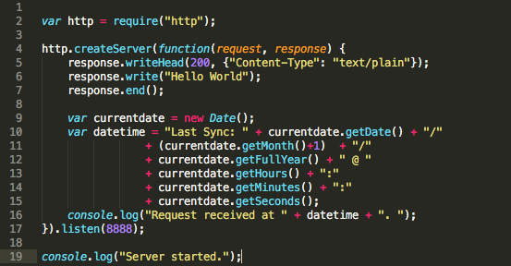
Demo 1: barebone web server

Slide 3
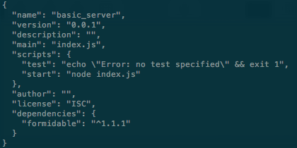
Demo 2: A simple web server
Prepatation
npm init
npm install formidable --save
mkdir tmp

Slide 4
Organization
Mainfile: index.js/app.js
HTTP server: server.js
Router: router.js
Request handlers: requestHandlers.js

Slide 5
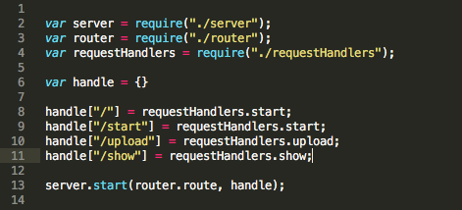
Mainfile

Slide 6
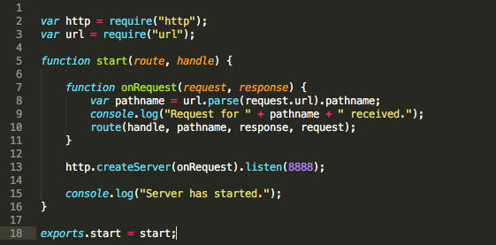
HTTP server

Slide 7
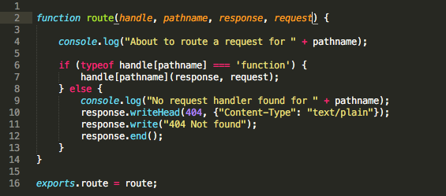
Router

Slide 8
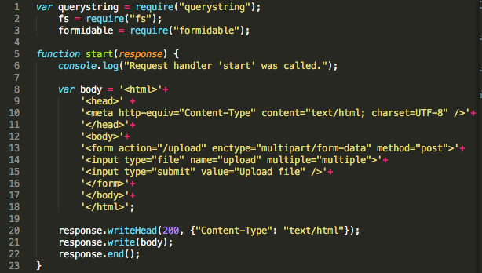
Request handlers

Slide 9
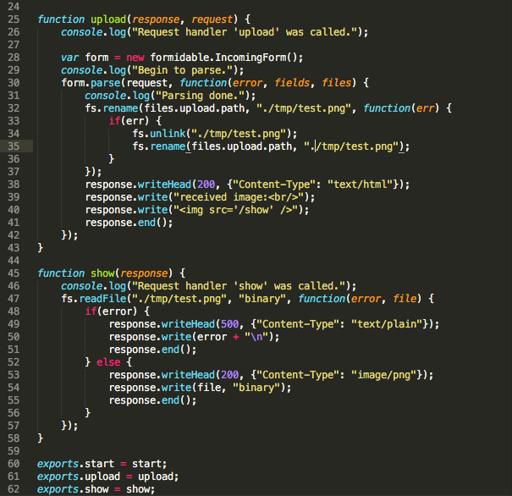

Slide 10
Demo 2: A simple web server
Express
Jade
Mongo DB

Slide 11
Demo 3: Potential to incorporate ML/AI
Game demo
ML/AI is computation intensive

