Slide 1




Real-Time Hand Gesture Recognition
Via Fine-Tuned EfficientNet-B0
Deep Learning
2026 May

Slide 2
Table of Contents
Group Members
3
CNN’s Problems
8
Introduction
4
EfficientNet
10
Challenges
5
Conclusions
15
Dataset
6

Slide 3






Group Members
Pham Quoc Hung
Dinh Bui Khanh Huy
Nguyen Dong Quan
3

Slide 4


Introduction
Why gesture recognition?
What we built
Control devices naturally - no touch, no gloves, just your hand. Used in AR/VR, smart homes, and sign-language tools.
Fine-tuned EfficientNet-B0 on 17,000 images across 34 gesture classes. Runs live on webcam. 79% accuracy.
4

Slide 5




The Challenge of Gesture Recognition
Machines can't naturally understand human hand gestures from a plain camera
Same gesture looks different across people, lighting, and angles
Similar gestures (three vs three2 vs three3) are easy for humans, hard for models
5
34 gestures. 1 camera. Real-time.

Slide 6
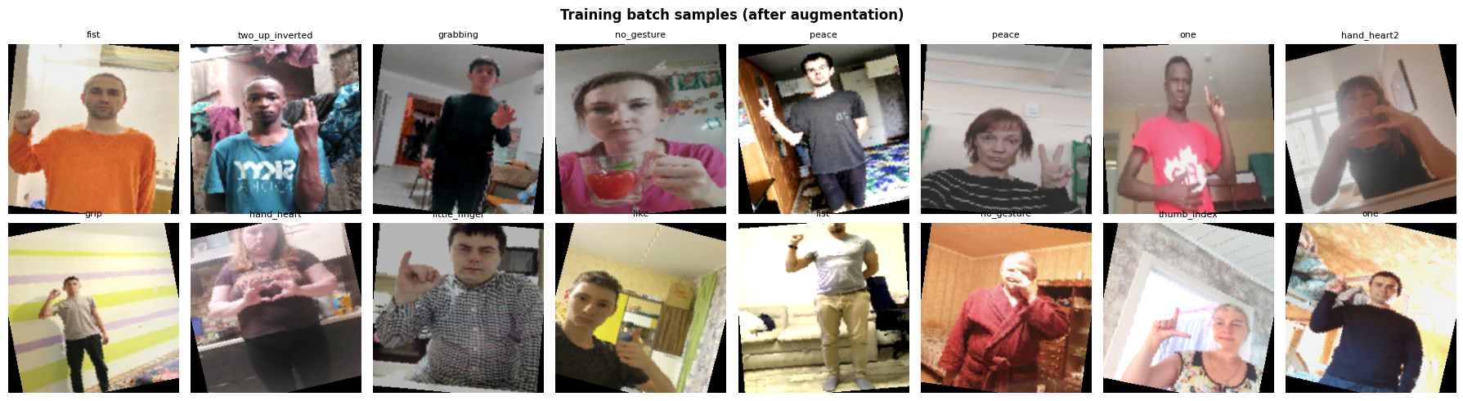
Dataset Overview
HaGRIDv2 Dataset
Big stats
34 gesture classes
500 images per class - perfectly balanced
17,000 total images → 13,600 train / 1,700 val / 1,700 test
128×128 stored → upscaled to 224×224 for model input
6
Source : HuggingFace - GestureDetectionConnoisseurs/hagrid_subset

Slide 7
Dataset Insights (EDA)
Finding | Details
Perfectly balanced | No class weighting needed
Leading hand | Both left & right hand captured per gesture
Bounding boxes | Each image annotated with hand region
Diverse | Varied backgrounds, lighting, skin tones
"no_gesture" included as its own class - important for real-world use where hands may appear but no gesture is being made
7

Slide 8

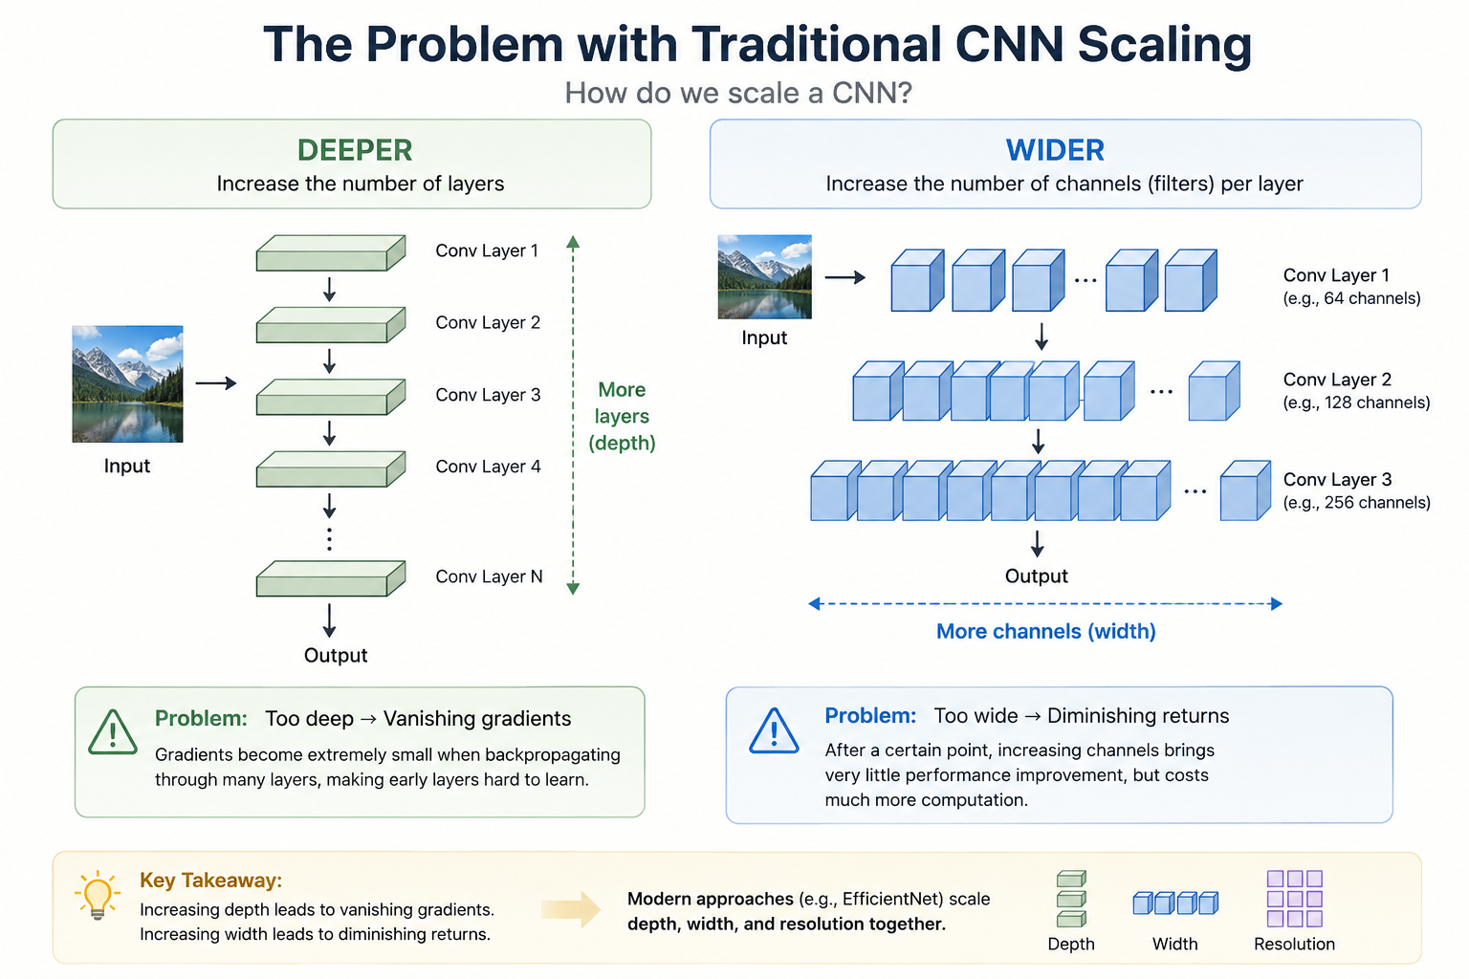
The Problem with Traditional CNNs
How Do We Scale a CNN?
Deeper
Wider
Vanishing gradients
Diminishing returns
8

Slide 9
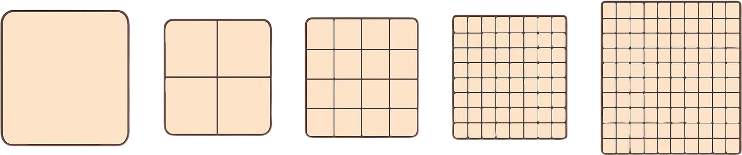
The Problem with Traditional CNNs
How Do We Scale a CNN?
Higher resolution
Huge compute cost
9

Slide 10


EfficientNet's Answer
EfficientNet - Compound Scaling
Scale depth + width + resolution together using one coefficient φ - like turning a single dial
EfficientNet is a family of convolutional neural networks (CNNs) introduced by Google AI researchers Mingxing Tan and Quoc V. Le in May 2019 with the paper "EfficientNet: Rethinking Model Scaling for Convolutional Neural Networks."
The initial release featured a baseline model, EfficientNet-B0, developed using Neural Architecture Search (NAS) to optimize the balance between accuracy and FLOPs (floating-point operations).
10

Slide 11

EfficientNet's Variants
EfficientNet - Compound Scaling
EfficientNet models scale from B0 to B7, starting with B0 as the baseline that balances speed and accuracy. Each version increases depth, width, and image resolution, improving accuracy. However, they also demand more computational power, from the B1 and B2 to the high-performing B6 and B7.
While EfficientNet-B3 and EfficientNet-B4 models strike a balance for larger images, B5 is often chosen for complex datasets that require precision. Beyond these models, the latest model, EfficientNet V2, can improve training speed, handle small datasets better, and is optimized for modern hardware.
11

Slide 12
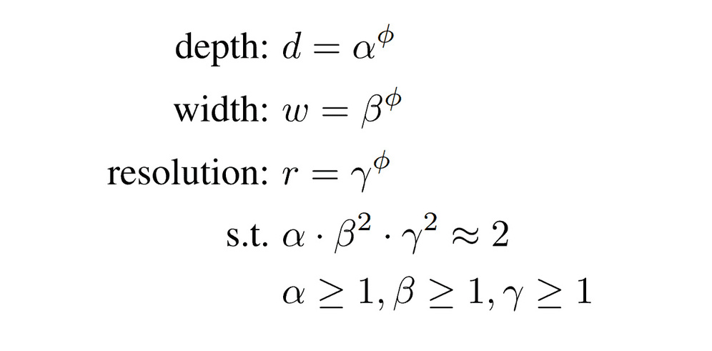
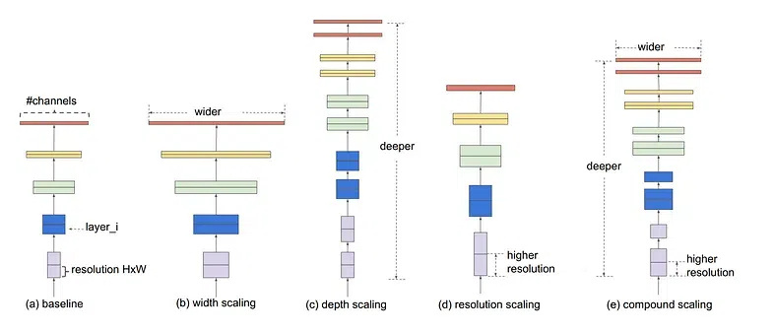
EfficientNet's Magic
Compound Scaling
Traditional CNNs scale one thing randomly.
EfficientNet asks: "If I have 2x more compute, what's the best ratio to distribute it?" → Answer: scale all three, but not equally
12

Slide 13
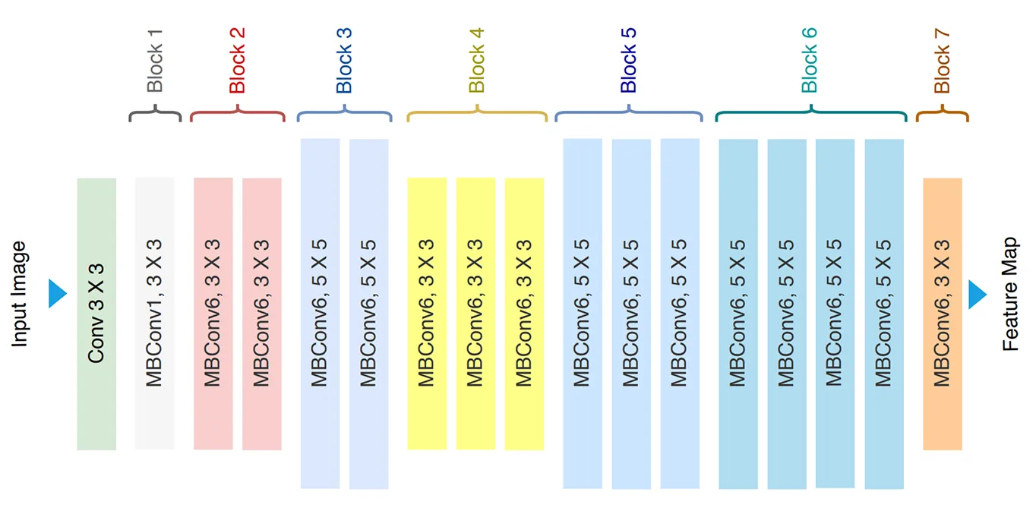
Inside EfficientNet
Architecture
EfficientNet-B0 serves as the base model.
The later versions, from B1 to B7, are scaled versions of this baseline architecture using compound scaling
13

Slide 14
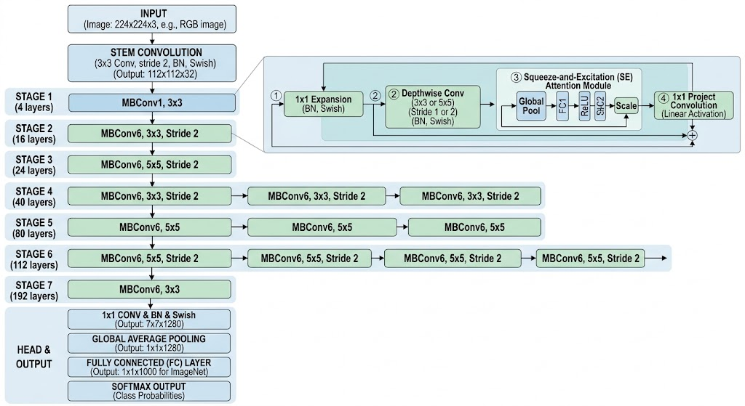
EfficientNet's WorkFlow
14

Slide 15
Demo
15

Slide 16

The End
Thank You for Listening
Tiffany Owen
2024 January

