Slide 1
Infrastructure Automation
Terraform Basics - Day 1

Slide 2

Introduce yourself
Your Name, Job Title and Experience with Terraform and IaC
Notes:
Before we begin, I would like you introduce yourself.

Slide 3




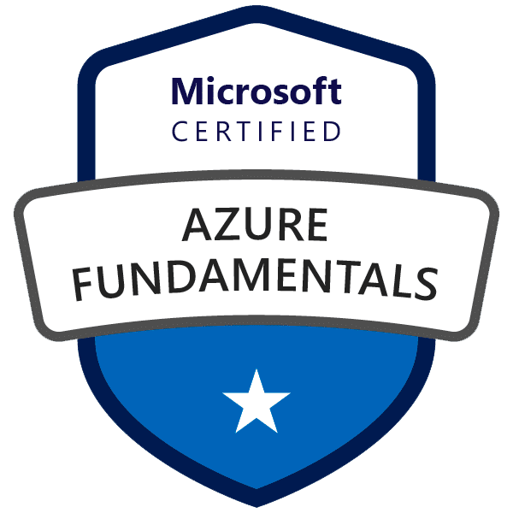
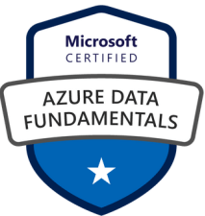
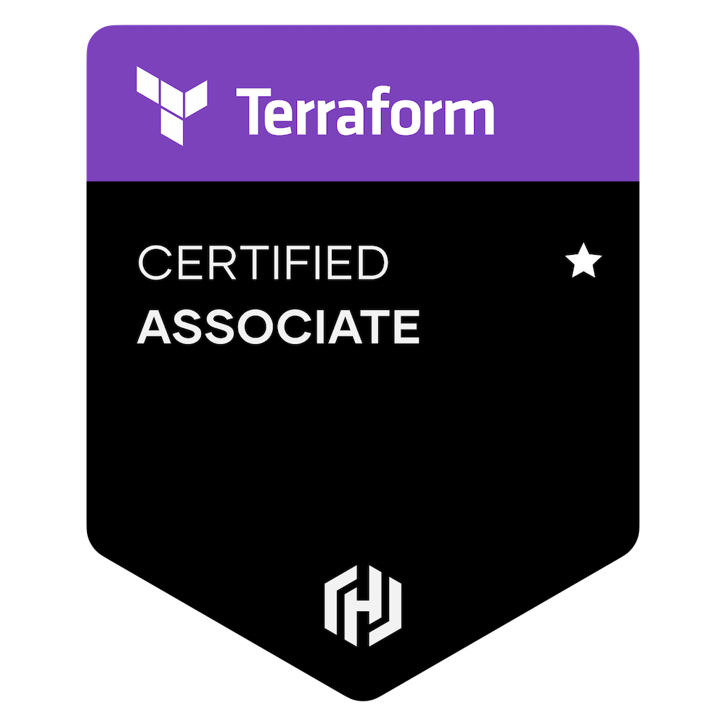
Who am I?
IvanPorta@outlook.com Senior DevOps Consultant
Technology: C# / .NET / Serverless / Container / Kubernetes / SharePoint Azure DevOps Engineer Expert Terraform Associate Microsoft Certified Trainer C# Corner MVP Tech enthusiast and blogger
Notes:
When I’m not fighting the white walkers I work at Senior DevOps Consultant.
Over 8 years working in IT as Developer and Consultant
I've had the privilege of collaborating with high-profile clients including Barclays and Microsoft, along with a multitude of others spread across continents, from the United States, Italy, The UK, the Saudi Emirates, and ultimately Japan.

Slide 4
Setup Demo Environment - Cloud
Create a VM for each student
Share the SSH credentials with the students
Make sure that the VM has Terraform installed
SETUP

Slide 5
Setup Demo Environment - Local
Windows
Download binaries from https://developer.hashicorp.com/terraform/downloads
Extract the .exe from the ZIP file to a folder eg C:\Apps\Terraform
Add the folder location to your PATH variable, eg: Control Panel -> System -> System settings -> Environment Variables
In System Variables, select Path > edit > new > Enter the location of the Terraform .exe, eg C:\Apps\Terraform then click OK
MacOS/Ubuntu
Download binaries from https://developer.hashicorp.com/terraform/downloads
Create a new Environment Variable
echo $PATH mv ~/Downloads/terraform /usr/local/bin/
SETUP

Slide 6
Agenda
Infrastructure as Code
What’s Terraform?
Terraform Command Line

Slide 7








50% of Fortune 500 in 2000 now replaced by organizations that use technology to deliver customer value faster, better, and cheaper
The Fortune 500 of today face the same challenge tomorrow
Innosight
Corporate Longevity: Turbulence Ahead for Large Organizations
Notes:
In an era where a sudden viral feed, post on TikTok, or breaking news can create immediate and unpredictable changes in demand, these usage patterns have become less predictable, making manual responsiveness obsolete. Reducing the Time to Market is not an option anymore. This is also proven by the exponential shift to cultures like DevOps.
Amazon: Amazon Web Services (AWS) deploys code every 11.6 seconds on average.
Google: Google releases software quickly and frequently, with over 4,000 deployments a day.
Facebook: Facebook pushes code updates twice daily. They've also mentioned in the past that they commit changes to their main repository approximately every 30 seconds.
Netflix: Netflix deploys code thousands of times per day. They've been known for their pioneering work in the microservices architecture and their deployment tool, Spinnaker.
Even if not all deployments will affect the underline Infrastructure, with such rapid deployment cycles, manual infrastructure management is not scalable and also prone to errors.

Slide 8
What is Infrastructure as Code?
Infrastructure as Code (IaC) is the process of managing and provisioning cloud infrastructure with machine-readable definition files.
Ensures uniformity in infrastructure provisioning and deployment
Easily replicate infrastructure across stages or projects
Reduce manual intervention and errors via automated provisioning
Accelerates deployment and scaling processes
Track, review, and rollback infrastructure changes
Standardize and enforce security best practices across infrastructure
Enable collaboration between different teams
Notes:
Consistency: This means that every time you deploy or provision using that code, you get the same result.
Reproducibility: Easily replicate infrastructure across stages or projects.
Automation: Enables automated provisioning, reducing manual intervention and errors.
Speed: Whether you're setting up a new server or scaling out to handle more traffic, IaC can expedite these processes significantly compared to manual methods.
Version Control: Track, review, and rollback infrastructure changes.
Security: If you have specific security or compliance configurations or rules, you can define them in your infrastructure code. Every time you deploy, those rules are enforced. This reduces the risk of oversight or misconfiguration that could expose your systems to threats.
Collaboration: Enable collaboration between different teams

Slide 9
What is Terraform?
Open-Source Infrastructure as code tool.
Maintained by HashiCorp.
It ships as a single binary which is written in GO.
Terraform is cross platform and can run on Linux, Windows, or MacOS.
Use HCL (HashiCorp Configuration Language).
Is platform agnostic, capable of deploying to many different providers.
No need to re-skill the developers for multiple platforms
Notes:
Terraform is one of the IaC tools available. (Microsoft Azure has Biceps, AWS has CloudFormation, and so on) A Terraform provider is a plugin that Terraform uses to interact with the APIs of various services and platforms. Each provider offers a set of resource types that you can manage using Terraform. When you define a resource in a Terraform configuration, Terraform uses the associated provider to create, update, or delete the actual infrastructure component.

Slide 10
Why Terraform?
ACME, Alicloud, Archive, Arukas, AWS, Azure, Azure Active Directory, Azure Stack, Bitbucket, Brightbox, CenturyLinkCloud, Chef, Circonus, Cisco ASA, Cloudflare, CloudScale.ch, CloudStack, Cobbler, Consul, Datadog, DigitalOcean, DNS, DNSimple, DNSMadeEasy, Docker, Dyn, External, F5 BIG-IP, Fastly, FlexibleEngine, FortiOS, GitHub, Gitlab, Google Cloud Platform, Grafana, Gridscale, Hedvig, Helm, Heroku, Hetzner Cloud, HTTP, HuaweiCloud, Icinga2, Ignition, InfluxDB, JDCloud, Kubernetes, Librato, Linode, Local, Logentries, LogicMonitor, Mailgun, MySQL, Naver Cloud, Netlify, New Relic, Nomad, NS1, Null, Nutanix, 1&1, OpenStack, OpenTelekomCloud, …
Notes:
These are just a few of providers supported by terraform. The one in bold are official providers released by Terraform and the others are developed by the community.
Something very cool is that you can use the same configuration file to provision infrastructure to multiple target at the same time. (This makes Terraform Ideal for multi-cloud projects).

Slide 11
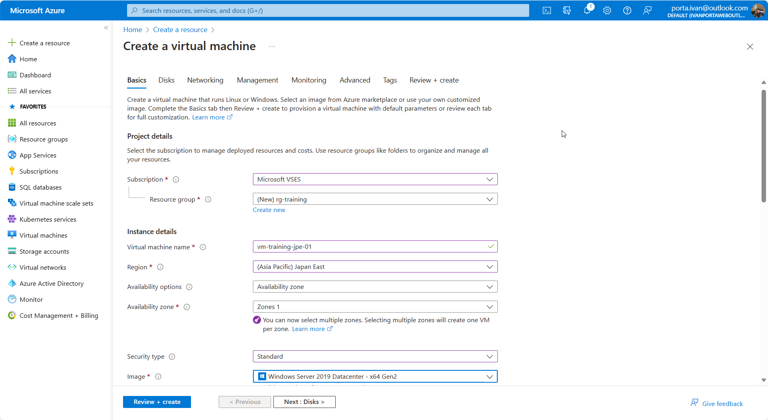
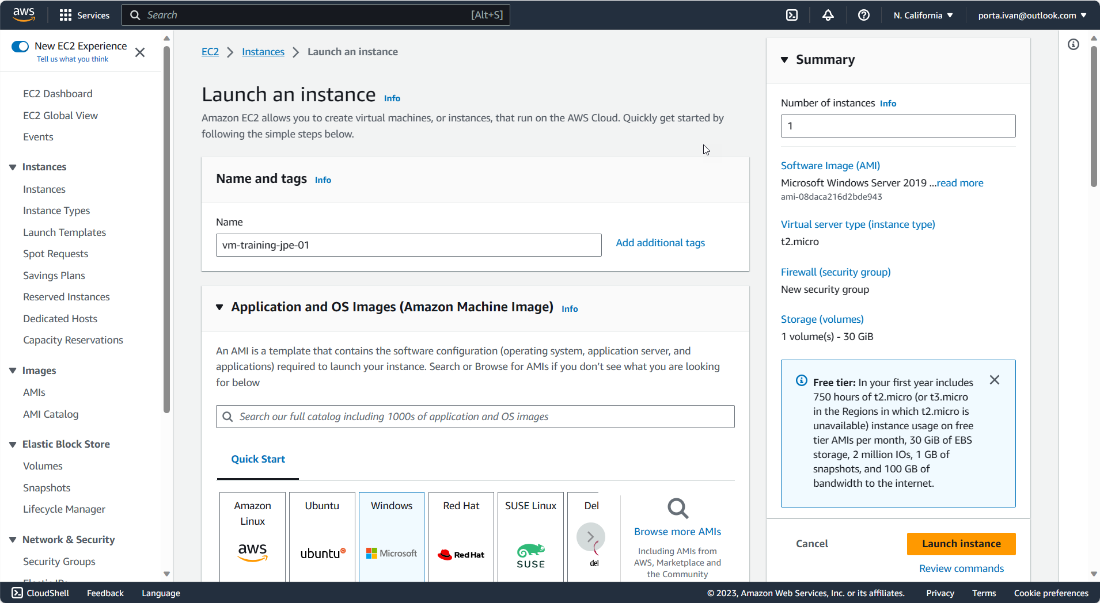
Provisioning Infrastructure - Portal

Slide 12
Provisioning Infrastructure – Templates
{
"type": "Microsoft.Compute/virtualMachines",
"name": "[variables('vmName')]",
"location": "[parameters('location')]",
"dependsOn": [
"[concat('Microsoft.Network/networkInterfaces/', variables('nicName'))]"
],
"properties": {
"hardwareProfile": {
"vmSize": "[parameters('virtualMachineSize')]"
},
}
}
{
"AWSTemplateFormatVersion" : "2010-09-09",
"Description" : "AWS CloudFormation Sample Template”
"Parameters" : {
"KeyName": {
"Description" : "Name of an existing EC2 KeyPair to enable SSH access to the instance",
"Type": "AWS::EC2::KeyPair::KeyName",
"ConstraintDescription" : "must be the name of an existing EC2 KeyPair."
},
Notes:
ARM Templates on the left and AWS CloudFormation on the right

Slide 13
Provisioning Infrastructure – Terraform
resource "azure_virtual_machine" "web" {
name = "vm-training-jpe "
image = "Windows 2019 R2"
vm_size = "Standard DS1"
location = "Japan East"
username = “admin"
password = "Password1234"
}
resource "aws_instance" "web" {
ami = data.aws_ami.windows.id
instance_type = "t2.micro"
tags = {
Name = "HelloWorld"
}
}

Slide 14






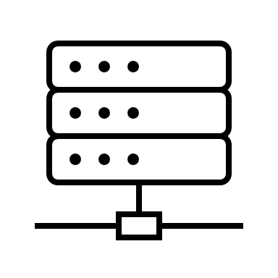

Terraform workflow
Modules
State file
State file
Init
Plan
Apply
Developers
Configuration
file(s)
Notes:
Terraform Init
Read the lock file
Reads the current configuration: This is the set of .tf files in the current directory
Download the providers if not present
Terraform Plan
Reads the current configuration: This is the set of .tf files in the current directory.
Reads the current state: This is typically stored in a .tfstate file, either locally or remotely. The state file contains information about what resources exist and their configurations.
Queries the actual infrastructure provider: This is where it checks the real-world status of the resources. For example, if you're using the AWS provider, Terraform will make API calls to AWS to see the current state of the resources in question.
Terraform apply
Same as plan, but it asks for approval and then apply the changes

Slide 15
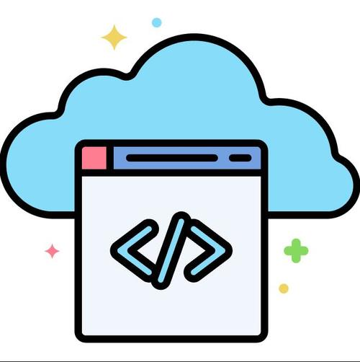
Live Demo
Notes:
Machine 1: 20.51.131.165 – student1 / P@ssw0rd1234!
Machine 2: 20.106.247.81 – student2 / P@ssw0rd1234!
Local terraform plan
terraform apply
Result: create file in the same path as the configuration
The .terraform.lock.hcl file was introduced in Terraform v0.14 as a way to provide more dependable builds in Terraform configurations. This file is used to lock the versions of providers and modules to ensure consistent behavior across different environments and Terraform runs.
This ensures that every time you or your team runs terraform init, the same versions of providers and modules are fetched, leading to consistent behavior.
Cloud [2m20s elapsed]
terraform plan
terraform plan --out output.tfplan
terraform show -no-color -json output.tfplan > output.json
Prettify with Shift + Alt + F
Show the resources created on the portal
Show the statefile with the ID reference
Show the JSON plan
Code Repository: GTRekter/Terraform-Workshop (github.com) → Not necessary

Slide 16
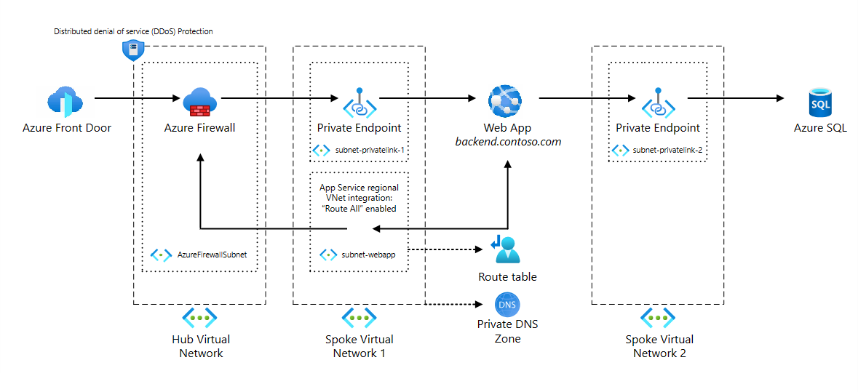
Lab 1

Slide 17
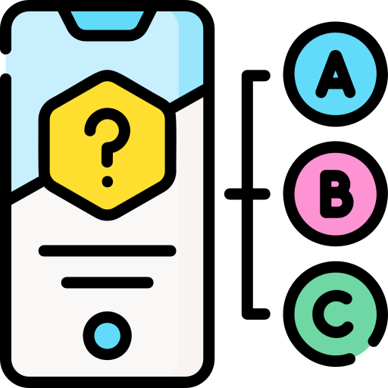
Quiz
Browse to menti.com and use the code 3198 0624

