Slide 1


Guatemala SQL Server group
January 2019

Slide 2

Christian Araujo @charaujo
Carlos Lopez @CarlosLopezSQL
Eduardo Pivaral @EduardoDBA
Carlos Robles @dbamastery
* Allan Fong @omegagt
gtssug.pass.org
Board Members

Slide 3

Upcoming Virtual Group Webinars
Virtual Group | Meeting Date | Time | Topic | Website
Hybrid | Jan 23, 2019 | 19:00 – 20:00 (UTC) | Data Analytics with Azure Cosmos Schema-less Data and Power BI - Jen Stirrup | http://hybridvc.pass.org
Global Hebrew | Jan 24, 2019 | 13:00 – 14:00 (UTC) | SQL Azure DB options - Pini Krisher | http://globalhebrew.pass.org
Global Italian | Jan 30, 2019 | 17:00 – 18:00 (UTC) | Monitoraggio di Reporting Services - Lorenzo Vercellati | http://globalitalian.pass.org
DBA Fundamentals | Feb 5, 2019 | 17:00 – 18:00 (UTC) | Understanding SQL Server Backup and Restore - Tim Radney | http://fundamentals.pass.org
DBA Fundamentals | Feb 12, 2019 | 02:30 – 03:30 (UTC) | Let's talk about Big Data using SQL Data Warehouse - Vitor Fava | http://fundamentals.pass.org

Slide 4
Upcoming Virtual Group Webinars
Virtual Group | Meeting Date | Time | Topic | Website
Women in Technology | Feb 12, 2019 | 17:00 – 18:00 (UTC) | Winning the Head Game in 2019 - Bobbi-Jo Brighton | http://wit.pass.org
Data Architecture | Feb 13, 2019 | 19:00 – 20:00 (UTC) | Azure SQL Database for the Production DBA - Tim Radney | http://dataarch.pass.org
Global Hebrew | Feb 20, 2019 | 15:00 – 16:00 (UTC) | Data Platforms News - Yossi Elkayam | http://globalhebrew.pass.org
Global Italian | Feb 20, 2019 | 17:00 – 18:00 (UTC) | Implementazione del Distaster Recovery di SQL Server in Azure - Marco Obinu | http://globalitalian.pass.org

Slide 5


Upcoming SQLSaturdays
US/Canada
EMEA
Feb 02 Cleveland
Feb 09 Redmond
Jan 18 Linz
Feb 09 Krakow
Feb 23 Pordenone
LATAM
APAC
Feb 16 Guatemala
Feb 23 Costa Rica – BI Edition
Jan 26 Malaysia
Register in Guatemala’s SQL Saturday HERE

Slide 6
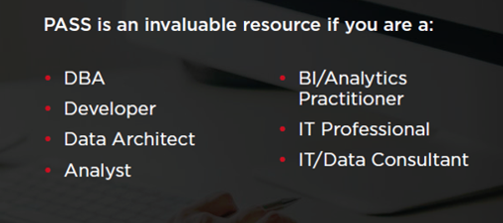
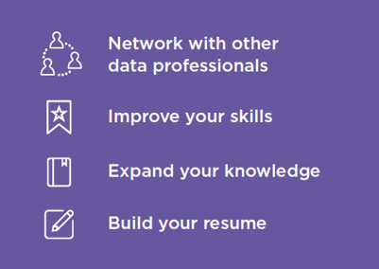

Join PASS to Grow Your Career
Connect with a global network of 250,000+ data professionals
Become a member and gain free access to:
Online educational content
Live webinars
In-person meetups, events, and conferences
Networking, volunteering, and speaking opportunities
The Community
The Benefits
… Join Today!
Notes:
PASS is a global, not-for-profit association where data professionals Connect, Share and Learn.
Joining PASS is free, and gives you access to hundreds of hours of free online content, live virtual and in-person events, the ability to join Local Groups in your area, and an annual conference, PASS Summit.
PASS is a great way to connect with like-minded professionals, increase your technical expertise, and grow your career.

Slide 7


Tech news
GitHub free private repos
Developers can use GitHub for their private projects with up to three collaborators per repository for free.
Register
More information
Azure Data Studio 1.3.8 (January release)
Azure Data Studio is complementary to SQL Server Management Studio with experiences around query editing and data development, while SQL Server Management Studio still offers the broadest range of administrative functions, and remains the flagship tool for platform management tasks.
Download link
More information

Slide 8

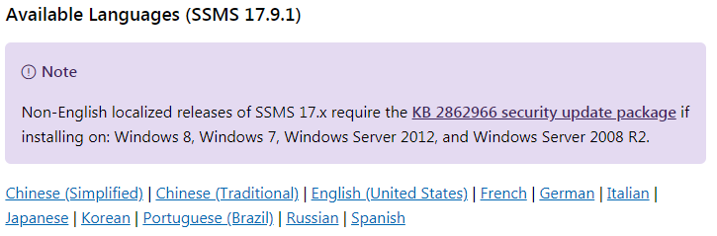
SQL Server Management Studio 17.9.1 goes GA (General Availability)
SSMS is an integrated environment for managing any SQL infrastructure, from SQL Server to Azure SQL Database.
Download link
More information

Slide 9

SentryOne Plan Explorer Simplify Your SQL Server Query Tuning
Plan Explorer helps you quickly get to the root of the toughest SQL Server query problems.
Break through database performance barriers with advanced query tuning features not found in any other tool.
Plan Explorer is a single installation file containing the application and the SQL Server Management Studio (SSMS) add-in
Plan Explorer is Free to use.
You can download it from here:
https://www.sentryone.com/plan-explorer

Slide 10
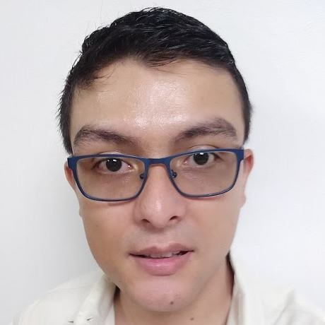


Community news
Welcome Allan Fong as new board member!!!
@omegagt
in/fong
Database Administrator and Technology enthusiast with 13 years of working experience in Technology, nine of which have been on Database Administration, worked with International Banks and big US Insurance companies.
Having being assigned to SQL Server (Windows), Oracle (Windows, Linux, AIX, HPUX) and recently PostgreSQL and MySQL projects.

Slide 11
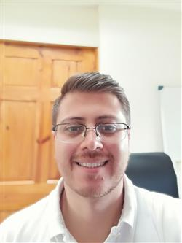
Congratulations to Christian Araujo for his new job!!!
@charaujo
in/charaujo

Slide 12
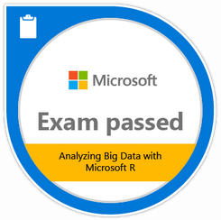
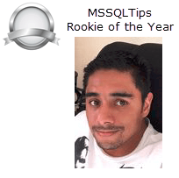

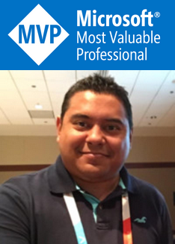
Community news
Pablo Echeverria
Passed Exam 773: Analyzing Big Data with Microsoft R
Eduardo Pivaral
MSSQLTips - Rookie of the year :
Author of the year runners-up:
Alejandro Cobar, Pablo Echeverria
Carlos Robles
Microsoft Most Valuable Professional (MVP) 2018
Category: Data Platform
Country or region: United States

Slide 13

Christian Araujo
Mynor Bolaños
Carlos Lopez

Slide 14
Speakers from our PASS group
Eduardo Pivaral
Carlos Robles
General (all board members)
Register in Guatemala’s SQL Saturday HERE

Slide 15
Call for speakers
Want to participate as speaker in the next Guatemala's SQL Server User Group meeting? Then fill out the online form with a brief description of your session here:
https://gtssug.pass.org/en-us/sessionsubmission.aspx

Slide 16



Sponsors
Want to become a sponsor? Send an email to: gtssug@pass.org

Slide 17
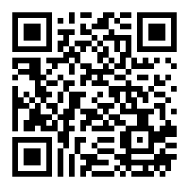
Survey
Just scan the following QR code and help us filling the form:

Slide 18



Follow us
Sign up for a free membership today at:
GTSSUG.PASS.org
#SQLPassGT @gtssug

Slide 19


Connect with PASS
Sign up for a free membership today at:
PASS.org
#sqlpass @sqlpass
@passcommunity

