Slide 1
Verilog – Module (8)
Continuous Assignments:
Continuous assignments provide a way of modeling combinational logic at a higher level of abstraction than Gate-Level logic. It allows the use of Boolean logic rather than gate connections.
Continuous assignments are always active and assignments occur whenever the right-hand side operands changes.
wire out; // create net (data type)
assign out = A & B ; // cont. assgn.
// equal to wire out = A & B ;

Slide 2
//Circuit specified with Boolean equations
module circuit_bln (x,y,A,B,C,D);
input A,B,C,D;
output x,y;
assign x = A | (B & C) | (~B & C);
assign y = (~B & C) | (B & ~C & ~D);
endmodule

Slide 3
Verilog – Module (10)
User Defined Primitives (UDP):
The logic gates used in HDL descriptions with keywords and, or,etc., are defined by the system and are referred to as system primitives.
The user can create additional primitives by defining them in tabular form.
These type of circuits are referred to as user-defined primitives.

Slide 4
Verilog – Module (12)
UDP features ….
UDP’s do not use the keyword module. Instead they are declared with the keyword primitive.
There can be only one output and it must be listed first in the port list and declared with an output keyword.
There can be any number of inputs. The order in which they are listed in the input declaration must conform to the order in which they are given values in the table that follows.
The truth table is enclosed within the keywords table and endtable.
The values of the inputs are listed with a colon (:). The output is always the last entry in a row followed by a semicolon (;).
It ends with the keyword endprimitive.

Slide 5
Verilog – Module (13)
//User defined primitive(UDP)
primitive crctp (x,A,B,C);
output x; // only 1 output
input A,B,C;
//Truth table for x(A,B,C) = Minterms (0,2,4,6,7)
table
// A B C : x (Note that this is only a comment)
0 0 0 : 1;
0 0 1 : 0;
0 1 0 : 1;
0 1 1 : 0;
1 0 0 : 1;
1 0 1 : 0;
1 1 0 : 1;
1 1 1 : 1;
endtable
endprimitive
// Instantiate primitive
module declare_crctp;
reg x,y,z;
wire w;
crctp (w,x,y,z);
endmodule

Slide 6
Verilog – Module (14)
A module can be described in any one (or a combination) of the following modeling techniques.
Gate-level modeling using instantiation of primitive gates and user defined modules.
This describes the circuit by specifying the gates and how they are connected with each other.
Dataflow modeling using continuous assignment statements with the keyword assign.
This is mostly used for describing combinational circuits.
Behavioral modeling using procedural assignment statements with keyword always.
This is used to describe digital systems at a higher level of abstraction.

Slide 7
Gate-Level Modeling
Here a circuit is specified by its logic gates and their interconnections.
It provides a textual description of a schematic diagram.
Verilog recognizes 12 basic gates as predefined primitives.
4 primitive gates of 3-state type.
Other 8 are: and, nand, or, nor, xor, xnor, not, buf
When the gates are simulated, the system assigns a four-valued logic set to each gate – 0,1,unknown (x) and high impedance (z)

Slide 8
Gate-level modeling (2)
When a primitive gate is incorporated into a module, we say it is instantiated in the module.
In general, component instantiations are statements that reference lower-level components in the design, essentially creating unique copies (or instances) of those components in the higher-level module.
Thus, a module that uses a gate in its description is said to instantiate the gate.

Slide 9
Gate-level Modeling (3)
Modeling with vector data (multiple bit widths):
A vector is specified within square brackets and two numbers separated with a colon.
e.g. output[0:3] D; - This declares an output vector D with 4 bits, 0 through 3.
wire[7:0] SUM; – This declares a wire vector SUM with 8 bits numbered 7 through 0.
The first number listed is the most significant bit of the vector.

Slide 10
Gate-level Modeling
Two or more modules can be combined to build a hierarchical description of a design.
There are two basic types of design methodologies.
Top down: In top-down design, the top level block is defined and then sub-blocks necessary to build the top level block are identified.
Bottom up: Here the building blocks are first identified and then combine to build the top level block.
In a top-down design, a 4-bit binary adder is defined as top-level block with 4 full adder blocks. Then we describe two half-adders that are required to create the full adder.
In a bottom-up design, the half-adder is defined, then the full adder is constructed and the 4-bit adder is built from the full adders.

Slide 11
Gate-level Modeling
A bottom-up hierarchical description of a 4-bit adder is described in Verilog as
Half adder: defined by instantiating primitive gates.
Then define the full adder by instantiating two half-adders.
Finally the third module describes 4-bit adder by instantiating 4 full adders.
Note: In Verilog, one module definition cannot be placed within another module description.

Slide 12
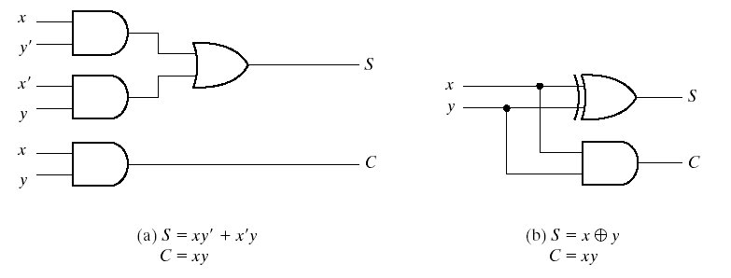
4-bit Half Adder

Slide 13
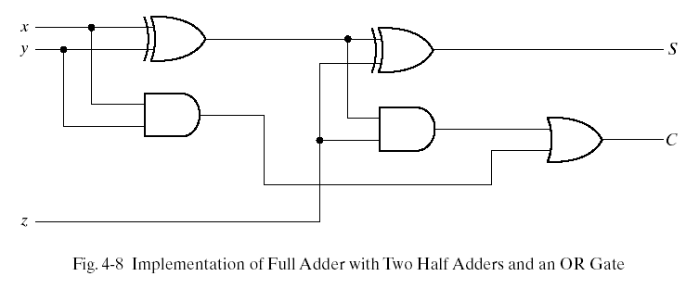
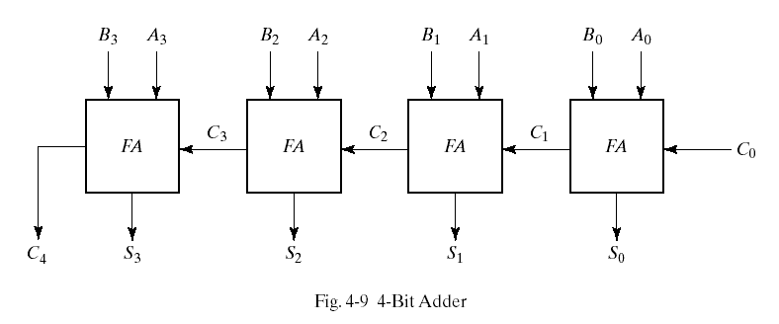
4-bit Full Adder

Slide 14
4-bit Full Adder
//Gate-level hierarchical description of 4-bit adder
module halfadder (S,C,x,y);
input x,y;
output S,C;
//Instantiate primitive gates
xor (S,x,y);
and (C,x,y);
endmodule
module fulladder (S,C,x,y,z);
input x,y,z;
output S,C;
wire S1,D1,D2; //Outputs of first XOR and two AND gates
//Instantiate the half adders
halfadder HA1(S1,D1,x,y), HA2(S,D2,S1,z);
or g1(C,D2,D1);
endmodule

Slide 15
4-bit Full Adder
module _4bit_adder (S,C4,A,B,C0);
input [3:0] A,B;
input C0;
output [3:0] S;
output C4;
wire C1,C2,C3; //Intermediate carries
//Instantiate the full adder
fulladder FA0 (S[0],C1,A[0],B[0],C0),
FA1 (S[1],C2,A[1],B[1],C1),
FA2 (S[2],C3,A[2],B[2],C2),
FA3 (S[3],C4,A[3],B[3],C3);
endmodule

Slide 16
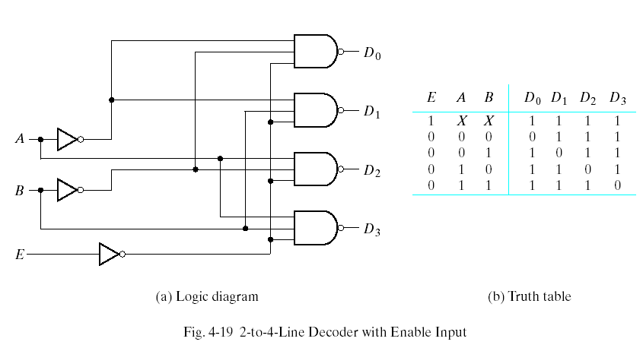
2 to 4 Decoder

Slide 17
2 to 4 Decoder
//Gate-level description of a 2-to-4-line decoder
module decoder_gl (A,B,E,D);
input A,B,E;
output[0:3]D;
wire Anot,Bnot,Enot;
not
n1 (Anot,A),
n2 (Bnot,B),
n3 (Enot,E);
nand
n4 (D[0],Anot,Bnot,Enot),
n5 (D[1],Anot,B,Enot),
n6 (D[2],A,Bnot,Enot),
n7 (D[3],A,B,Enot);
endmodule

Slide 18
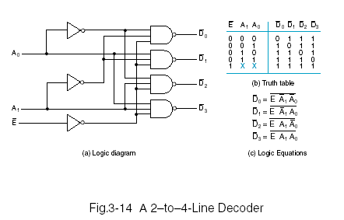
2-to-4 Line Decoder

Slide 19
2-to-4 Line Decoder
//2 to 4 line decoder
module decoder_2_to_4_st_v(E_n, A0, A1, D0_n, D1_n, D2_n, D3_n);
input E_n, A0, A1;
output D0_n, D1_n, D2_n, D3_n;
wire A0_n, A1_n, E;
not g0(A0_n, A0), g1(A1_n, A1), g2(E,E_n);
nand g3(D0_n,A0_n,A1_n,E), g4(D1_n,A0,A1_n,E),
g5(D2_n,A0_n,A1,E), g6(D3_n,A0,A1,E);
endmodule

Slide 20
Dataflow Modeling
Dataflow modeling uses a number of operators that act on operands to produce desired results.
Verilog HDL provides about 30 operator types.
Dataflow modeling uses continuous assignments and the keyword assign.
A continuous assignment is a statement that assigns a value to a net.
The value assigned to the net is specified by an expression that uses operands and operators.

Slide 21
Dataflow Modeling (2)
//Dataflow description of a 2-to-4-line decoder
module decoder_df (A,B,E,D);
input A,B,E;
output [0:3] D;
assign D[0] = ~(~A & ~B & ~E),
D[1] = ~(~A & B & ~E),
D[2] = ~(A & ~B & ~E),
D[3] = ~(A & B & ~E);
endmodule
A 2-to-1 line multiplexer with data inputs A and B, select input S, and output Y is described with the continuous assignment
assign Y = (A & S) | (B & ~S)

Slide 22
Dataflow Modeling (3)
//Dataflow description of 4-bit adder
module binary_adder (A,B,Cin,SUM,Cout);
input [3:0] A,B;
input Cin;
output [3:0] SUM;
output Cout;
assign {Cout,SUM} = A + B + Cin;
endmodule
//Dataflow description of a 4-bit comparator.
module magcomp (A,B,ALTB,AGTB,AEQB);
input [3:0] A,B;
output ALTB,AGTB,AEQB;
assign ALTB = (A < B),
AGTB = (A > B),
AEQB = (A == B);
endmodule

Slide 23
Dataflow Modeling (4)
The addition logic of 4 bit adder is described by a single statement using the operators of addition and concatenation.
The plus symbol (+) specifies the binary addition of the 4 bits of A with the 4 bits of B and the one bit of Cin.
The target output is the concatenation of the output carry Cout and the four bits of SUM.
Concatenation of operands is expressed within braces and a comma separating the operands. Thus, {Cout,SUM} represents the 5-bit result of the addition operation.

Slide 24
Dataflow Modeling (5)
Dataflow Modeling provides the means of describing combinational circuits by their function rather than by their gate structure.
Conditional operator (?:)
condition ? true-expression : false-expression;
A 2-to-1 line multiplexer
assign OUT = select ? A : B;
//Dataflow description of 2-to-1-line mux
module mux2x1_df (A,B,select,OUT);
input A,B,select;
output OUT;
assign OUT = select ? A : B;
endmodule

Slide 25
Behavioral Modeling
Behavioral modeling represents digital circuits at a functional and algorithmic level.
It is used mostly to describe sequential circuits, but can also be used to describe combinational circuits.
Behavioral descriptions use the keyword always followed by a list of procedural assignment statements.
The target output of procedural assignment statements must be of the reg data type.
A reg data type retains its value until a new value is assigned.

Slide 26
Behavioral Modeling (2)
The procedural assignment statements inside the always block are executed every time there is a change in any of the variable listed after the @ symbol. (Note that there is no “;” at the end of always statement)
//Behavioral description of 2-to-1-line multiplexer
module mux2x1_bh(A,B,select,OUT);
input A,B,select;
output OUT;
reg OUT;
always @(select or A or B)
if (select == 1) OUT = A;
else OUT = B;
endmodule

Slide 27
Behavioral Modeling (4)
//Behavioral description of 4-to-1 line mux
module mux4x1_bh (i0,i1,i2,i3,select,y);
input i0,i1,i2,i3;
input [1:0] select;
output y;
reg y;
always @(i0 or i1 or i2 or i3 or select)
case (select)
2'b00: y = i0;
2'b01: y = i1;
2'b10: y = i2;
2'b11: y = i3;
endcase
endmodule

Slide 28
Writing a Test Bench
A test bench is an HDL program used for applying stimulus to an HDL design in order to test it and observe its response during simulation.
In addition to the always statement, test benches use the initial statement to provide a stimulus to the circuit under test.
The always statement executes repeatedly in a loop. The initial statement executes only once starting from simulation time=0 and may continue with any operations that are delayed by a given number of units as specified by the symbol #.

Slide 29
Writing a Test Bench (2)
initial begin
A=0; B=0; #10 A=1; #20 A=0; B=1;
end
The block is enclosed between begin and end. At time=0, A and B are set to 0. 10 time units later, A is changed to 1. 20 time units later (at t=30) a is changed to 0 and B to 1.

Slide 30
Writing a Test Bench (2)
Inputs to a 3-bit truth table can be generated with the initial block
initial begin
D = 3’b000; repeat (7); #10 D = D + 3’b001;
end
The 3-bit vector D is initialized to 000 at time=0. The keyword repeat specifies looping statement: one is added to D seven times, once every 10 time units.

Slide 31
Writing a Test-Bench (3)
A stimulus module is an HDL program that has the following form.
module testname
Declare local reg and wire identifiers
Instantiate the design module under test.
Generate stimulus using initial and always statements
Display the output response.
endmodule
A test module typically has no inputs or outputs.
The signals that are applied as inputs to the design module for simulation are declared in the stimulus module as local reg data type.
The outputs of the design module that are displayed for testing are declared in the stimulus model as local wire data type.
The module under test is then instantiated using the local identifiers.

Slide 32
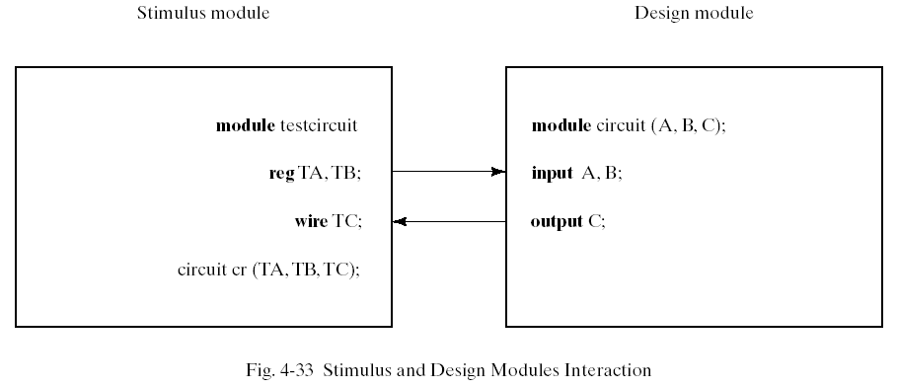
Writing a Test-Bench (4)
The stimulus model generates inputs for the design module by declaring identifiers TA and TB as reg data type, and checks the output of the design unit with the wire identifier TC. The local identifiers are then used to instantiate the design module under test.

Slide 33
Writing a Test-Bench (5)
The response to the stimulus generated by the initial and always blocks will appear at the output of the simulator as timing diagrams.
It is also possible to display numerical outputs using Verilog system tasks.
$display – display one-time value of variables or strings with end-of-line return,
$write – same $display but without going to next line.
$monitor – display variables whenever a value changes during simulation run.
$time – displays simulation time
$finish – terminates the simulation
The syntax for $display,$write and $monitor is of the form
Task-name (format-specification, argument list);
E.g. $display(%d %b %b, C,A,B);
$display(“time = %0d A = %b B=%b”,$time,A,B);

Slide 34
Writing a Test-Bench (6)
//Stimulus for mux2x1_df
module testmux;
reg TA,TB,TS; //inputs for mux
wire Y; //output from mux
mux2x1_df mx (TA,TB,TS,Y); // instantiate mux
initial begin
$monitor(”select=%b A=%b B=%b OUT=%b",TS,TA,TB,Y);
TS = 1; TA = 0; TB = 1;
#10 TA = 1; TB = 0;
#10 TS = 0;
#10 TA = 0; TB = 1;
end
endmodule

Slide 35
Writing a Test-Bench (7)
//Dataflow description of 2-to-1-line multiplexer
module mux2x1_df (A,B,select,OUT);
input A,B,select;
output OUT;
assign OUT = select ? A : B;
endmodule

Slide 36
Descriptions of Circuits
Structural Description – This is directly equivalent to the schematic of a circuit and is specifically oriented to describing hardware structures using the components of a circuit.
Dataflow Description – This describes a circuit in terms of function rather than structure and is made up of concurrent assignment statements or their equivalent. Concurrent assignments statements are executed concurrently, i.e. in parallel whenever one of the values on the right hand side of the statement changes.

Slide 37
Descriptions of Circuits (2)
Hierarchical Description – Descriptions that represent circuits using hierarchy have multiple entities, one for each element of the Hierarchy.
Behavioral Description – This refers to a description of a circuit at a level higher than the logic level. This type of description is also referred to as the register transfers level.

Slide 38
4-to-1 Multiplexer – Data Flow
//4-to-1 Mux: Dataflow description
module mux_4_to_1(S,D,Y);
input [1:0]S;
input [3:0]D;
output Y;
assign Y = (~S[1]&~S[0]&D[0])|(~S[1]&S[0]&D[1]) |(S[1]&~S[0]&D[2])|(S[1]&S[0]&D[3]);
endmodule
//4-to-1 Mux: Conditional Dataflow description
module mux_4_to_1(S,D,Y);
input [1:0]S;
input [3:0]D;
output Y;
assign Y = (S==2’b00)?D[0] : (S==2’b01)?D[1] : (S==2’b10)?D[2] : (S==2’b11)?D[3]:1’bx;;
endmodule

Slide 39
4-bit Adder
//4-bit adder : dataflow description
module adder_4bit (A,B,C0,S,C4);
input [3:0] A,B;
input C0;
output [3:0]S;
output C4;
assign {C4,S} = A + B + C0;
endmodule

Slide 40
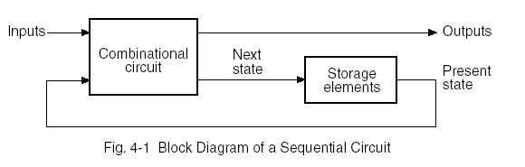
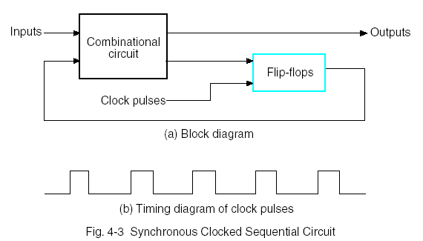
Sequential System Design

Slide 41
Sequential System Design (2)
Obtain either the state diagram or the state table from the statement of the problem.
If only a state diagram is available from step 1, obtain state table.
Assign binary codes to the states.
Derive the flip-flop input equations from the next-state entries in the encoded state table.
Derive output equations from the output entries in the state table.
Simplify the flip-flop input and output equations.
Draw the logic diagram with D flip-flops and combinational gates, as specified by the flip-flop I/O equations.

Slide 42
Behavioral Modeling in SSD
There are two kinds of behavioral statements in Verilog HDL: initial and always.
The initial behavior executes once beginning at time=0.
The always behavior executes repeatedly and re-executes until the simulation terminates.
A behavior is declared within a module by using the keywords initial or always, followed by a statement or a block of statements enclosed by the keywords begin and end.

Slide 43
Behavioral Modeling in SSD (2)
An example of a free-running clock
initial begin
clock = 1’b0;
#300 $finish;
end
always #10 clock = ~clock

Slide 44
Behavioral Modeling in SSD (3)
The always statement can be controlled by delays that wait for a certain time or by certain conditions to become true or by events to occur.
This type of statement is of the form:
always @ (event control expression)
Procedural assignment statements
The event control expression specifies the condition that must occur to activate the execution of the procedural assignment statements.
The variables in the left-hand side of the procedural statements must be of the reg data type and must be declared as such.

Slide 45
Behavioral Modeling in SSD (4)
The statements within the block, after the event control expression, execute sequentially and the execution suspends after the last statement has executed.
Then the always statement waits again for an event to occur.
Two kind of events:
Level sensitive (E.g. in combinational circuits and in latches)
always @(A or B or Reset) will cause the execution of the procedural statements in the always block if changes occur in A or B or Reset.
Edge-triggered (In synchronous sequential circuits, changes in flip-flops must occur only in response to a transition of a clock pulse.
always @(posedge clock or negedge reset)will cause the execution of the procedural statements only if the clock goes through a positive transition or if the reset goes through a negative transition.

Slide 46
Behavioral Modeling in SSD (5)
A procedural assignment is an assignment within an initial or always statement.
There are two kinds of procedural assignments: blocking and non-blocking
Blocking assignments (executed sequentially in the order they are listed in a sequential block)
B = A
C = B + 1
Non-blocking assignments (evaluate the expressions on the right hand side, but do not make the assignment to the left hand side until all expressions are evaluated.
B <= A
C <= B + 1

