Slide 1
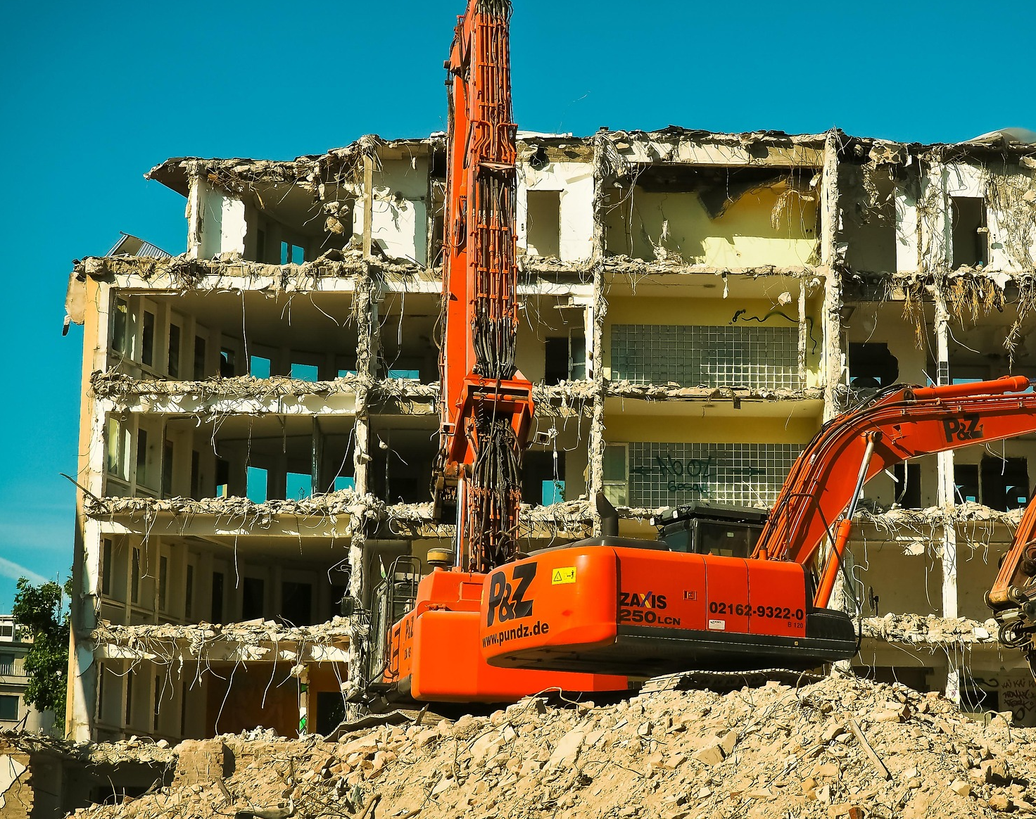
Optimization of Waste Clean-Up After Large Scale Disasters
Final Presentation

Slide 2
GTU COMPUTER ENGINEERING CSE 495 / 496 PRESENTATION
Çağrı Yıldız – Furkan Taşkın
Project Advisor: Prof. Dr. Didem Gözüpek Kocaman
Article: C. Cheng, R. Zhu, A. M. Costa, and R. G. Thompson, “Optimisation of waste clean-up after large-scale disasters,” Waste Management, vol. 119, pp. 1–10, 2021. https://doi.org/10.1016/j.wasman.2020.09.023
January 2025

Slide 3
Content
Timeline
What We Have Done
GUI Overview
Success Criteria
Article’s Heatmap Output
Challenges
Model Results
How To Test
Test Results
References

Slide 4
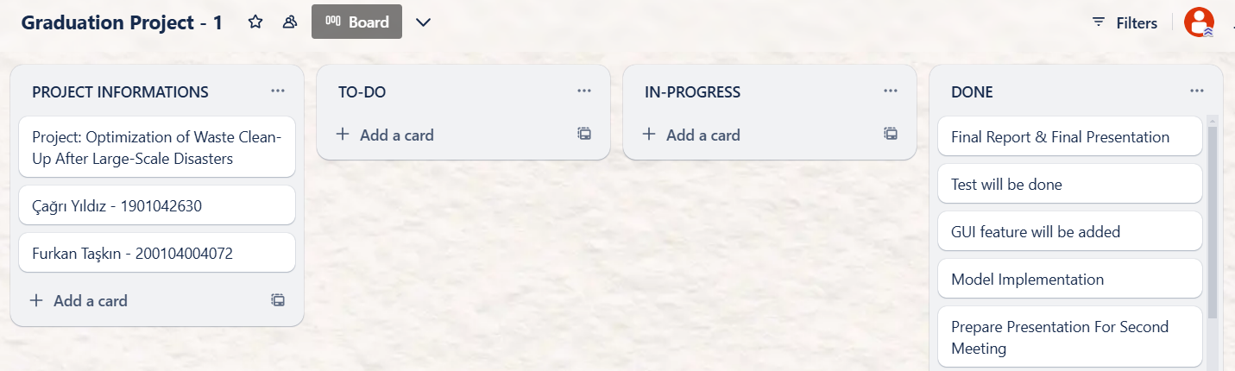
Timeline

Slide 5
What We Have Done
Completed model implementation in CPLEX
Tested in different scenarios
Developed a GUI for model visualization

Slide 6
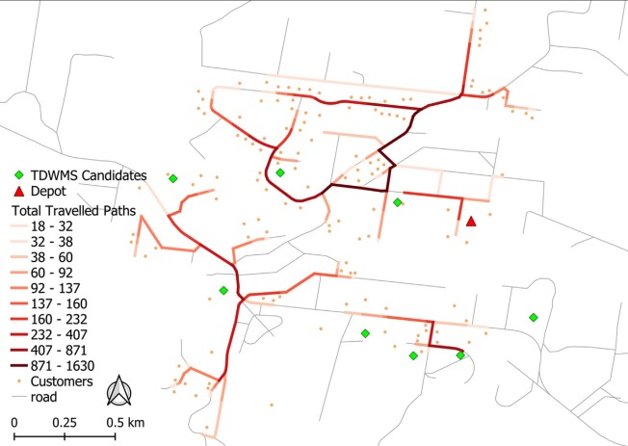
Article’s Heatmap Output

Slide 7
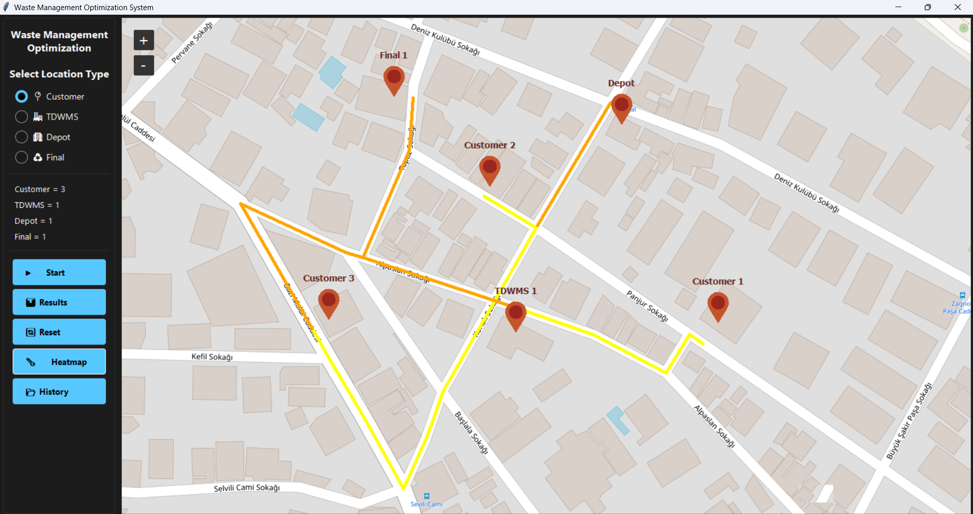
GUI OVERVIEW -1

Slide 8
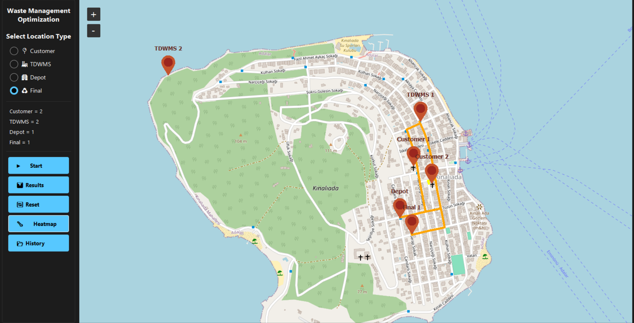
GUI OVERVIEW -2

Slide 9
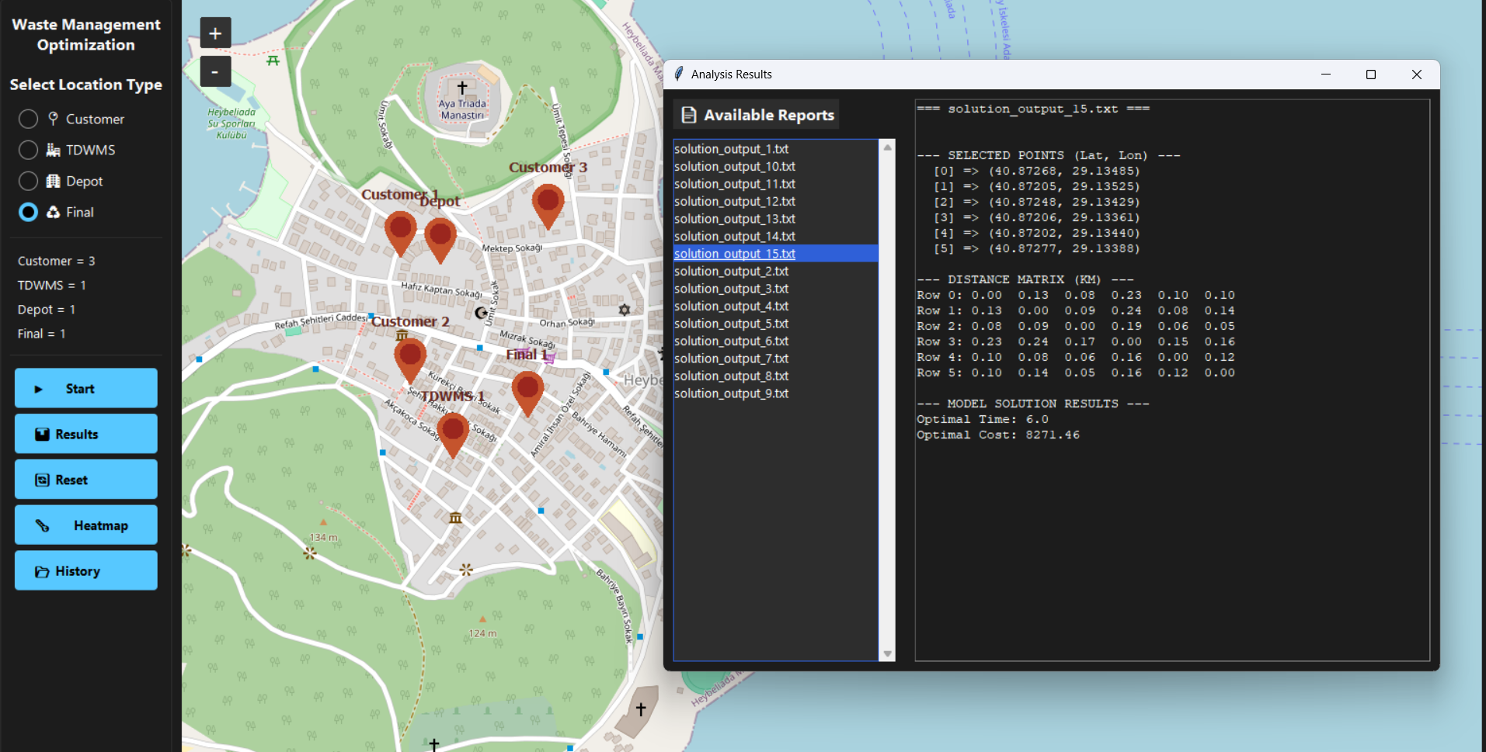
Model Results

Slide 10
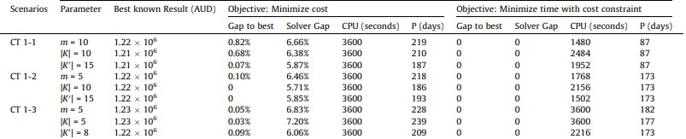
How To Test

Slide 11
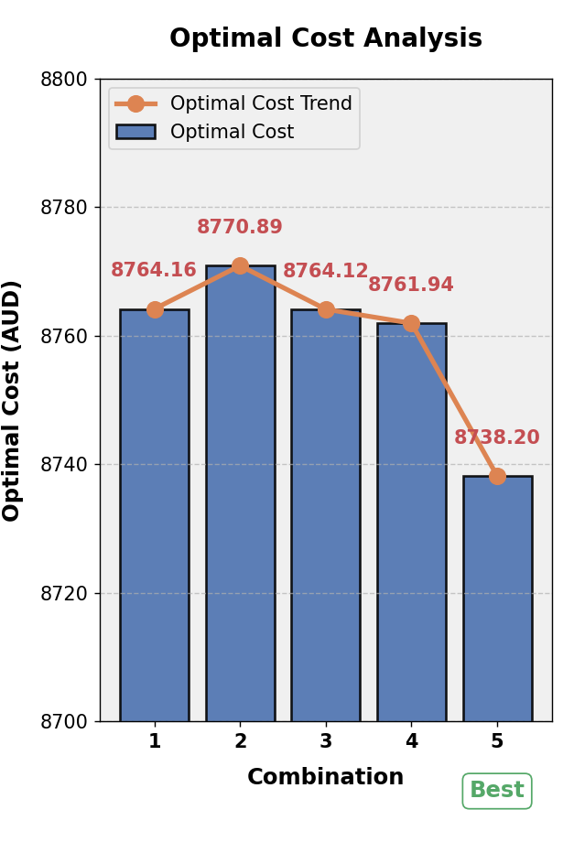
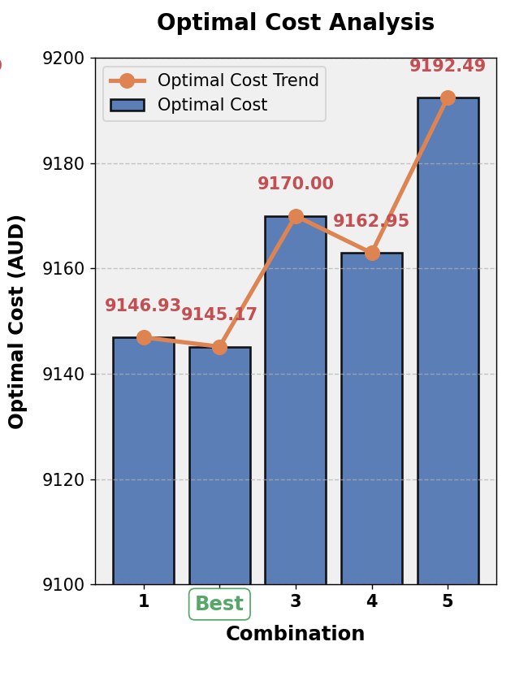
Test Results

Slide 12
Challenges
Implementation Of Model: Our model is multi-objective and has lots of variables,parameters and constraints. This resulted in increased development time.
Data Limitations: There is no available data to compare our model results. As a solution we compare the results with among themselves.
Integration with GUI: The model was initially implemented in IBM CPLEX Studio IDE. To integrate it with a interface, we converted the model into Python code using the docplex library.

Slide 13
Success Criteria
Minimizing Time: Ensure waste collection and disposal are completed within the shortest possible time
Minimizing Cost: Keep total clean-up costs within the set budget by optimizing routes and resources.
Visualizing the Model: Develop a GUI to display the waste management process. The interface will show nodes with color-coding to indicate usage levels, routes taken, and display duration and cost.

Slide 14
References
https://www.sciencedirect.com/science/article/abs/pii/S0956053X20305341
https://citeseerx.ist.psu.edu/document?repid=rep1&type=pdf&doi=3dba4ce1e3265e480da88f76d00e53909e775513
https://www.sciencedirect.com/science/article/abs/pii/S0921344922000222
https://www.sciencedirect.com/science/article/pii/S0952197624000903

