Slide 1
GTU COMPUTER ENGINEERING CSE 495 / 496 PRELIMINARY PRESENTATION Optimisation of Waste Clean-Up After Large-Scale Disasters
Çağrı Yıldız – Furkan Taşkın
Project Advisor: Prof. Dr. Didem Gözüpek Kocaman
October 2024

Slide 2
Content
Scheme and Description of the Project
Project Design Plan
Timeline
Project Requirements
Success Criteria
References

Slide 3
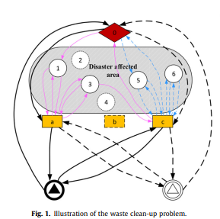
Scheme and Description of the Project
- This project focuses on efficiently collecting and managing waste from destroyed buildings after large-scale disasters.
- The goal is to remove debris safely and quickly, aiding recovery and reducing environmental impact.
- The diagram illustrates key steps:
Depot: Starting and return point for all vehicles each day.
Customer Nodes: Points where waste is collected.
Temporary Waste Management Sites (TDWMS): Short-term storage locations.
Landfill: Final disposal area for collected waste
- The model offers faster, more organized clean-up and recovery efforts post-disaster.

Slide 4
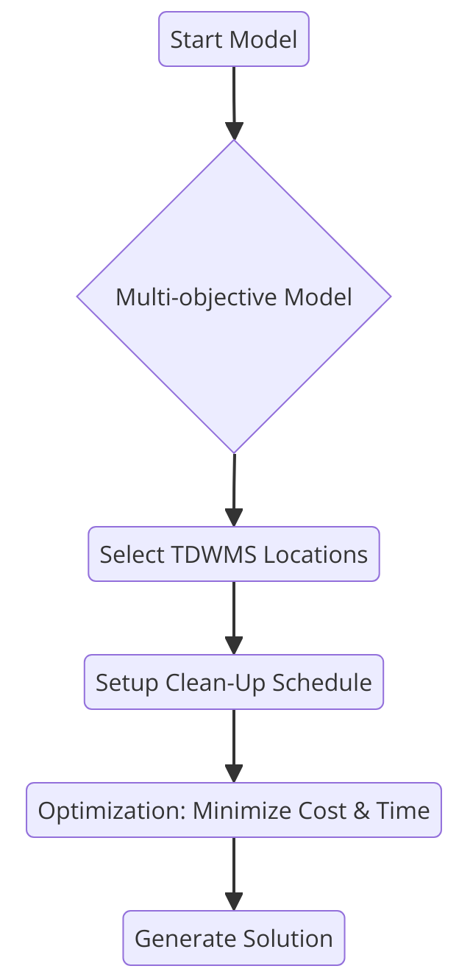
Project Design Plan
Start Model: The process begins by collecting the needed data and setting limits for the waste clean-up.
Multi-Objective Model: A model is created to focus on both cost and time. The goal is to lower the total clean-up expenses and the time required.
Choose TDWMS Locations: Temporary Disaster Waste Management Sites (TDWMS) are chosen as locations to store and handle waste. Placing them in the right spots is important to save time and reduce costs.
Set Up Clean-Up Schedule: A plan is made for when and where the waste will be collected during the project.
Optimize Cost & Time: Using the model, the clean-up is optimized to cut down on both cost and time, making the best use of resources.
Create Solution: In the end, an ideal plan is created, showing the best order and methods to complete the clean-up at the lowest cost and in the shortest time.

Slide 5



Timeline
To Do
Understanding the Model
In Progress
Researching Data Sources
Finding Reference Materials
Reviewing the Article
Completed
Listing Objective Functions, Decision Variables, and Constraints
Examining Real-Life Scenarios
Implementing an Application for Demonstration of Algorithm

Slide 6
Project Requirements - 1
Determine Collection and Disposal Sites: Identify the locations of Temporary Disaster Waste Management Sites (TDWMS) and final disposal areas within the disaster-affected zone.
Estimate Waste Volume: Estimate the amount of waste generated at each customer node (collapsed building) to plan vehicle capacity and transport schedules accordingly.
Plan Number and Capacity of Vehicles: Define the number and capacity of vehicles needed for waste collection and transportation.
Set Demolition Sequence and Collection Schedule: Establish the order of demolitions and schedule waste collection activities for each day.
Develop a Multi-Objective Model: Create a multi-objective model to minimize both the total cost and clean-up time.
Apply Optimization and Simulation: Run optimization on the developed model to find the best solution that meets the set objectives.
Data Collection and Analysis: Analyze simulation results to ensure project goals are met and adjust the model if necessary.
Visualize Results: Present the waste management process and route planning visually to make the project more understandable.

Slide 7
Project Requirements - 2
Software Requirements:
Programs and Libraries: Tools like Python, CPLEX (for optimization), and OpenMapAPI (for mapping) are needed for modeling, optimization, and data analysis. Important libraries include Pandas, NumPy, Matplotlib, and network optimization libraries.
Data Requirements:
Datasets and Samples: Datasets on disaster-affected areas, building locations, waste volume estimates, road networks, and TDWMS locations are necessary. Sample data on vehicle capacities, costs, and demolition schedules will also be needed for accurate testing and simulations.

Slide 8
Success Criteria
Minimizing Duration
Ensure waste collection and disposal are completed within the shortest possible time.
Minimizing Cost
Keep total clean-up costs within the set budget by optimizing routes and resources.
Visualizing the Model
Develop a GUI to display the waste management process. The interface will show nodes with color-coding to indicate usage levels, routes taken, and display duration and cost.

Slide 9
References
https://www.sciencedirect.com/science/article/abs/pii/S0956053X20305341
https://citeseerx.ist.psu.edu/document?repid=rep1&type=pdf&doi=3dba4ce1e3265e480da88f76d00e53909e775513
https://www.sciencedirect.com/science/article/abs/pii/S0921344922000222
https://www.sciencedirect.com/science/article/pii/S0952197624000903

