Slide 1

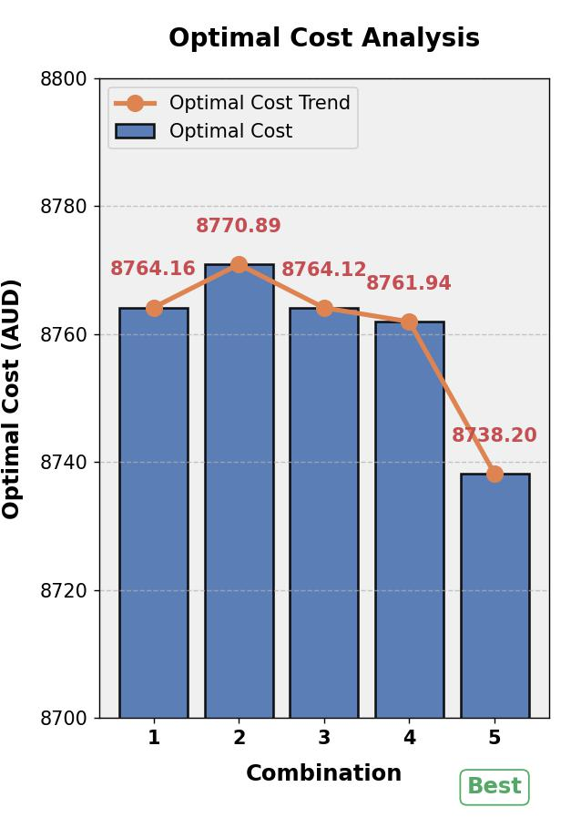
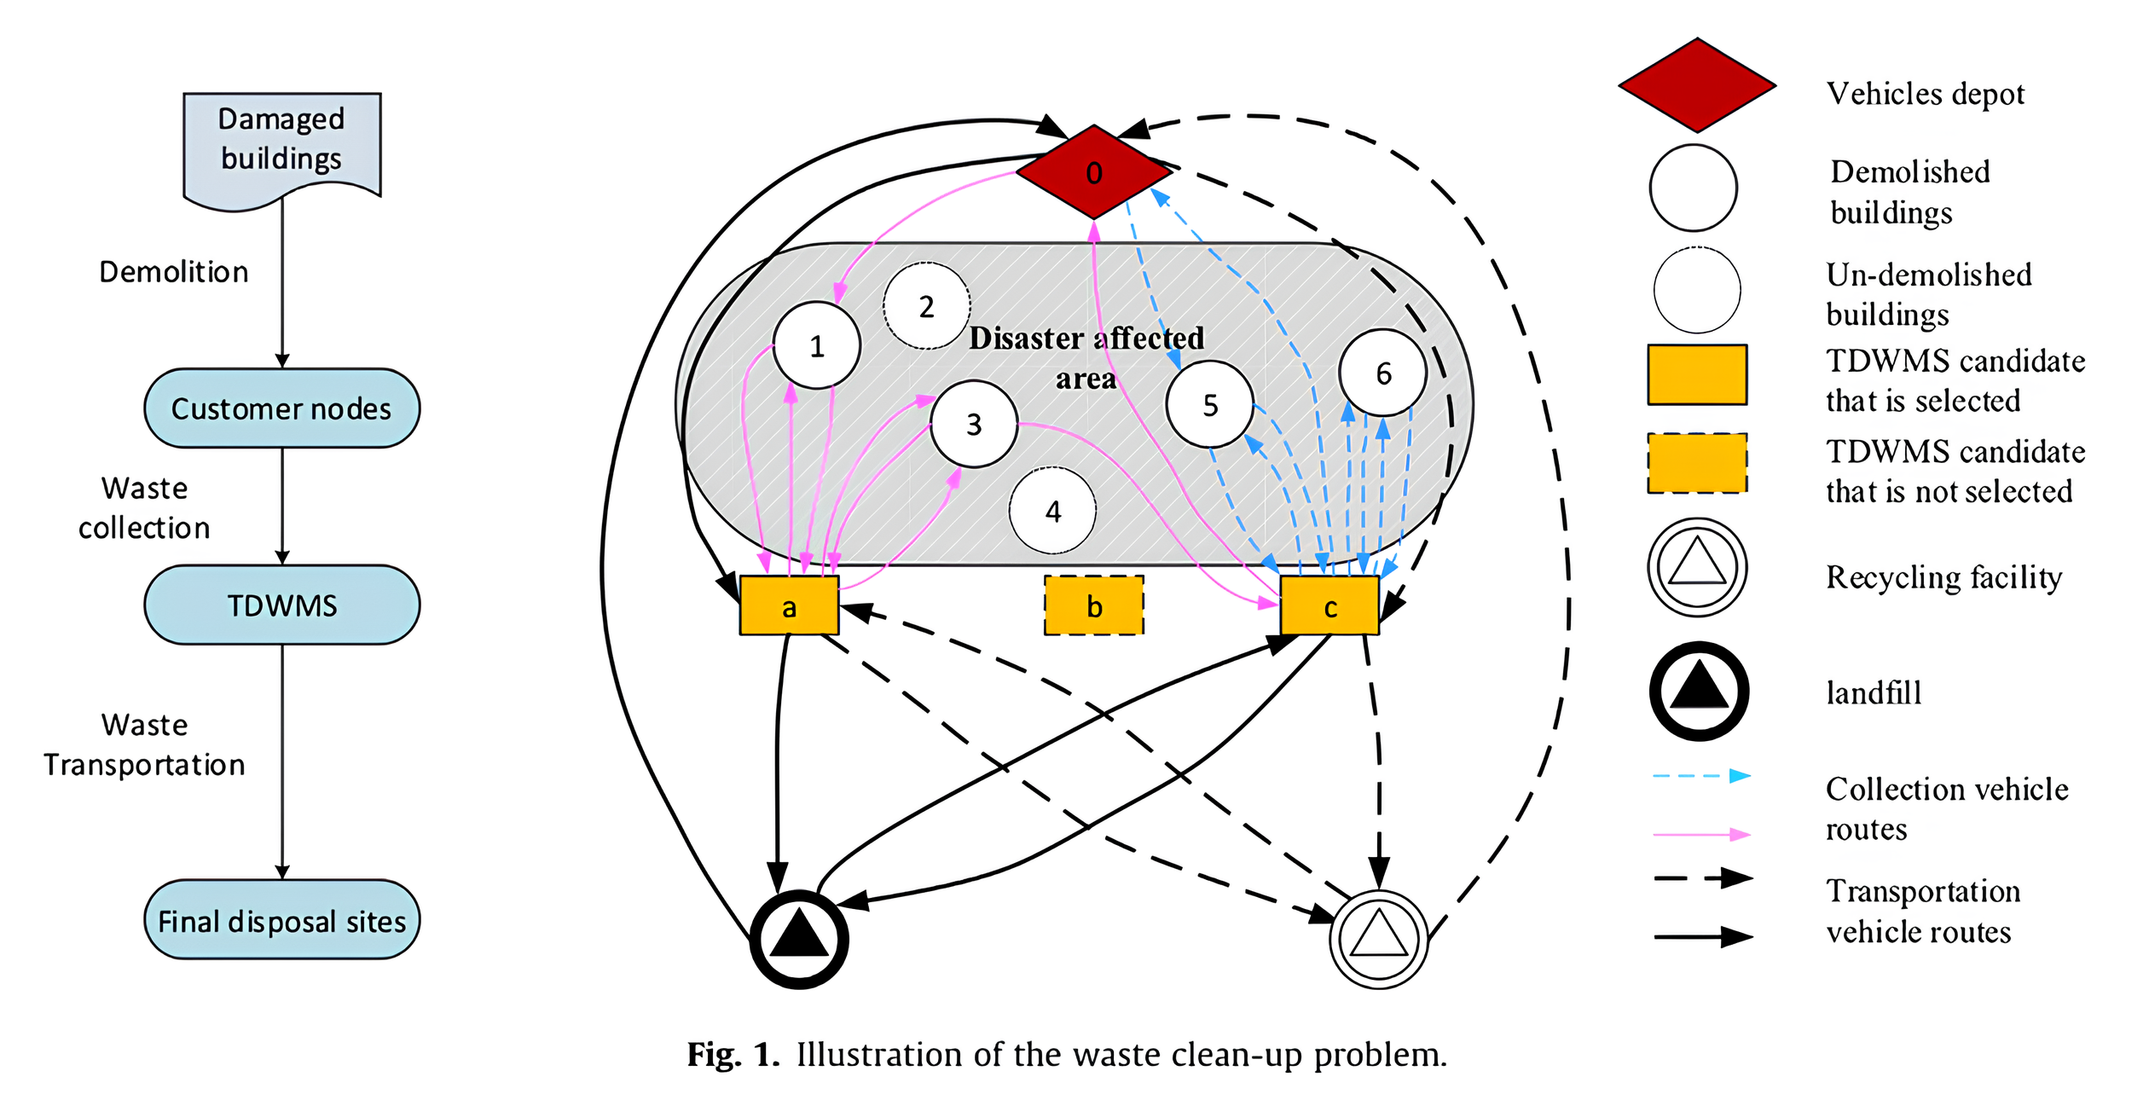
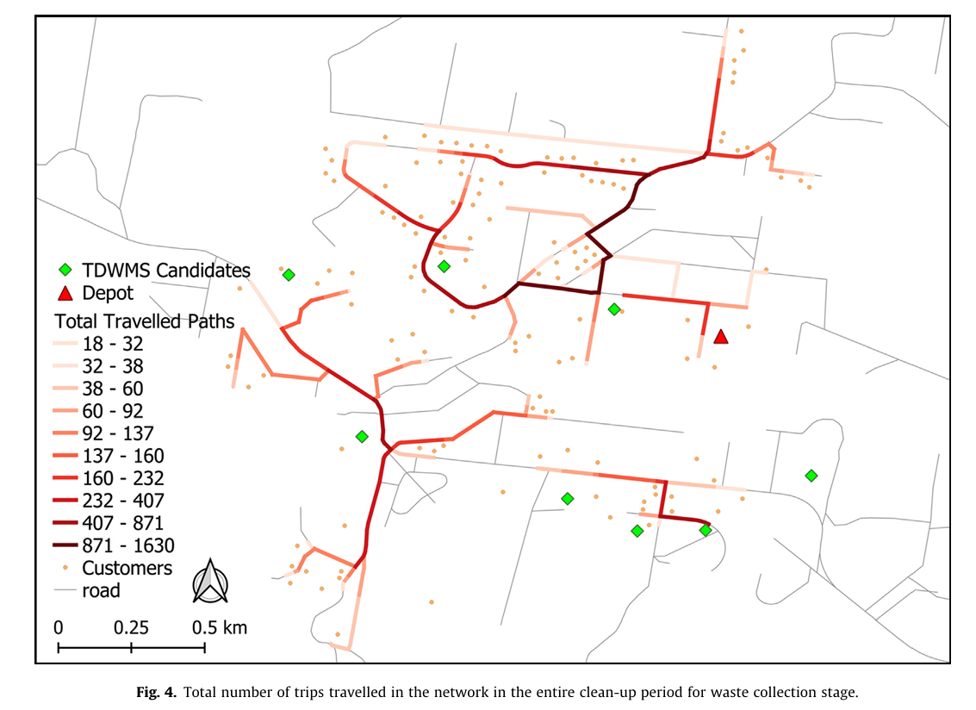
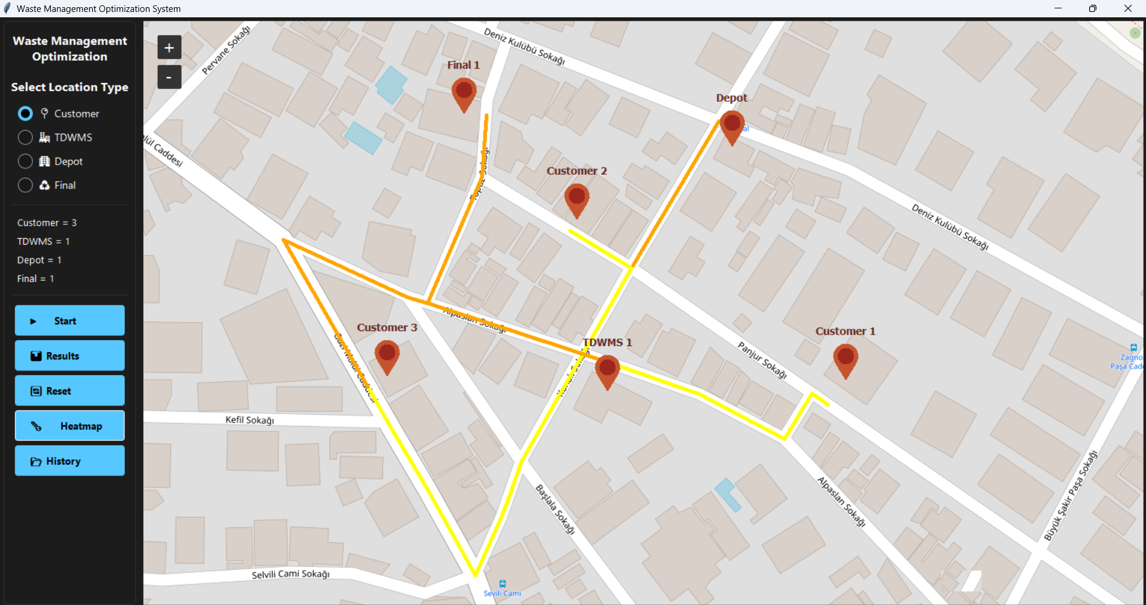
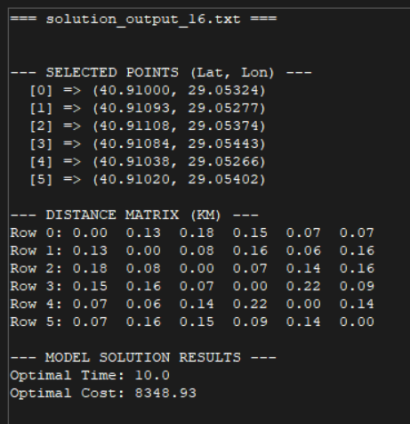
OPTIMIZATION OF WASTE CLEAN-UP AFTER LARGE SCALE DISASTERS
Çağrı Yıldız, Furkan Taşkın Computer Engineering - c.yildiz2019@gtu.edu.tr - f.taskin2020@gtu.edu.tr
Gebze Technical University Faculty of Engineering, Undergraduate Graduation Projects Exhibition, January 16, 2025
Abstract
Challenges and Constraints
Tables and Graphs
This study addresses optimizing waste cleanup operations following large-scale disasters, aiming to minimize total cost and time. A mathematical model is developed to address aspects like building demolition, waste collection, processing at temporary disaster waste management sites (TDWMS) and vehicle routes to final disposal sites. The model is a mixed integer programming (MIP). The model is implemented using CPLEX with Python. To show how the model works, a graphical user interface is developed. This GUI has a heatmap feature that visualizes the frequency of route usages and offers insights to decision makers for planning and executing strategies. The results show that combining demolition schedules with waste collection and transport plans is very important. This helps reduce costs and save time
The development of the A1 model and its GUI encountered several challenges and limitations:
Computational Limitations: The docplex library issued warnings when handling scenarios with more than 4-5 customer nodes, which limited the model's scalability. Adjustments were necessary to manage computational resources effectively.
Data Availability: Acquiring accurate data, such as road distances, waste generation rates, and processing capacities, proved to be difficult. Although the OSRM API was used to calculate distances, occasional connection issues led to incomplete data.
Input Validation: To ensure model stability, constraints like limiting location distances to 5 km were implemented. While these constraints improved accuracy, they also reduced flexibility in some instances.
Test Validation: Validating the results was challenging due to the absence of real-world benchmarks. This required thorough analysis of the outputs and iterative improvements to the model.
Computation Time: Larger datasets and more complex routing scenarios significantly increased computation time, underscoring the need for efficient parameter tuning and optimization.
Test Case | Parameters (M, k, k0, t) | Node Configuration | Optimal Time | Optimal Cost
1 | M, k, k0, t = 6 | 2,2,2 | 6.0 | 8429.02
2 | M, k, k0, t = 6 | 2,4,2 | 6.0 | 8422.965
3 | M, k, k0, t = 6 | 2,2,4 | 6.0 | 8422.01
4 | M, k, k0, t = 12 | 2,2,2 | 9.0 | 8422.035
5 | M, k, k0, t = 12 | 2,4,2 | 9.0 | 8422.715
6 | M, k, k0, t = 12 | 2,2,4 | 9.0 | 8421.88
Introduction
Waste management is a critical component of disaster recovery, particularly after events such as earthquakes, floods, and industrial accidents. These disasters generate significant amounts of debris that must be efficiently collected, transported, and disposed of to support recovery efforts and minimize environmental harm. This project addresses the challenges of disaster waste management by developing a structured and systematic approach. The main objectives of the project are:
Development of the A1 Model: Using mixed-integer programming (MIP), the A1 model optimizes the planning of waste collection, transportation, and disposal operations.
Graphical User Interface (GUI): Designing a user-friendly interface to enable the selection of customer nodes (damaged buildings), Temporary Disaster Waste Management Sites (TDWMS), depots, and final disposal sites.
Performance Validation: Testing the model with simulations and case studies to evaluate its efficiency in reducing costs and cleanup time.
Outputs and Figures
The analysis shows that Combination 5 (1 demolition machine, 1 collection vehicle, and 2 transportation vehicles) achieves the lowest optimal cost (8738.20 AUD). Increasing the number of transportation vehicles (K0) tends to reduce costs, while increasing demolition machines (m) or collection vehicles (K) has a minimal impact. The optimal cleanup time remains consistent at 6.0 days across all combinations, indicating that resource allocation primarily affects cost efficiency.
Acknowledgement
We would like to thank our supervisor, Prof. Dr. Didem Gözüpek, for her invaluable guidance, support, and mentorship throughout this project.
Conclusion
Methods
This project developed a disaster waste management system that integrates the A1 optimization model with a graphical user interface (GUI), effectively optimizing cleanup costs and time for disaster scenarios while offering a user-friendly interface for decision-making. The system is well-suited for simple to moderately complex scenarios but has limitations in handling large datasets or multiple objectives due to computational constraints. It simplifies real-world factors, such as waste processing dynamics and transportation uncertainties, to maintain feasibility. Despite these challenges, the system remains a valuable tool for initial planning and decision-making in disaster waste management.
Graphical User Interface (GUI): Developed using Tkinter and TkinterMapView, allowing users to manage key locations like customer nodes, TDWMS, depots, and disposal sites. Features include heatmap visualization, input validation (e.g., 5 km distance limit), and access to historical results.
Mathematical Model Integration: The optimization uses docplex for Mixed Integer Programming (MIP). A two-stage approach is used: Stage 1 minimizes cleanup time, and Stage 2 minimizes cost within the time constraint.
Distance Calculations: Integrated OSRM API calculates road distances to improve routing accuracy.
Visualization: Heatmaps of transportation flows are generated with color-coded intensity levels (yellow, orange, red) and saved for review.
Data Handling: Optimization results, including locations, distances, and model solutions, are recorded and stored for user review.
Numerical Parameters: The model uses real-world disaster waste management parameters, such as vehicle capacities, working hours, TDWMS storage, and recycling rates.
Contact Info
Name - Surname: Çağrı Yıldız - Furkan Taşkın Department: Computer Engineering
Address: | Tel: 0533 411 43 75 0552 080 33 46 E-posta: c.yildiz2019@gtu.edu.tr f.taskin2020@gtu.edu.tr

