Slide 1

MUSIC CLASSIFICATION
Hasan MEN
Gebze Technical University
CSE 452 Final Project

Slide 2

Predicting genre of music
  Pop, jazz, country...
Active field of research in machine learning
Youtube, Spotify, Shazam …

Slide 3
DATASET
GTZAN Marsyas ( Train + Dev )
  10 Class, 1000 Music
  'metal', 'disco', 'classical', 'hiphop', 'jazz', 'country', 'pop', 'blues', 'reggae', 'rock'
  30 Seconds ( 6 Seconds )
Youtube Dataset ( Test )
  10 Class, 50 Music
  6 Seconds

Slide 4
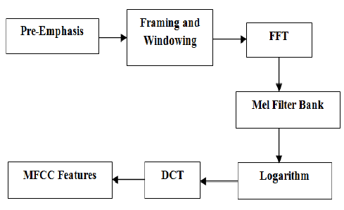
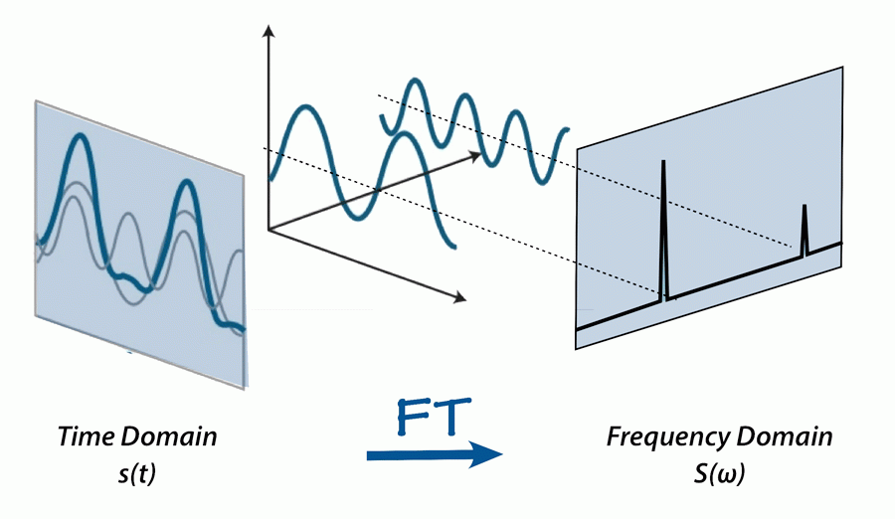
FEATURE EXTRACTION
Mel-frequency cepstral coefficients(MFCC)
  way to represent time domain waveforms as just a few frequency domain coefficients
Librosa FMCC

Slide 5
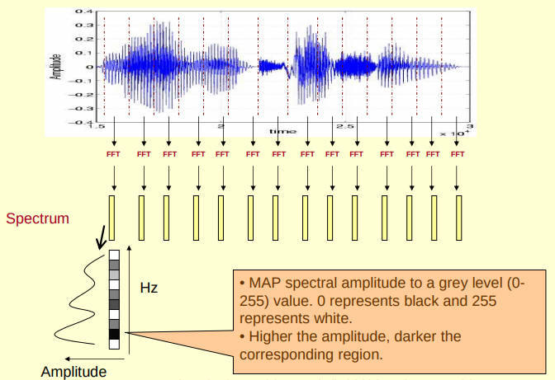

Slide 6
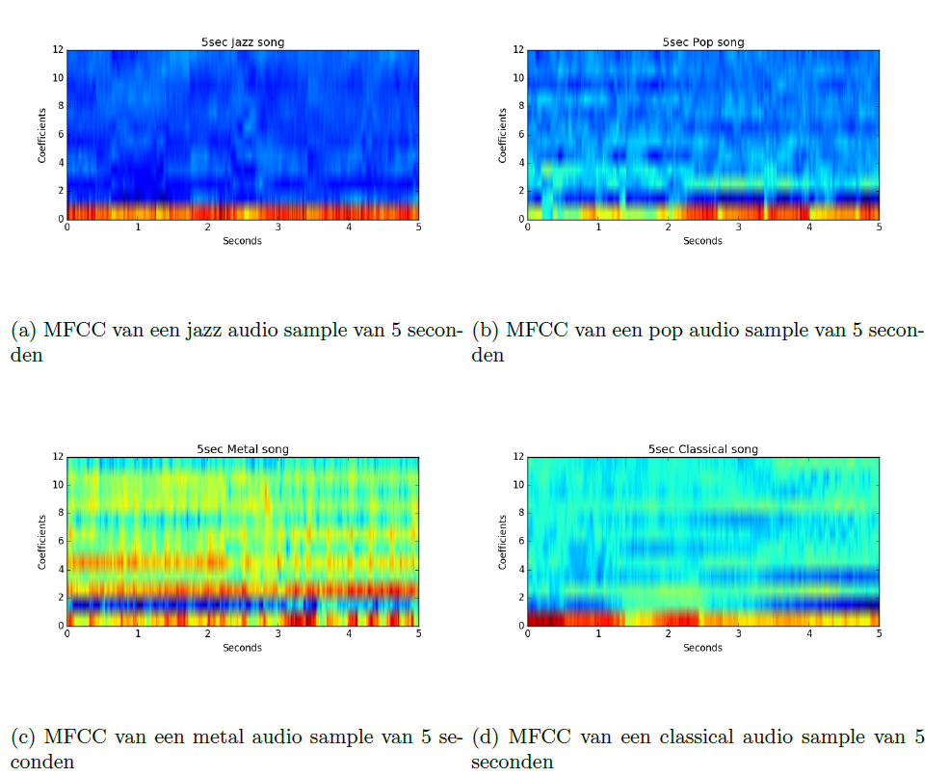

Slide 7
METHODS
SVM
KNN
Decision Tree
!XGBoost (eXtreme Gradient Boost – Ensemble)
  Optimized gradient boosting library
Random Forest (Ensemble - Bagging)

Slide 8
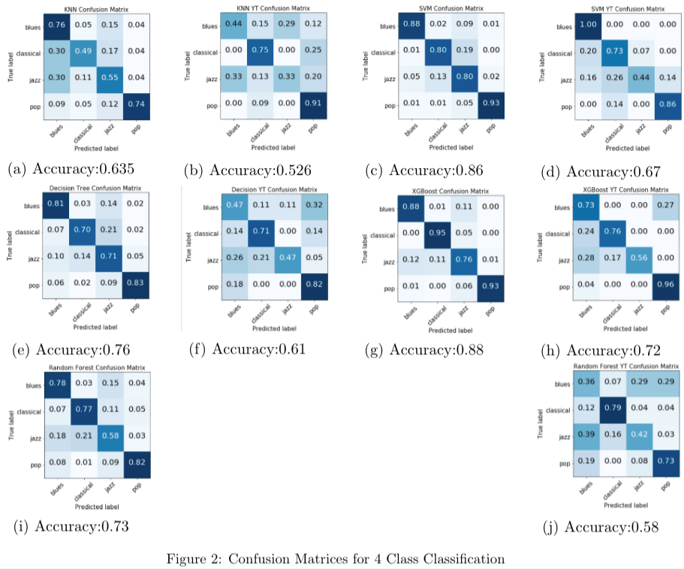
WORKS - 1

Slide 9
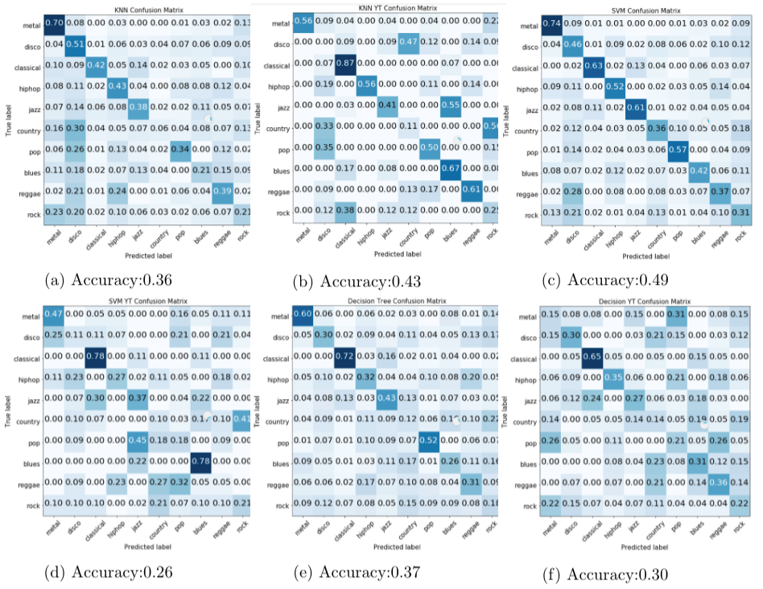
WORKS - 2

Slide 10
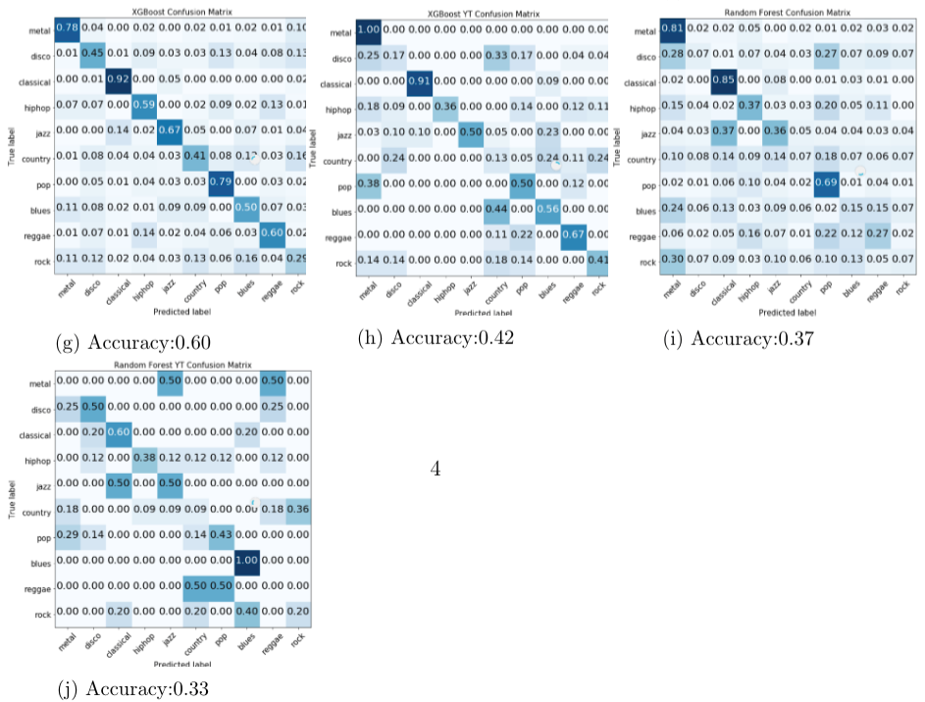
WORKS – 2(Cont.)

Slide 11
References
Marsyas "GTZAN Genre Collection". http://marsyasweb.appspot.com/download/data\_sets/, Last Visit: 23 May 2018.
Mel-frequency cepstral coefficients. https://www.wikiwand.com/en/Mel-frequency\_cepstrum, Last Visit: 23 May 2018.
Matthew Creme, Charles Burlin, Raphael Lenain. (Stanford University) Music Genre Classification, 2016.
Madhura Dole, Teja Mukka. (The University of Texas at Dallas) Music Genre Classification, 2017.
Librosa MFCC Guide. https://librosa.github.io/librosa/generated/librosa.feature.mfcc.html , Last Visit: 7 Jun 2018
Fourier Transform, https://aavos.eu/glossary/fourier-transform/, Last Visit: 8 Jun 2018
MFCC Explenation, http://www.speech.cs.cmu.edu/15-492/slides/03_mfcc.pdf, Last Visit: 8 Jun 2018

