Slide 1
The-Blechley-code-breakers
"Talk is cheap. Show me the code."
-Linus Torvalds

Slide 2
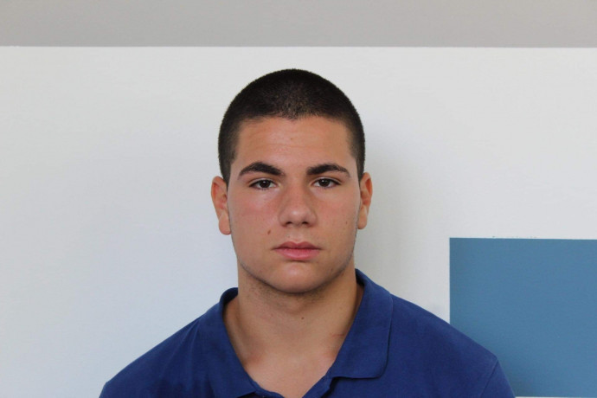
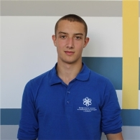
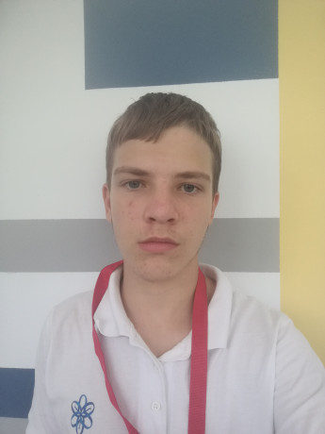
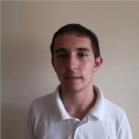

Collaborators of our team
Radoslav Ivanov
RMIvanov18@codingburgas.bg
Atanas Manov
AVManov18@codingburgas.bg
Stoicho Dimitrov
SDDimitrov18@codingburgas.bg
Georgi Zhechev
GTZhechev18@codingburgas.bg
Petur Borisov
PBBorisov18@codingburgas.bg

Slide 3



Communication
Visual studio
Github
Microsoft teams

Slide 4

Idea of the project
The idea of the project is to create a game and enjoy it.

Slide 5
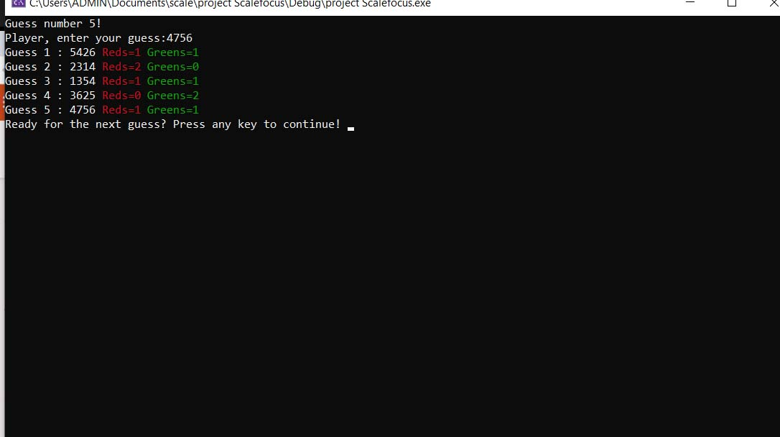
The Game

Slide 6
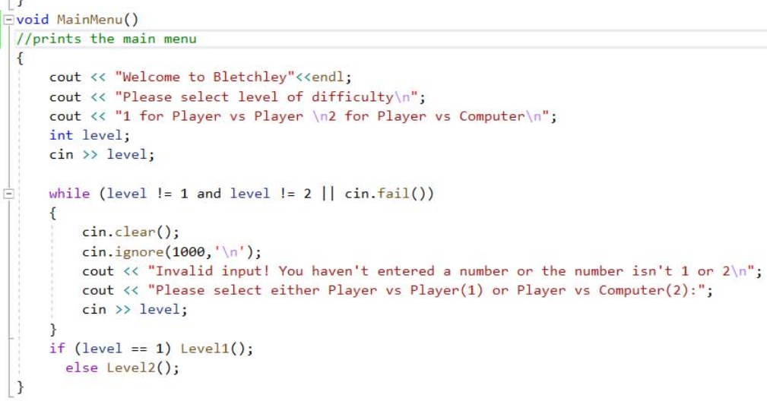
The main functions

Slide 7
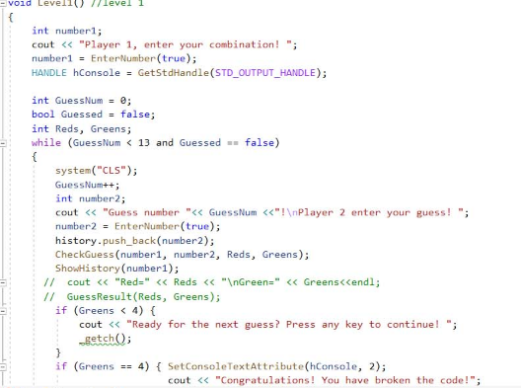
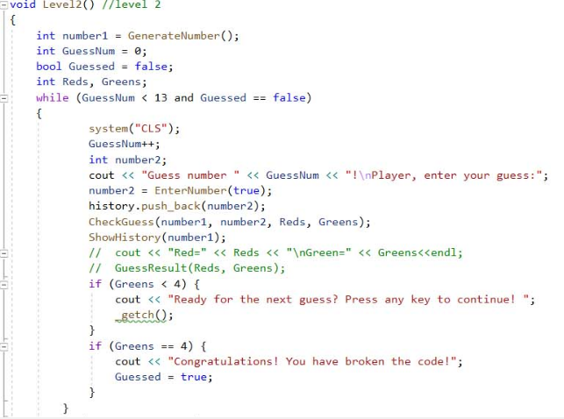

Slide 8
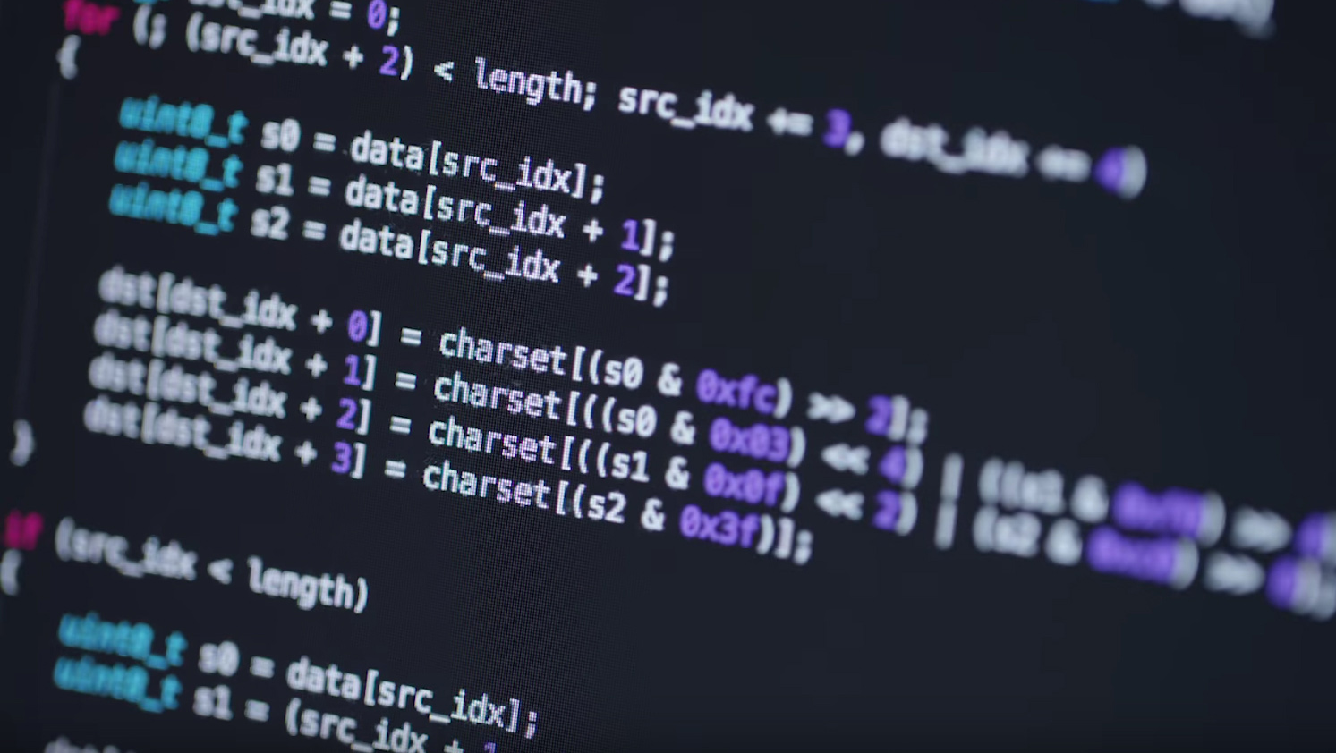
Thank you for your attention

