Slide 1
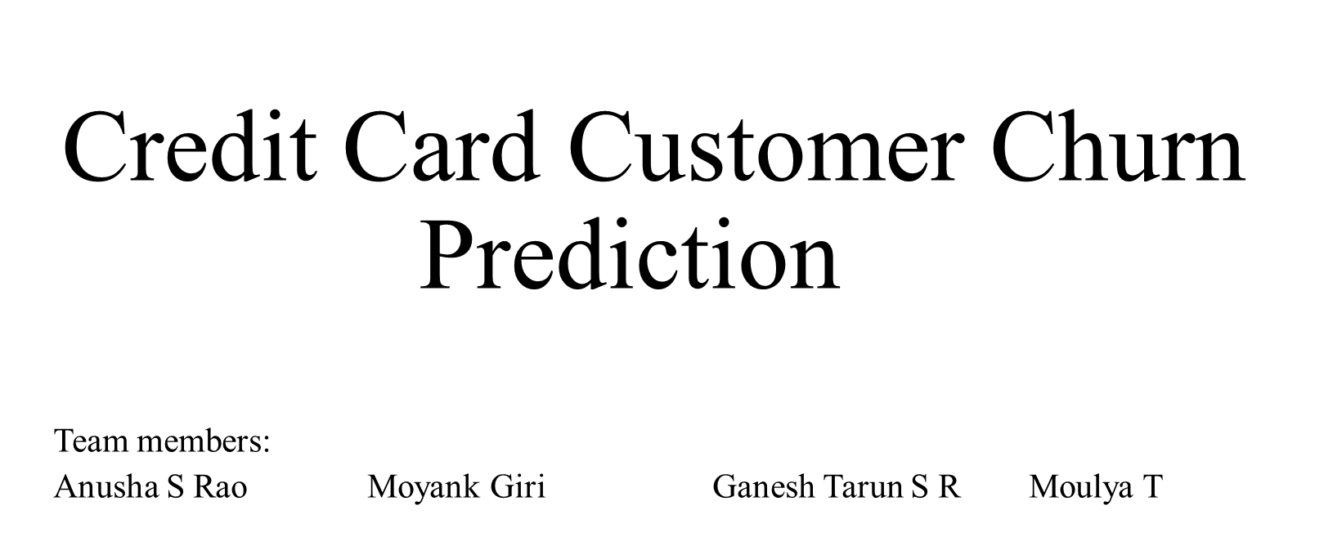

Slide 2
INTRODUCTION
The main aim of the projec is to deal with the analysis and come up with a predictive model for Credit Card Customer Churn. This is to support companies suffering from customer churn so that they can detect Churning Customers as early as possible and can take necessary action in order to retain the Churning Customers.

Slide 3
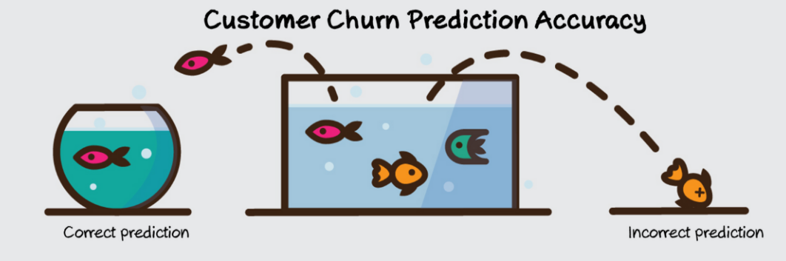
Why IS THIS PREDICTION IMPORTANT?
It is said that
"A bank can increase its profits by up to 85 % by improving the retention rate by up to 5 % "

Slide 4
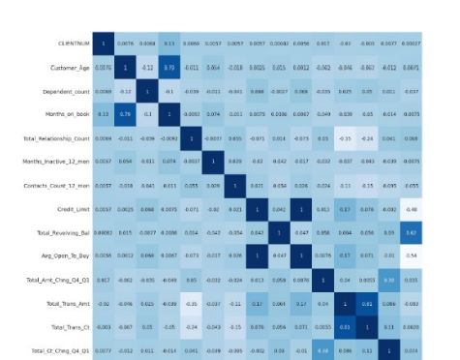
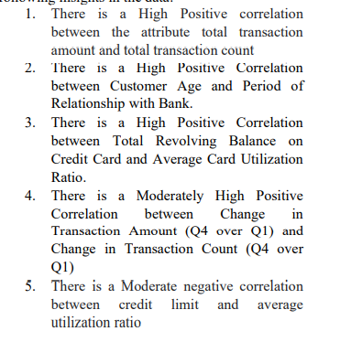
Initial Insights:

Slide 5
IMPLEMENATION AND VALDIDATION :
Find the link for implementation and evaluation :
https://colab.research.google.com/drive/1s6LBM0Te9XXLsNfwVCAVE85vBftVKLm8#scrollTo=L69lsAE2aowd

Slide 6
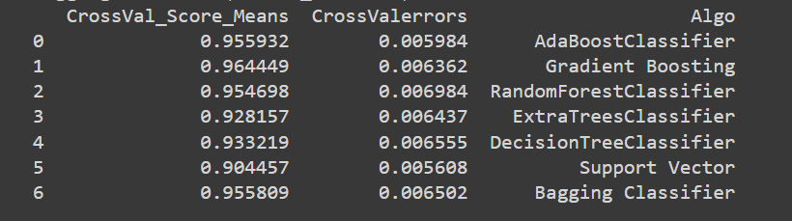
MODELS and Their Accuracy:

Slide 7
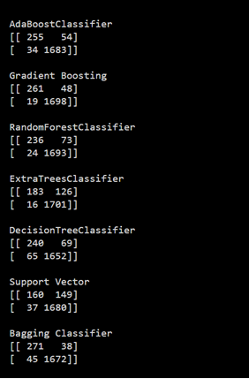
Confusion matrices of the Model:

Slide 8
CONCLUSIONS :
There are about 16 % of customers who have churned in the dataset.
The proportion of gender count is almost equally distributed
57.2% female existing customers, 52.1% attrited female customers
42.9% existing male customers, 47.9% attrited customers
compared to proportion of existing and attributed customer count (83.9% and 16.1%) which is highly imbalanced.
For the proportion of churned customers by gender there are 4.2% more female than male who have churned.
Customers who have churned are highly educated - A high proportion of education level of attrited customer is Graduate level (30.9 %)
A high proportion of marital status of customers who have churned is Married (46.3%), followed by Single (38.9%) compared to Divorced (7.4%) and Unknown (7.4%) status - Marital status of the attributed customers are highly clustered in Married status and Single.
Also, we can see that the proportion of income category of attrited customer, it is highly concentrated around “Less than 40K” income.
The Gradient Boosting in our case gave the highest accuracy of 96.69% whereas all the other model also produced an accuracy of more than 90% as shown in the above table.

Slide 9
THANK YOU

