Slide 1

SKN SINHGAD INSTITUTE OF TECHNOLOGY AND SCIENCE, LONAVALA DEPARTMENT OF COMPUTER ENGINEERING (A.Y.:- 2021-22)
Project Phase II Presentation
On
Comparative Analysis of Feature Selection Algorithms for
Computational Personality Prediction From Social Media
By
MR. Bhushan Nishane ( B151044300 )
MR. Suhas Dhole ( B151044242 )
MR. Atharv Sahare ( B151044325 )
MS. Aishwarya Kale ( B151044206 )
Under the guidance of
Prof. P. D. Halle

Slide 2
OUTLINE
Introduction
Motivation
Problem Statement
Literature Survey
Project Scope
Idea Matrix
Feasibility Analysis
Software Requirement Specification
Hardware Requirement Specification
Abstract
System Overview Diagram
Mathematical Model
Data Flow Diagram
UML Diagram
Conclusion
References

Slide 3
INTRODUCTION
Social media platforms such as Facebook, Twitter,Google, and Instagram has gained popularity due to ease access throughout the world and user-friendly interfaces to start communicating with others within a short period of time. Each user in these social networking sites (SNSs) is considered as an entity, and each entity is connected with other entities as friends, connections, or followers. Considering the trend, user may post his/her political views. Users behave differently in social media and real life.

Slide 4
MOTIVATION
The analysis of the data revealed that almost all respondents used social media. Based on factor analysis results, their motivations for doing so are entertainment, information seeking, personal utility and convenience.

Slide 5
PROBLEM STATEMENT
Applying different feature selection algorithms, such as the chi-squared (CHI) method, Pearson coefficient correlation, information gain (IG), correlation-based feature subset (CFS)-based subset evaluation, and symmetrical uncertainty attribute evaluation, to predict the big five personality traits.

Slide 6
LITERATURE SURVEY
Sr. No. | Paper Name | Author Name | Description
1. | Social Media Text - A Source for Personality Prediction | P. S. Dandannavar | Social media usage has been on an ever increasing exponential rise. Usage of social media sites, such as Twitter and Facebook, for social interaction has also become a popular trend. It is estimated that on an average, around 6,000 tweets are tweeted on Twitter every second. With people spending on an average 35 minutes on Facebook each day, it is also estimated that there are about 317,000 status updates on Facebook per minute. These vast volumes of data have powerful information locked within them. This data can be analyzed and several purposes. The use of such social media data for predicting user personality is common. Prediction models have been successfully built that can predict several user attributes - age, gender, personality traits, occupation, political orientation etc. Standards in personality models such as the Big Five model, DISC and the Myers-Briggs Type Indicator have been the basis for all such personality prediction. A user's social media data can thus be used to predict his/her personality. The main objective of this work is to review the work carried out for personality prediction using social media data.
2. | Personality Predictions Based on User Behaviour on the Facebook Social Media Platform | Michael M. Tadesse, Hongfei Lin | With the development of social networks, a large variety of approaches have been developed to define users’ personalities based on their social activities and language use habits. Particular approaches differ with regard to different machine learning algorithms, data sources and feature sets. The goal of this paper is to investigate the predictability of the personality traits of Facebook users based on different features and measures of the Big 5 model. We examine the presence of structures of social networks and linguistic features relative to personality interactions using the my Personality project dataset. We analyse and compare four machine learning models and perform the correlation between each of the feature sets and personality traits

Slide 7
LITERATURE SURVEY
Sr. No. | Paper Name | Author Name | Description
3. | Personality Recognition on Social Media with Label Distribution Learning | Di Xue, Zheng Hong, Shize Guo, Liang Gao, Lifa Wu | Personality is an important psychological construct accounting for individual differences in people. To reliably, validly, and efficiently recognize an individual’s personality is a worthwhile goal, however, the traditional ways of personality assessment through self report inventories or interviews conducted by psychologists are costly and less practical in social media domains, since they need the subjects to take active actions to cooperate. This paper proposes a method of Big Five personality recognition from microblog in Chinese language environments with a new machine learning paradigm named label distribution learning (LDL), which has never been previously reported to be used in personality recognition. One hundred and thirteen features are extracted from 994 active Sina Weibo users’ profiles and micro-blogs. Eight LDL algorithms and nine non-trivial conventional machine learning algorithms are adopted to train the Big Five personality traits prediction models. Experimental results show that two of the proposed LDL approaches outperform the others in predictive ability, and the most predictive one also achieves relatively higher running efficiency among all the algorithms.

Slide 8
PROJECT SCOPE
Social Media is the New Marketplace
Social Media for High ROI and Less Cost
The Smartphone Era is Here is to Stay

Slide 9
IDEA MATRIX
I
INCREASE :
Increase accuracy.
IMPROVE:
Deep web grows at a very fast pace.
D
DELIVER:
High Performance Searching entered query.
DECREASE:
Time and cost of this process is decreased.

Slide 10
IDEA MATRIX
E
EDUCATE :
The user to send request to the system and user can get proper Result.
EVALUATE :
Efficient Searching on web pages.
ELIMINATE :
The waiting time for searching entered query for long time.

Slide 11
IDEA MATRIX
A
ACCELERATE :
Interaction between the User request and the Dataset.
AVOID :
Searching large number of pages.

Slide 12
FEASIBILITY ANALYSIS
Cost-Benefit Analysis
Risk Assessment And solutions
Control Efficiency And Services

Slide 13
SOFTWARE REQUIREMENT SPECIFICATION
IDE : Spyder
Coding Language : Python Version 3.8
Operating System : Windows 10, Windows 11

Slide 14
HARDWARE REQUIREMENT SPECIFICATION
Processor : Pentium-IV
Speed : 1.1 GHz
RAM : 512 MB(min)
Hard Disk : 40 GB
Key Board : Standard Windows Keyboard
Mouse : Two or Three Button Mouse
Monitor : LCD/LED

Slide 15
ABSTRACT
With the rapid growth of social media, users are getting involved in virtual socialism, generating a huge volume of textual and image contents. Considering the contents such as status updates/tweets and shared posts/retweets, liking other posts is reflecting the online behavior of the users.
Predicting personality of a user from these digital footprints has become a computationally challenging problem. In a profile-based approach, utilizing the user-generated textual contents could be useful to reflect the personality in social media.

Slide 16
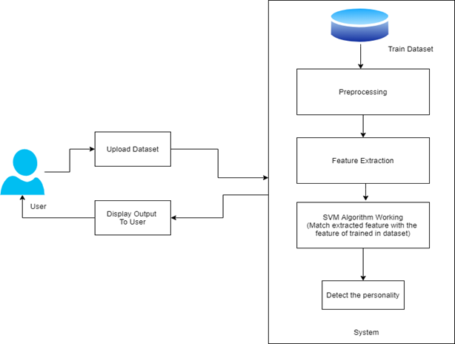
SYSTEM OVERVIEW DIAGRAM

Slide 17
MATHEMATICAL MODEL
Let S be the Whole system S= {I,P,O}
I-input
P-procedure
O-output
Input( I)
I={ Personality prediction dataset}
Where,
Dataset->
Activity of person
Procedure (P),
P={I, Using I System perform operations and calculate the prediction }
Output(O)-
O={System detect Personality Prediction}

Slide 18
DATA FLOW DIAGRAM
INPUT
PROCESS
OUTPUT
Fig. Data Flow Diagram

Slide 19
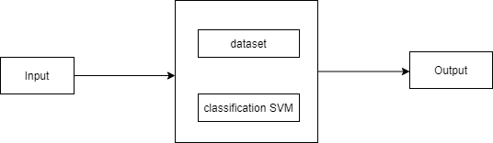
Fig. Data Flow Diagram(1)

Slide 20
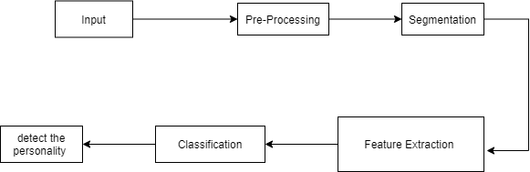
Fig. Data Flow Diagram(2)

Slide 21
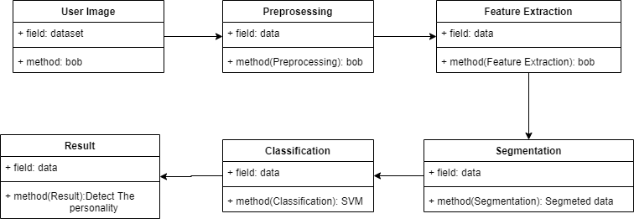
UML DIAGRAM
Fig. Class Diagram

Slide 22
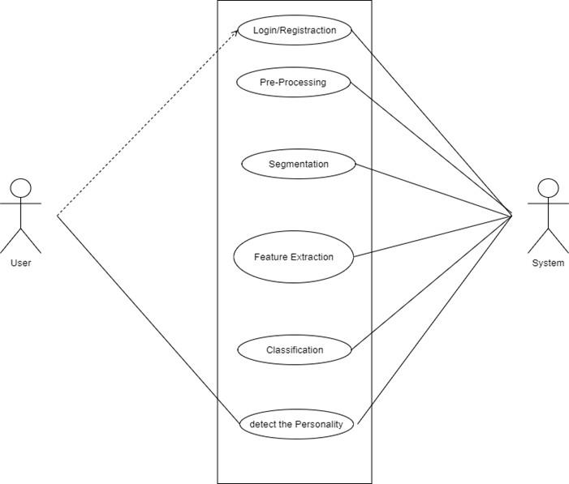
Fig. Use Case Diagram

Slide 23
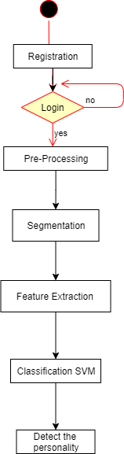
Fig. Activity Diagram

Slide 24
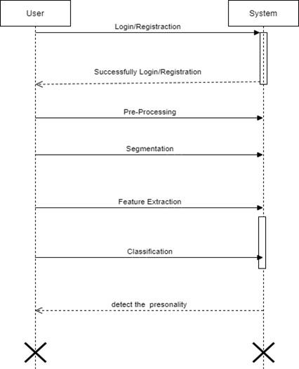
Fig. Sequence Diagram

Slide 25
CONCLUSION
As we know, the base of social media is basically a graph. The connections between the nodes and impact on them due to social media interactions could be reflected through the SN features.
We have designed and performed experiments utilizing the linguistic features as well as SN features. To the best of our knowledge, we have used the most number of features to compare the performance of the feature selection algorithms to predict personality traits

Slide 26
REFERENCES
Social Media Text - A Source for Personality Prediction
Personality Predictions Based on User Behaviour on the Facebook Social Media Platform
Personality Recognition on Social Media with Label Distribution Learning

Slide 27

THANK YOU

