Slide 1
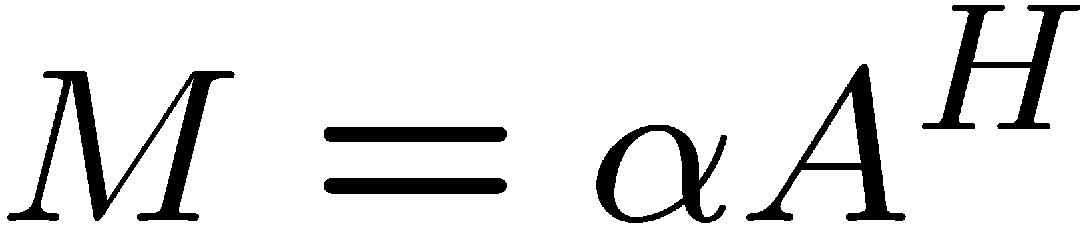
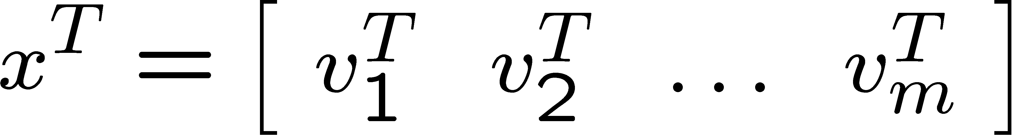
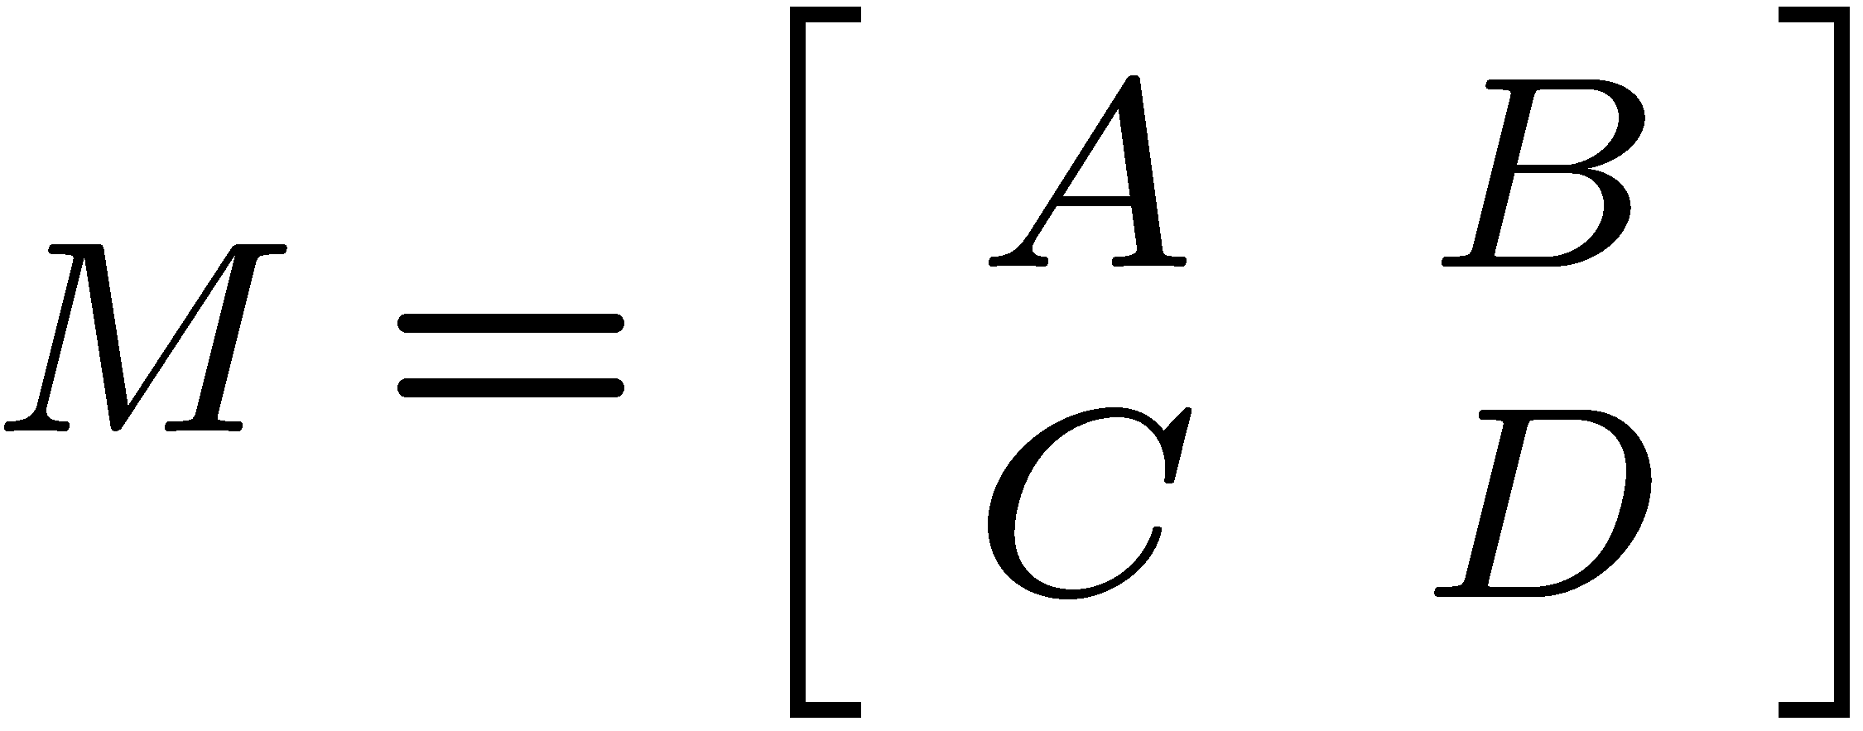

Thyra Composite/Decorator ANA Operator/Vector Subclasses
“Composite” subclasses allow a collection of objects to be manipulated as one object
Product vector spaces and product vectors:
  Product vector spaces:
  Product vectors:
“Decorator” subclasses wrap an object and changes its behavior
Scaled/Adjoint(transposed) linear operator:
VectorSpaceBase
blocks
VectorBase
blocks
ScaledAdjointLinearOp
1…m
1…m
ProductVectorSpace
ProductVector
<<create>>
1
1…*
blockRange
blockDomain
blocks
LinearOpBase
1…*
1…*
Blocked linear operator:
Multiplied (composed) linear operator:
Added (summation) linear operator:
BlockedLinearOp
MultipliedLinearOp
AddedLinearOp

Slide 2
Future Work: Preconditioners and Preconditioner Factories
PreconditionerFactoryBase : Creates and initializes precondtioner objects
fwdOp
PreconditionerFactoryBase
createPrecOp() : LinearOpBase
initializePrec( in fwdOp, inout precOp )
LinearOpBase
<<create>>
precOp
Given A, find P such that PA or AP is “easier” to solve linear systems with than A.
Allows unlimited creation/reuse of preconditioner objects
Supports reuse of factorization structures
Will have adapters for Ifpack, ML, etc …
Use Cases:
  Concrete iterative LinearOpWithSolveFactoryBase subclasses
    AztecOO/Thyra adapters
    Belos/Thyra adpaters

Slide 3
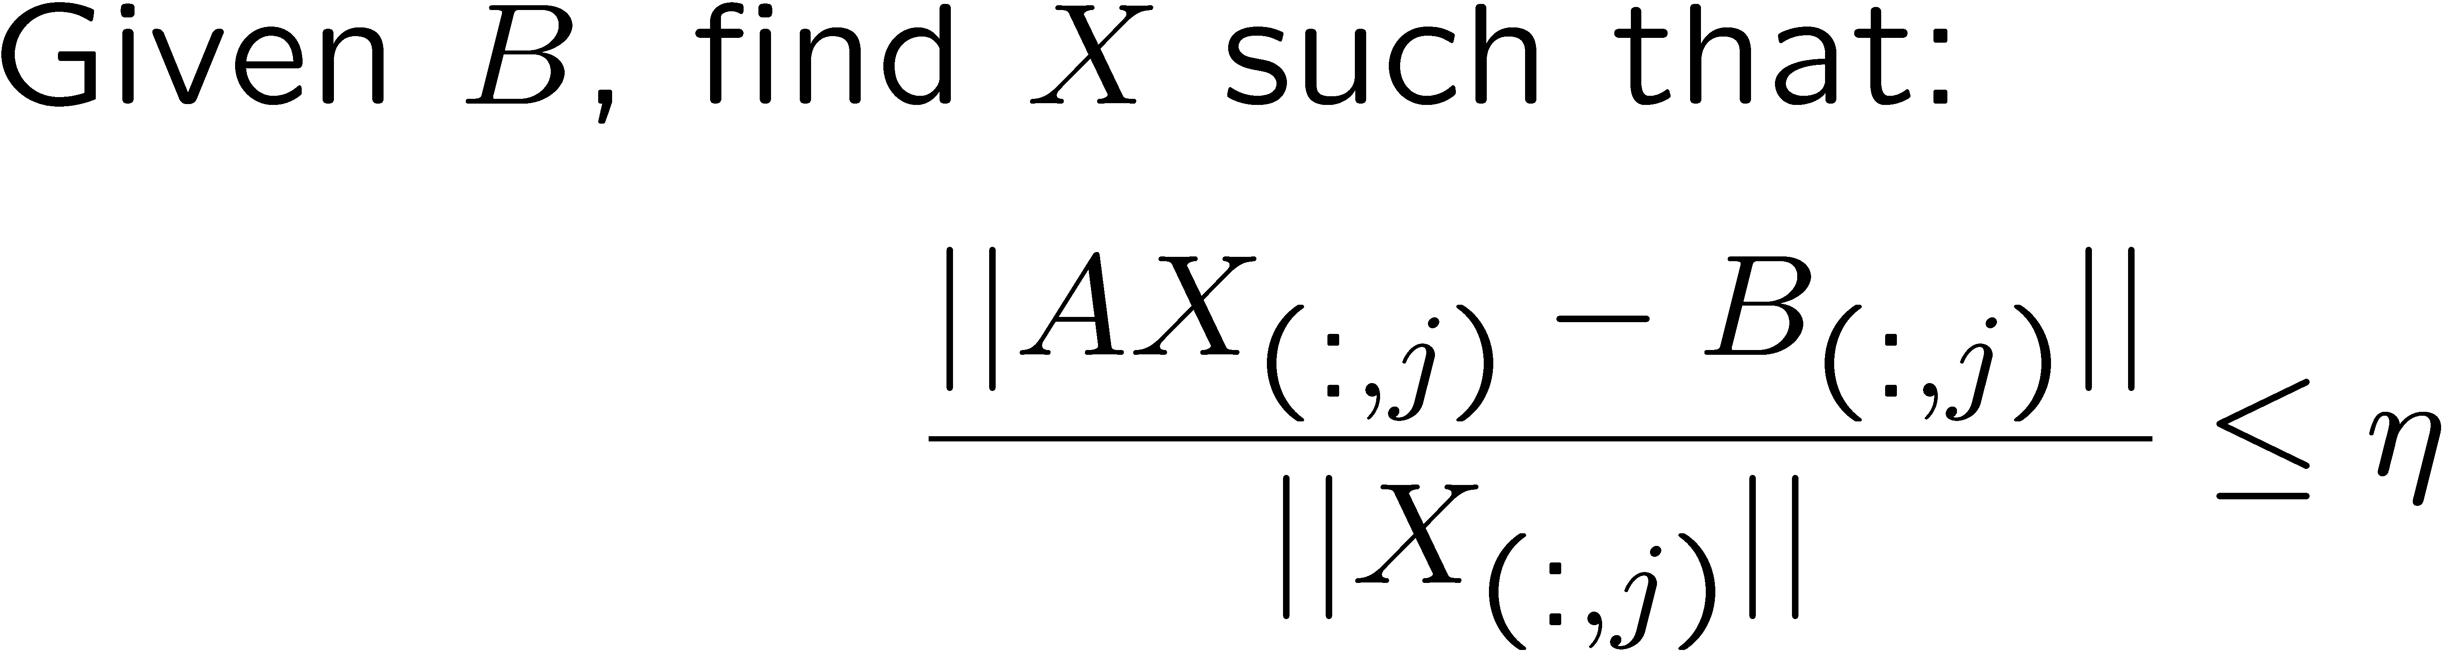
Prototype: Linear Operator With Solve and Factories
LinearOpWithSolveBase : Combines a linear operator and a linear solver
LinearOpBase
LinearOpWithSolveBase
solve( in B, inout X, … )
Appropriate for both direct and iterative solvers
Supports multiple simultaneous solutions as multi-vectors
Allows targeting of different solution criteria to different RHSs
Supports a “default” solve
LinearOpWithSolveFactoryBase :
Uses LinearOpBase objects in initialize LinearOpWithSolveBase objects
LinearOpWithSolveFactoryBase
createOp() : LinearOpWithSolveBase
initializeOp( in fwdOp, inout Op )
initializePreconditionedOp( in fwdOp, in precOp, inout Op)
<<create>>
LinearOpWithSolveBase
Allows unlimited creation/reuse of LinearOpWithSolveBase objects
Supports reuse of factorizations/preconditioners
Supports client-created external preconditioners (which are ignored by direct solvers)
Appropriate for both direct and iterative solvers
Concrete adatpers for Amesos and AztecOO available (Belos coming soon)

Slide 4
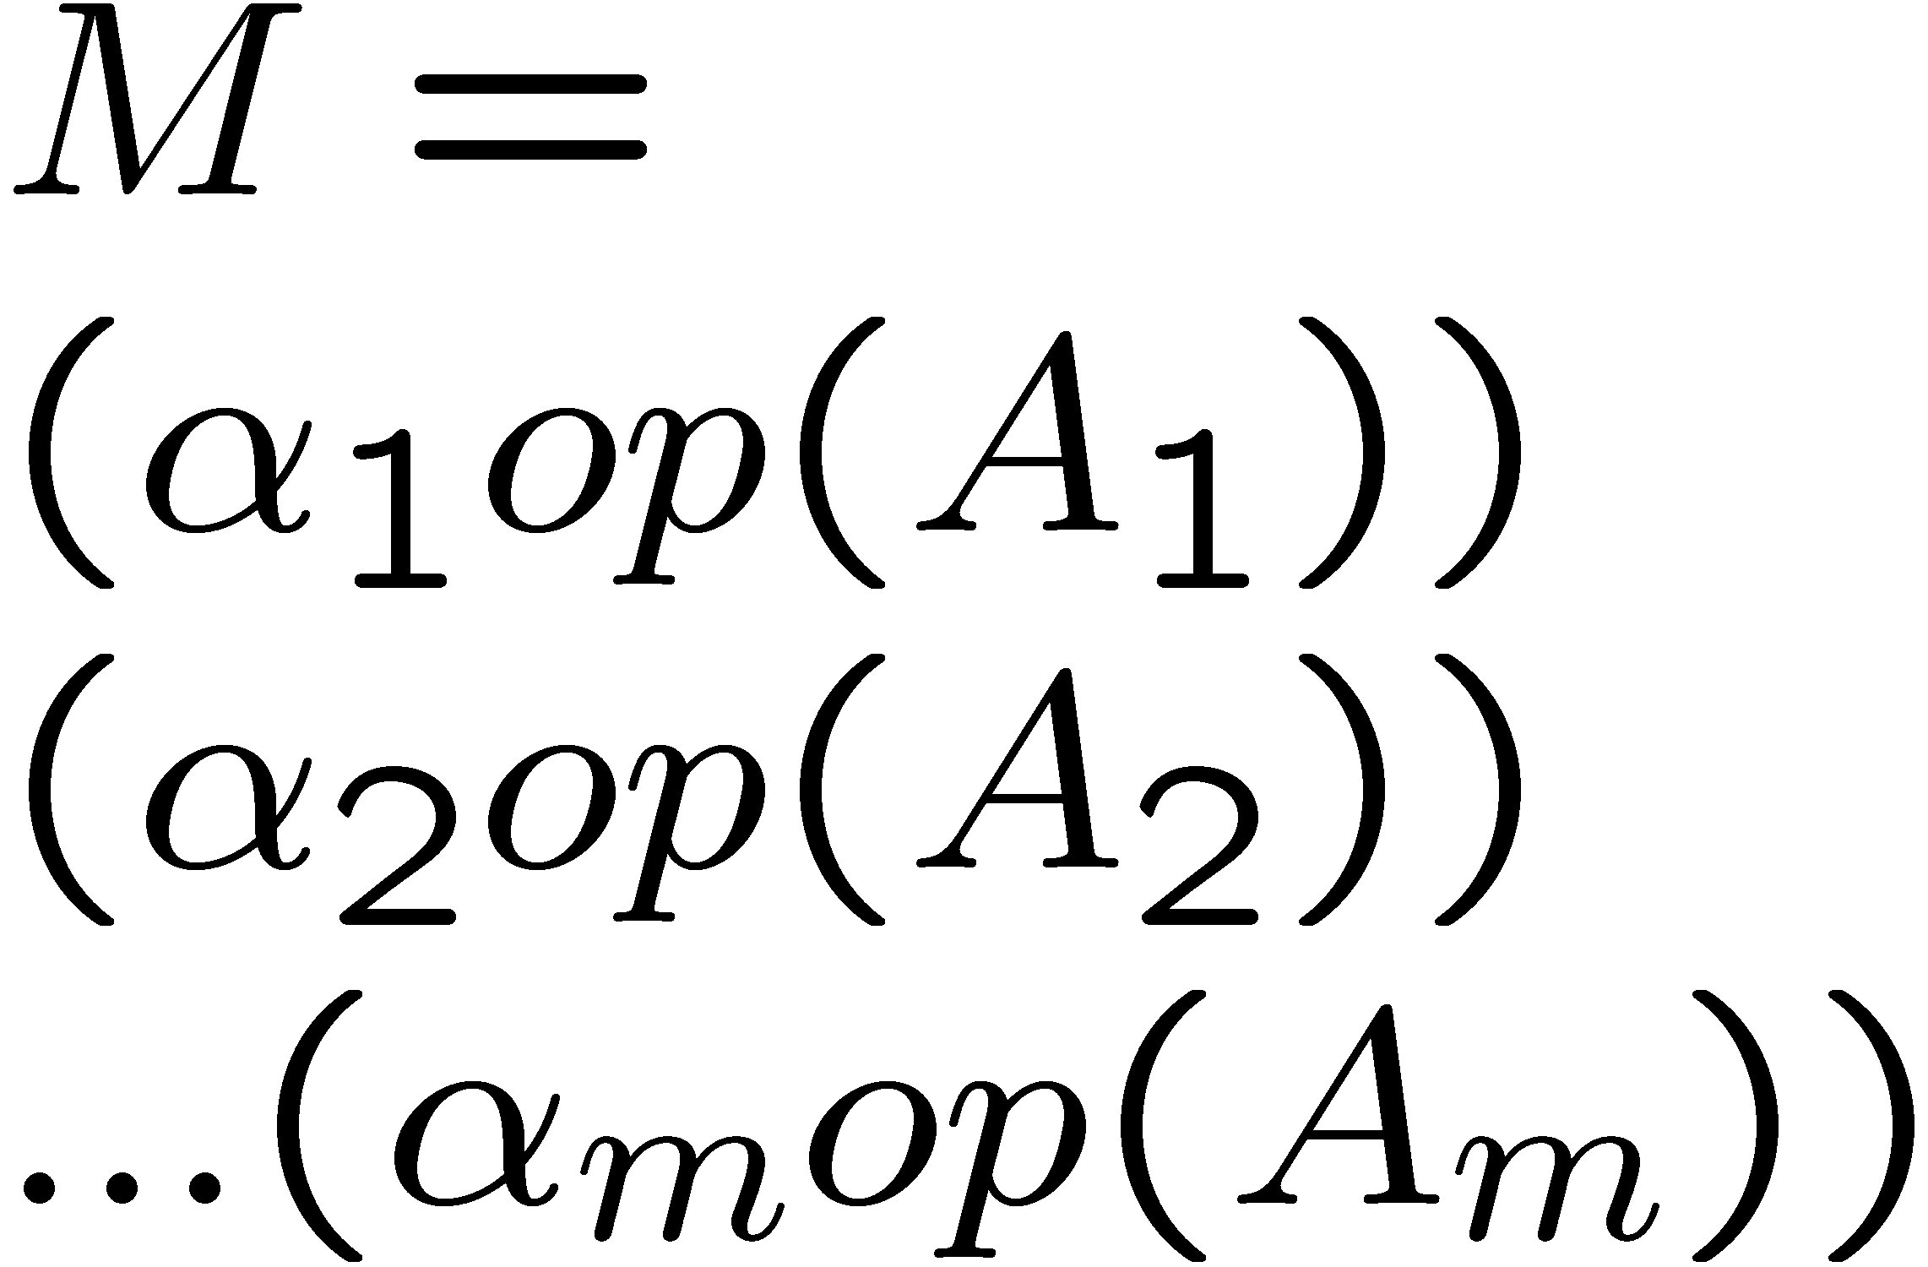
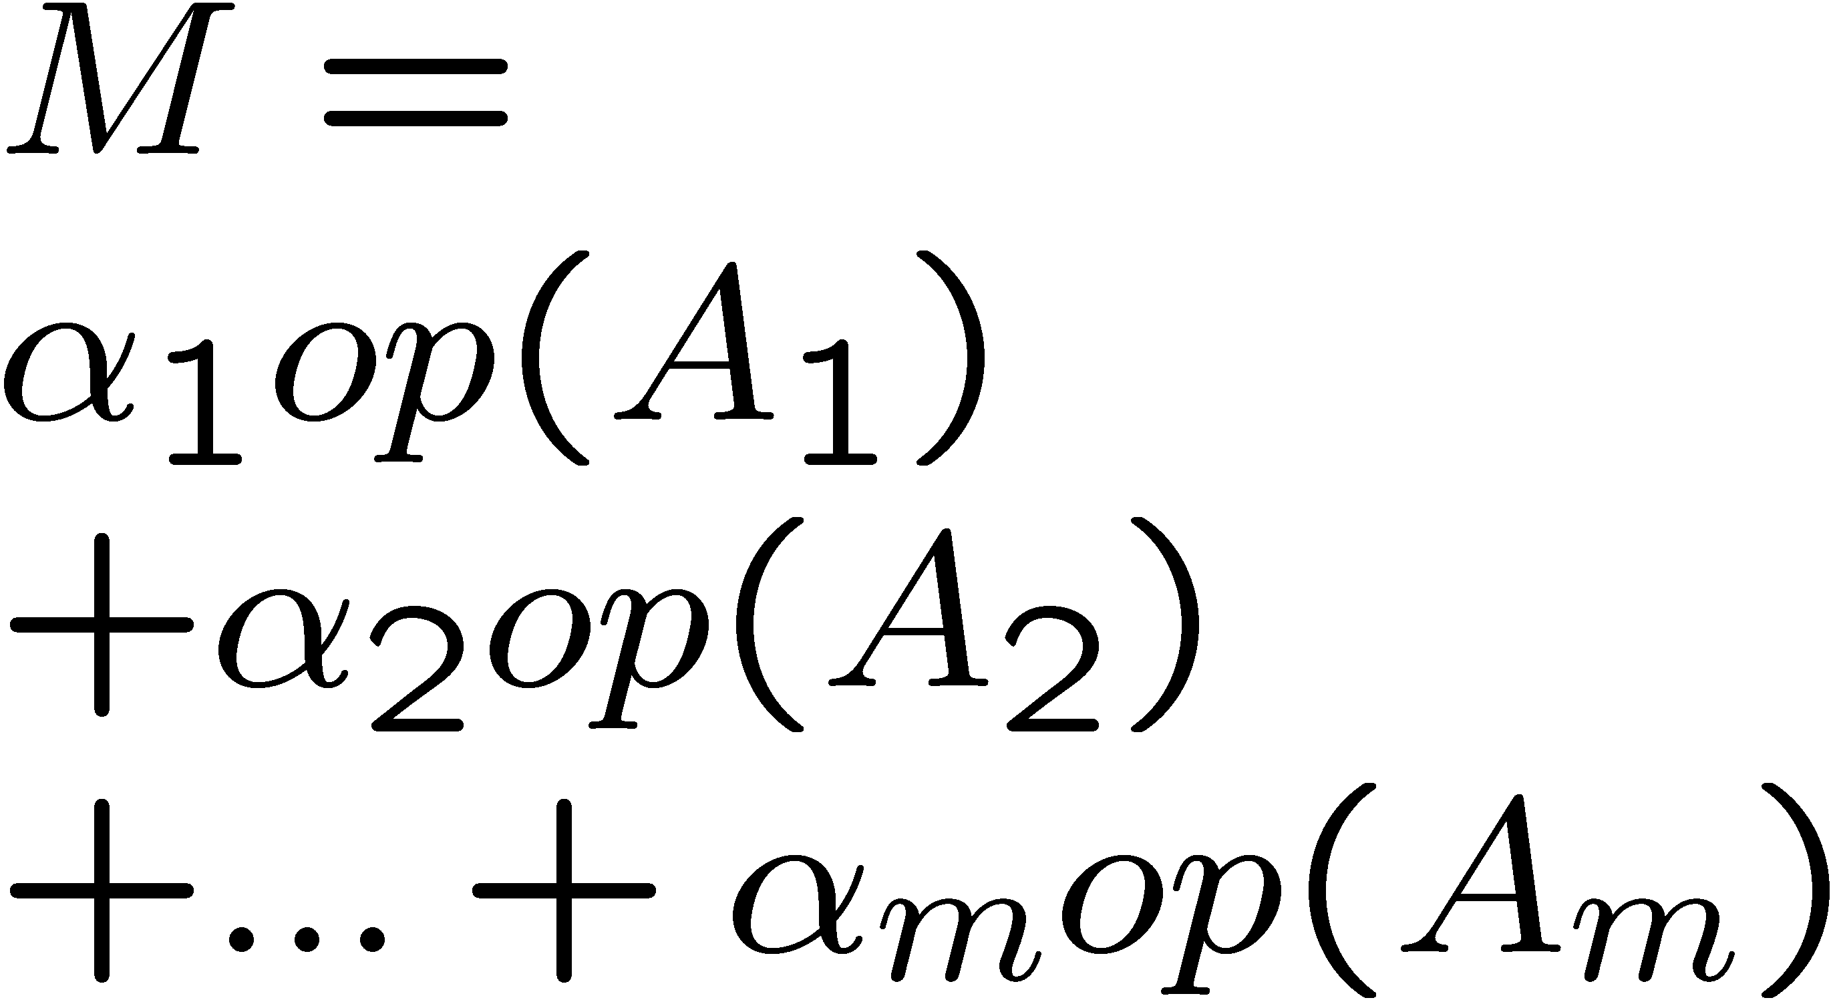
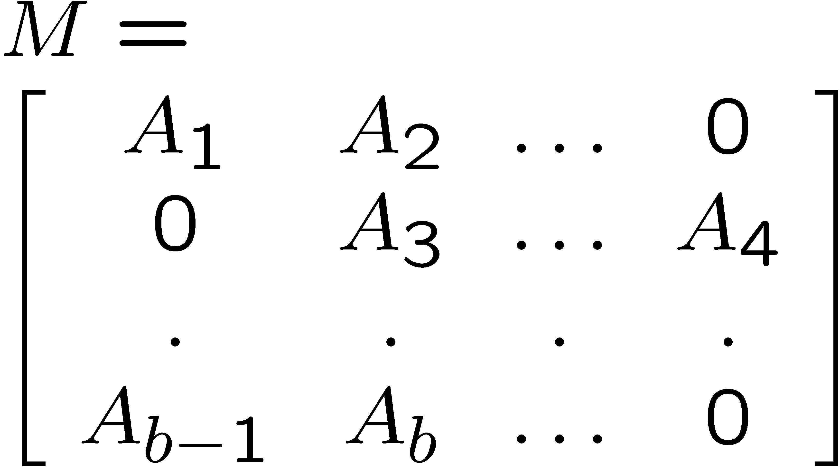
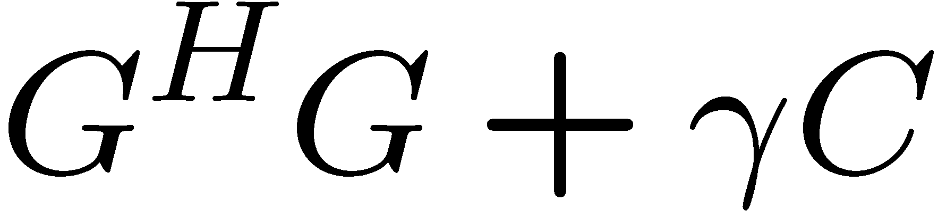
Implicit-to-Explicit Operator Conversions
General interface for transforming one linear operator into another for some purpose. Note that the created/updated LOB object for the explicit operator is managed just by the transform(…) function.
LinearOpMultiplierBase
transform( in A[1…m] : LOB, in transp[1…m] : Transp, in alpha[1..m] : Scalar, out eval : LinearOpMultiplierEvaluator )
LinearOpTransformerBase
estimateWork( in : LOB ) : double
transform( in : LOB, inout : RCP<LOB> )
LinearOpAdderBase
transform( in A[1…m] : LOB, in transp[1…m] : Transp, in alpha[1..m] : Scalar, out eval :LinearOpAdderEvaluator )
DefaultExplicitLinearOpTransformer
Default subclass for any blocked, added, multiplied and scaled/transposed implicit operator. Uses plugged in sub-strategy objects to perform addition, multiplication, transposition and blocking.
LinearOpBlockFillerBase
transform( in prodRange : VSB, in prodDomain :VSB, in A[1…b] : LOB, in blockIndexes[1…b] : pair<int,int>, in transp[1…b] : Transp, in alpha[1..b] : Scalar, out eval : LinearOpBlockFillerEvaluator )
Creates a full matrix from blocks specified in sparse block format
SymmetricWithAddLinearOpTransformer
Specialized for composed operators of type:
“Extended” interfaces for building explicit composed linear operators. These interfaces could have a variety of implementations from general to very specific. For example, very efficient implementations for Epetra_CrsMatrix are available (e.g. EpetraExt::MatrixMatrix)
All classes in Thyra namespace
LOB = LinearOpBase
VSB = VectorSpaceBase

Slide 5
Atomic Operator Strategies and Evaluators
LinearOpAdderDirector
1
Uses a smart runtime selector method to determine which adder strategy to use for a particular set of atomic linear operator objects.
1…*
LinearOpAdderBase
transform( in A[1…m] : LOB, in transp[1…m] : Transp, in alpha[1..m] : Scalar, out eval : LinearOpAdderEvaluator )
Row Accessible-LinearOpAdder
LinearOpEvaluatorBase
EpetraCrsAdder
Every adder, multiplier, and blocker strategy interface/subclass has an associated Evaluator interface/subclass. The Evaluator object maintains input-operator-specific information about how to do the transformation again and again more efficiently than the first time. For example, the EpetraCrsLinearOpEvaluator object might store the graph even or the whole matrix for the sum of two or more linear operators. Therefore, later adds would not need to perform any expensive memory management or resizing.
EpetraExt
::MatrixMatrix
LinearOpAdderEvaluator
evaluate( in A[1…m] : LOB, in transp[1…m] : Transp, in alpha[1..m] : Scalar)
getLeaf( in int i ) :
getOp : RCP<LOB>
<<create>>
EpetraCrsAdderEvaluator
<<create>>
Row Accessible-LinearOpEvaluator

Slide 6
Example of Implicit and associated Evaluation Trees
The formStrategy object creates the E_explicit LOB object and takes care of parsing the input implicit operator tree rooted at E. Note that while E is being parsed, the evaluation tree rooted at E_eval can be picked apart by single dynamic casts. For example, since E is an AddedLinearOp, then E_eval must be a LinearOpAdderEvaluator and so on.
The link from the E_explicit object to the E_eval object might be maintained through extra data in the RCP object that wraps the E_explicit object. That is one reason why the LinearOpTransformerBase::transform(…) interface must work with RCP<LOB> as the input/output object.
formStrategy : DefaultExplicit-LinearOpTransformer
<<create>>
E_explicit : EpetraLinearOp
E : AddedLinearOp
E_eval : EpetraCrsAddedEvaluator
D : MultipliedLinearOp
D_eval : EpetraCrsMultiplierEvalutor
C : AddedLinearOp
C_eval : EpetraCrsAdderEvaluator
A : EpetraLinearOp
B : EpetraLinearOp
A_eval : ???
B_eval : ???
Above is the implict operator tree created by the statements:
C = A + B
D = trans(C) * C
E = B + D
Above is the evaluator object tree that is associated with the implicit operator tree on the left. Each of the node objects C_eval, D_eval and E_eval maintain a graph or the matrix for the target of the operation.

Slide 7
Preconditioner Factory with Transformations
This concrete precondtioner factory (e.g. for Ifpack, ML etc.) can only take explicitly formed input linear operators
PreconditionerFactoryBase
ConcretePreconditionerFactory
Knows the correct format of input LOB
wrappedFactory
LinearOpConverter-PreconditionerFactory
transformer
LinearOpTransformerBase
Standard “decorator” subclass that converts the input linear operator with transformer and then gives this transformed input operator to the concrete precondtioner factory wrappedFactory to create the actual preconditioner.
ConcreteLinearOpTransformer
Concrete implementation of the implicit-to-explicit LinearOpBase conversion where the output type is designed to be used with ConcretePreconditionerFactory
All classes in Thyra namespace
LOB = LinearOpBase

Slide 8
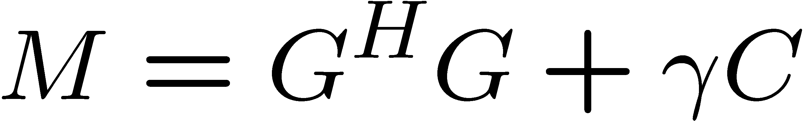
Preconditioner Factory with Transformations : Meros Example
M : AddedLinearOp
: ScaledAdjointLinearOp
: MultpliedLinearOp
scalar=gamma
: Meros
: ScaledAdjointLinearOp
transp=CONJTRANS
G : EpetraLinearOp
C : EpetraLinearOp
: LinearOpConverterPreconditionerFactory
: GeneralExplicitLinearOpTransformer
: MLPrecondtionerFactory
: EpetraCrsLinearOpMultiplier
: EpetraCrsLinearOpAdder
: ML
: EpetraExt::MatrixMatrix
: EpetraCrsBlockFiller
Here is an example configuration for Meros that is for Epetra_CrsMatrix implementations of the atomic operator objects and we just use a general implementation of the transformation routines based on EpetraExt::MatrixMatrix and the Epetra_CrsMatrix class itself.

