Slide 1
Statistical Machine Learning Theory and Applications
[70240413 Statistical Machine Learning, Spring, 2019]
Jun Zhu
dcszj@mail.tsinghua.edu.cn
http://ml.cs.Tsinghua.edu.cn/~jun
State Key Lab of Intelligent Technology & Systems
Tsinghua University
February 27, 2019

Slide 2
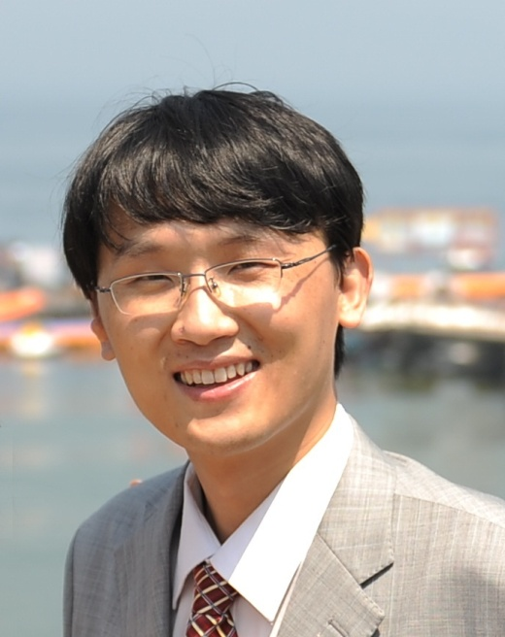
A bit about the Instructors
Jun Zhu, Professor, Depart. of Computer Science & Technology. I received my Ph.D. in DCST of Tsinghua University in 2009. My research interests include statistical machine learning, Bayesian nonparametrics, and data mining
I did post-doc at the Machine Learning Department in CMU with Prof. Eric P. Xing. Before that I was invited to visit CMU for twice. I was also invited to visit Stanford for joint research (with Prof. Li Fei-Fei)
2015: Adjunct Associate Professor at CMU
Published 100+ research papers on the top-tier ML conferences and journals, including JMLR, TPAMI, ICML, NIPS, etc.
Served as Area Chairs for ICML, NIPS, UAI, AAAI, IJCAI; Associate Editor for PAMI, AI Journal
Research is supported by National 973, NSFC, “Tsinghua 221 Basic Research Plan for Young Talents”.
Homepage: http://ml.cs.tsinghua.edu.cn/~jun

Slide 3
Contact Information
Jun Zhu
State Key Lab of Intelligent Technology and Systems, Department of Computer Science, Tsinghua U.
Office: Rm 4-513, FIT Building
E-mail: dcszj@tsinghua.edu.cn
Phone: 62772322, 18810502646
Office hours: Thursday afternoon 3:00pm-5:00pm

Slide 4
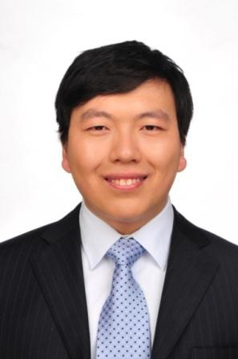
A bit about the Instructors
Hang Su, Assistant Researcher, Depart. of Computer Science & Technology.
Research interests include interpretable AI algorithm, computer vision and reinforcement learning
Published 50+ research papers on the top-tier conferences and journals including three best paper awards.
Served as senior PC or PC members in the dominant international conferences including IJCAI, AAAI, CVPR, and reviewers for top journals such as TPAMI, TIP, TMI, etc.
Contact Information:
Office: Rm 1-508, FIT Building
E-mail: suhangss@tsinghua.edu.cn
Phone: 13810667245
Wechat: suhangss
Homepage: http://www.suhangss.me
Office hours: Thursday afternoon 3:00pm-5:00pm

Slide 5
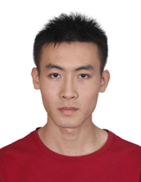
Teaching Assistants
Yinpeng Dong (Head TA)
Office: Rm 1-509, FIT Building
E-mail: dongyinpeng@gmail.com
Phone: 62795869, 18603303421
Deep Learning, Robust machine learning
Publish at NIPS, CVPR, AAAI, IJCV, etc.
http://ml.cs.tsinghua.edu.cn/~yinpeng

Slide 6
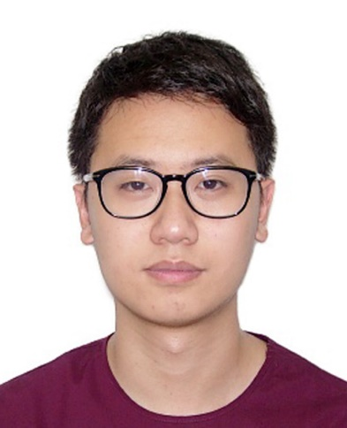
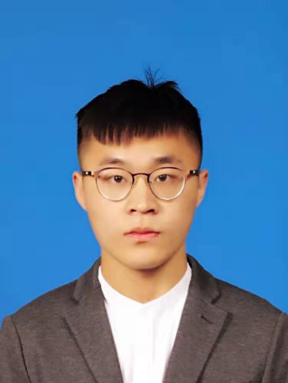
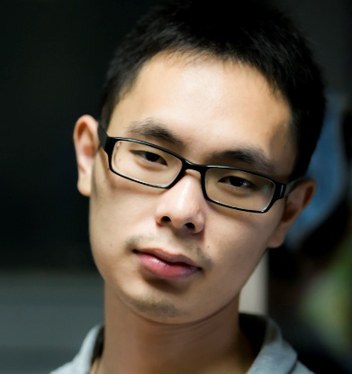
Teaching Assistants
Yanze Min
E-mail: minyz16@mails.tsinghua.edu.cn
Phone: 62795869, 18811369952
Deep learning, Bayesian methods
Zhijie Deng
E-mail: dzj13@mails.tsinghua.edu.cn
Phone: 62795869, 15600614105
Deep learning, Probabilistic models
Publish at NIPS
Shiyu Huang
E-mail: 18801216815@163.com
Phone: 62795869, 18801216815
Reinforcement learning, Latent variable models
Publish at CVPR, AAAI.
TA office hours: Wednesday afternoon 3:00pm-5:00pm
Office: Rm 1-508/509, FIT Building

Slide 7
Resources
Mainly class slides/notes
Recommended text books
Christopher M. Bishop. Pattern Recognition and Machine Learning, Springer, 2007.
Trevor Hastie, Robert Tibshirani, Jerome Friedman. Elements of Statistical Learning. 2nd Edition, Springer, 2009.
Further readings:
Conferences:
Theory: ICML, NIPS, UAI, COLT, AISTATS, AAAI, IJCAI
App: KDD, SIGIR, WWW, ACL
Journals:
JMLR, PAMI, MLJ

Slide 8
Prerequisites
Knowledge of probability, linear algebra, statistics and algorithms
Calculus:
Derivative, integral of multivariate functions
Linear Algebra
Matrix inversion, eigen-decomposition, …
Basic Probability and Statistics
Probability distributions, Mean, Variance, Conditional probabilities, Bayes rule, …
Knowledge of programming languages, e.g., C/C++, Java, matlab, Python
Homework 0: take the Self-Evaluation
Minimum & modest background tests (available at course webpage)

Slide 9
Overview of Class
Introduction
Supervised learning
Unsupervised learning
Learning theory
Probabilistic graphical models
Bayesian methods
Deep learning
Reinforcement learning
3 units
9 units
HW1 out
6 units
HW1 due
HW2 out
3 units
6 units
HW2 due
HW3 out
3 units
6 units
HW3 due
HW4 out
6 units
HW4 due
June 28

Slide 10
Grading
Participation (10%)
1 mid-term quiz (10 points)
Homeworks (40%)
4 homeworks (10 points each time)
Project (50%)
2~4 students to form a team
Apply machine learning to solve a real problem
Choose one task at Kaggle (http://www.kaggle.com/competitions) or other data science competitions
TAs defined tasks (e.g., Adversarial attack & defense for DNNs)
Self-proposed projects (e.g., ??)
Submit materials:
a proposal (6th week), a mid-term report (9th week), a final report (18th week), and the implementation code (18th week)
All reports should be in NIPS format, written in English: (https://nips.cc/Conferences/2018/PaperInformation/StyleFiles )
Poster presentation (16th week)
Notes:
Some candidates:
Microsoft Malware Classification Challenge (BIG 2015)
http://www.kaggle.com/c/malware-classification

Slide 11
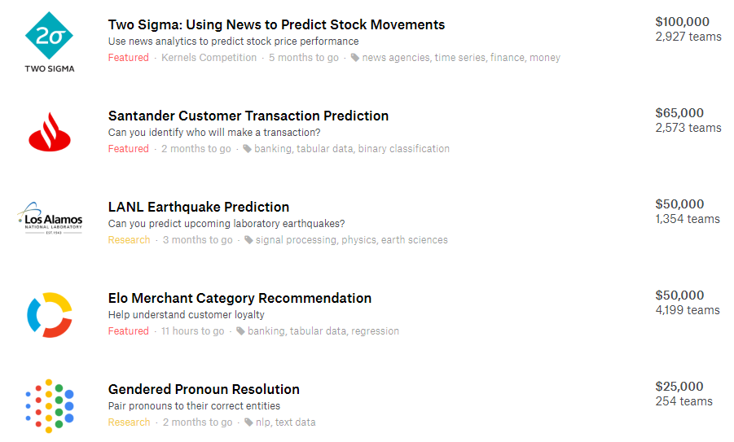
Some example Kaggle tasks
Notes:
Diabetic Retinopathy:糖尿病视网膜病

Slide 12
If the end date is later than June 28, report the position in the leaderboard;
Otherwise, TAs will define a train/test split and compare your methods with 1 or 2 baselines.

Slide 13
Questions?

