Slide 1
Assignment 3: create a SymbolicDictionary
Use Z3’s array theory to support Python’s dictionary (dict), modelling the following operations
Length: __length__(self)
Get: __getitem__(self,key)
Set: __setitem__(self,key,value)
Lookup: __contains__(self,key)
Should support SymbolicInteger as a key and a value
What about?
Delete: __delitem__(self,key)

Slide 2
Python
Program
object
SymbolicType
int
SymbolicObject
Loader
FunctionInvocation
SymbolicInteger
ExplorationEngine
PathToConstraint
Z3Expression
Z3Wrapper
Constraint
Predicate
Z3Integer
Z3BitVector

Slide 3
The Power of the Object Protocol
As long as code is using the Python object protocol, comparisons via SymbolicType will be visible
Example:
D = [ j for j in range(len(A)) if A[j] ]
if x in D # implies equality comparison of x against each element of D
Sometimes the runtime uses concrete value rather than object protocol (for efficiency)
if A[j] # j is cast out of object domain to a system32
print(self.toString())

Slide 4
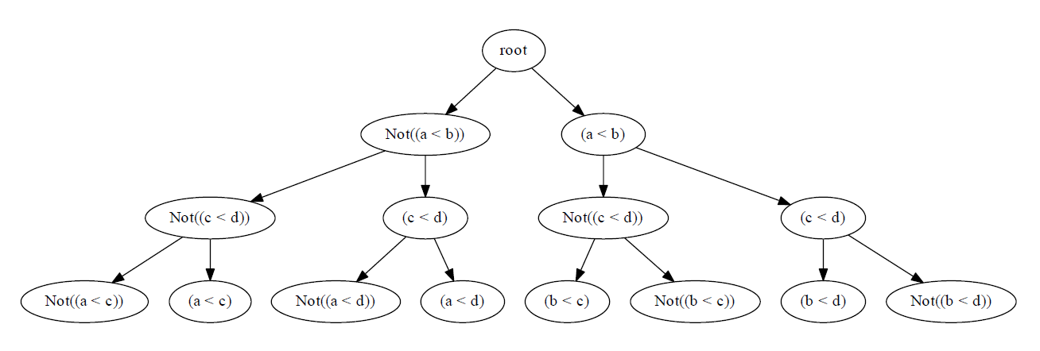
PathToConstraint
PathToConstraint
Translates execution path to a sequence of predicates (a constraint)
Receives notification from __bool__ interception of SymbolicType and concrete comparison result
Maintains tree of explored/unexplored constraints

