Slide 1
Assignments

Slide 2
Assignment 1
Download
Python 3.2.3 or later (http://www.python.org/)
Z3 'unstable’ for your platform (http://z3.codeplex.com/)
Git client (http://www.github.com/)
Clone https://github.com/thomasjball/PyExZ3.git
Or get the code I have on USB key for Windows (and Z3 for all platforms)
Write a Python function to encode n-bit multiplication using Z3 Bools (you can use PyExZ3\examples\adder.py)
Use Z3 to prove that your multiplier is equivalent to Z3’s BitVector multiplier (you can use PyExZ3\examples\check_adder.py)

Slide 3
Assignment 2
Get new PyExZ3 from me or from www.github.com/thomasjball
PyExZ3 regression tests should pass (python run_tests.py test)
Write and submit new test cases
At least one test case that passes
At least one that shows off a deficiency in the implementation
Send email with new tests to tball@microsoft.com - I will add to github

Slide 4
Assignment 3: create a SymbolicDictionary
Use Z3’s array theory to support Python’s dictionary (dict), modelling the following operations
Length: __length__(self)
Get: __getitem__(self,key)
Set: __setitem__(self,key,value)
Lookup: __contains__(self,key)
Should support SymbolicInteger as a key and a value
What about?
Delete: __delitem__(self,key)

Slide 5
Assignment 4
Add basic support for strings into PyExZ3
Using the theory of lists, how much can we do?
Constants
Concatenation (+)
Substring matching (and extraction?)

Slide 6
SFA axioms (Th(A))
Regex: \d+|[a-z]
Theory
SFA:
(y:List<Σ>)
Acc₀(y) ⬄ Acc₁(y) ∨ Acc₃(y)
Acc₁(y) ⬄ y≠[] ∧ ‘0’≤first(y)≤’9’ ∧ Acc₂(rest(y))
Acc₂(y) ⬄ y=[] ∨
(y≠[] ∧ ‘0’≤first(y)≤’9’ ∧ Acc₂(rest(y)))
Acc₃(y) ⬄ y≠[] ∧ ‘a’≤first(y)≤’z’ ∧ Acc₄(rest(y))
Acc₄(y) ⬄ y=[]
0≤ x ∧ x ≤9
0≤ x ∧ x ≤9
1
2
ε
0
a≤ x ∧ x ≤z
ε
3
4
Note: a move (p, ϕ[x], q) encodes the set of transitions
{(p, x^{M}, q) | M ⊧ ϕ[x]}

Slide 7
Code Review Design and Implementation of Dynamic Symbolic Execution (for Python, in Python)
https://github.com/thomasjball/PyExZ3

Slide 8
Classes
Identify the code under test (CUT)
Identify symbolic inputs
Reinterpret instructions
Trace the control flow
Collect path constraint
Generate new input from path constraint
Restart execution of CUT (from initial state)
Search strategy to expose new paths
Loader
FunctionInvocation
SymbolicType
SymbolicInteger
PathToConstraint
Constraint
Predicate
Z3Wrapper
ConcolicEngine

Slide 9
Python
Program
int
SymbolicType
Loader
FunctionInvocation
SymbolicInteger
ConcolicEngine
Z3Wrapper
PathToConstraint
Z3.py
Constraint
Predicate
Z3 SMT
Solver

Slide 10
Loader
Loader
FunctionInvocation
Uses reflection to
load the code under test and identify function entry point F
determine the number of arguments to F
Creates a FunctionInvocation object to encapsulate
entry point F and
symbolic argument values
Creates a SymbolicInteger for each argument
symbolic\loader.py

Slide 11
SymbolicType
SymbolicType
An abstract base class representing a pair of
a concrete value of type T
a symbolic value of type T (represented by an abstract syntax tree)
Overrides basic object operations:
Comparisons: __eq__, __ne__, __lt__, __le__, __gt__, __ge__
Coercion to Boolean: __bool__
symbolic\symbolic_types

Slide 12
SymbolicInteger
int
SymbolicType
SymbolicInteger
A SymbolicInteger is
a Python int, and
a SymbolicType
SymbolicInteger overloads arithmetic operations for which we know how to translate to logic and solver with Z3
For other operations, we default to concrete execution
symbolic\symbolic_types

Slide 14
Intercepting Control-flow in Python
Conditionals
if e1, while e1, e1 and e2 , e1 or e2, not e
Any object can be used in a conditional test
Python calls __bool__ method to get a Boolean from object
Used whenever a conditional test (predicate) encountered
We override __bool__ in order to intercept control-flow and determine which way predicate will evaluate (true, false)

Slide 15
The Power of the Object Protocol
As long as code is using the Python object protocol, comparisons via SymbolicType will be visible
Example:
D = [ j for j in range(len(A)) if A[j] ]
if x in D # implies equality comparison of x against each element of D
Sometimes the runtime uses concrete value rather than object protocol (for efficiency)
if A[j] # j is cast out of object domain to a system32
print(self.toString())

Slide 16
Predicate
Predicate
Tracks a Boolean expression in the program and which direction it took (T,F)

Slide 17
Constraint
Constraint
A sequence of predicates corresponding to an execution path

Slide 18
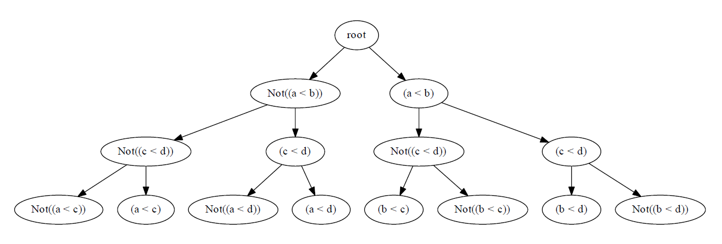
PathToConstraint
PathToConstraint
Translates execution path to a sequence of predicates (a constraint)
Receives notification from __bool__ interception of SymbolicType and concrete comparison result
Maintains tree of explored/unexplored constraints

Slide 19
Z3Wrapper
Z3Wrapper
Z3.py
Translate from AST expression (in SymbolicType) into Z3 expression
Z3 SMT
Solver

Slide 20
ConcolicEngine
ConcolicEngine
Generational search procedure
Uses a queue to perform breadth-first exploration of paths

