Slide 1


Automated Test Generation via SAT/SMT Solvers
Summer School, Marktoberdorf, 2014

Slide 2
Lecture 1
Automated Test Generation (ATG) and applications
SAT solving via DPLL
Encoding of basic (program) operations over bit vectors to SAT
Z3: SAT/SMT Solver (Python interface)
ATG of programs via reduction to SAT
From symbolic execution to dynamic symbolic execution

Slide 3
Lecture 2
Design and implementation of dynamic symbolic execution
for Python
in Python
Exercises and extensions for you to work on!

Slide 4
Lecture 3
On the power/limits of dynamic symbolic execution
Satisfiability modulo theories (SMT) solvers
Extending DSE for Python with SymbolicDict via array theory

Slide 5
Lecture 4
Strings, Regular Expressions and Symbolic Automata

Slide 6
Lecture 1
Automatic Test Generation
via
Dynamic Symbolic Execution

Slide 7
Automated (White Box) Test Generation
Given a program with a set of input parameters, automatically generate a set of input values that will cover as many statements/branches/paths as possible (or find as many bugs as possible)
Thanks to Patrice Godefroid, Nikolai Tillman

Slide 8
Applications
Security: Whitebox File Fuzzing (MSR’s SAGE)
Software development: Parameterized Unit Testing (MSR’s Pex)
Many others
Performance testing of operating systems (MIT’s Commuter)
Malware analysis (CMU/Berkeley’s BitScope)
Generate of worm filters (MSR’s Vigilante)

Slide 9
Zero to Crash in 10 Generations
00000000h: 00 00 00 00 00 00 00 00 00 00 00 00 00 00 00 00 ; ................
00000010h: 00 00 00 00 00 00 00 00 00 00 00 00 00 00 00 00 ; ................
00000020h: 00 00 00 00 00 00 00 00 00 00 00 00 00 00 00 00 ; ................
00000030h: 00 00 00 00 00 00 00 00 00 00 00 00 00 00 00 00 ; ................
00000040h: 00 00 00 00 00 00 00 00 00 00 00 00 00 00 00 00 ; ................
00000050h: 00 00 00 00 00 00 00 00 00 00 00 00 00 00 00 00 ; ................
00000060h: 00 00 00 00 ; ....
Generation 0 – seed file
Starting with 100 zero bytes …
SAGE generates a crashing test for Media1 parser:

Slide 10
Zero to Crash in 10 Generations
00000000h: 52 49 46 46 00 00 00 00 00 00 00 00 00 00 00 00 ; RIFF............
00000010h: 00 00 00 00 00 00 00 00 00 00 00 00 00 00 00 00 ; ................
00000020h: 00 00 00 00 00 00 00 00 00 00 00 00 00 00 00 00 ; ................
00000030h: 00 00 00 00 00 00 00 00 00 00 00 00 00 00 00 00 ; ................
00000040h: 00 00 00 00 00 00 00 00 00 00 00 00 00 00 00 00 ; ................
00000050h: 00 00 00 00 00 00 00 00 00 00 00 00 00 00 00 00 ; ................
00000060h: 00 00 00 00 ; ....
Generation 1
Starting with 100 zero bytes …
SAGE generates a crashing test for Media1 parser:

Slide 11
Zero to Crash in 10 Generations
00000000h: 52 49 46 46 00 00 00 00 ** ** ** 20 00 00 00 00 ; RIFF....*** ....
00000010h: 00 00 00 00 00 00 00 00 00 00 00 00 00 00 00 00 ; ................
00000020h: 00 00 00 00 00 00 00 00 00 00 00 00 00 00 00 00 ; ................
00000030h: 00 00 00 00 00 00 00 00 00 00 00 00 00 00 00 00 ; ................
00000040h: 00 00 00 00 00 00 00 00 00 00 00 00 00 00 00 00 ; ................
00000050h: 00 00 00 00 00 00 00 00 00 00 00 00 00 00 00 00 ; ................
00000060h: 00 00 00 00 ; ....
Generation 2
Starting with 100 zero bytes …
SAGE generates a crashing test for Media1 parser:

Slide 12
Zero to Crash in 10 Generations
00000000h: 52 49 46 46 3D 00 00 00 ** ** ** 20 00 00 00 00 ; RIFF=...*** ....
00000010h: 00 00 00 00 00 00 00 00 00 00 00 00 00 00 00 00 ; ................
00000020h: 00 00 00 00 00 00 00 00 00 00 00 00 00 00 00 00 ; ................
00000030h: 00 00 00 00 00 00 00 00 00 00 00 00 00 00 00 00 ; ................
00000040h: 00 00 00 00 00 00 00 00 00 00 00 00 00 00 00 00 ; ................
00000050h: 00 00 00 00 00 00 00 00 00 00 00 00 00 00 00 00 ; ................
00000060h: 00 00 00 00 ; ....
Generation 3
Starting with 100 zero bytes …
SAGE generates a crashing test for Media1 parser:

Slide 13
Zero to Crash in 10 Generations
00000000h: 52 49 46 46 3D 00 00 00 ** ** ** 20 00 00 00 00 ; RIFF=...*** ....
00000010h: 00 00 00 00 00 00 00 00 00 00 00 00 00 00 00 00 ; ................
00000020h: 00 00 00 00 00 00 00 00 00 00 00 00 00 00 00 00 ; ................
00000030h: 00 00 00 00 73 74 72 68 00 00 00 00 00 00 00 00 ; ....strh........
00000040h: 00 00 00 00 00 00 00 00 00 00 00 00 00 00 00 00 ; ................
00000050h: 00 00 00 00 00 00 00 00 00 00 00 00 00 00 00 00 ; ................
00000060h: 00 00 00 00 ; ....
Generation 4
Starting with 100 zero bytes …
SAGE generates a crashing test for Media1 parser:

Slide 14
Zero to Crash in 10 Generations
00000000h: 52 49 46 46 3D 00 00 00 ** ** ** 20 00 00 00 00 ; RIFF=...*** ....
00000010h: 00 00 00 00 00 00 00 00 00 00 00 00 00 00 00 00 ; ................
00000020h: 00 00 00 00 00 00 00 00 00 00 00 00 00 00 00 00 ; ................
00000030h: 00 00 00 00 73 74 72 68 00 00 00 00 76 69 64 73 ; ....strh....vids
00000040h: 00 00 00 00 00 00 00 00 00 00 00 00 00 00 00 00 ; ................
00000050h: 00 00 00 00 00 00 00 00 00 00 00 00 00 00 00 00 ; ................
00000060h: 00 00 00 00 ; ....
Generation 5
Starting with 100 zero bytes …
SAGE generates a crashing test for Media1 parser:

Slide 15
Zero to Crash in 10 Generations
00000000h: 52 49 46 46 3D 00 00 00 ** ** ** 20 00 00 00 00 ; RIFF=...*** ....
00000010h: 00 00 00 00 00 00 00 00 00 00 00 00 00 00 00 00 ; ................
00000020h: 00 00 00 00 00 00 00 00 00 00 00 00 00 00 00 00 ; ................
00000030h: 00 00 00 00 73 74 72 68 00 00 00 00 76 69 64 73 ; ....strh....vids
00000040h: 00 00 00 00 73 74 72 66 00 00 00 00 00 00 00 00 ; ....strf........
00000050h: 00 00 00 00 00 00 00 00 00 00 00 00 00 00 00 00 ; ................
00000060h: 00 00 00 00 ; ....
Generation 6
Starting with 100 zero bytes …
SAGE generates a crashing test for Media1 parser:
Notes:
Strf shows up here for the first time.
15

Slide 16
Zero to Crash in 10 Generations
00000000h: 52 49 46 46 3D 00 00 00 ** ** ** 20 00 00 00 00 ; RIFF=...*** ....
00000010h: 00 00 00 00 00 00 00 00 00 00 00 00 00 00 00 00 ; ................
00000020h: 00 00 00 00 00 00 00 00 00 00 00 00 00 00 00 00 ; ................
00000030h: 00 00 00 00 73 74 72 68 00 00 00 00 76 69 64 73 ; ....strh....vids
00000040h: 00 00 00 00 73 74 72 66 00 00 00 00 28 00 00 00 ; ....strf....(...
00000050h: 00 00 00 00 00 00 00 00 00 00 00 00 00 00 00 00 ; ................
00000060h: 00 00 00 00 ; ....
Generation 7
Starting with 100 zero bytes …
SAGE generates a crashing test for Media1 parser:

Slide 17
Zero to Crash in 10 Generations
00000000h: 52 49 46 46 3D 00 00 00 ** ** ** 20 00 00 00 00 ; RIFF=...*** ....
00000010h: 00 00 00 00 00 00 00 00 00 00 00 00 00 00 00 00 ; ................
00000020h: 00 00 00 00 00 00 00 00 00 00 00 00 00 00 00 00 ; ................
00000030h: 00 00 00 00 73 74 72 68 00 00 00 00 76 69 64 73 ; ....strh....vids
00000040h: 00 00 00 00 73 74 72 66 00 00 00 00 28 00 00 00 ; ....strf....(...
00000050h: 00 00 00 00 00 00 00 00 00 00 00 00 C9 9D E4 4E ; ............ÉäN
00000060h: 00 00 00 00 ; ....
Generation 8
Starting with 100 zero bytes …
SAGE generates a crashing test for Media1 parser:

Slide 18
Zero to Crash in 10 Generations
00000000h: 52 49 46 46 3D 00 00 00 ** ** ** 20 00 00 00 00 ; RIFF=...*** ....
00000010h: 00 00 00 00 00 00 00 00 00 00 00 00 00 00 00 00 ; ................
00000020h: 00 00 00 00 00 00 00 00 00 00 00 00 00 00 00 00 ; ................
00000030h: 00 00 00 00 73 74 72 68 00 00 00 00 76 69 64 73 ; ....strh....vids
00000040h: 00 00 00 00 73 74 72 66 00 00 00 00 28 00 00 00 ; ....strf....(...
00000050h: 00 00 00 00 00 00 00 00 00 00 00 00 01 00 00 00 ; ................
00000060h: 00 00 00 00 ; ....
Generation 9
Starting with 100 zero bytes …
SAGE generates a crashing test for Media1 parser:

Slide 19
Zero to Crash in 10 Generations
00000000h: 52 49 46 46 3D 00 00 00 ** ** ** 20 00 00 00 00 ; RIFF=...*** ....
00000010h: 00 00 00 00 00 00 00 00 00 00 00 00 00 00 00 00 ; ................
00000020h: 00 00 00 00 00 00 00 00 00 00 00 00 00 00 00 00 ; ................
00000030h: 00 00 00 00 73 74 72 68 00 00 00 00 76 69 64 73 ; ....strh....vids
00000040h: 00 00 00 00 73 74 72 66 B2 75 76 3A 28 00 00 00 ; ....strf²uv:(...
00000050h: 00 00 00 00 00 00 00 00 00 00 00 00 01 00 00 00 ; ................
00000060h: 00 00 00 00 ; ....
Generation 10
Starting with 100 zero bytes …
SAGE generates a crashing test for Media1 parser:
Notes:
Recall that MSRC 7051 was an error in validating the length field of strf records.
19

Slide 20
Example
void top(char input[4])
{
int cnt = 0;
if (input[0] == ‘b’) cnt++;
if (input[1] == ‘a’) cnt++;
if (input[2] == ‘d’) cnt++;
if (input[3] == ‘!’) cnt++;
if (cnt >3) crash();
}
input = “good”
Path constraint:
I₀!=‘b’
bood
→ I₀=‘b’
I₁!=‘a’
gaod
→ I₁=‘a’
→ I₂=‘d’
I₂!=‘d’
godd
→ I₃=‘!’
I₃!=‘!’
goo!
good
Gen 1
Negate each constraint in path constraint
Solve new constraint → new input
Notes:
20

Slide 21
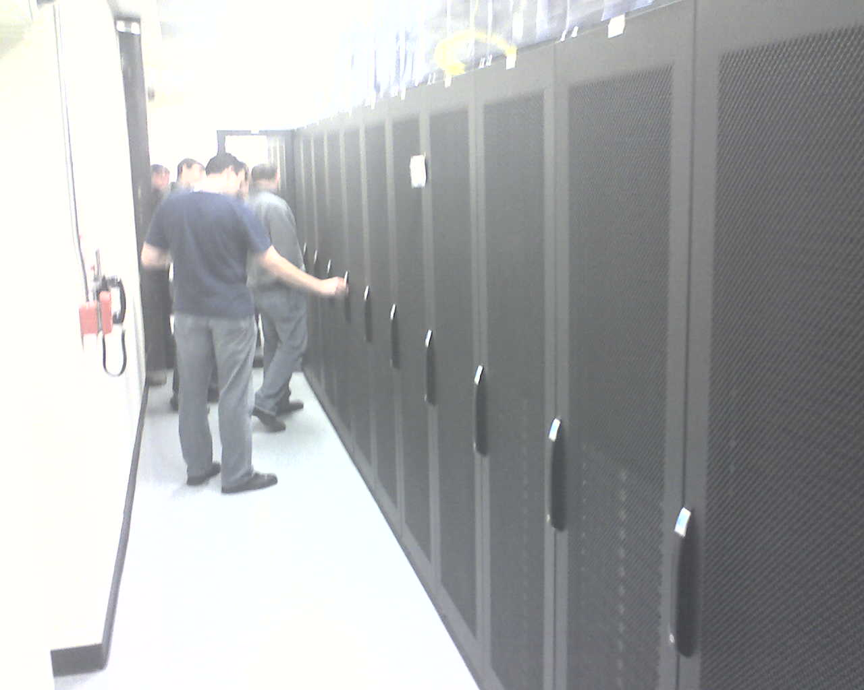
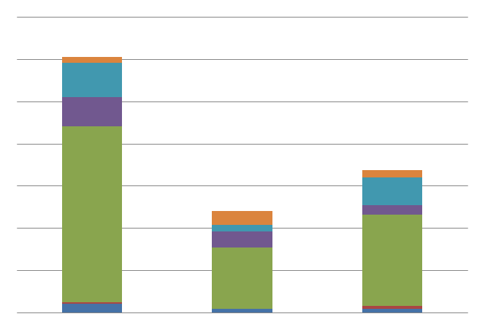
Whitebox File Fuzzing
SAGE @ Microsoft:
1st whitebox fuzzer for security testing
400+ machine years (since 2008) →
3.4+ Billion constraints
100s of apps, 100s of security bugs
Example: Win7 file fuzzing
~1/3 of all fuzzing bugs found by SAGE →
(missed by everything else…)
Bug fixes shipped (quietly) to 1 Billion+ PCs
Millions of dollars saved
for Microsoft + time/energy for the world
How fuzzing bugs were found
(Win7, 2006-2009) :
Blackbox
Fuzzing
+ Regression
All Others
SAGE
Notes:
Test generation is big business
What is the #1 application of SMT solvers today measured by CPU usage? Test Generation
Specifically, at Microsoft, we are using this tool named SAGE for finding security bugs using automatic test generation techniques
Missed by static analysis, blackbox fuzzing
Bug fixes shipped quietly (no MSRCs) to 1 Billion+ PCs

Slide 22
Whitebox Testing and Satisfiability (SAT)
Testing
SAT
Source
Program
Boolean formula
Is there an input that covers some statement?
Is there a satisfying assignment?
Question
Complexity
Undecidable
NP-complete

Slide 23
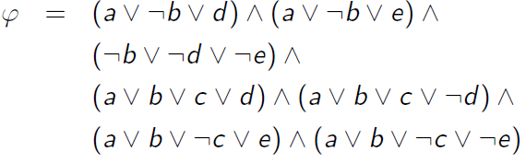
Propositional Formula (CNF)

Slide 24
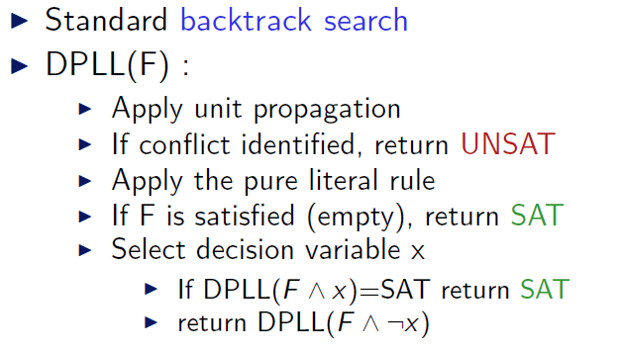
SAT Solving via DPLL

Slide 25
DPLL (example)

Slide 26
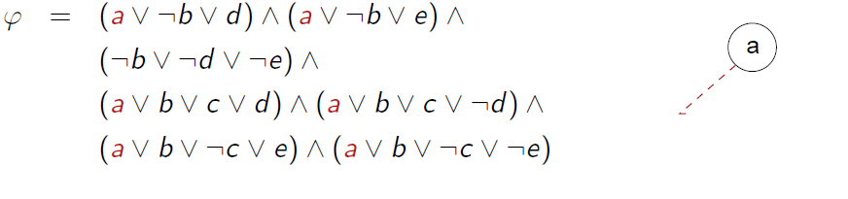
DPLL (example)

Slide 27
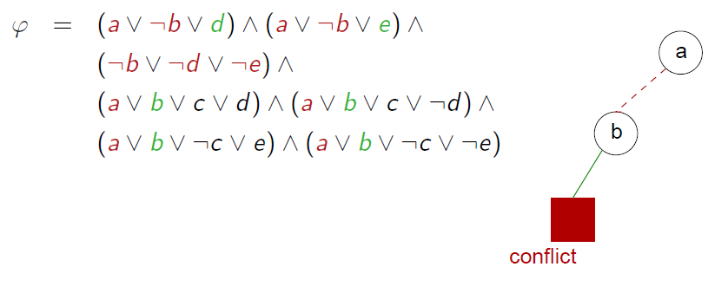
DPLL (example)

Slide 28
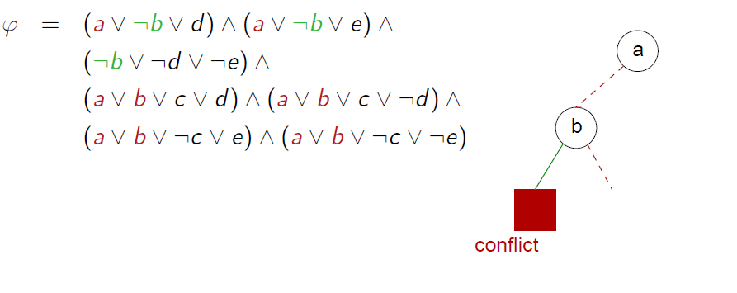
DPLL (example)

Slide 29
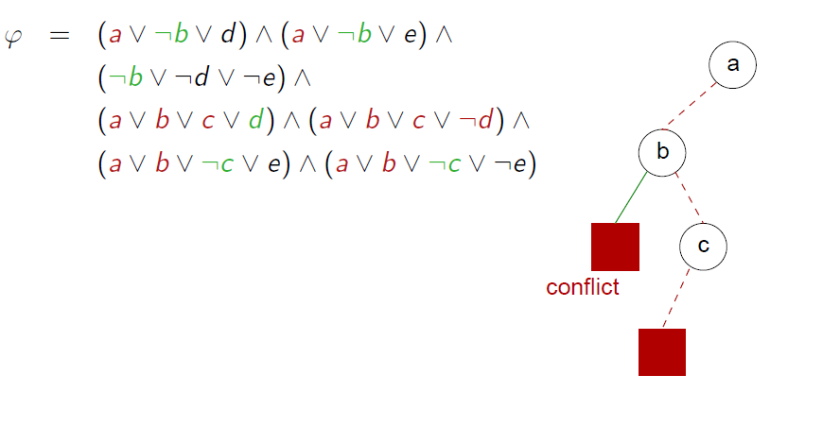
DPLL (example)

Slide 30
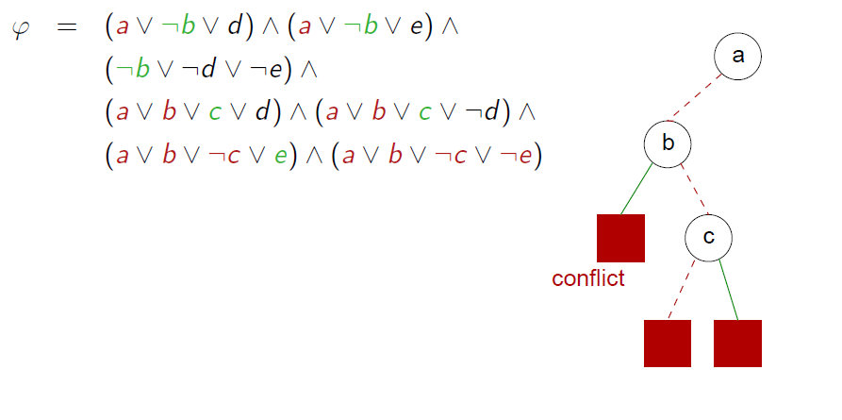
DPLL (example)

Slide 31
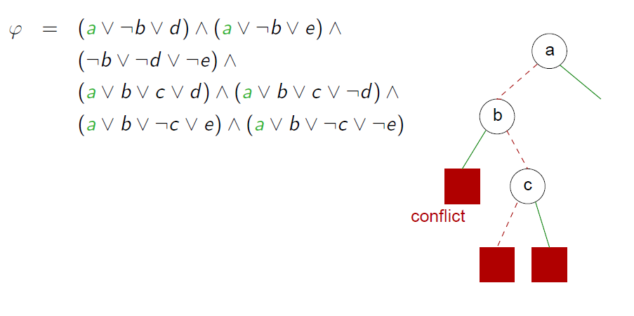
DPLL (example)

Slide 32
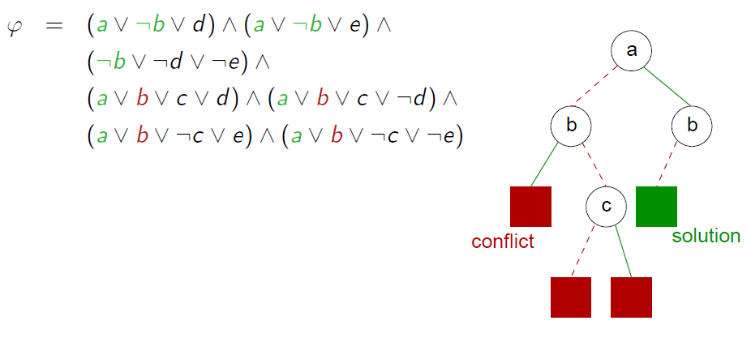
DPLL (example)

Slide 33
Bit-vector / Machine arithmetic
Let x, y and z be 8-bit (unsigned) integers.
Is x > 0 ∧ y > 0 ∧ z = x + y ⇒ z > 0
valid?
equivalently,
Is x > 0 ∧ y > 0 ∧ z = x + y ∧ ¬(z > 0)
unsatisfiable?
from z3 import *
x = BitVec("x",8)
y = BitVec("y",8)
z = BitVec("z",8)
s = Solver()
s.add(UGT(x,0),UGT(y,0),z==x+y)
s.add(Not(UGT(z,0)))
result = s.check()
if result == sat:
print(s.model())
else:
print(result)

Slide 34
Bit-vector / Machine arithmetic
We can encode bit-vector satisfiability problems in propositional logic.
Idea 1:
Use n propositional variables to encode n-bit integers.
x → (x₁, …, x_{n})
Idea 2:
Encode arithmetic operations using hardware circuits.

Slide 35
Encoding equality
p ⇔ q is equivalent to (¬p ∨ q) ∧ (¬q ∨ p)
The bit-vector equation x = y is encoded as:
(x₁ ⇔ y₁) ∧ … ∧ (x_{n} ⇔ y_{n})

Slide 36
Encoding addition
We use (r₁, …, r_{n}) to store the result of x + y
p xor q is defined as ¬(p ⇔ q)
xor is the 1-bit adder
carry
p | q | p xor q | p ∧ q
0 | 0 | 0 | 0
1 | 0 | 1 | 0
0 | 1 | 1 | 0
1 | 1 | 0 | 1

Slide 37
Encoding 1-bit full adder
1-bit full adder
Three inputs: x, y, c_{in}
Two outputs: r, c_{out}
x | y | c_{in} | r = x xor y xor c_{in} | c_{out} = (x ∧ y)∨(x ∧ c_{in})∨(y ∧ c_{in})
0 | 0 | 0 | 0 | 0
1 | 0 | 0 | 1 | 0
0 | 1 | 0 | 1 | 0
1 | 1 | 0 | 0 | 1
0 | 0 | 1 | 1 | 0
1 | 0 | 1 | 0 | 1
0 | 1 | 1 | 0 | 1
1 | 1 | 1 | 1 | 1

Slide 38
Encoding n-bit adder
We use (r₁, …, r_{n}) to store the result of x + y,
r₁ ⇔ (x₁ xor y₁)
c₁ ⇔ (x₁ ∧ y₁)
r₂ ⇔ (x₂ xor y₂ xor c₁)
c₂ ⇔ (x₂ ∧ y₂) ∨ (x₂ ∧ c₁) ∨ (y₂ ∧ c₁)
…
r_{n} ⇔ (x_{n} xor y_{n} xor c_{n-1})
c_{n} ⇔ (x_{n} ∧ y_{n}) ∨ (x_{n} ∧ c_{n-1}) ∨ (y_{n} ∧ c_{n-1})

Slide 39
Whitebox Testing and Satisfiability (SAT)
Testing
SAT
Source
Program
Boolean formula
Is there an input that covers some statement?
Is there a satisfying assignment?
Question
Complexity
Undecidable
NP-complete

Slide 40
Reduction of Program Testing to SAT: Bounds!
Unbounded number of execution paths?
Explicit enumeration/exploration of program paths
Bound the number of paths explored
Unbounded execution path length?
Bound the input size and/or path length
Bounded exploration
enables conversion of a program path to a (finite) logic formula

Slide 41
Symbolic Execution
Exploration of all feasible execution paths:
Start execution from initial state with symbolic values for all input
Program operations yield terms over symbolic values
At conditional branch, fork execution for each feasible evaluation of the condition
For each path, we get an accumulated path condition
For each path, check if path condition is satisfiable and generate input
See: [King76]
if (p) then … else …
C
p
true
false
C’=C⋀p
C’=C⋀⌝p
Notes:
A very old idea from the 70ties.

Slide 42
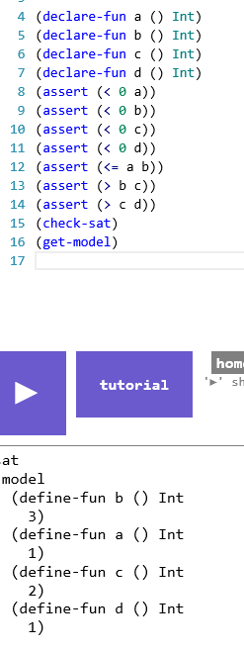
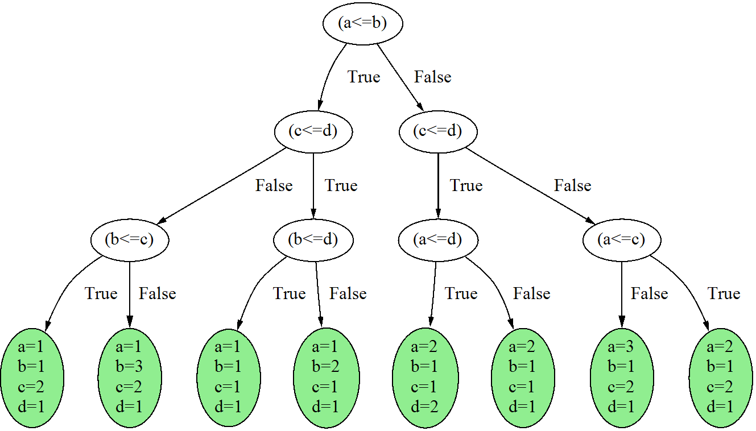
Symbolic Execution Illustrated
int Max(int a, int b, int c, int d) {
return Max(Max(a, b), Max(c, d));
}
int Max(int x, int y) {
if (x <= y) return y;
else return x;
}

Slide 43
Many problems remain
Code that is hard to analyze
Path explosion
Loops
Procedures
Environment (what are the inputs to the program under test?)
pointers, data structures, …
files, data bases, …
threads, thread schedules, …
sockets, …

Slide 44
1. Code that is hard to analyze
int obscure(int x, int y) {
if (x==complex(y)) error();
return 0;
}
May be very hard to statically generate values for x and y
that satisfy “x==complex(y)” !
Sources of complexity:
Virtual functions (function pointers)
Cryptographic functions
Non-linear integer or floating point arithmetic
Calls to kernel mode
…

Slide 45
Directed Automated Random Testing [PLDI 2005]
Run 1 :
- start with (random) x=33, y=42
execute concretely and symbolically:
if (33 != 567) | if (x != complex(y))
int obscure(int x, int y) {
if (x==complex(y)) error();
return 0;
}
constraint too complex
→ simplify it: x != 567
solve: x==567 → solution: x=567
- new test input: x=567, y=42
Run 2 : the other branch is executed
All program paths are now covered !
Also known as concolic execution (concrete + symbolic)
Referred to here as dynamic symbolic execution

Slide 46
Dynamic Symbolic Execution
Choose next path
Code to generate inputs for:
Solve
Execute&Monitor
void CoverMe(int[] a)
{
if (a == null) return;
if (a.Length > 0)
if (a[0] == 1234567890)
throw new Exception("bug");
}
Constraints to solve
a!=null
a!=null &&
a.Length>0
a!=null &&
a.Length>0 &&
a[0]==1234567890
Data
null
{}
{0}
{123…}
Observed constraints
a==null
a!=null &&
!(a.Length>0)
a!=null &&
a.Length>0 &&
a[0]!=1234567890
a!=null &&
a.Length>0 &&
a[0]==1234567890
a==null
F
T
a.Length>0
F
T
Done: There is no path left.
a[0]==123…
F
T

Slide 47
Dynamic Symbolic Execution The high-level algorithm
Formula F := False
Loop
Find program input i in solve(negate(F)) // stop if no such i can be found
Execute P(i); record path condition C // in particular, C(i) holds
F := F \/ C
End
Notes:
Note that neg(F) is in CNF!

Slide 48
Dynamic Symbolic Execution: many implementations
Defined by execution environment / programming language, symbolic execution precision, and constraint solving
Execution environment: C, Java, x86, .NET,…
Precision: linear vs. non-linear arithmetic, “gods integers” vs. bitvectors, concrete heap vs. symbolic heap., floating-point values, etc.
Solvers: lp_solve, CVCLite, STP, Disolver, Z3,…
Examples of DSE implementations:
DART (Bell Labs), and also CUTE “concolic execution”
EXE/EGT/KLEE (Stanford) “constraint-based execution”
Vigilante (Microsoft) to generate worm filters
BitScope (CMU/Berkeley) for malware analysis
Sage (Microsoft) for security testing of X86 code
Yogi (Microsoft) to verify device drivers (integrated in SLAM)
Pex (Microsoft) for parameterized unit testing of .NET code
CREST, jCUTE, jFuzz, …
Notes:
[Vigilante: given an execution trace where an attack is observed, Vigilante attempts to generate alternative executions traces witnessing the same attack; and then blocks all these inputs.]

Slide 49
Recap: Test Generation using SAT solvers
SAT solving is
NP-complete
Initially, choose arbitrary
Test Inputs
Constraint System
Execution Path
Known Paths
Reachability is undecidable!

Slide 50
References
James C. King, Symbolic execution and program testing, Communications of the ACM, v.19 n.7, p.385-394, July 1976
João P. Marques Silva, Karem A. Sakallah: GRASP: A Search Algorithm for Propositional Satisfiability. IEEE Trans. Computers 48(5): 506-521 (1999)
Patrice Godefroid, Nils Klarlund, Koushik Sen: DART: directed automated random testing. PLDI 2005: 213-223
Nikolai Tillmann, Wolfram Schulte: Parameterized unit tests. ESEC/SIGSOFT FSE 2005: 253-262
Leonardo de Moura, Nikolaj Bjørner: Z3: An Efficient SMT Solver. TACAS 2008: 337-340
Cristian Cadar, Daniel Dunbar, Dawson R. Engler: KLEE: Unassisted and Automatic Generation of High-Coverage Tests for Complex Systems Programs. OSDI 2008: 209-224
Dries Vanoverberghe, Nikolai Tillmann, Frank Piessens: Test Input Generation for Programs with Pointers. TACAS 2009: 277-291
Kenneth L. McMillan: Lazy Annotation for Program Testing and Verification. CAV 2010: 104-118
Ella Bounimova, Patrice Godefroid, David A. Molnar: Billions and billions of constraints: whitebox fuzz testing in production. ICSE 2013: 122-131

Slide 51
Assignment 1
Download
Python 3.2.3 or later (http://www.python.org/)
Z3 'unstable’ for your platform (http://z3.codeplex.com/)
Git client (http://www.github.com/)
Clone https://github.com/thomasjball/PyExZ3.git
Or get the code I have on USB key for Windows (and Z3 for all platforms)
Write a Python function to encode n-bit multiplication using Z3 Bools (you can use PyExZ3\examples\adder.py)
Use Z3 to prove that your multiplier is equivalent to Z3’s BitVector multiplier (you can use PyExZ3\examples\check_adder.py)

