Slide 2
Directed Automated Random Testing [PLDI 2005]
Run 1 :
- start with (random) x=33, y=42
execute concretely and symbolically:
if (33 != 567) | if (x != complex(y))
int obscure(int x, int y) {
if (x==complex(y)) error();
return 0;
}
constraint too complex
→ simplify it: x != 567
solve: x==567 → solution: x=567
- new test input: x=567, y=42
Run 2 : the other branch is executed
All program paths are now covered !
Also known as concolic execution (concrete + symbolic)
Referred to here as dynamic symbolic execution

Slide 3
Dynamic Symbolic Execution The high-level algorithm
Formula F := False
Loop
Find program input i in solve(negate(F)) // stop if no such i can be found
Execute P(i); record path condition C // in particular, C(i) holds
F := F \/ C
End
Notes:
Note that neg(F) is in CNF!

Slide 4
Lecture 2 Design and Implementation of Dynamic Symbolic Execution (for Python, in Python)
https://github.com/thomasjball/PyExZ3

Slide 5
The Code
Derived from the NICE project (http://code.google.com/p/nice-of/)
Ported to use Z3 (instead of STP)
Removed platform dependences (should run on Linux, MacOS, etc.)
DSE hooks solely via method overloading
No AST rewriting
No bytecode interpretation
Made error checking more robust
Added more regression tests

Slide 7
Requirements
Identify the code under test (CUT)
Identify symbolic inputs
Trace the CUT
Reinterpret instructions to compute symbolic expressions
Collect path constraint
Generate new input
Restart execution of CUT (from initial state)
Search strategy to expose new paths

Slide 8
Classes
Identify the code under test (CUT)
Identify symbolic inputs
Trace the CUT
Reinterpret instructions
Collect path constraint
Generate new input from path constraint
Restart execution of CUT (from initial state)
Search strategy to expose new paths
Loader
FunctionInvocation
SymbolicType
SymbolicInteger
PathToConstraint
Constraint
Predicate
Z3Wrapper
ConcolicEngine

Slide 9
Python
Program
int
SymbolicType
Loader
FunctionInvocation
SymbolicInteger
ConcolicEngine
Z3Wrapper
PathToConstraint
Z3.py
Constraint
Predicate
Z3 SMT
Solver

Slide 10
Loader
Loader
Uses reflection to
load the code under test and identify function entry point F
determine the number of arguments to F
Creates a SymbolicInteger for each argument
Creates a FunctionInvocation object to encapsulate
entry point F and
symbolic argument values
symbolic\loader.py

Slide 11
SymbolicType
SymbolicType
An abstract base class representing a pair of
a concrete value of type T
a symbolic value of type T
Overrides basic object operations:
Comparisons: __eq__, __ne__, __lt__, __le__, __gt__, __ge__
Coercion to Boolean: __bool__
symbolic\symbolic_types

Slide 12
SymbolicInteger
SymbolicInteger
A SymbolicInteger is
a Python int, and
a SymbolicType
SymbolicInteger overloads arithmetic operations for which we know how to translate to logic and solver with Z3
symbolic\symbolic_types

Slide 14
Intercepting Control-flow in Python
Conditionals
if e1, while e1, e1 and e2 , e1 or e2, not e
Any object can be used in a conditional test
Python calls __bool__ method to get a Boolean from object
Used whenever a conditional test (predicate) encountered
We override __bool__ in order to intercept control-flow and determine which way predicate will evaluate (true, false)

Slide 15
Predicate
Predicate
Tracks a predicate in the program and which direction it took (T,F)

Slide 16
Constraint
Constraint
A sequence of predicates corresponding to an execution path

Slide 17
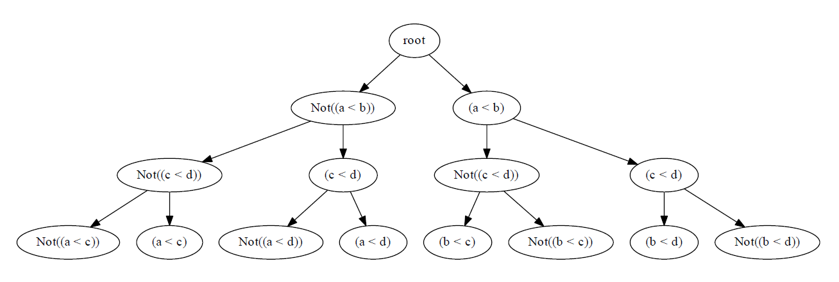
PathToConstraint
PathToConstraint
Translates execution path to a sequence of predicates (a constraint)
Receives notification from __bool__ interception of SymbolicType and concrete comparison result
Maintains tree of explored/unexplored constraints

Slide 18
Z3Wrapper
Z3Wrapper
Translate from AST expression (in SymbolicType) into Z3 expression

Slide 19
Python Semantics -> Logic
Python integers
Python’s integer representation grows to limits of machine memory
Arithmetic operations do not cause overflows!
Z3 BitVectors
Z3 BitVectors have finite width (they do not grow)
Arithmetic operations do cause overflows…

Slide 20
Given a Diophantine equation with any number of unknown quantities and with rational integral numerical coefficients: To devise a process according to which it can be determined in a finite number of operations whether the equation is solvable in rational integers.
There is a polynomial p(a,x1,…xn) with integer coefficients such that
the set of values of a for which p(a,x1,…xn) = 0
has solutions in the natural numbers is not computable.

Slide 23
ConcolicEngine
ConcolicEngine
Generational search procedure

Slide 24
Python
Program
int
SymbolicType
Loader
FunctionInvocation
SymbolicInteger
ConcolicEngine
Z3Wrapper
PathToConstraint
Z3.py
Constraint
Predicate
Z3 SMT
Solver

Slide 25
Deficiencies
One process, many executions
Clean restart of state problematic
Means we may not be able to control program to go where we want it to…
Path divergence
Poor handling of while loops
Take whileloop.py and remove “0 < x < 10”

Slide 26
Assignment 2
Get new PyExZ3 from me or from www.github.com/thomasjball
PyExZ3 regression tests should pass
Write and submit new test cases
At least one test case that passes
At least one that shows off a deficiency in the implementation
Send email with new tests to tball@microsoft.com - I will add to github

