Slide 1
Lecture 3
On the power/limits of dynamic symbolic execution
(from “Higher-order test generation”, Patrice Godefroid PLDI 2011)
Powering up DSE with Satisfiability Modulo Theories
Thanks to Patrice Godefroid, Leonardo de Moura

Slide 3
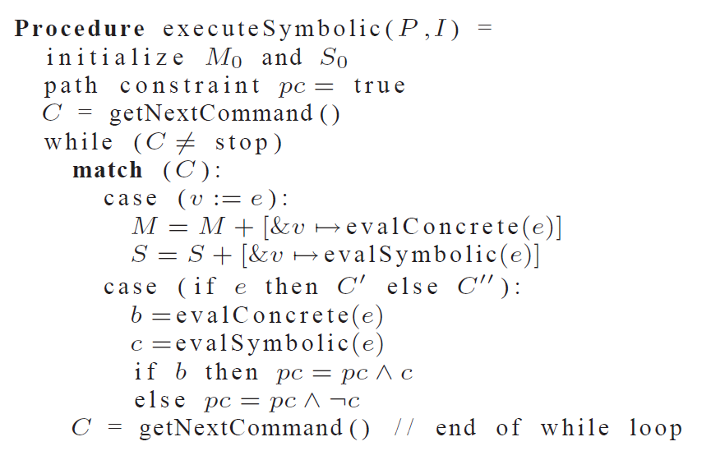

Slide 4
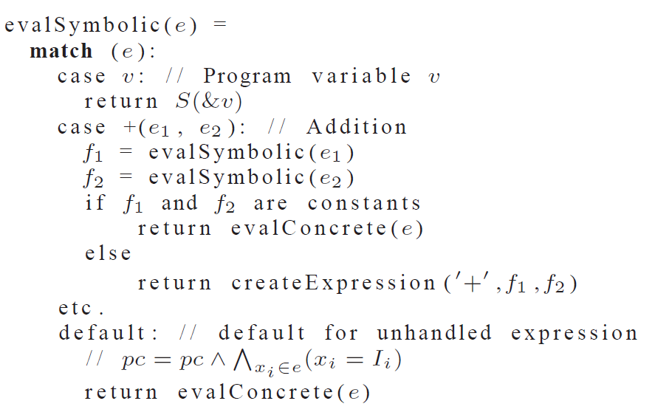

Slide 5
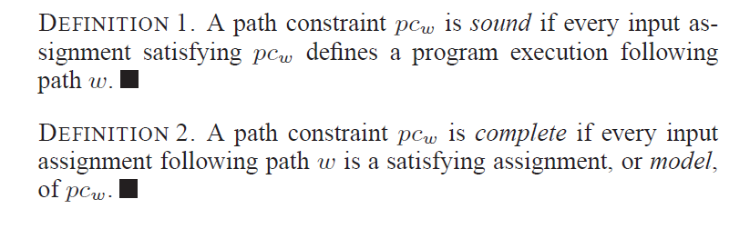

Slide 9
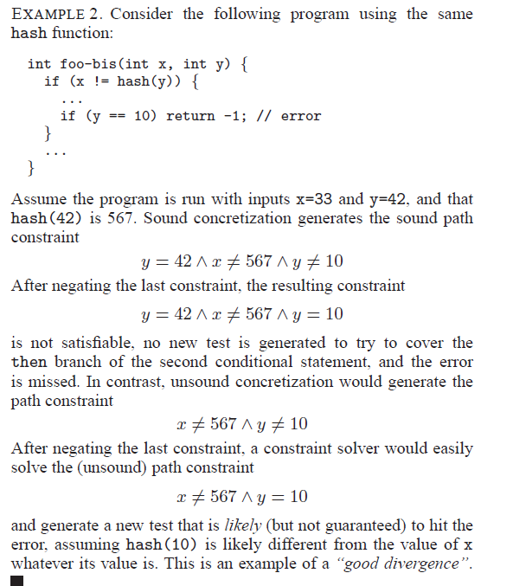

Slide 10
Satisfiability Modulo Theories (SMT)
Is formula F satisfiable modulo theory T ?
SMT solvers have specialized algorithms for T

Slide 11
Satisfiability Modulo Theories (SMT)
b + 2 = c and f(read(write(a,b,3), c-2)) ≠ f(c-b+1)

Slide 12
Satisfiability Modulo Theories (SMT)
b + 2 = c and f(read(write(a,b,3), c-2)) ≠ f(c-b+1)
Arithmetic

Slide 13
Satisfiability Modulo Theories (SMT)
b + 2 = c and f(read(write(a,b,3), c-2)) ≠ f(c-b+1)
Array Theory
Arithmetic

Slide 14
Satisfiability Modulo Theories (SMT)
b + 2 = c and f(read(write(a,b,3), c-2)) ≠ f(c-b+1)
Uninterpreted Functions
Array Theory
Arithmetic

Slide 15
Satisfiability Modulo Theories (SMT)
b + 2 = c and f(read(write(a,b,3), c-2)) ≠ f(c-b+1)
Substituting c by b+2

Slide 16
Satisfiability Modulo Theories (SMT)
b + 2 = c and f(read(write(a,b,3), b+2-2)) ≠ f(b+2-b+1)
Simplifying

Slide 17
Satisfiability Modulo Theories (SMT)
b + 2 = c and f(read(write(a,b,3), b)) ≠ f(3)

Slide 18
Satisfiability Modulo Theories (SMT)
b + 2 = c and f(read(write(a,b,3), b)) ≠ f(3)
Applying array theory axiom
forall a,i,v: read(write(a,i,v), i) = v

Slide 19
Satisfiability Modulo Theories (SMT)
b + 2 = c and f(3) ≠ f(3)
Inconsistent

Slide 20

SMT : Basic Architecture
SAT
Theory
Solvers
SMT
Equality + UF
Arithmetic
Bit-vectors
…
Case Analysis

Slide 21
DPLL
The Davis–Putnam–Logemann–Loveland (DPLL) algorithm tries to find a satisfying assignment for logic formulae in conjunctive normal form (CNF).
DPLL is a complete, backtracking-based search algorithm for deciding the satisfiability of propositional logic formulae in conjunctive normal form.

Slide 22
DPLL (abstract view)
evolving
M | F
Partial model
Set of clauses

Slide 23
DPLL (abstract view)
Guessing
p | p ∨ q, ¬q ∨ r
p, ¬q | p ∨ q, ¬q ∨ r

Slide 24
DPLL (abstract view)
Deducing
p | p ∨ q, ¬p ∨ s
p, s| p ∨ q, ¬p ∨ s

Slide 25
DPLL (abstract view)
Backtracking
p, ¬s, q | p ∨ q, s ∨ q, ¬p∨ ¬q
p, s| p ∨ q, s ∨ q, ¬p∨ ¬q

Slide 26
SAT + Theory solvers
Basic Idea
x ≥ 0, y = x + 1, (y > 2 ∨ y < 1)
Abstract (aka “naming” atoms)
p₁, p₂, (p₃ ∨ p₄)
p₁ ≡ (x ≥ 0), p₂ ≡ (y = x + 1),
p₃ ≡ (y > 2), p₄ ≡ (y < 1)

Slide 27
SAT + Theory solvers
Basic Idea
x ≥ 0, y = x + 1, (y > 2 ∨ y < 1)
Abstract (aka “naming” atoms)
p₁, p₂, (p₃ ∨ p₄)
p₁ ≡ (x ≥ 0), p₂ ≡ (y = x + 1),
p₃ ≡ (y > 2), p₄ ≡ (y < 1)
SAT
Solver

Slide 28
SAT + Theory solvers
Basic Idea
x ≥ 0, y = x + 1, (y > 2 ∨ y < 1)
Abstract (aka “naming” atoms)
p₁, p₂, (p₃ ∨ p₄)
p₁ ≡ (x ≥ 0), p₂ ≡ (y = x + 1),
p₃ ≡ (y > 2), p₄ ≡ (y < 1)
SAT
Solver
Assignment
p₁, p₂, ¬p₃, p₄

Slide 29
SAT + Theory solvers
Basic Idea
x ≥ 0, y = x + 1, (y > 2 ∨ y < 1)
Abstract (aka “naming” atoms)
p₁, p₂, (p₃ ∨ p₄)
p₁ ≡ (x ≥ 0), p₂ ≡ (y = x + 1),
p₃ ≡ (y > 2), p₄ ≡ (y < 1)
SAT
Solver
Assignment
p₁, p₂, ¬p₃, p₄
x ≥ 0, y = x + 1,
¬(y > 2), y < 1

Slide 30
SAT + Theory solvers
Basic Idea
x ≥ 0, y = x + 1, (y > 2 ∨ y < 1)
Abstract (aka “naming” atoms)
p₁, p₂, (p₃ ∨ p₄)
p₁ ≡ (x ≥ 0), p₂ ≡ (y = x + 1),
p₃ ≡ (y > 2), p₄ ≡ (y < 1)
SAT
Solver
Assignment
p₁, p₂, ¬p₃, p₄
x ≥ 0, y = x + 1,
¬(y > 2), y < 1
Unsatisfiable
x ≥ 0, y = x + 1, y < 1
Theory
Solver

Slide 31
SAT + Theory solvers
Basic Idea
x ≥ 0, y = x + 1, (y > 2 ∨ y < 1)
Abstract (aka “naming” atoms)
p₁, p₂, (p₃ ∨ p₄)
p₁ ≡ (x ≥ 0), p₂ ≡ (y = x + 1),
p₃ ≡ (y > 2), p₄ ≡ (y < 1)
SAT
Solver
Assignment
p₁, p₂, ¬p₃, p₄
x ≥ 0, y = x + 1,
¬(y > 2), y < 1
New Lemma
¬p₁∨¬p₂∨¬p₄
Unsatisfiable
x ≥ 0, y = x + 1, y < 1
Theory
Solver

Slide 32
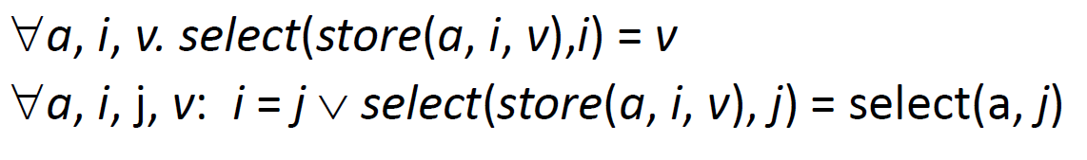
Array Theory
c:\Program Files (x86)\XEmacs\XEmacs-21.4.22\i586-pc-win32\

Slide 33
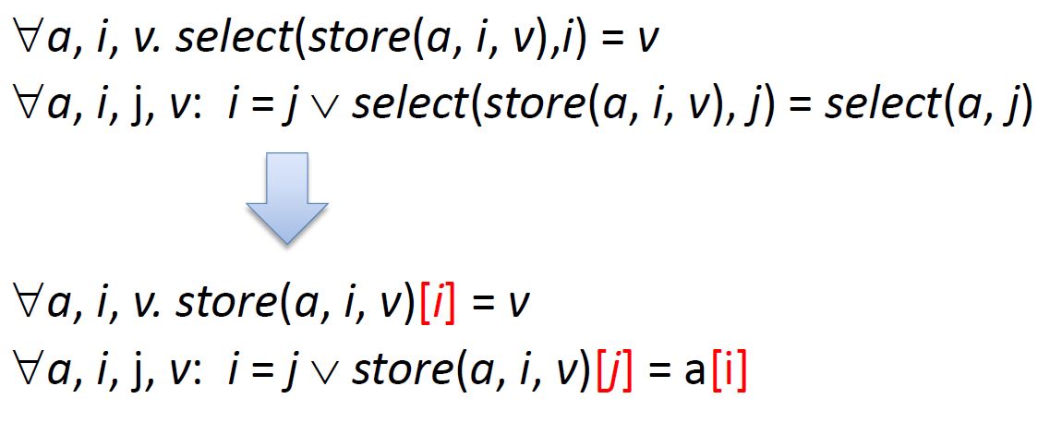
Array Theory: a more familiar notation
c:\Program Files (x86)\XEmacs\XEmacs-21.4.22\i586-pc-win32\

Slide 34
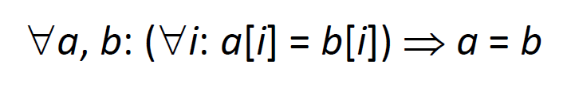
Extentional Array Theory

Slide 35
Arrays are actually “maps”
We have arrays from D to R
D does not need to be the Integers

Slide 36
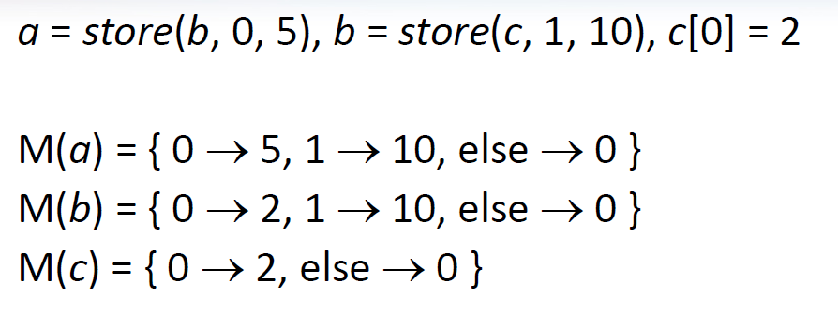
Models for arrays are “finite graphs”

Slide 37
Z3 API for Arrays
Array(name,dom,range)
Select(a,i)
Update(a,i,v)

Slide 38
Assignment: create a SymbolicDictionary
Use Z3’s array theory to support Python’s dictionary (dict), modelling the following operations
Length: __length__(self)
Get: __getitem__(self,key)
Set: __setitem__(self,key,value)
Lookup: __contains__(self,key)
Should support SymbolicInteger as a key and a value
What about?
Delete: __delitem__(self,key)

