Slide 1
Assignment Update
We have our first pull requests with passing/failing programs
thanks to Jakub Z., Daniel D., and Thomas P.
Tutorial (code review) on Wednesday at 13:30-14:15
we will start on an implementation of SymbolicDictionary
I soon will write a paper on dynamic symbolic execution, including your contributions
Acknowledgements for people who submit passing/failing tests
Co-authorship for people who contribute significant idea or code contribution
New symbolic data type
Fix of failing tests (improve coverage)
…

Slide 2
An interesting test case: saga of control/data
A = [0, 1]
def arrayindex(a):
if A[a]:
return A[a]
else:
return "OTHER"

Slide 3
Since A is finite and iterable, we can invert it!
A = [0, 1]
def arrayindex2(a):
b = false
for x in A if A[x]:
b = b or (a==x)
if b:
return A[a]
else:
return "OTHER"
A = [0, 1]
def arrayindex(a):
if A[a]:
return A[a]
else:
return "OTHER"

Slide 4
The need for applying multiple theories of integer arithmetic
In Python, (a+1 < a) never evaluates to true
Using BitVectors it takes too much time to “prove” this fact
First apply Linear Integer Arithmetic (LIA) + Equality with Uninterpreted Functions (EUF)
If UNSAT, return UNSAT
If SAT, check result (may be incorrect because of EUF)
If UNKNOWN, apply BitVector

Slide 5
Lecture 4
Strings, Regular Expressions and Symbolic Automata
via
Z3’s algebraic datatypes and quantifiers
Thanks to Margus Veanes, Nikolaj Bjorner

Slide 6
Solving regular membership constraints
Example:
x is a valid email address: ^[A-Za-z0-9]+@(([A-Za-z0-9\-])+\.)+([A-Za-z\-])+$
x starts and ends with letter m ^m.*m$
Solution to both constraints: x = m@v.com
When using an SMT solver, can be combined with other (e.g. arithmetical) constraints
Length(x) < y + z

Slide 7
Supporting regex constraints in DSE
if re.match(x, "^m.*m$"):
...
else:
...
Find a value for parameter x to reach this branch

Slide 8
The plan…
A regex r is translated into a symbolic finite acceptor (SFA) A_{r}
A_{r} is given to a SMT solver (Z3)
The solver may support other constraints

Slide 9
Symbolic Finite Acceptor (SFA)
Classical acceptor modulo a rich alphabet
Alphabet is an effective Boolean Algebra
Core idea: represent labels with predicates
Separation of concerns: finite graph / algebra of labels
Concrete transitions:
Symbolic transition:
bitvector predicate
p
p
…
a
b
z
λ x. 61₁₆ ≤ x ≤ 7A₁₆
q
q

Slide 10
SFA axioms (Th(A))
Regex: \d+|[a-z]
Theory
SFA:
(y:List<Σ>)
Acc₀(y) ⬄ Acc₁(y) ∨ Acc₃(y)
Acc₁(y) ⬄ y≠[] ∧ ‘0’≤first(y)≤’9’ ∧ Acc₂(rest(y))
Acc₂(y) ⬄ y=[] ∨
(y≠[] ∧ ‘0’≤first(y)≤’9’ ∧ Acc₂(rest(y)))
Acc₃(y) ⬄ y≠[] ∧ ‘a’≤first(y)≤’z’ ∧ Acc₄(rest(y))
Acc₄(y) ⬄ y=[]
0≤ x ∧ x ≤9
0≤ x ∧ x ≤9
1
2
ε
0
a≤ x ∧ x ≤z
ε
3
4
Note: a move (p, ϕ[x], q) encodes the set of transitions
{(p, x^{M}, q) | M ⊧ ϕ[x]}

Slide 11
Conditional correctness of Th(A)
Theorem*: Let A be an FSA without ε-loops. Th(A) ∧ Acc^{A}(s,k) is sat. ⬄ s ∈ L(A) and len(s)=k.
The theorem fails if ε-loops are allowed.
During regex to SFA construction, ε-loops are eliminated, but some ε-moves may remain. Full ε-elimination may increase the number of moves considerably and slow down the analysis

Slide 12
Step-by-step example (Th(A) construction)
{a} = {x^{M} | M ⊧ x=a}
Given regex r: “a”, i.e. L(r)={a}
Construct automaton A
Define Th(A):
∀s Acc_{q}(s,0) ⬄ false (q is not final)
∀s n Acc_{q}(s,succ(n)) ⬄ hd(s)=a ∧ Acc_{p}(tl(s),n)
∀s Acc_{p}(s,0) ⬄ s=nil (p is final)
∀s n Acc_{p}(s,succ(n)) ⬄ false (p has no outgoing moves)
q
x=a
p

Slide 13
E-matching in Z3
In general, axioms may also be nonequational and are triggered by associated patterns
Equational axioms have the form ∀ x (lhs[x] = rhs[x]) (Note that ‘=’ is same as ‘⬄’ when lhs,rhs:B)
There is a current goal that is a quantifier free ground formula, axioms are used to rewrite the goal during model generation by matching axioms (from left to right):
current goal =
t
(∃ θ) t = rhsθ
new goal =
rhsθ

Slide 14
Step-by-step example (solving)
Assuming Th(A_{r}) as defined earlier for r=“a”
Declare w:l⟨C⟩ as an uninterpreted constant
Consider the goal Acc_{q}(w, succ(0))
E-matching:
Now hd(w)=a ∧ tl(w)=nil has a model M using the built-in list theory, namely w^{M} = cons(a,nil)
Acc_{q}(w, succ(0))
(∃ θ={s↦w, n↦0}) Acc_{q}(w, succ(0)) = Acc_{q}(s, succ(n))θ
Thus: replace Acc_{q}(w, succ(0)) with hd(s)=a ∧ Acc_{p}(tl(s),n)θ
hd(w)=a ∧ Acc_{p}(tl(w),0)
(∃ θ={s↦tl(w)}) Acc_{p}(tl(w),0) = Acc_{p}(s,0)θ
Thus: replace Acc_{p}(tl(w),0) with (s=nil)θ
hd(w)=a ∧ Acc_{p}(tl(w),0)
Acc_{p}(tl(w),0)
hd(w)=a ∧
tl(w)=nil

Slide 15
Algorithms on SFAs
There are straightforward generalizations of classical algorithms of (N)FAs to SFAs, such as:
Epsilon elimination
Determinization
Minimization
Product construction

Slide 16
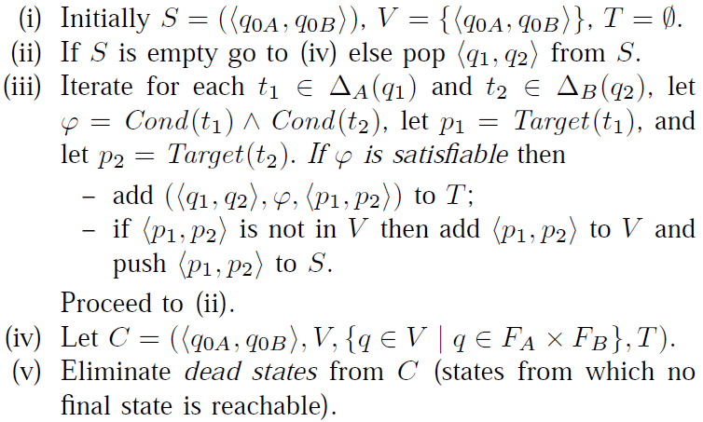
Product construction of SFAs
Given A and B construct C, L(C) = L(A)∩L(B)
Using constraint solver

Slide 17
Relativized Formal Language Theory
string transformation
Symbolic Word Transducers
≈
Classical Word Transducers modulo Th(Σ)
Classical Word Transducers
(e.g. decoding automata, rational transductions)
Classical I/O Automata
(e.g. Mealy machine)
Symbolic Word Acceptors
Classical Word Acceptors
(NFA, DFA)
≈
Classical Word Acceptors modulo Th(Σ)
regex matching

Slide 18
Core Question
Can classical automata theory and algorithms be extended to work modulo large (infinite) alphabets ∑ ?
Not obvious: e.g. NFA determinization is O(|∑|2^{n}), DFA minimization is O(|∑|nlogn),
why?
why?
Analysis of: string acceptors
regexes (∑ is Unicode)
Analysis of: string transformers
sanitizers, encoders, decoders
how?
how?
Symbolic Finite Acceptors
(application) ICST 2010
(theory) LPAR 2010
(evaluation) VMCAI 2011
Symbolic Finite Transducers
(evaluation) USENIX Security 2011
(theory) POPL 2012, VMCAI 2013
(tool) TACAS 2012

Slide 19
Assignment
Add basic support for strings into PyExZ3
Using the theory of lists, how much can we do?
Constants
Concatenation (+)
Substring matching (and extraction?)

Slide 20
Summary: a white-box approach to automated test generation
Dynamic Symbolic Execution
Execute a program P on concrete input I
Collect symbolic constraints characterizing P(I)
Negate constraints to find new input
Satisfiability Modulo Theories Solvers (like Z3)
SAT solver for propositional logic
SMT = SAT + Theories
bitvectors, arrays, algebraic data types, quantifiers

Slide 21
Let’s Party!
Code review on Wednesday at 13:30
Get latest code from me or github…
After the school, contribute/discuss via
http://www.github.com/thomasjball/PyExZ3/
Email: tball@microsoft.com

