Slide 1

Hadoop Distributed File System

Slide 2
What is HDFS?
It is a java-based distributed file system for storing very large volumes of data.
Fault tolerant.
Scalable.
Low cost.
Ideal for large files and datasets.

Slide 3



How does HDFS work?
DataNode-01
Edge Node
DataNode-02
DataNode-03
NameNode
Secondary/Standby NameNode
DataNode-04

Slide 4

Name Node and DataNode
DataNode-01
Edge Node
DataNode-02
Metadata, file system, block addresses
User access authorization control
Managing file system operations (read, write, create, move etc.)
Recording DataNodes, keeping their pulse
Order replication
Processing block reports from DataNodes
DataNode-03
NameNode
Secondary/Standby NameNode
DataNode-04

Slide 5




HDFS Read
DataNode-01
Edge Node
DataNode-02
DataNode-03
NameNode
Secondary/Standby NameNode
DataNode-04
DataNode-01
Disk-1-Blok-1:Orange
Assuming each fruit is one block file.

Slide 6
HDFS Write
DataNode-01
Edge Node
DataNode-02
DataNode-03
NameNode
Secondary/Standby NameNode
DataNode-04
DataNode-01
Disk-1-Blok-1:Orange
Assuming each fruit is one block file.

Slide 7
HDFS Write
Architecting Modern Data Platforms: A Guide to Enterprise Hadoop at Scale, O’Reilly, 2018

Slide 8
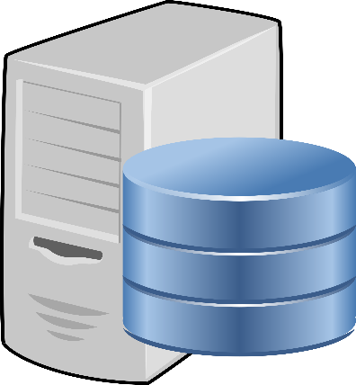
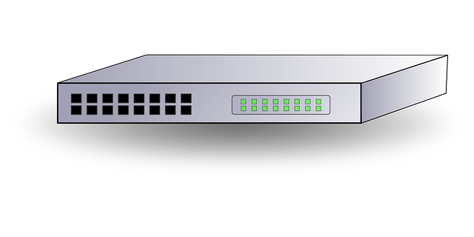









HDFS Fault Tolerance
DataNode-01
Disk-1-Blok-1:Orange
Disk-2 Blok-2:Apple
Disk-2-Blok-3:Cherry
DataNode-02
Disk-1-Blok-1:Orange
Disk-2 Blok-2:Apple
DataNode-03
Disk-1-Blok-1:Apple
Disk-2 Blok-2:Cherry
DataNode-04
Disk-1-Blok-1:Orange
Disk-2 Blok-3:Cherry
NameNode
DataNode-01
DataNode-02
DataNode-03
DataNode-04
Assuming each fruit is one block file.

Slide 9
HDFS High Availability (HA)
NameNode /Quorum Journal manager
JournalNode
Standby NameNode /Quorum Journal manager
JournalNode
JournalNode
DataNod-1
DataNode-2
DataNode-N
Zookeeper-1
Zookeeper-2
Zookeeper-3

Slide 10
HDFS on Training VM
60 GB
HDFS
Lokal
/etc
/home
/home/train/datasets
/tmp
/user
/user/train/datasets
512 GB

