Slide 1
File Formats and Compression

Slide 2
"File format selection and configuration significantly affects performance."
[1] Ivanov, Todor, and Matteo Pergolesi. "The impact of columnar file formats on SQL‐on‐hadoop engine performance: A study on ORC and Parquet." Concurrency and Computation: Practice and Experience 32.5 (2020): e5523.

Slide 3
"Small gains in small data make big differences in big data."

Slide 4
Format
A storage format is just a way to define how information is stored in a file.

Slide 5
If we choose right format
Faster read times
Faster write times
Splitable files (so you don’t need to read the whole file, just a part of it)
Schema evolution support (allowing you to change the fields in a dataset)
Advanced compression support (compress the files with a compression codec without sacrificing these features)
Well-defined and expressive
Be able to handle variety of data structures specifically structs, records, maps, arrays along with strings, numbers

Slide 6
What we expect form a file
Quick read.
Write fast.
Let it be splitable so that each part of the file can be processed in parallel.
Support schema evolution so we can change the schema at any time.
Compress well.

Slide 7


Memory
Serialization
Disk
Deserialization

Slide 8
Serialization
In computing, serialization is the process of translating a data structure or object state into a format that can be stored (for example, in a file or memory data buffer) or transmitted (for example, over a computer network) and reconstructed later (possibly in a different computer environment).
https://en.wikipedia.org/wiki/Serialization

Slide 9
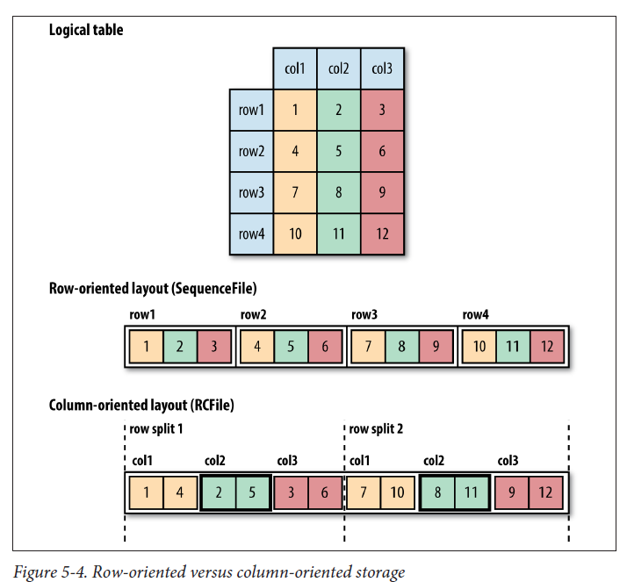
Column and Row Oriented
White, Tom. Hadoop: The definitive guide. " O'Reilly Media, Inc.", 2015.

Slide 10

Splitable
Block size:128 mb
20.000 MB / 128 = 160 blocks
If the file is splitable, I process these 160 parts simultaneously with 160 task. If not, I have to process it with a single task.
Size: 20 GB

Slide 11

File Formats
Görsel: https://www.datanami.com/2018/05/16/big-data-file-formats-demystified/

Slide 12
File Formats
Text Files (csv, tsv, txt)
Avro file
ORC file (Columnar)
Parquet file (Columnar)

Slide 13
1. Text Files (csv, tsv, txt, xml)
The common format is also common outside of Hadoop.
Each line is a record and the line break usually ends in \n.
Good writing performance, but poor read performance.
It does not support block level compression, so file compression tools (e.g. BZIP2) have to be used.
It can be split into parts (splitable) via the \n character.
Partially supports schema evolution. New fields can be added and existing ones cannot be changed.
stored as textfile;

Slide 14
2. Avro file
In addition to being a file format, it is a serialization and data exchange system at the same time.
It carries the schema along with the file and does not allow the schema to be repeated for each value like json. Thus, it takes up little space and serialization is fast. The schema is defined in json format.
It has an average read/write performance.
Splitable
Schema evolution is available (column addition and subtraction).
stored as avro;

Slide 15
3. ORC file (Optimized Row Columnar)
Improved version of RC (Optimized RC)
It was designed for fast reads, but in return it sacrificed write performance (better than RC).
It is highly suitable for block compression (higher than RC).
Splittable
No schema evolution. Main focus: fast read.
It can be used to efficiently store data in Hive (up to 75%).
Fast read performance is available for large tables waiting to be expected.
stored as orc; orc.compress = {NONE, ZLIB, SNAPPY} default ZLIB
https://orc.apache.org/docs/hive-config.html

Slide 16
4. Parquet file (Columnar)
It is the most common column-based file format in the Hadoop and big data world.
Stores nested data structures in columnar flat format.
Reading speed is higher than writing.
It supports compression especially with snappy.
Limited schema evolution (New fields can be added but old ones cannot be deleted).
It is successful for large column-based analytical queries.
stored as parquet; parquet.compress = {UNCOMPRESSED, GZIP, SNAPPY} default SNAPPY

Slide 17
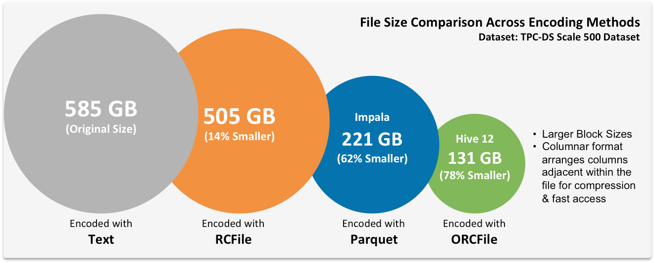
https://www.hdfstutorial.com/input-file-formats-in-hadoop/hdfs-file-format-data/

Slide 18
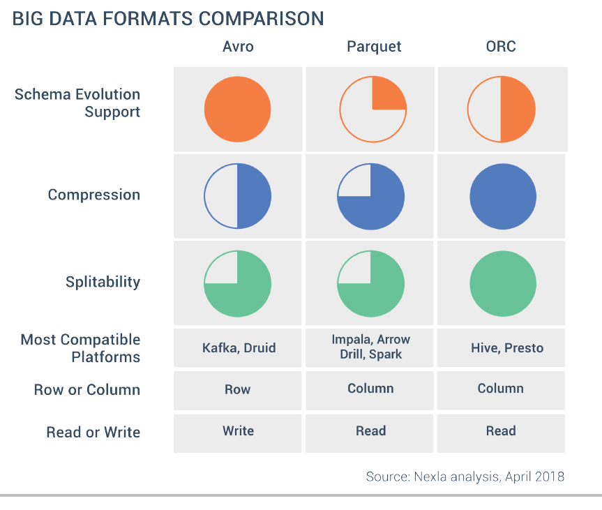
https://towardsdatascience.com/new-in-hadoop-you-should-know-the-various-file-format-in-hadoop-4fcdfa25d42b

Slide 19

Compression
https://images.app.goo.gl/1dBSbuvmXHyDs9wAA

Slide 20
Compression
It reduces the space required for storage.
It speeds up data transfer.
In general, the compression ratio is directly proportional to the time spent on compression.
Different compression algorithms have different characteristics.
The more pattern in data, the higher compression.

Slide 21
Compression
Standard: gzip, snappy, lzo, lzip, bzip2
There are native and Java implementations.
In general, native ones are faster.
Except for bzip2, none of them are splitable, but bzip2 has only java implementation.

Slide 22
Compression tips
gzip: It consumes more CPU power than snappy and lzo, but provides higher compression.
Snappy and LZO are generally faster. Snappy is faster in decompress than LZO.
bzip2 compresses better than gzip but slower. If you are looking for splitable use bzip2 or prepend by indexing the LZO.

Slide 23
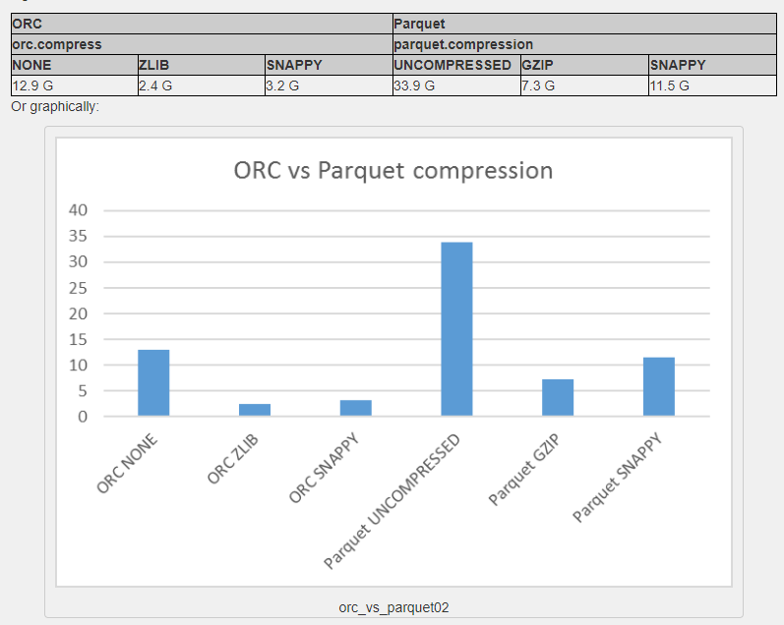
https://blog.yannickjaquier.com/hadoop/orc-versus-parquet-compression-and-response-time.html

Slide 24
Generic performance tips
Use ORC for hive and use a compression method (e.g. snappy)
Use partition and bucket
Run analyze table command
Remember that compression has a lot to do with the content of the data. "No pattern, no compression.«
Using non-splitable compression for very large files is extremely slow.
Don’t use Snappy compression for text files.

Slide 25
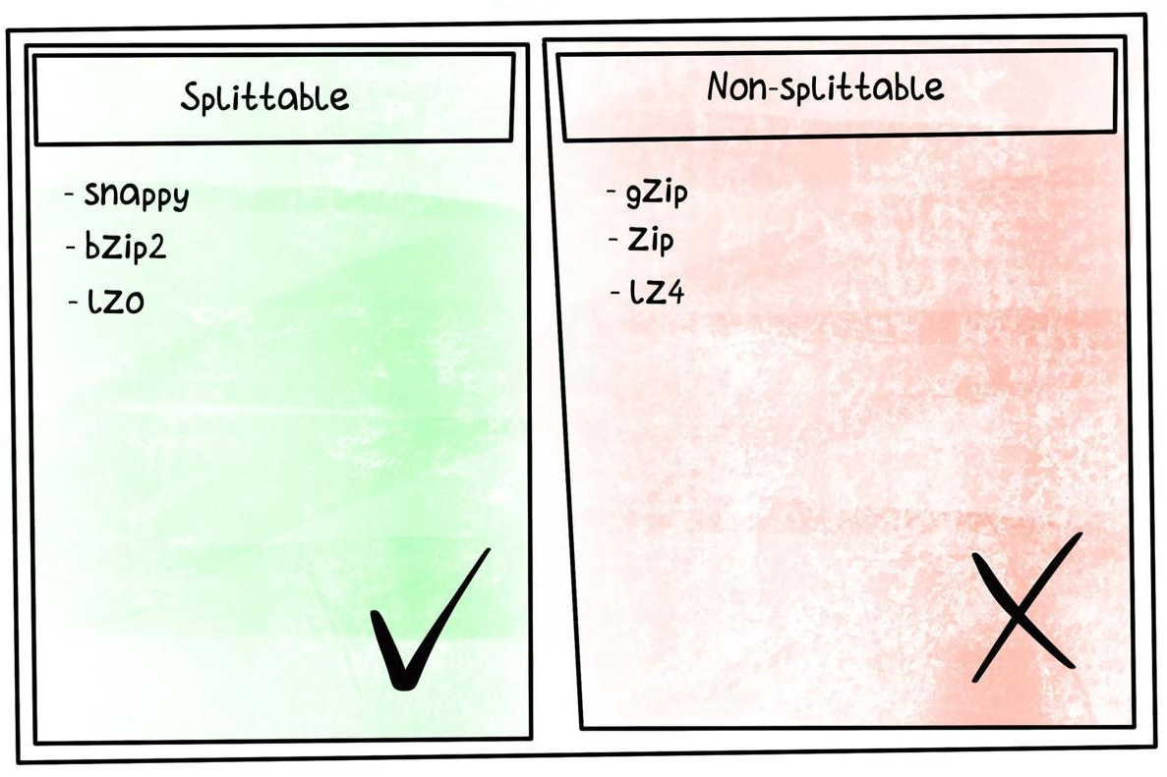
Generic performance tips
Do not use gzip, zip or lz4 compression for very large files because they are not splitable.
It takes too long because it has to be read by a single task (parallel reading is not possible).
** Snappy blocks are NOT splittable but files with snappy blocks are splittables.
https://www.linkedin.com/pulse/snappy-splittable-sachin-mondal/

Slide 26
References
Ivanov, Todor, and Matteo Pergolesi. "The impact of columnar file formats on SQL‐on‐hadoop engine performance: A study on ORC and Parquet." Concurrency and Computation: Practice and Experience 32.5 (2020): e5523.
https://nxtgen.com/hadoop-file-formats-when-and-what-to-use

