Slide 1
Querying Big Data

Slide 2
Query Types
Interactive, fast
Cloudera Impala
Presto
Apache Drill
Trino
Hive LLAP (Low Latency Analytical Processing)
Spark SQL (Thrift server)
Athena
Big Query
Long Run, slow, big
Hive (MapReduce, Tez, Spark)
Spark SQL with YARN

Slide 3
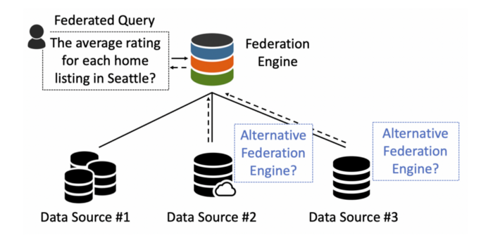
Federated Query
Federated queries are queries that join tables from different datasets
https://blog.devgenius.io/understanding-federated-query-engines-624c57435118

