Slide 1

Developer Perspective

Slide 2
Content
Introduction to Apache Kafka
Producer
Consumer
Broker
Cluster
Topic
Partitions
Offset
Consumer groups
Sample use cases
Setting up multi-node cluster with docker-compose
Setting up a simple Kafka client
Hands-on: Kafka topics

Slide 3
Content
Hands-on : Console producer and consumer
Hands-on : Consumer group
Hands-on: Python Kafka producer
Hands-on: Python Kafka consumer
Kafka Advanced
Message Delivery Reliability
Kafka Ecosystem
Producer ACKs
Producer Retries
Idempotent & Safe Producer
Compression
Hands-on: Kafka configs
Q&A

Slide 4
Introduction

Slide 5





Why Kafka
web server
back-end servers
web server

Slide 6


Why Kafka
s3 object storage
web server
back-end servers
s3://word-bucket/clientx/xxxx.docx
web server

Slide 7
Why Kafka
App-1
Web-1
DB
DB
App-2
Web-2
Security
E-mail
Veri Depoları
Hadoop
Veri Depoları
…..
…..
DWH
DM
Search
…..
…..
…..
…..

Slide 8
Why Kafka
If there are 6 different sources and 6 different sinks, 36 different data integrations are required.
Different connections: TCP, HTTP, REST, FRP, JDBC, ODBC etc.
Different formats: Binary, json, csv, avro, parquet etc.
The production rate of the data source can be much higher than the digest rate of the sink.

Slide 9

Why Kafka
App-1
Web-1
DB
DB
App-2
Web-2
Security
E-mail
Asynchronous Transmission
Veri Depoları
Hadoop
Veri Depoları
…..
…..
DWH
DM
Search
…..
…..
…..
…..

Slide 10
Apache Kafka
Apache Kafka is an open-source streaming data platform originally developed by LinkedIn.
It is similar to an institution/company message queue (MQ) or message system.
It works with the logic of Publish / Subscribe
It stores messages for a certain period of time in a fault-tolerant manner.
It transmits the message as it is, does not change it.
It works in clusters and can be scaled horizontally.

Slide 11
Apache Kafka
Developed by LinkedIn. It is now an open source project.
Supporting company: Confluent
It can scale up to 100 nodes.
It can process millions of messages per second.
It is high performance.
The delay is a few milliseconds. That's why it's realtime.
It has a very widespread usage.
More than 80% of all Fortune 100 companies trust, and use Kafka.

Slide 12





Who uses Kafka

Slide 13
Use case categories
Incremental ETL (CDC -> realtime process -> sink)
Realtime reporting
Activity tracking
Realtime alerting
Realtime decision making and ML prediction (Final Project)
Online ML and AI
https://kafka.apache.org/uses

Slide 14

Sample Use Case
DB
CDC
ETL

Slide 15


Sample Usage
Application
Consumer
DB

Slide 16
Rivals of Kafka
Google Cloud Pub/Sub
Apache Pulsar
Amazon Kinesis Data Streams
Similar of Kafka
RabbitMQ
ActiveMQ
Kafka vs Kinesis Data Streams

Slide 17
Basic Concepts
Producer
Consumer
Broker
Cluster
Topic
Partitions
Offset
Consumer groups

Slide 18





Producer
The application sending messages to Kafka Cluster.

Slide 19
Message
The least piece processed by Kafka.
You can think a message as a row in the table.
Binary format
Kafka doesn’t know the content.
Serializer - deserializer

Slide 20
Message
ID | Doctor | Clinic | Hospital | Operation | Date
1 | Ahmet UYSAL | KBB | Yozgat – Çekerek | Ameliyat | 2018-04-29
2 | Murat ÇAMUR | Genel Cerrahi | Çorum – Sungurlu | Ameliyat | 2018-04-29
3 | Ayla TOPAÇ | Fizik Tedavi | Kırşehir – Çiçekdağı | Muayene | 2018-04-30
4 | Gülsüm ŞEN | Göz | Van – Erciş | Muayene | 2018-05-02
Message 1
Message 4
1,"Gülsüm",35
2,"Cemal",23
3,"Elif",29
4,"Funda",41
5,"Hamza",33
6,"Yalçın",45
7,"Mehmet",44
8,"Gülay",33
Message 1
Message/Record
Message 5
Key
Value
Timestamp
Headers
Message 8

Slide 21

Consumer
Application reading messages from Kafka
Producer
KAFKA CLUSTER
Consumer
Producer
Consumer
Producer
Consumer

Slide 22
Broker
A node in the Kafka Cluster
KAFKA CLUSTER
Request
Producer
Consumer
Producer
Request
Consumer
Producer
Request
Consumer

Slide 23
Topic
Concept of organizing events same type together.
ID | Doctor | Clinic | Hospital | Operation | Date
1 | Ahmet UYSAL | KBB | Yozgat – Çekerek | Ameliyat | 2018-04-29
2 | Murat ÇAMUR | Genel Cerrahi | Çorum – Sungurlu | Ameliyat | 2018-04-29
3 | Ayla TOPAÇ | Fizik Tedavi | Kırşehir – Çiçekdağı | Muayene | 2018-04-29
4 | Gülsüm ŞEN | KBB | Van – Erciş | Muayene | 2018-04-29
operations
1,"Gülsüm",35
2,"Cemal",23
3,"Elif",29
4,"Funda",41
5,"Hamza",33
6,"Yalçın",45
7,"Mehmet",44
8,"Gülay",33
patients
We can simulate a table for a topic and a row for a message.

Slide 24

Partitions
Performance
KAFKA CLUSTER
1,"Gülsüm",35
Producer determines partition number per topic
2,"Cemal",23
3,"Elif",29
0,
1,
4,"Funda",41
0,
1,
Replication factor provides fault tolerance
5,"Hamza",33
6,"Yalçın",45
7,"Mehmet",44
8,"Gülay",33
2,
3,
2,
3,

Slide 25
Partitions
Producer
KAFKA CLUSTER
Partition
Message
Color represents topic

Slide 26

Offset
Topic
To address a message;
Cluster
Topic
Partition
Offset
KAFKA CLUSTER
p1
0 . . . . . . . . | 16 | 17 | 18 | 19 | 20 | 21 | 22
0,
0,
0,
1,"Gülsüm",35
1,
3,"Elif",29
1,
1,
0,
1,
2,"Cemal",23
4,"Funda",41
p2
0 . . . . . . . . | 19 | 20 | 21 | 22 | 23 | 24 | 25
0,
2,
3,
7,"Mehmet",44
0,
5,"Hamza",33
1,
2,
1,
3,
8,"Gülay",33
6,"Yalçın",45
p3
0 . . . . . . . . | 13 | 14 | 15 | 16 | 17 | 18 | 19
Offset

Slide 27

Order Guarantee
Kafka can only guarantee message order per partition.
Partitioner
Kafka guarantees same key goes to same partition.

Slide 28
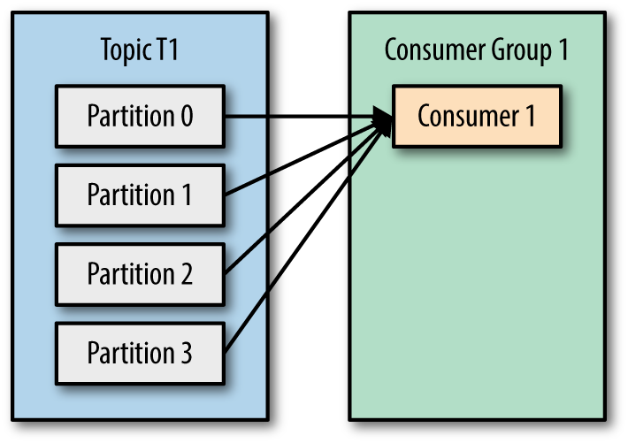
Consumer Group
https://www.oreilly.com/library/view/kafka-the-definitive/9781491936153/ch04.html

Slide 29
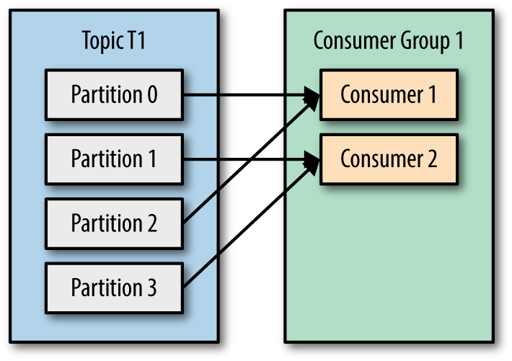
Consumer Group
https://www.oreilly.com/library/view/kafka-the-definitive/9781491936153/ch04.html

Slide 30
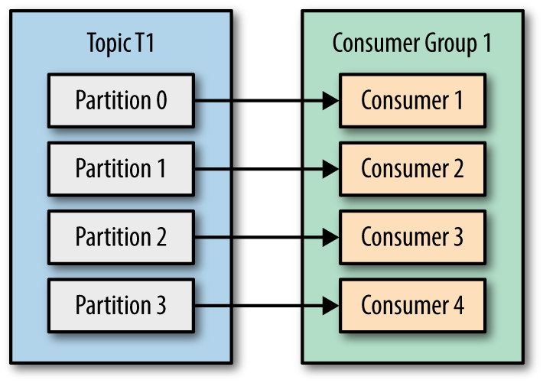
Consumer Group
https://www.oreilly.com/library/view/kafka-the-definitive/9781491936153/ch04.html

Slide 31
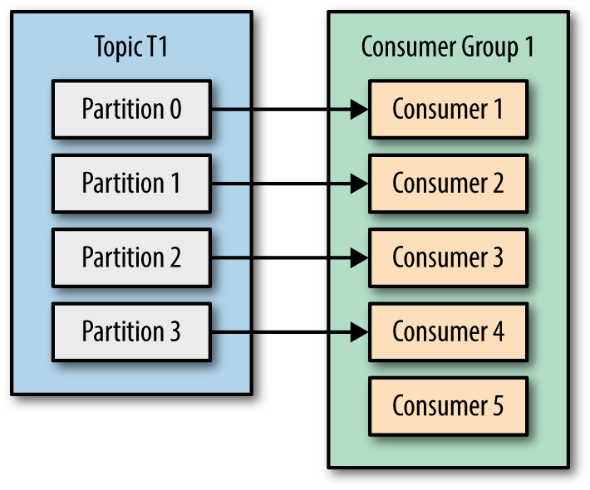
https://www.oreilly.com/library/view/kafka-the-definitive/9781491936153/ch04.html

Slide 32

Fault Tolerance
replication-factor=2
KAFKA CLUSTER
KAFKA CLUSTER
0,
0,
0,1,3,"Elif",29
0,1,3,"Elif",29
0,0,1,"Gülsüm",35
0,1,3,"Elif",29
0,0,1,"Gülsüm",35
0,0,1,"Gülsüm",35
0,
0,
1,1,4,"Funda",41
1,1,4,"Funda",41
1,0,2,"Cemal",23
1,1,4,"Funda",41
1,0,2,"Cemal",23
1,0,2,"Cemal",23
Replication is determined at topic level
Applied to partition.
1,
1,
0,3,5,"Hamza",33
0,2,7,"Mehmet",44
1,
1,
1,3,6,"Yalçın",45
1,2,8,"Gülay",33
0,
0,
0,3,5,"Hamza",33
0,3,5,"Hamza",33
0,2,7,"Mehmet",44
0,3,5,"Hamza",33
0,2,7,"Mehmet",44
0,2,7,"Mehmet",44
0,
0,
1,3,6,"Yalçın",45
1,3,6,"Yalçın",45
1,2,8,"Gülay",33
1,3,6,"Yalçın",45
1,2,8,"Gülay",33
1,2,8,"Gülay",33
1,
1,
0,0,1,"Gülsüm",35
0,1,3,"Elif",29
1,
1,
1,0,2,"Cemal",23
1,1,4,"Funda",41

Slide 33

Leader Replica
Leader replica: Only one per partition.
Follower replica: All rest.
KAFKA CLUSTER
Producer
0,0,1,"Gülsüm",35
ACK
1,0,2,"Cemal",23
Consumer
0,0,1,"Gülsüm",35
1,0,2,"Cemal",23
Kafka producers only write data to the current leader broker for a partition.

Slide 34
Zookeeper (Deprecated)
Zookeeper is the glue that holds it all together, and is responsible for:
Electing a controller (Kafka broker that manages partition leaders)
Recording cluster membership
Maintaining topic configuration
Applying any quotas you’ve set to limit the throughput of producers and consumers.

Slide 35



Simple Simulation
Data Sources
Sink
physicians
KBB, 2
Genel Cerrahi, 1
Fizik Tedavi, 1
KAFKA Connect
clinical
patients
operations

