Slide 1
Data Engineering Concept

Slide 2
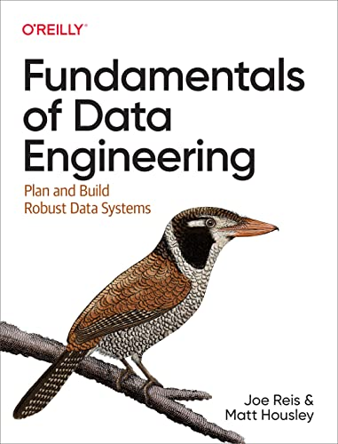

Slide 3
Data Engineering
Data engineering is the development, implementation, and maintenance of systems that process raw data and produce high-quality data.
Data engineering is the intersection of security, data management, DataOps, data architecture, orchestration, and software engineering.

Slide 4
Data Maturity Levels
The ability level of data utilization, capabilities, and integration across the organization.
Sometimes a start-up might have higher maturity level than old and big corporate.
Maturity levels can be categorized in 3 different levels.
[1]

Slide 5
Data Maturity Levels
Leading with data
Data-driven
The automated pipelines and systems created by data engineers allow people within the company to do self-service analytics and ML.
Introducing new data sources is seamless, and tangible value is derived.
Data engineers implement proper controls and practices to ensure that data is always available to the people and systems.
Data engineering roles continue to specialize more deeply than in stage 2. [1] p.16
Scaling with data
Starting with data
Challenge is creating scalable data architectures and planning for a future where the company is genuinely data-driven.
Data engineering roles move from generalists to specialists, with people focusing on particular aspects of the data engineering lifecycle.
Establish formal data practices.
Create scalable and robust data architectures.
Adopt DevOps and DataOps practices.
Build systems that support ML. [1] p.16
A data engineer is usually a generalist and plays several other roles, such as data scientist, solution architect, software engineer, devops engineer. The goal here is to move fast, get traction, and add value.
The practicalities of getting value from data are typically poorly understood, but the desire exists.
It’s tempting to jump headfirst into ML at this stage.
Countless data teams get stuck and fall short when they try to jump to ML without building a solid data foundation. [1] p.14

Slide 6
Veri Olgunluk Seviyeleri
Verisine Yön Veren
Verisini Ölçekleyen
Veriye Yeni Başlayan

Slide 7
Data Engineering Life Cycle
Visualization
Source
Source
Source
Source
Reporting
Ingest and store raw data
Clean and Transform
Serve
Source
Source
Source
ML/AI
Source
Source
STORAGE
Data Analysis
Source
Source
Source
…
Data Management
Data Architecture
Software Engineering
Orchestration
Security
DataOps
Inspired: Fundamentals of Data Engineering, O’Reilly, 2022, by Joe Reis and Matt Housley

Slide 8
Medallion Architecture
Bronze
(Raw, original)
Silver
(Filtered, cleaned, transformed)
Gold
(Business level aggregations)
Source
Source
Source
Source
Source
Source
Source
Sink
STORAGE
A medallion architecture is a data design pattern used to logically organize data in a lakehouse, with the goal of incrementally and progressively improving the structure and quality of data as it flows through each layer of the architecture (from Bronze ⇒ Silver ⇒ Gold layer tables). Medallion architectures are sometimes also referred to as "multi-hop" architectures.
https://www.databricks.com/fr/glossary/medallion-architecture

Slide 9
Data Flow
Upstream
Downstream
Data Sources
Data Engineering Process
Data Consumers

Slide 10
Credits: https://us.semantix.ai/

Slide 11
Architecture vs. Tools
Before picking up tools you need good architecture.
Architecture is strategic where tools are tactical. Perfect tactics doesn’t lead victory under bad strategy.
Architecture is the high-level design of data system that makes sure to accomplish business goals.
Architecture answers why, what, when.
Tools answer how.

Slide 12
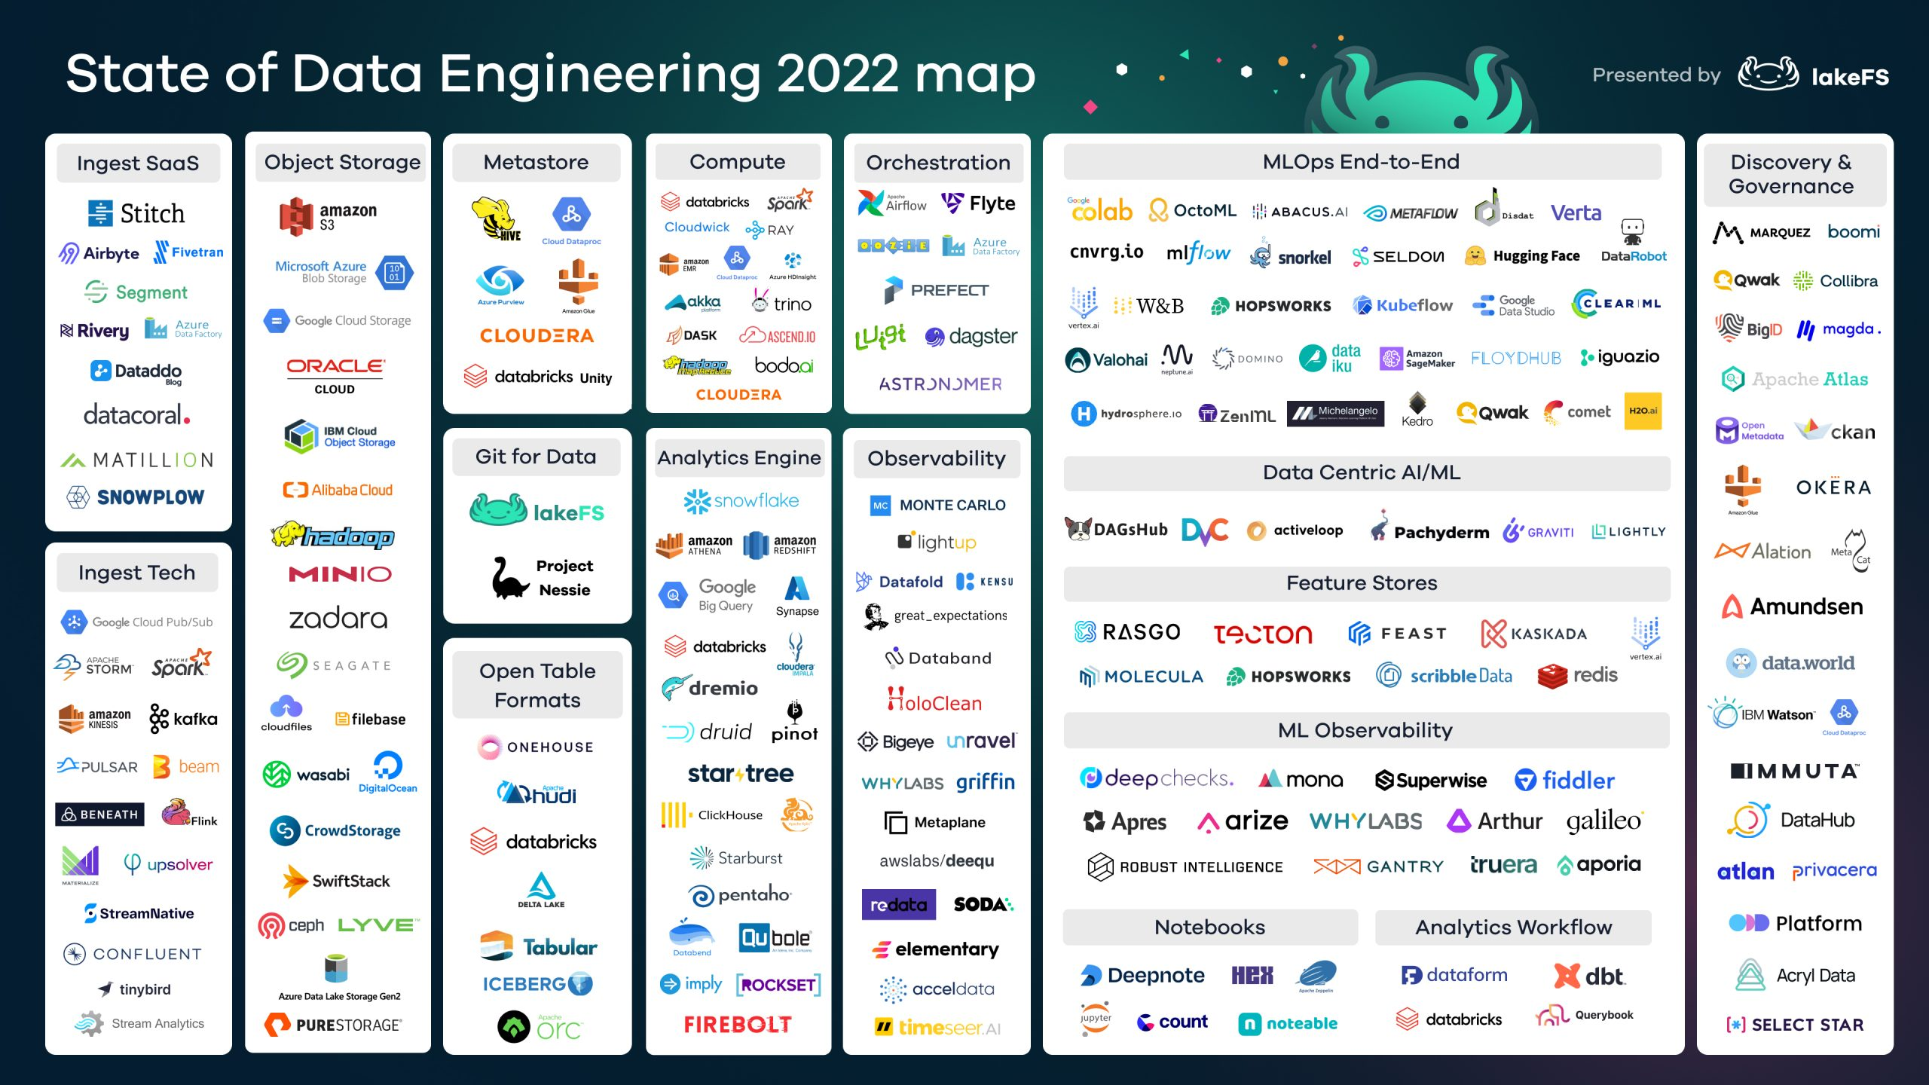
https://lakefs.io/the-state-of-data-engineering-2022/

Slide 13
Selecting Right Tools
Talent lack: Flink fits best for event processing layer but …
Talent attraction: Can we hire and hold them?
License costs
Future of the tool
Community strength (if open source)
Location (Cloud, on-prem)
Microservice, VM
IaaS, PaaS, SaaS
Build vs. buy
Costs

Slide 14
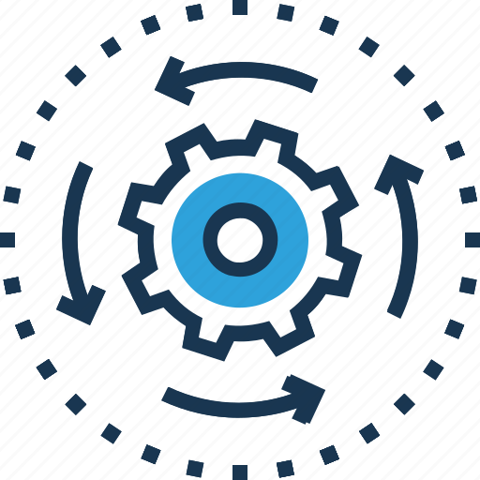
1. Data Sources/Generation
Files, unstructured data (csv, json, avro, binary etc.)
APIs (Getting popular)
RDBMS (Usually OLTP, OLAP, CDC)
NoSQL databases
Logs (OS, apps, servers, devices, DB logs etc.,)
Stream platforms (Kafka)
Image source: https://www.iconfinder.com/icons/1730247/cogwheel_generator_initiator_processing_icon

Slide 15
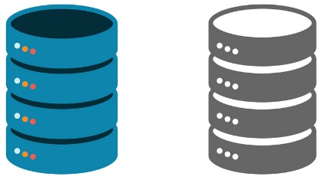
2. Data Storage
Storage Systems:
Object storage (S3, Azure, Google, Ozone, MinIO etc.)
Hadoop HDFS
Streaming (Kafka, RabbitMQ etc.)
RDBMS
NoSQL (wide-column, document, key-value)
Usage
Data Warehouse (DWH) on-prem or cloud
Data Lake
Lakehouse
Image source: https://www.vectorstock.com/royalty-free-vector/data-storage-flat-icon-vector-7640655

Slide 16
2. Data Storage
Storage Hardware, Format, Compression
Hard disk
SSD
Memory (RAM)
RDBMS
NoSQL (wide-column, document, key-value, graph)
Caching (Store frequently or recently accessed data in a fast access layer, memory)
File formats (parquet, avro, orc, text)
Compression codecs (snappy, bzip2 etc.)
Serialization (Serialization is the process of flattening and packing data into a standard format that a reader will be able to decode)
Image source: https://www.vectorstock.com/royalty-free-vector/data-storage-flat-icon-vector-7640655

Slide 17
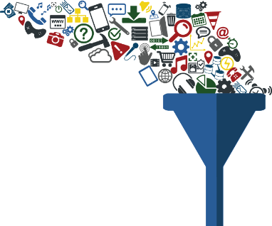
3. Data Ingestion
Data movement from source systems into storage
Batch vs streaming
If batch frequency?
CDC
Idempotency, ordering, late-arriving
Schema change
Volume
Format and shape (tabular, embedded, unstructured text, audio)
Pull vs. push
Reliability durability (E.g. IoT device vs. database)
Image source: https://techguysfdc.medium.com/tools-for-data-ingestion-33c4a67769eb

Slide 18
3. Data Ingestion
Batch Ingestion
Time interval (Daily, hourly)
Size interval (1 GB, 5 GB etc.)
ETL vs. ELT
Data Migration
Moving whole data or database from one system to another.
Schema Evolution
Replay (E.g. Kafka resetting offsets)
Time to Live (TTL)
Image source: https://techguysfdc.medium.com/tools-for-data-ingestion-33c4a67769eb

Slide 19
3. Data Ingestion
DB Connections
JDBC/ODBC
Drivers
Rest API
APIs
APIs continue to grow in importance and popularity.
Secure Shell (SSH), Secure Copy (SCP), SSH File Transfer Protocol (SFTP)
Webhooks (An API waits for calls where as webhook makes API calls)
Web Scraping
Data Sharing (E.g.: Delta Share)
Image source: https://techguysfdc.medium.com/tools-for-data-ingestion-33c4a67769eb

Slide 20
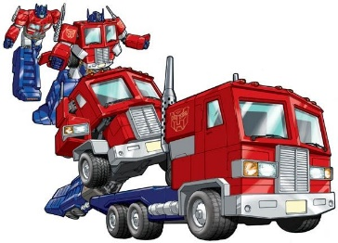
4. Clean and Transform
Query
Data Definition Language - DDL (CREATE; DROP, ALTER)
Data manipulation Language - DML (SELECT, INSERT, UPDATE, MERGE, DELETE)
Data Control language – DCL (GRANT, REVOKE, DENY)
Transaction Control Language – TCL (COMMIT, ROLLBACK)
LIFE of SQL QUERY
SQL code
Parse and convert bytecode
Query plan and optimization
Execution
Result
So much room for query optimization
Image source: https://www.pinterest.com/pin/jacob-halloween--349310514822290044/

Slide 21
4. Clean and Transform
Data Modeling
A data model represents the way data relates to the real world.
Very important
Types of Data Modeling: Conceptual, logical and physical
Normalization (don’t repeat yourself)
Denormalized: No normalization. Nested and redundant data is allowed.
First normal form (1NF): Each column is unique and has a single value. The table has a unique primary key.
Second normal form (2NF): The requirements of 1NF, plus partial dependencies are removed.
Third normal form (3NF): The requirements of 2NF, plus each table contains only relevant fields related to its primary key and has no transitive dependencies.
A database is usually considered normalized if it’s in third normal form.
Image source: https://www.pinterest.com/pin/jacob-halloween--349310514822290044/

Slide 22
4. Clean and Transform
DWH Modeling Approaches
Bill Inmon’s Snowflake Schema
Ralph Kimball Star Schema (Fact and Dimension tables, denormalization)
Data vault
Slowly Changing Dimensions
Type-1: Override (default behavior)
Type-2: Add new for updates (popular)
Type-3: Add new field for updates
Image source: https://www.pinterest.com/pin/jacob-halloween--349310514822290044/

Slide 23
4. Clean and Transform
Transformation: Batch transformations (hourly, daily)
ETL vs. ELT
SQL vs. code base transformations
Data wrangling
Materialized Views
A materialized view does some or all of the view computation in advance.
Federation
Federated queries are a database feature that allows an OLAP database to select from an external data source, such as object storage or RDBMS (Snowflake S3 external table, PostgreSQL, MySQL)
Data Virtualizations
Any query/processing engine that supports external tables can serve as a data virtualization engine (Presto, Trino, Apache Drill).
Image source: https://www.pinterest.com/pin/jacob-halloween--349310514822290044/

Slide 24
4. Clean and Transform
Transformation: Streaming
Enriching events
Micro batch
Batch-oriented framework and apply it in a streaming situation (Spark).
True streaming
Process one event at a time (Flink).
Image source: https://www.pinterest.com/pin/jacob-halloween--349310514822290044/

Slide 25

5. Serve
To whom will it be served
Analytics, BI, Reporting
Data science team
Model predictions
Where will be served
RDBMS
Streaming systems (E.g. Kafka)
NoSQL DBs
APIs
Image source: https://www.statefoodsafety.com/Resources/Resources/is-left-right

Slide 26
5. Serve
Expected features of served data
Trust
Accuracy
Right Format
Right shape/schema
Right Granularity
Right time (SLA, latency)
Image source: https://www.statefoodsafety.com/Resources/Resources/is-left-right

Slide 27
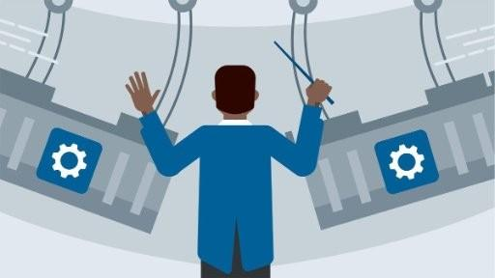
6. Orchestration
Orchestration is the process of coordinating many jobs as their inter-dependencies
Airflow is one of the popular orchestrator.
Since many jobs rely on orchestration system it must be robust and highly available.
Trigger and schedule
Airflow is orchestrator as a code.
Apache Oozie was very popular in Hadoop ecosystem.
Airflow alternatives: Prefect and Dagster
Argo is an orchestration engine built around Kubernetes.
Image source: https://www.bonitasoft.com/news/how-use-bpm-ochestration-micro-services-people-robots

Slide 28

7. Security
Regulations (GDPR, HIPPA, KVKK, etc.)
Enterprise security policies
People (Friend or manager asked you to share a data. What to do?)
Authentication (Do I really who I am?)
Password
MFA
Certificate
Biometric
Token
Single Sign-On (SSO)
Kerberos (strong cryptography and third-party ticket authorization)
Authorization (Do I have right to access this data?)
Encryption (At-rest and on-flight)
Image source: https://www.uplabs.com/posts/creative-hand-painted-web-network-security-logo

Slide 29
7. Security
Logging, Monitoring, and Alerting
Network Access
Image source: https://www.uplabs.com/posts/creative-hand-painted-web-network-security-logo

Slide 30
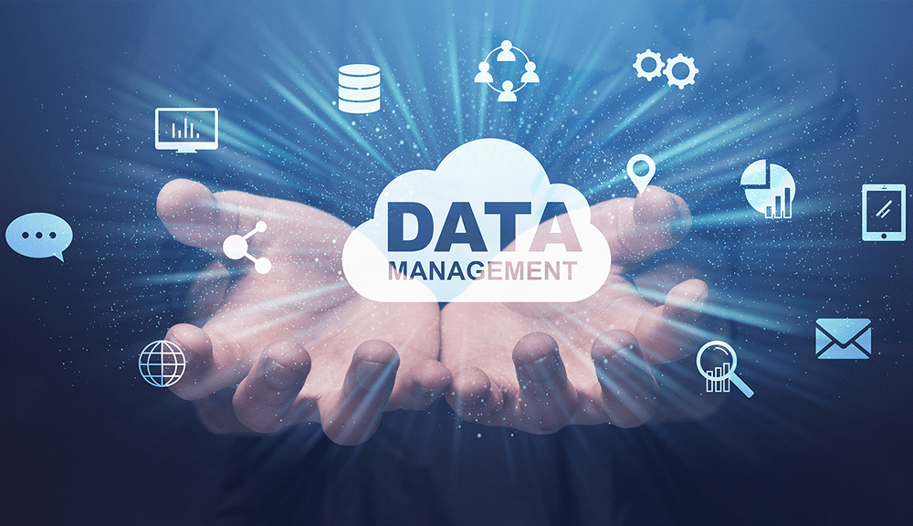
8. Data Management
Development, execution, and supervision of plans, policies, programs, and practices that deliver, control, protect, and enhance the value of data and information assets throughout their lifecycle. [1]
Data governance
Data observability and accountability
Data lineage
Data modeling
Data integrations and interoperability
Data catalog, metadata (Business, technical, operational, reference)
We want to analyze subscribers data. Build a data pipeline please. Subscriber? Who is subscriber?
Discoverability
Image source: https://www.clicdata.com/blog/data-management-for-business-success/

Slide 31
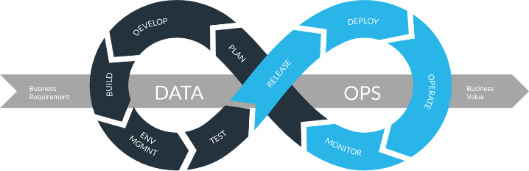
9. DataOps
DevOps aims to improve the release and quality of software products, DataOps does the same thing for data products. [1]
DataOps is a collection of technical practices, workflows, cultural norms, and architectural patterns that enable [2]:
Rapid innovation and experimentation delivering new insights to customers with increasing velocity
Extremely high data quality and very low error rates
Collaboration across complex arrays of people, technology, and environments
Clear measurement, monitoring, and transparency of results
Image source: https://www.snowflake.com/blog/the-rise-of-dataops-governance-and-agility-with-truedataops/

Slide 32
9. DataOps
Infrastructure as Code (IaS): Terraform
Jenkins
Ansible
CI/CD
GitHub/Gitlab
Image source: https://www.snowflake.com/blog/the-rise-of-dataops-governance-and-agility-with-truedataops/

Slide 33
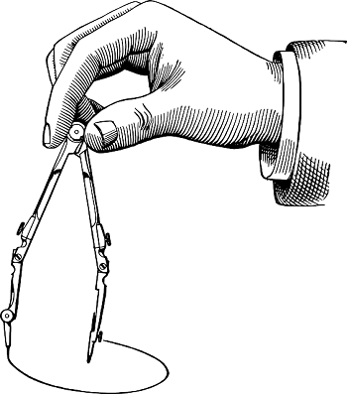
10. Data Architecture
Successful data engineering is built upon rock-solid data architecture. It is a part of enterprise IT architecture [1]
Data architecture is the design of systems to support the evolving data needs of an enterprise, achieved by flexible and reversible decisions reached through a careful evaluation of trade-offs.
Solution and data architects decide what, data engineers decide how.
Image source: https://www.nkfu.com/pergel-nedir-ve-ne-ise-yarar/

Slide 34
10. Data Architecture
Features of Good Data Architecture
1. Choose common components wisely.
2. Plan for failure.
3. Architect for scalability.
4. Architecture is leadership.
5. Always be architecting.
6. Build loosely coupled systems.
7. Make reversible decisions.
8. Prioritize security.
9. Embrace FinOps.
Image source: https://www.nkfu.com/pergel-nedir-ve-ne-ise-yarar/

Slide 35
10. Data Architecture
Examples and Types of Data Architecture
Data Warehouse
Data Lake
Lakehouse
Lambda Architecture
Kappa Architecture
The Dataflow Model and Unified Batch and Streaming
Architecture for IoT
Image source: https://www.nkfu.com/pergel-nedir-ve-ne-ise-yarar/

Slide 36

11. Software Engineer
Software engineering is critical to data engineering. Inevitably a data engineer has to code through data engineering life cycle. [1]
Python, Scala, SQL (can be considered as code)
Testing (unit, regression, integration, end-to-end, and smoke)
Using open source projects and contributing back them requires SE skills
Streaming applications require coding
Infrastructure as code (IaC)
Pipelines as a Code
Image source: https://abbtech.az/en/proqram-teminati-muhendisliyi

Slide 37
References
Fundamentals of Data Engineering, O’Reilly, 2022, by Joe Reis and Matt Housley.
What Is DataOps, DataKitchen FAQ page, accessed May 5, 2022, https://oreil.ly/Ns06w.

