Slide 1

Join Strategies

Slide 2
It is possible to make RDBMS-like joins with Spark Dataframe. However, there is a lot of data exchange between the executors during the join. For this reason, there are different strategies for join.

Slide 3
Distributed join problem
Worker Node
What if the row that needs to be joined is in a different executor?
What if it's on a different node?
Executors
BillID | Prodoct | Amt
6 | Bike | 101.50
2 | Toy | 8.75
8 | Glasses | 37.44
BillID | State
1 | Pending
2 | Paid
3 | Canceled
Worker Node
Executors
Yarn Node Manager
BillID | Prodoct | Amt
3 | Skater | 62.50
7 | Gloves | 3.75
9 | Wine | 13.49
BillID | State
4 | Pending
5 | Paid
6 | Canceled
YARN Container
YARN Container
Executor
Executor
Cache
Cache
Worker Node
Executors
Task
Task
Task
Task
BillID | Prodoct | Amt
4 | Car | 22.50
5 | Cof.mac | 132.75
1 | Pan | 19.49
BillID | State
7 | Pending
8 | Paid
9 | Canceled

Slide 4
Spark Join Strategies
The broadcast Hash Join (BHJ)
Shuffle Sort Merge Join (SMJ)
Shuffle Hash Join (SHJ)
Broadcast Nested Loop Join (BNLJ)
Shuffle and Replicated Nested Loop Join (Castesian product)

Slide 5


1. Broadcast Hash Join (BHJ)
No product information in order(order_items) RDD?
I need to access this information from the product (products) file.
Product file to avoid shuffle cost
Let me send it as a broadcast variable to each worker node.
Worker Node
Executors
Orders-1
Task
Task
Worker Node
Driver
Executors
products
products
products
Orders-2
sc.broadcast( )
Task
Task
Broadcast to all executors if one of the tables is small and will fit in the executor memory. It works by default for tables less than 10 MB.
Worker Node
Executors
spark.sql.autoBroadcastJoinThreshold
You can increase this value if you wish,
if you make -1 it will not make any BHJ.
Just equi '=' join.
All join types.
Orders-3
Task
Task

Slide 6
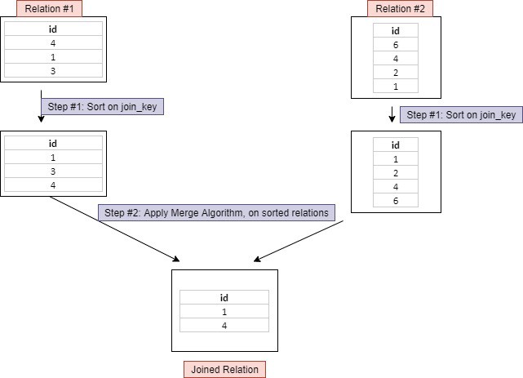
2. Shuffle Sort Merge Join
Worker Node
For a join of two large datasets?
Join must be sortable and over a singular column (key).
Rows belonging to the same key go to the same partition.
Thus, shuffle does not occur.
It happens in two stages: Sort and merge
spark.sql.join.preferSortMergeJoin default true
Executors
BillID | Prodoct | Amt
6 | Bike | 101.50
2 | Toy | 8.75
8 | Glasses | 37.44
BillID | State
1 | Pending
2 | Paid
3 | Canceled
Worker Node
Executors
BillID | Prodoct | Amt
3 | Skater | 62.50
7 | Gloves | 3.75
9 | Wine | 13.49
BillID | State
4 | Pending
5 | Paid
6 | Canceled
Worker Node
Executors
BillID | Prodoct | Amt
4 | Car | 22.50
5 | Cof.mac | 132.75
1 | Pan | 19.49
BillID | State
7 | Pending
8 | Paid
9 | Canceled
https://towardsdatascience.com/strategies-of-spark-join-c0e7b4572bcf

Slide 7
3. Shuffle Hash Join (SHJ)
If one of the tables is too large to broadcast
If two tables are not balanced large, one is relatively small
If the join key is not sortable

Slide 8
4. Broadcast Nested Loop Join
All rows in one of the tables are passed over the other table.
So it is an expensive strategy.
Broadcast is used to reduce this cost.
Supports equi '=' and non-equi-joins('≤=', '<' etc.).
It supports all join types.

Slide 9
Summary
Broadcast Hash Join:
One side should be small. No shuffle. No sorts. Pretty fast
Sort-Merge Join:
It works solid. It works on all data sizes. It does shuffle and sort. It can be slower if the tables are small.
Shuffle Hash Join:
There is shuffle, no sort. It can handle large tables, but may throw an OOM error if the data is skewed.
Shuffle Nested Loop Join:
No need to join key

