Slide 1


Slide 2
Agenda
What is Trino?
Trino Architecture & Concepts
Demo

Slide 3
What is Trino?

Slide 4



What is Trino?
Trino is an open-source distributed SQL query engine designed to query large data sets distributed over one or more heterogeneous data sources.
Why Trino?

Slide 5
Trino
Architecture & Concepts

Slide 6
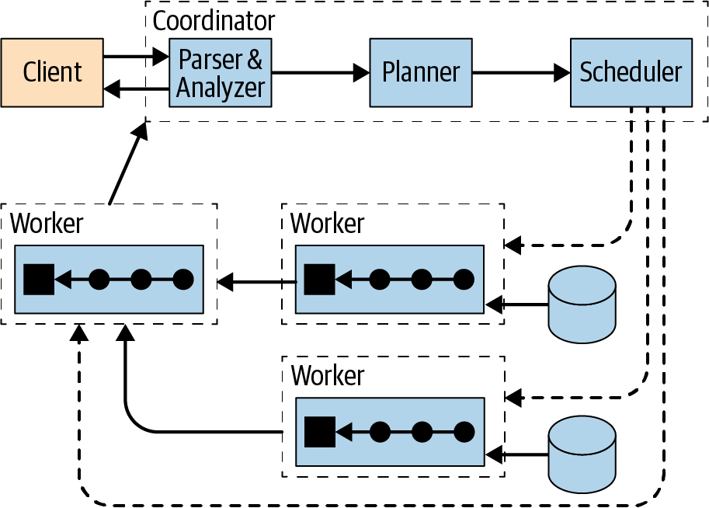
Architecture

Slide 7
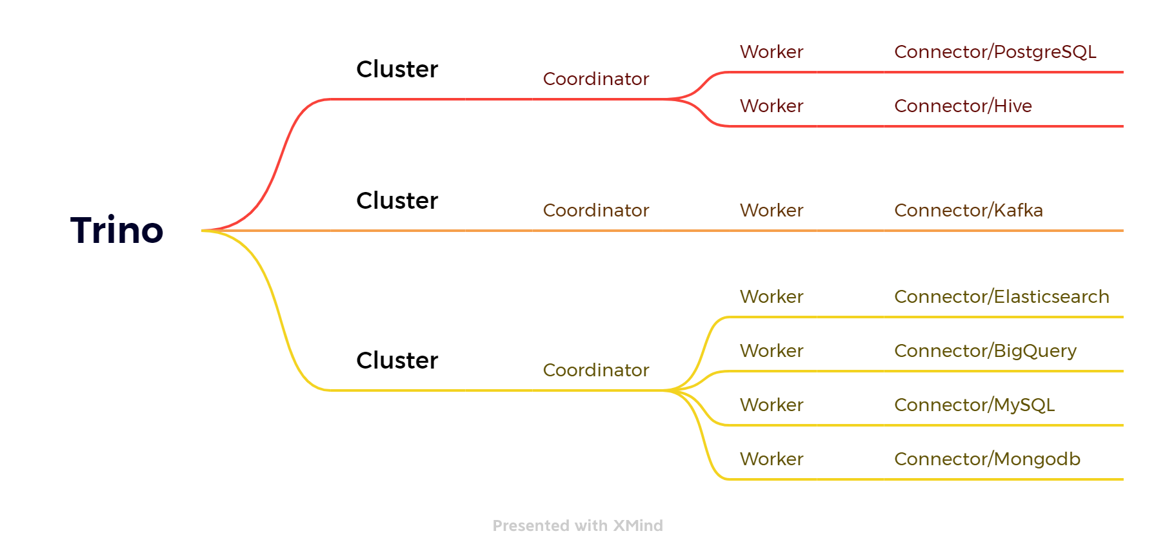

Slide 8
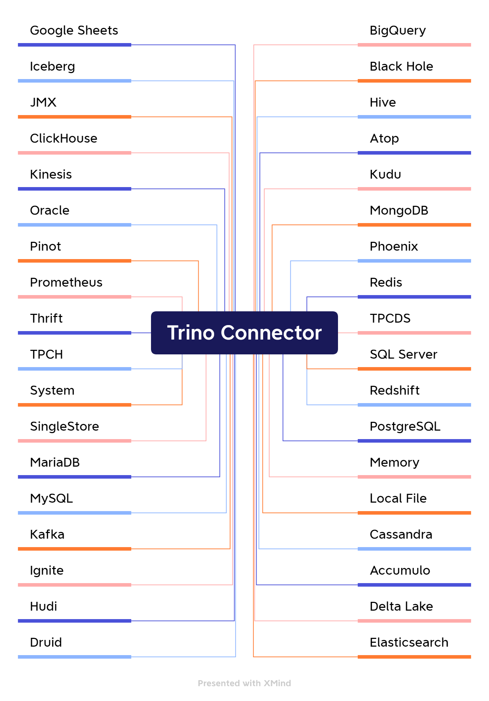
Concepts
Connector
Catalog
Schema
Table

Slide 9









Slide 10
Demo

Slide 11


Client
QUERY
Single Node
Trino setup with Docker
docker-compose
create connector
DBeaver Connection
Queries
Insert data
Query
Coordinator/Worker

Slide 12

Client
Coordinator
Coordinator
Multi Node
QUERY
Trino setup with Docker
docker-compose
Create connector
DBeaver Connection
Queries
Insert data
Query
Worker
Worker
Worker
Worker
RESULT
RESULT
RESULT

Slide 13
Resources
Trino: The Definitive Guide: SQL at Any Scale, on Any Storage, in Any Environment
https://trino.io/docs/current/
https://www.oreilly.com/library/view/trino-the-definitive/9781098107703/ch04.html
https://github.com/bitsondatadev/trino-getting-started
https://github.com/Lewuathe/docker-trino-cluster
https://www.linkedin.com/pulse/10-distributed-sql-queryengine-big-data-kumar-chinnakali/
https://github.com/starburstdata/presto-minio

