Slide 1
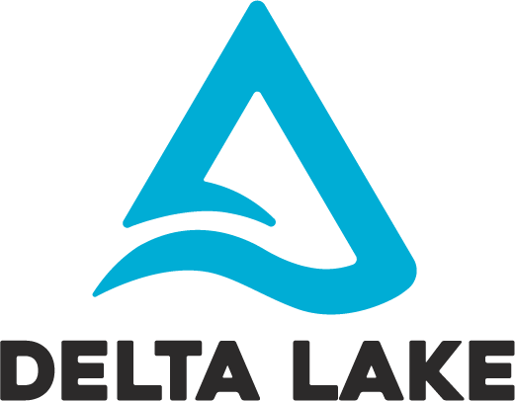
One platform to unify all of your data, analytics, and AI workloads.

Slide 2
Delta Lake is an open source storage layer that brings reliability to data lakes.
Combines best of transactional reliability of databases with horizontal scalability of data lakes.

Slide 3
Delta Lake provides
ACID transactions,
Scalable metadata handling,
Unifies streaming and batch data processing.
Delta Lake runs on top of your existing data lake and is fully compatible with Apache Spark APIs.

Slide 4
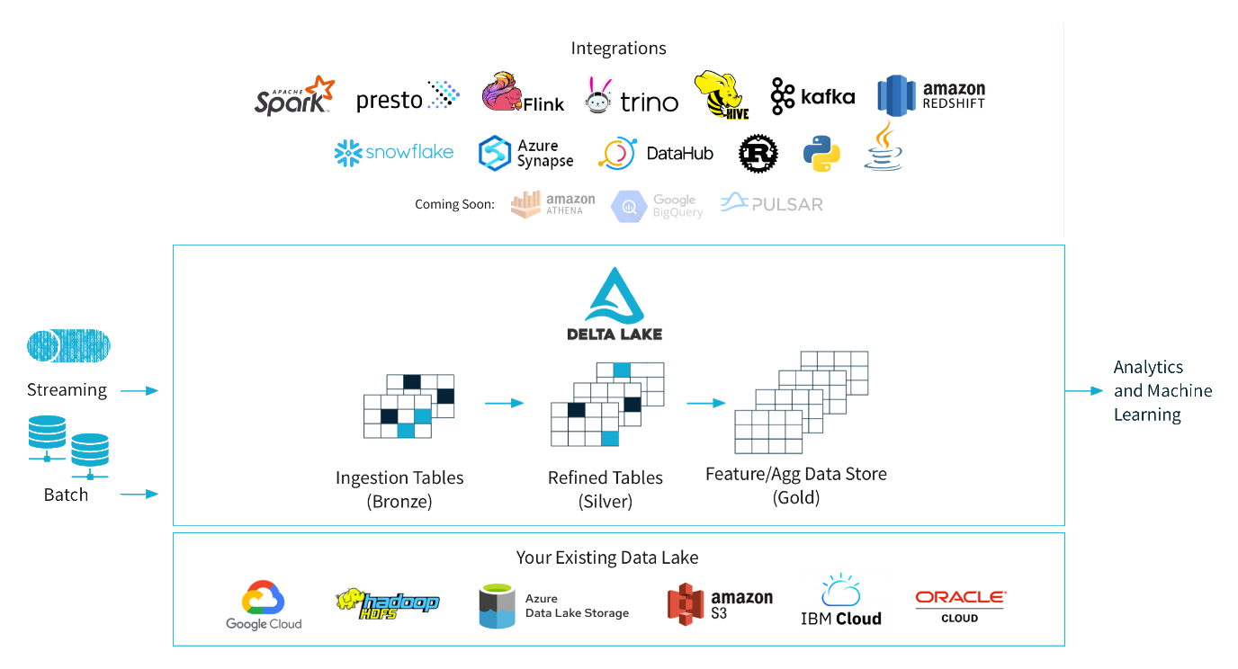
Görsel: https://delta.io

Slide 5
Delta Lake in Spark Stack
Spark Streaming
Spark GraphX
Spark SQL
Spark MLlib
Spark Core
Unstructured: RDD, Accumulators, and Broadcast variables
Structured: DataFrames, Datasets, Spark SQL
Cluster Managers(YARN, Mesos, Standalone, K8s)
Delta Lake
Storage (HDFS, S3, etc.)

Slide 6



 | RDMS DW | Hadoop MapReduce | Apache Spark
Separate Compute & Storage
More than an SQL (ML, stream, graph vb.)
Open Source at Scale
SQL & Optimization
Data Model & Catalog
ACID Transaction
Data Science at Scale

Slide 7
Some Important Offerings
ACID guarantees
Scalable data and metadata handling
Audit History and Time travel
Schema enforcement and schema evolution
Support for deletes, updates, and merge
Streaming and batch unification

Slide 8
Example SparkSession for Spark 3.1
spark = pyspark.sql.SparkSession.builder.appName("MyApp") \
.config("spark.jars.packages", "io.delta:delta-core_2.12:1.0.0") \
.config("spark.sql.extensions", "io.delta.sql.DeltaSparkSessionExtension") \
.config("spark.sql.catalog.spark_catalog", "org.apache.spark.sql.delta.catalog.DeltaCatalog") \
.getOrCreate()
from delta.tables import *

Slide 9
Example SparkSession for Spark 2.4.0
spark = pyspark.sql.SparkSession.builder.appName("MyApp") \
.config("spark.jars.packages", "io.delta:delta-core_2.11:0.6.1") \
.config("spark.sql.extensions", "io.delta.sql.DeltaSparkSessionExtension") \
.config("spark.sql.catalog.spark_catalog", "org.apache.spark.sql.delta.catalog.DeltaCatalog") \
.getOrCreate()
from delta.tables import *

Slide 10
