Slide 1
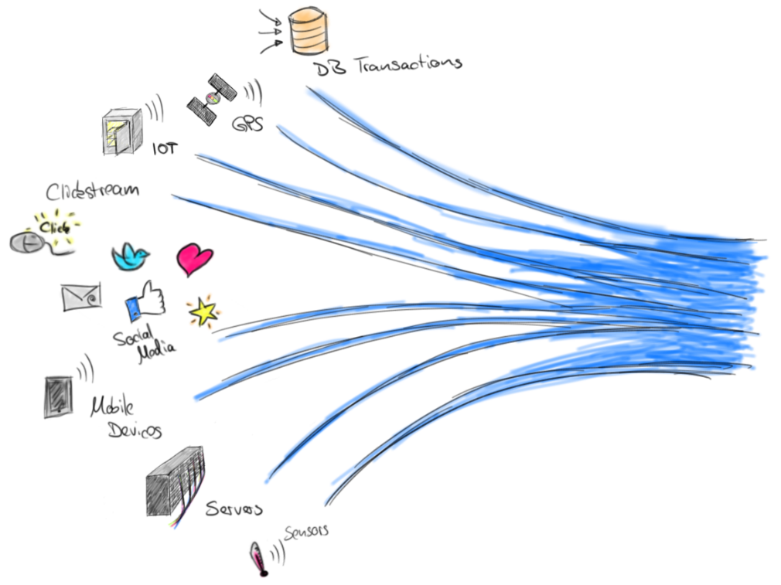
Realtime Streaming
Data Processing
Görsel: https://flink.apache.org/news/2017/04/04/dynamic-tables.html

Slide 2
Batch processing
Data sources
Batches
Batch processing
Storage/ DB
Result
Real-time stream processing
Data sources
Realtime processing
Result
Allen, S. T., Jankowski, M., & Pathirana, P. (2015). Storm Applied: Strategies for real-time event processing. Manning Publications Co..

Slide 3
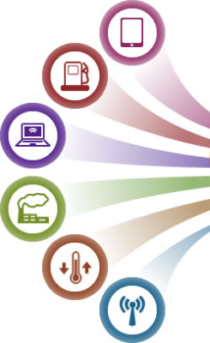



Realtime Data Processing Example
Collection Tier
Message Queuing Tier
Analysis Tier
Data Access Tier

Slide 4
Batch processing
Real-time stream processing
The data saved in the storage is analyzed.
Frequency: Several hours, days, weeks, months.
No clear now focus.
The latency of events is not so important.
Data processing task starts, continues and ends.
Processing historical accumulated data.
No long-term storage.
Frequency: Seconds or sub-seconds.
Time focus: The present time.
Up-to-dateness of events is very important.
Data processing task is continuous.
For instant information needs.

Slide 5

Where are the planes?

Slide 6
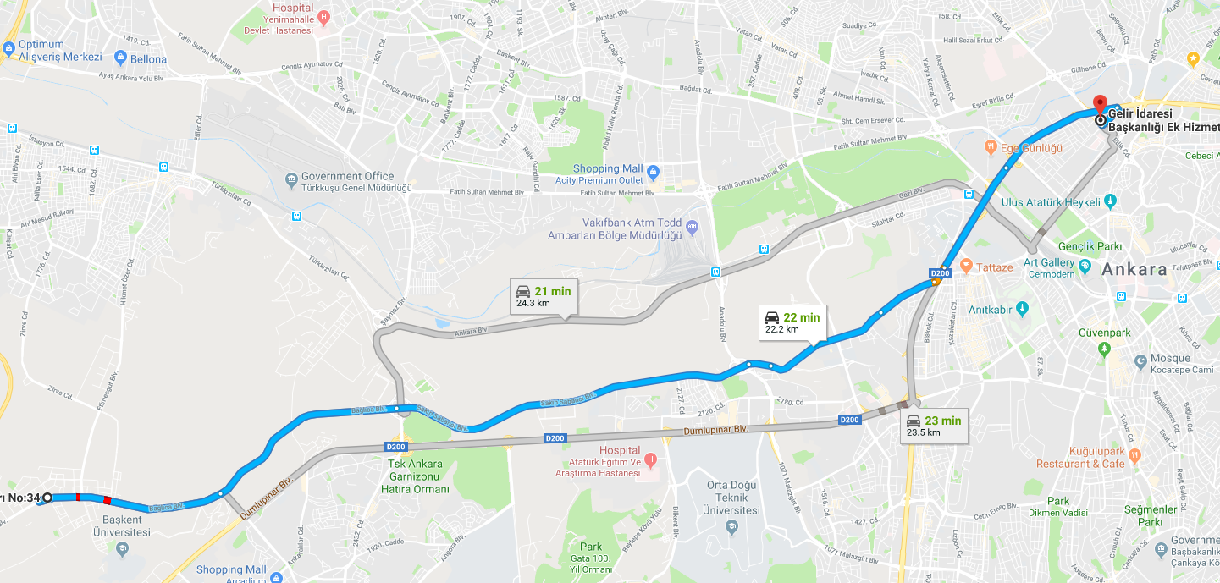
Without traffic jam

Slide 7






Without being scammed…
Realtime fraud detection system

Slide 8
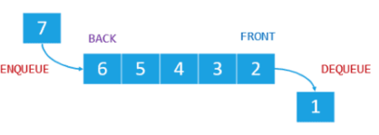
Realtime Stream Processing Layers
4
Developer Experience API
Apache Beam
KSQL, FlinkSQL
3
Higher level functionality data processing
map, filter, joing etc.
Kafka KStreams
Spark Streaming
Flink, Samza, Storm
2
Consumer/Producers
API
Drivers
At most/At least
Exactly
Kafka
Python Java
Spark
. . .
1
Commit Log
Kafka Topics
Kineis
RabbitMQ
ActiveMQ
HDFS/S3
. . .
https://www.youtube.com/watch?v=_8fHV5woDtQ&t=533s

Slide 9
Features of Realtime Stream Processing System
Scalable
Fault tolerance
No data loss
High throughput
Easy to operate
Multiple languages
Cluster isolation
Jain, A. (2017). Mastering Apache Storm: Processing big data streams in real time. Pack Publishing

Slide 10
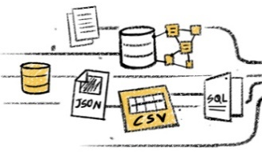
1. Scalable

Slide 11
1. Scalable

Slide 12
1. Scalable

Slide 13
2. Fault tolerance

Slide 14

2. Fault tolerance

Slide 15
3. No data loss

Slide 16
4. High throughput
M4
M3
M2
M1
M4
M3
M2
M1

Slide 17
5. Easy to operate
Easy to set up
Easy to use
Easy to learn
Simple and plain
Easy to expand

Slide 18
6. Multiple languages
Python, Scala, Java vb.
7. Cluster isolation
Cluster servers should be dedicated to streaming jobs only.

Slide 19
Alibaba
Alibaba made $50 billion sales on Singles Day 2020. That's $35 million sales per second.
Flink
1.7 EB per day, 4 million records per second at peak time.

Slide 20
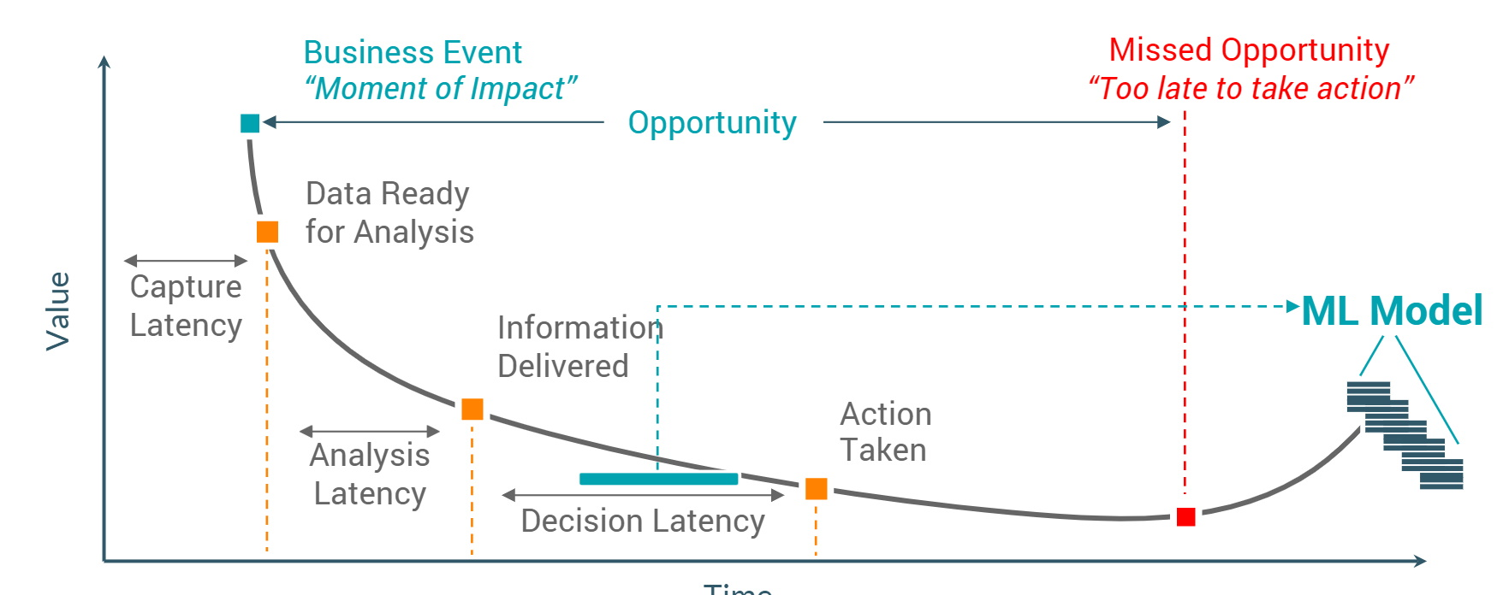
Value
Time

